Slide 1
AntiVenom: One Captured Poison, a Protected Swarm
A new defence: one confirmed poison becomes a portable antibody that protects the whole swarm
Daniel Foo · Nanyang Technological University (NTU), Singapore
Apart Research Swarm Alignment Hackathon, 6–8 November 2026 · Track 4: Multi-Agent Oversight and Control
60% → 8%
+11.8 pts
7% vs 5%
receivers fooled: untreated → shared claim (Phase 2: 200 incidents, all 5 blocks, clean accuracy within 5 points)
clean accuracy vs the Stealth Lens filter at matched protection
one receiver vs CoordGuard (Phase 1), at 18 s vs 25 s per question
One pre-registered evaluation in two phases: Phase 1 completed before the sprint weekend, Phase 2 during it (report, Appendix A.2).
Notes:
When one agent confirms a poisoned record, what should it tell the others? AntiVenom passes a question-scoped false claim. We evaluated it in two pre-registered phases. One receiver alone matches CoordGuard's blocking and is faster. In the swarm, the claim cut fooled receivers from 60% to 8% and matched the Stealth Lens filter's protection with 11.8 points more clean accuracy. We also report where it loses: the raw record blocks slightly more on these near-duplicate poisons.

Slide 2
Swarm poisoning needs a different question
One planted claim, stored under three different IDs
Prior focus | AntiVenom's reframe | What it revealed
How a passage looks (clusters, attention) | What the poison claims | Stealth Lens protection, +11.8 pts clean
Each agent defends itself; share IDs or trust | A detection is a transferable antibody | 8% fooled vs 60% with shared IDs
Filter every query | The claim can be the trigger | Gate restores clean accuracy, gives back protection
share ID
share claim
Agent A
record #1702
“…main industry is fishing”
caught
caught
Agent B
record #4419
“…main industry is fishing”
missed
caught
Agent C
record #8830
“…main industry is fishing”
missed
caught
Inspired by antivenom: each step of the treatment becomes a step of the defence
🐍 Capture a sample
🐍 Recognise the toxin, not the snake
🐍 Circulate everywhere
🐍 Treat on symptoms
🤖 Catch one record
🤖 Distil the claim, not the ID
🤖 Broadcast 257 bytes
🤖 Act when the claim appears
Notes:
In a swarm a planted record reaches every agent, often renamed. Sharing an ID protects only agents whose copy has the same name. Prior defences ask how a passage looks or whether its source is trusted, and each agent decides alone. AntiVenom asks what the poison is trying to make agents believe: every working copy must carry that claim. The design mirrors antivenom: capture a sample, recognise the toxin rather than the snake, circulate, and treat only on symptoms.

Slide 3
How AntiVenom works, and how we tested it
Finder catches
one record
Distil (Q, C)
257-byte claim
Claim check
NLI entailment ≥ 0.00217
+ attention
fused score ≥ 0.0989
Delete + refill
next-ranked evidence
Gate (optional)
act if max e ≥ 0.975
Every receiver uses only the shared claim and its own reader; thresholds fixed on calibration at 5% clean removal; the reader is never fine-tuned.
📚 Calibration
🧪 Phase 1 · one receiver
🐝 Phase 2 · swarm
NQ 1–20 · all thresholds frozen
100 fresh questions vs CoordGuard and TrustRAG
200 incidents × 3 receivers, 14 set-ups, 5 blocks; each test changes one factor
Controls
Pre-registered
Scoring checked
Same incidents, poisons and contexts for every set-up; sham and forged claims; random deletion; arm order shuffled; 5/5 drift checks identical.
Protocol, incidents and code hashed before outcomes; a code check refuses any test that changes two settings.
Rules vs blinded LLM judge (300 answers) and blinded human (58): about 94% and 89% rule accuracy.
Notes:
The finder turns one caught record into a question and a false claim. Each receiver checks its passages for that claim with an NLI model, optionally adds its reader's attention, deletes what matches and refills from the next-ranked evidence. We tested it in two pre-registered phases with one shared calibration: one receiver against published defences, then the swarm, one factor per test in five replicate blocks.

Slide 4
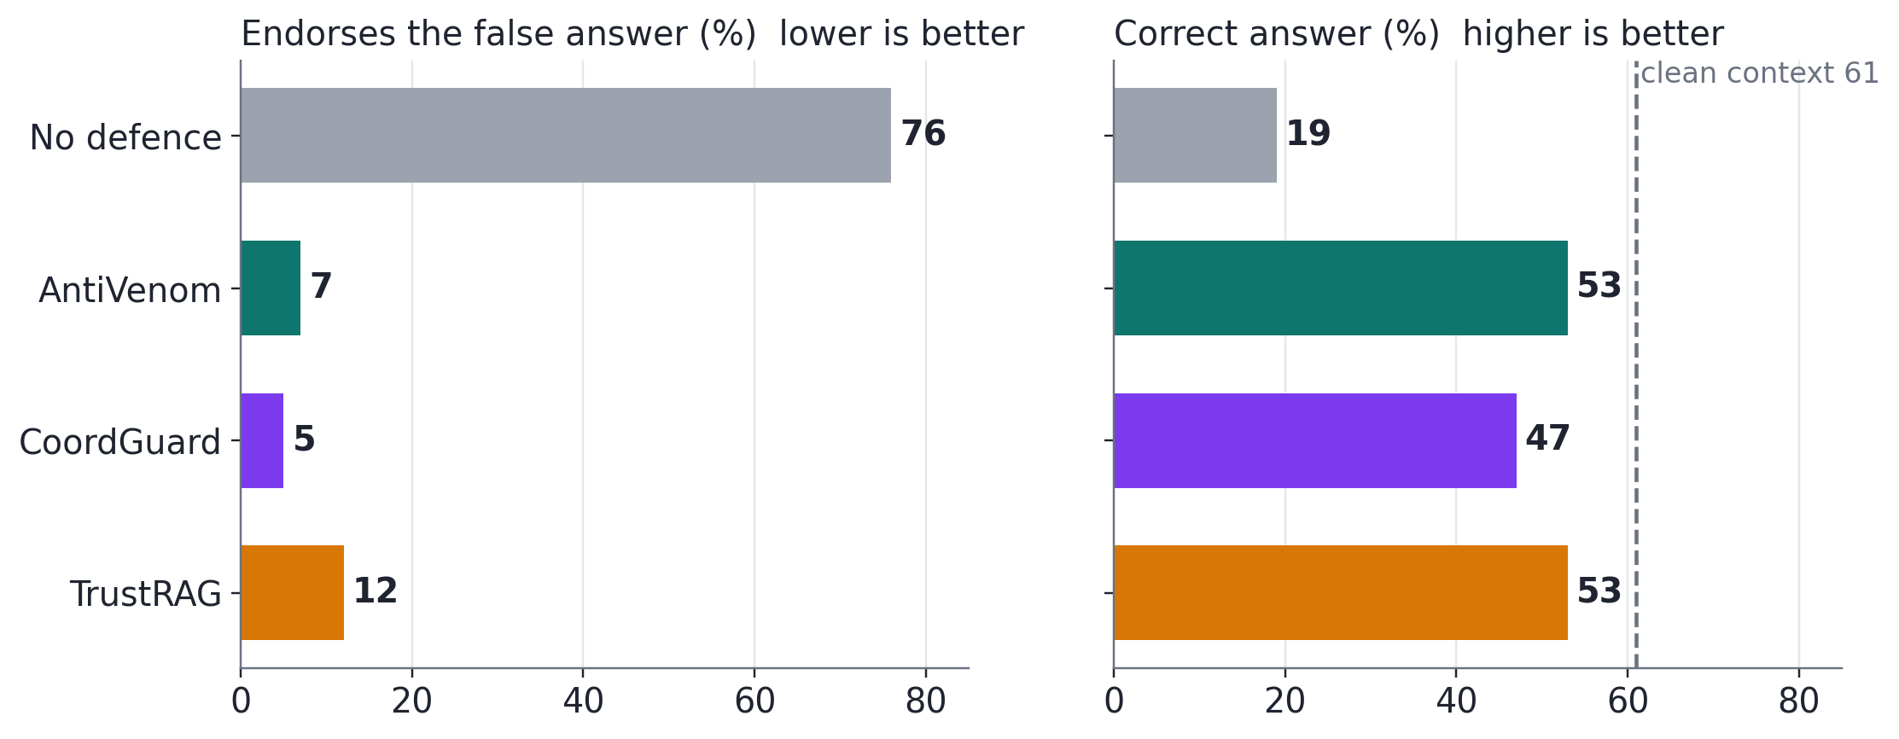
Results: published-defence protection, and every part matters
Phase 1 · one receiver vs published defences
Phase 2 · the swarm, one factor per test (all 5 blocks)
Question | Result | What it means
Claim vs shared IDs? | −52.0 pts | 60% → 8% fooled; IDs miss renamed copies
Real vs sham claim? | −47.3 pts | Protection comes from the claim's content
Claim with vs without question? | −11.2 pts | The question scopes the claim
Add the reader's attention? | −6.8 pts | 1% fooled, but −13 pts clean
Delete vs warn? | −9.2 pts | Remove poison, don't argue with it
Refill vs delete only? | +3.7 pts acc. | Refill turns removals into right answers
Claim vs raw record? | +5.8 pts | Record blocks more on near-copies
Matches CoordGuard, faster
7% vs 5% fooled (no defence 76%); random deletion 64%, so the gain is detection. 18 s vs 25 s per question. With one poison: 3% vs 72% clean passages lost; without the prefix shortcut at matched recall: 9% vs 52%.
Differences in endorsement unless noted; 95% CIs exclude zero; Holm-corrected p < 0.001.
Notes:
Phase 1: one receiver alone blocks as well as CoordGuard and TrustRAG, faster, and loses far fewer clean passages when the benchmark's shortcuts are removed. Phase 2: in the swarm, the claim cut fooled receivers from 60% to 8%; its content and its question matter; attention adds protection at a clean cost; deleting beats warning; refilling helps. Against our prediction, the raw record blocks slightly more on these near-duplicate poisons.

Slide 5
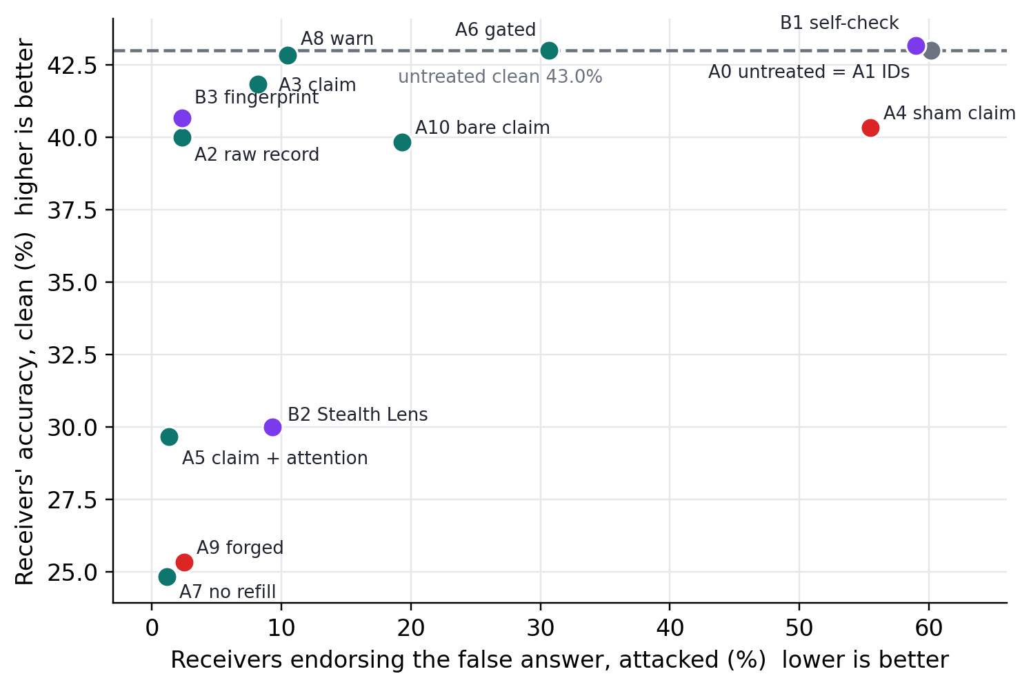
Where AntiVenom stands, what it costs, what it means
Defence | Protects others? | Fooled | Clean vs untreated
Shared record IDs | only if names match | 60.2% | 0.0
Raw record + cosine | yes; sends record | 2.3% | −3.0
BinaryShield-style fingerprint | yes | 2.3% | −2.3
Stealth Lens | no | 9.3% | −13.0
Self-check prompt | no | 59.0% | +0.2
AntiVenom claim + attention | yes; 257-byte claim | 1.3% | −13.3
AntiVenom claim | yes; 257-byte claim | 8.2% | −1.2
Costs, reported
Conclusion
Raw record blocks more on near-duplicate poisons. The gate as calibrated lets 31% of attacks through. A forged claim costs 17.7 pts clean: authenticate claims.
Share what the poison claims, not where it is stored. One 257-byte claim protects a swarm at almost no clean cost; next: diverse, adaptive poisons.
Notes:
The scorecard puts every defence on the same two axes from the swarm phase. Identifiers protect nobody. Content-based messages protect; among them, the claim keeps clean accuracy closest to untreated, and it matches the Stealth Lens filter's protection with 11.8 points more clean accuracy. We report the costs: the record blocks more on near-copies, the gate gives back protection, and forged claims cause harm, so claims must be authenticated.

