Slide 1
20181123 web
Client:html5/css3/javascript
Server:PHP

Slide 2
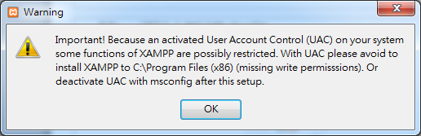

Slide 3
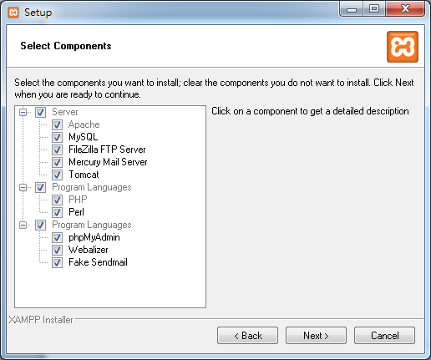

Slide 4
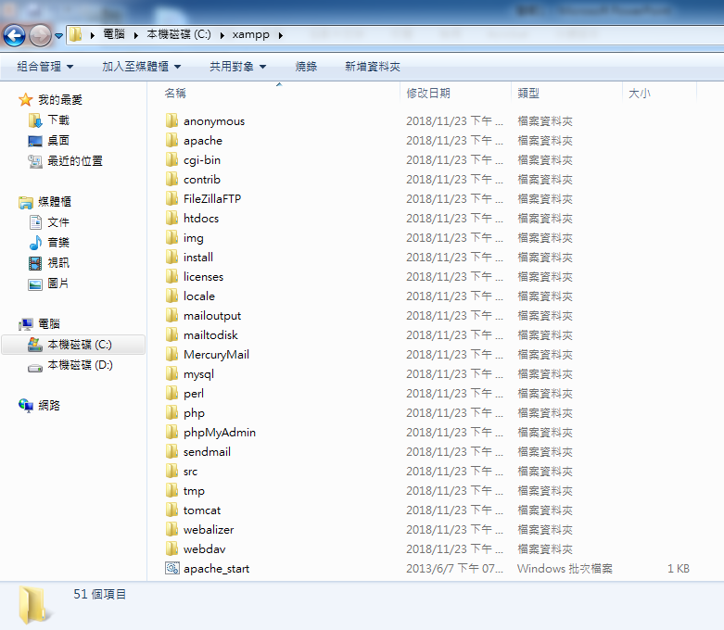

Slide 5
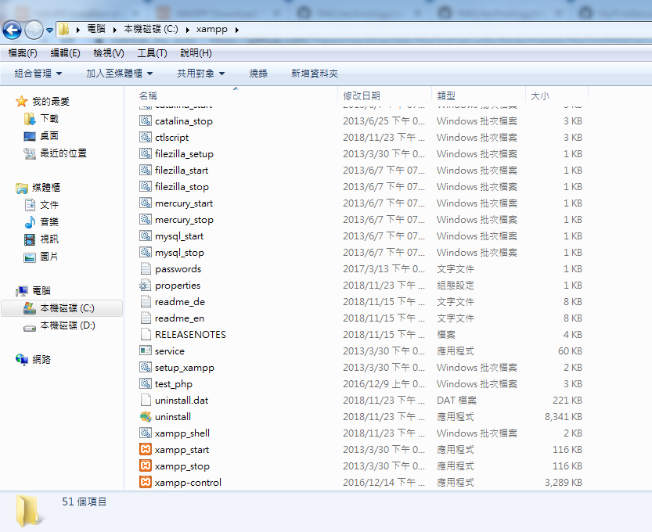

Slide 6
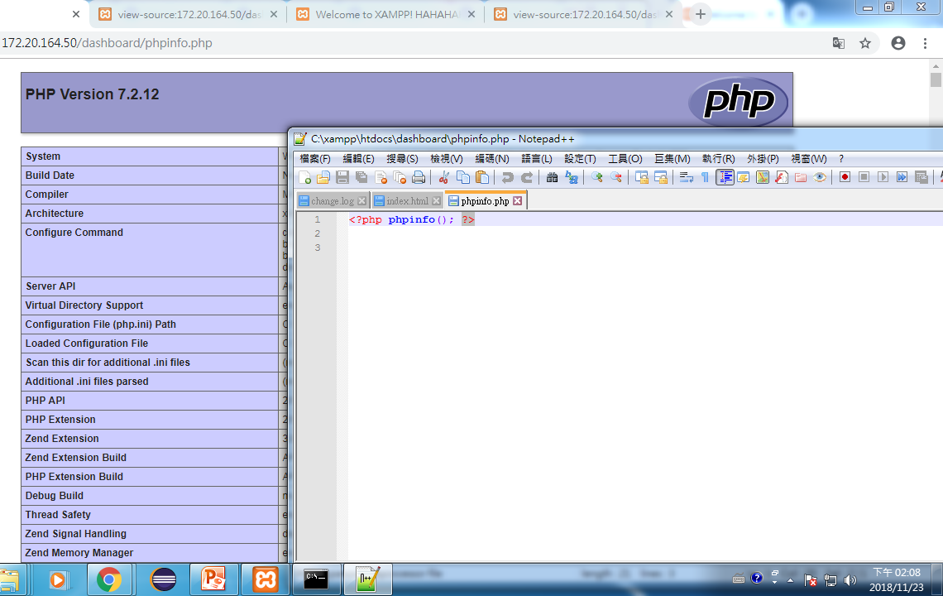
server
http://172.20.164.50/dashboard/phpinfo.php
C:\xampp\htdocs\dashboard\phpinfo.php

Slide 7
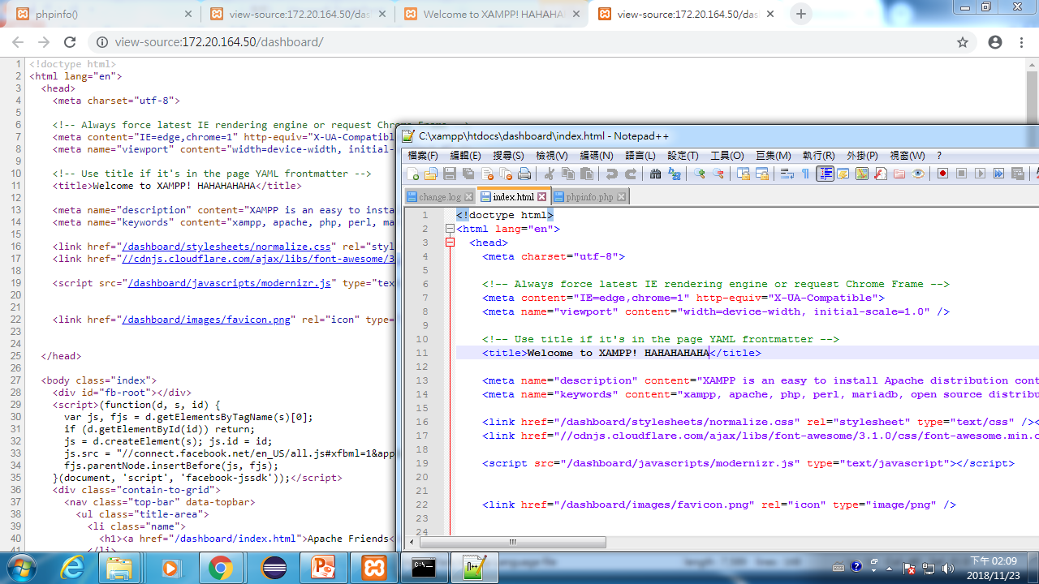
client
http://172.20.164.50/dashboard/index.html
C:\xampp\htdocs\dashboard\index.html

Slide 8
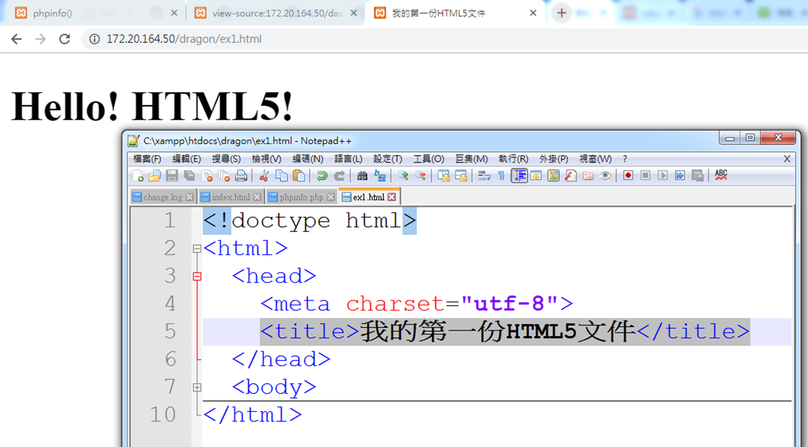

Slide 9
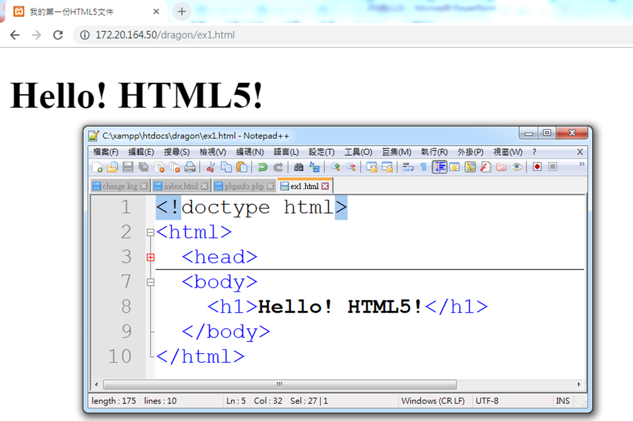

Slide 10
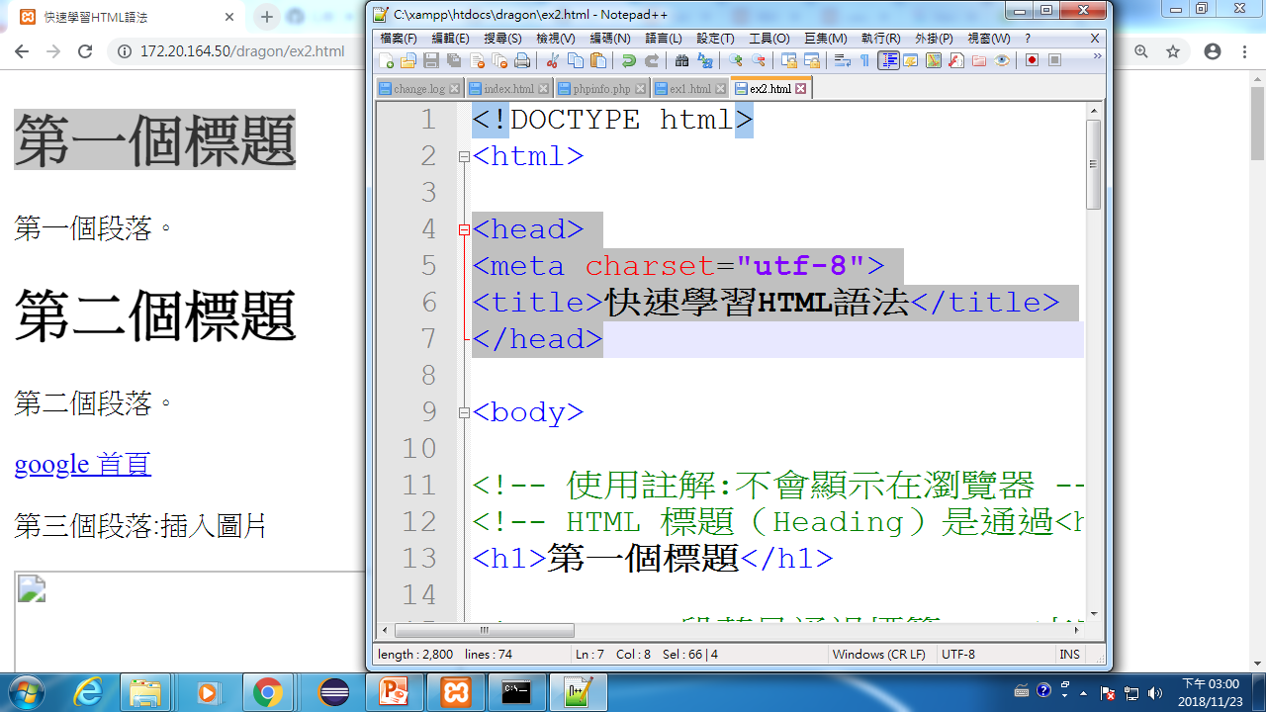

Slide 11
