Slide 1


Slide 2
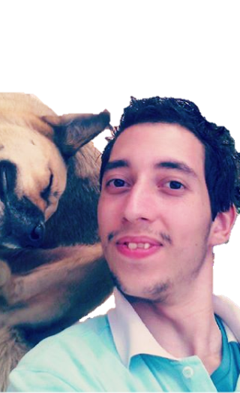






P
lasmmer

Slide 3


oney

Slide 4

Plasmmer

