Slide 1
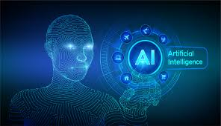
MACHINE LEARNING AND ARTIFICIAL INTELLIGENCE COULD TRANSFORM HEALTH CARE AND EDUCATION.
Daniella Ojekere
Data Scientist

Slide 2
Session Goals:
Explore the opportunities available in health care and education to application of machine learning.
Mind set repositioning for the next mega hit in AI
Interact with experienced and interesting people

Slide 3
DEFINITION OF TERMS
MACHINE LEARNING: Machine learning (ML) is a statistical technique for fitting models to data and to ‘learn’ by training models with data.
ARTIFICIAL INTELLIGENCE: Artificial intelligence (AI) is the simulation of human intelligence processes by machines.
Notes:
Using algorithms that iteratively learn from data, machine learning allows computers to find hidden insights without being explicitly programmed where to look. Machine learning is one of the most common forms of AI; in a 2018 Deloitte survey of 1,100 US managers whose organizations were already pursuing AI, 63% of companies surveyed were employing machine learning in their businesses (Davenport, 2019).
Learning processes. This aspect of AI programming focuses on acquiring data and creating rules for how to turn the data into actionable information. The rules, which are called algorithms, provide computing devices with step-by-step instructions for how to complete a specific task.

Slide 4
RELATIONSHIP BETWEEN ML AND AI
Machine learning is an application of Artificial Intelligence wherein the system looks at observations or data, such as: direct experience, or instruction, figures out patterns in data and predicts events in the future based on the examples that we provide
Notes:
1.

Slide 5
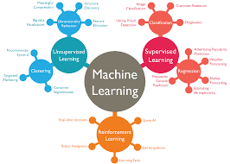

Slide 6
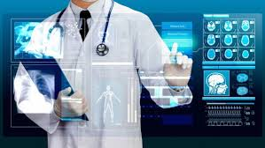
AI and ML and Health

Slide 7
COMMON FORMS OF ML IN HEALTHCARE
Machine learning and precision medicine applications require a training dataset for which the outcome variable (eg onset of disease) is known; this is called supervised learning.

Slide 8
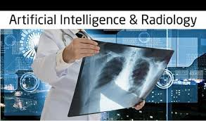
A common application of deep learning in healthcare is recognition of potentially cancerous lesions in radiology images

Slide 9

A more complex form of machine learning is the neural network. It has been likened to the way that neurons process signals, but the analogy to the brain's function is relatively weak.
The most complex forms of machine learning involve deep learning, or neural network models with many levels of features or variables that predict outcomes.
.
“Just as machines made human muscles a thousand times stronger, machines will make the human brain a thousand times more powerful.”

Slide 10
WAYS ML IS REDEFINING HEALTHCARE
A) Feebris uses AI algorithms for precise detection of complex respiratory conditions.
B) MIT’s Computer Science and Artificial Intelligence Lab has developed a new deep learning-based prediction model that can forecast the development of breast cancer up to five years in advance. Their model was trained on mammograms and patient follow-up data to identify patterns that would not be obvious to or even observable by human clinicians.
1. Identifying and diagnosis of diseases:
Notes:
B) . The results have so far shown to be far more precise, especially at predictive, pre-diagnosis discovery.

Slide 11
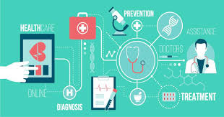
2. Medical imaging diagnosis
A) Enlitic, Zebra Medical Vision and Sophia Genetics.
B) Convolutional neural network or CNN—developed by a team from Germany, France and the US—can diagnose skin cancer more accurately than dermatologists.
C) FDA-approved imaging tool called IDx-DR for diagnosing diabetic eye disease.
Notes:
Enlitic, Zebra Medical Vision and Sophia Genetics have developed ML algorithm-based analysis of all types of medical imaging reports and can diagnose abnormalities with a higher accuracy rate than healthcare professionals.
B) In a recently reported study, the software was able to accurately detect cancer in 95% of images of cancerous moles and benign spots, whereas a team of 58 dermatologists was accurate 87% of the time.

Slide 12
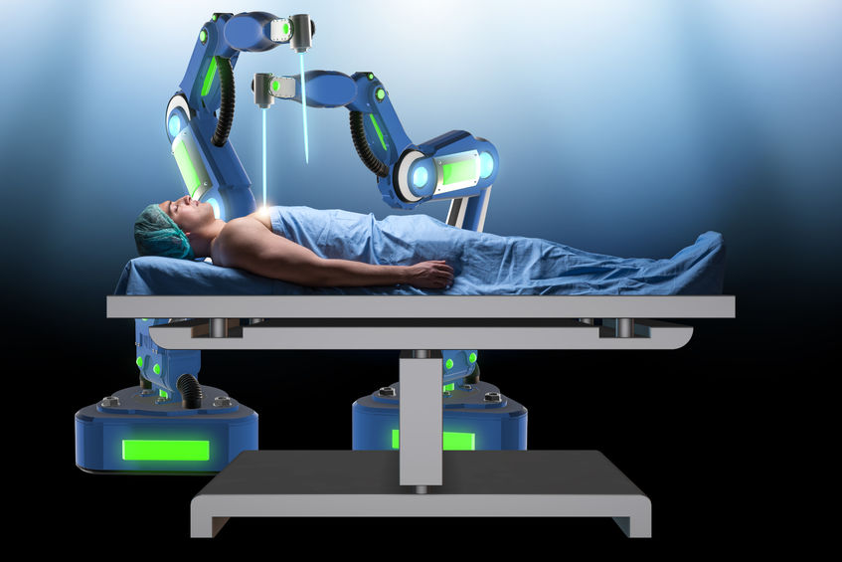
3. Robotic surgery:

Slide 13
4. Drug development
A) AI company Atomwise’s platform AtomNet uses deep learning software to sift through millions of possible molecules in a day or two, which would normally take months via traditional methods.
B) Deepmind, the AI arm of Google’s parent Alphabet Inc It has been able to identify possible medicines for the deadly Ebola virus
Notes:
ML can be applied at all stages of new drug discovery including designing the chemical/protein structure of drugs, target validation, investigating drug safety and managing clinical trials.
The software then analyzes simulations that show how the potential medicine will behave in the human body.
B) is also making huge progress in this field.

Slide 14
AI and Covid-19
Planning and tracking: Migration map
Disease Diagnose
Virtual health assistants.
AI for fever detection and facial recognition.
Robots and ai systems are being used for disinfection.
Notes:
Migration map which uses mobile phones, mobile payment and social media to collect real time data on the location of people was used by Chinese authorities to track movement of people who had visited the wuhan market. South Korea had implemented tools for aggressive contact tracing, using security camera footage, facial recognition technology, bank card records, and global positioning system (GPS) data from vehicles and mobile phones to provide real-time data and detailed timelines of people's travel.
Thousands of possible COVID-19 pneumonia patients had overwhelmed Chinese hospitals and coronavirus testing facilities as at march, 2020. . Software created by Beijing startup Infervision was used by 34 hospitals in China on more than 32,000 potential cases to expedite diagnosis. Alibaba’s research institute, Damo Academy, claims that their trained AI model uses sample data from more than 5,000 confirmed cases to diagnose coronavirus differences in CT scans with an accuracy of up to 96% within 20 seconds (Vota, 2020).
Canada based startup Stallion.ai developed an ai multilingual virtual healthcare agent. It can answer questions related to COVID-19 and provide information, clear guidelines, recommend protection measures, and even check and monitor symptoms.
This is being used at airports and borders for control. It instantly detect people with fever, those wearing or not wearing a mask etc.
Uventions is currently working on solutions of this magnitude.
For all this to be possible: the data input to AI must be in high volume and of clinically high quality/relevance. Fundamentally flawed data cannot substitute for high volume. Currently most of the AI applications are using the paradigm of ‘deductive reasoning’ and we need to move from towards ‘inductive reasoning’.

Slide 15
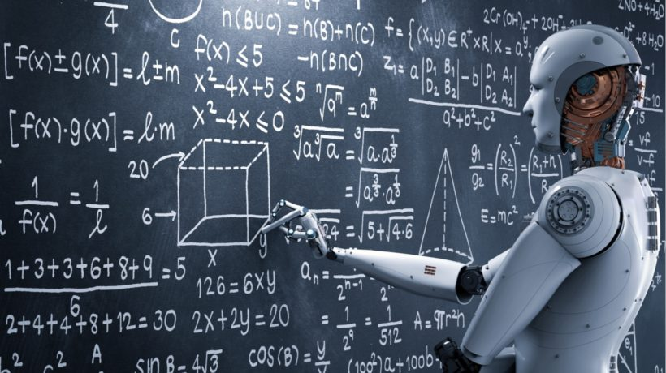
ML and AI in Education
It is expected that AI in U.S. Education will grow by 47.5% from 2017-2021 according to the Artificial Intelligence Market in the US Education Sector report.
Notes:
Even though most experts believe the critical presence of teachers is irreplaceable, there will be many changes to a teacher’s job and to educational best practices.

Slide 16
APPLICATIONS OF AI TO EDUCATION
1. Personalized Learning: It is expected that by 2024 upwards of 47% of learning management tools will be enabled by AI capabilities. AI-enabled e-Learning tools will reach over $6 Billion in market size by 2024.
Notes:
There are several companies such as Content Technologies and Carnegie Learning currently developing intelligent instruction design and digital platforms that use AI to provide learning, testing and feedback to students from pre-K to college level that gives them the challenges they are ready for, identifies gaps in knowledge and redirects to new topics when appropriate. As AI gets more sophisticated, it might be possible for a machine to read the expression that passes on a student's face that indicates they are struggling to grasp a subject and will modify a lesson to respond to that

Slide 17
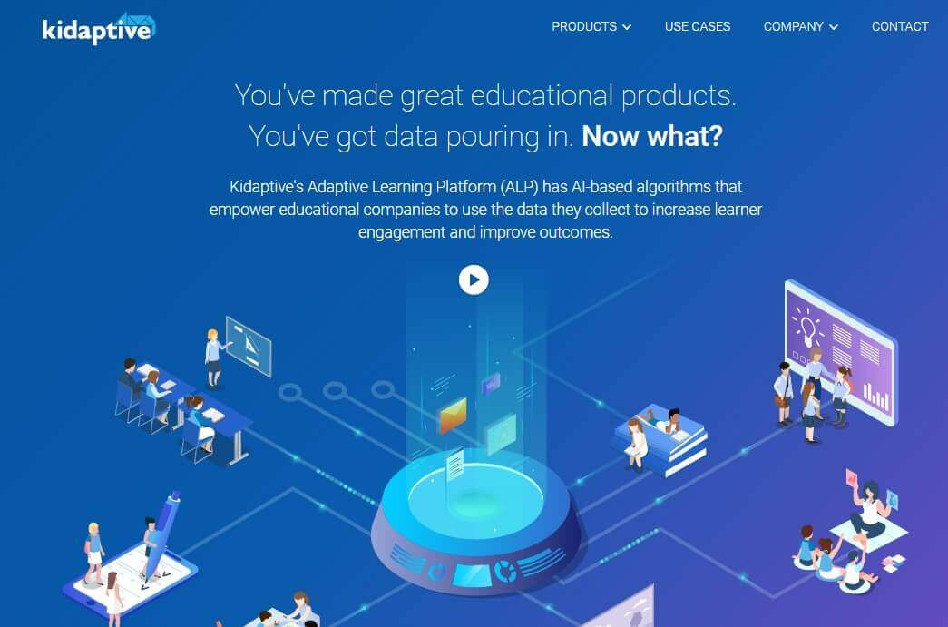
Kidaptive: This is a cloud-computing platform that provides adaptive learning programs, and predicts academic performance, by applying underlying patterns and relationships.
Notes:
For suggesting the next task to learners, the Artificial Intelligence education platform uses Bayesian-IRT psychometric framework.

Slide 18
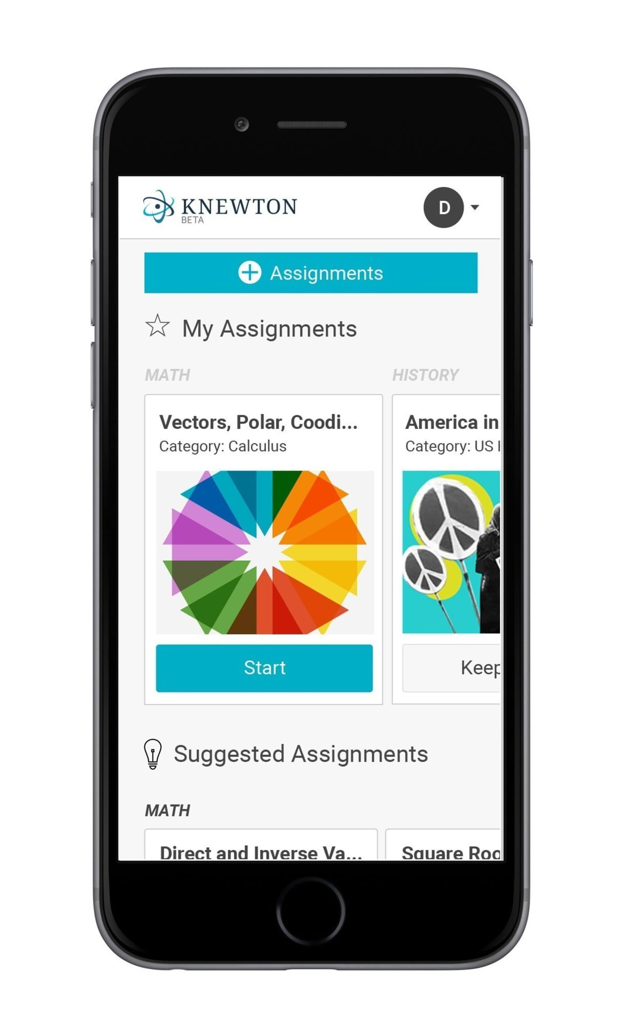
Knewton, a platform with adaptive learning capabilities for higher education. The software leverages AI and ML to find gaps in a student's knowledge and remediate them with adaptive assignments while students complete their courses.

Slide 19

2. Adoption of voice assistant: Voice assistants such as Amazon Alexa, Google Home, Apple Siri, and Microsoft Cortana are giving students a chance to interact with educational material without the interaction of the teacher.
3. Universal access for all students
Notes:
In the higher education environment, universities and colleges are giving students voice assistants instead of the traditionally printed student handbooks or hard-to-navigate websites for help with a number of campus-related informational needs.
Example of institutions adopting this is Arizona State University making use of Amazon Alex for freshmen.
3. Artificial intelligence tools can help make global classrooms available to all including those who speak different languages or who might have visual or hearing impairments. Presentation Translator is a free plug-in for PowerPoint that creates subtitles in real time for what the teacher is saying.

Slide 20
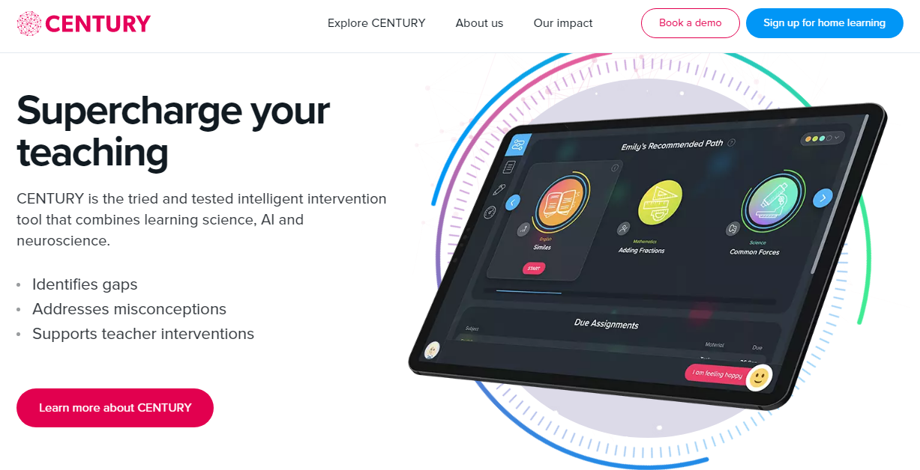
4. Assisting educators with organizational tasks. Example of such an education AI solution is the Century Tech platform.
Notes:
Educators often spend up to 50% of their time on non-teaching tasks such as essay evaluation, grading of exams, filing necessary paperwork, HR and personnel related issues, ordering and managing classroom materials, responding to parents, dealing with sick or otherwise absent students, and otherwise facilitating the learning environment.
Example of such an education AI solution is the Century Tech platform.
It applies data analytics and cognitive neuroscience to identify a student's gap in knowledge, suggests learning material, and automatically marks answers. Teachers can monitor individual students and whole-class performance via a Dashboard

Slide 21
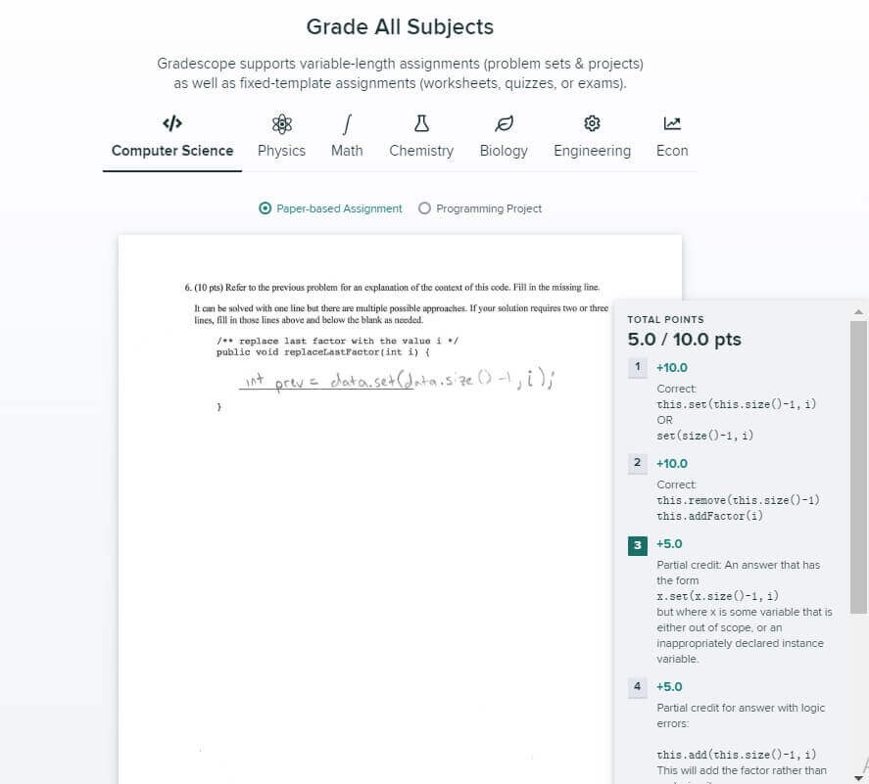
Apart from tests, AI can be applied for grading handwritten students' work. One example is Gradescope, an online grading app developed by a group of UC Berkeley researchers.
Notes:
To train the algorithm to identify numerical, single word, and one-line answers, developers used cuDNN, a Deep Neural Network library, and TensorFlow, a computational framework for building machine learning models. As a result, the app shortens grading time from 50 to 75%.

Slide 22
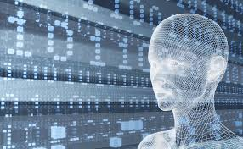
5. Intelligent Assistants
6. After school support
Notes:
5. Education administrators assign administrative tasks to intelligent assistants. Task such as budgeting, student applications and enrollment, course management etc. On the higher education side, college admissions officials are looking at using AI systems to improve the fairness and quality of the admissions process.
6. To support students outside of classes, you can develop a tutoring chatbot empowered by Natural Language Processing technology. The main benefit of NLP in smart assistants is that the AI algorithm understands a student's query and answers with a non pre-scripted text.
Chatbots even inform students about new curriculum and provide campus information during their first year at the university. Such a chatbot is available 24/7, unlike human personal.

Slide 23
The most outstanding example of implementing chatbots in education is Jill Watson, a teacher assistant powered by IBM’s AI-system, adopted by the Georgia Institute of Technology
Notes:
. Ashok Goel, a Computer Science Professor, developed such a Virtual Teaching Assistant to answer students' routine queries. For this goal, the professor trained Jill Watson's machine learning algorithm with over 40,000 forum posts. As a result, the chatbot interacted with students in a human-like manner and students didn't realize they were interacting with the Artificial Intelligence algorithm.
In the not too distant future, you can expect that AI and machine learning will be a core part of all educational experiences. AI is starting to show its benefits and application to a wide range of educational needs, and the hope is that it will greatly improve overall learning outcomes for all.
Artificial Intelligence might inform the students how their career paths look like depending on their goals thus assisting them beyond academics. Only time can tell the ultimate impact of AI in the education industry

Slide 24
OTHER APPLICATIONS OF AI IN EDUCATION
1. Content analytics that organize and optimize content modules:
a. Gooru , IBM Watson Content Analytics
2. Learning analytics that track student knowledge and recommend next steps:
a. Adaptive learning systems: DreamBox, ALEKS, Reasoning Mind, Knewton
b. Game-based learning: ST Math, Mangahigh
3. Dynamic scheduling matches students that need help with teachers that have time:
a. NewClassrooms uses learning analytics to schedule personalized math learning experiences.

Slide 25
4.Grading systems that assess and score student responses to assessments and computer assignments at large scale, either automatically or via peer grading:
a. Pearson’s WriteToLearn and Turnitin’s Lightside can score essays and detect plagiarism.
5. Matching teachers and schools:
a. MyEdMatch and TeacherMatch are eHarmony for schools.

Slide 26
THANK YOU FOR PARTICIPATING

