Slide 1
Risk Assessment for New Aviation Division
Identifying Low-Risk Aircraft Models Using NTSB Accident Data (1990–Present)
Presented by: Daniella Muli

Slide 2
Executive Summary
Project Goal
Key Finding
Actionable Strategy
Establish an objective, quantitative framework for acquiring the safest aircraft fleet by minimizing risk to personnel and capital.
Analysis of NTSB data (1990+) identified 971 statistically relevant aircraft models. The most significant finding is the existence of multiple models with a 0.0% Fatality Rate despite experiencing 10+ accidents.
The resulting strategy provides a "Buy List" (zero-fatality models) and a strict "Avoid List" (high-risk outliers).

Slide 3
Content Outline
• Business Problem
• Data
• Methods
• Results: Risk Distribution Map
• Conclusions & Three Business Recommendations

Slide 4
Business Problem:
The Challenge of Risk in Fleet Acquisition
The Problem
The Objective
The new Aviation Division faces exposure to catastrophic risk and liability if fleet acquisition relies solely on cost or availability. We must minimize risk to personnel and capital.
To establish an objective, statistically sound method to rank all potential aircraft models based on historical safety performance (Fatality Rate) to inform purchasing decisions.

Slide 5
Data Source and Filtering for Modern Relevance
Source: National Transportation Safety Board (NTSB) Aviation Accident Data
Scope: All accident reports from 1990 to the present.
Key Risk Metric: Fatality Rate: Calculated as
Fatality Rate = Total Fatal Injuries / Total People Aboard
This is the single measure of survivability we prioritize.
Filtering for Reliability: Data was filtered to events since 1990 (for modern relevance) and restricted to aircraft models with at least 10 recorded accidents to ensure statistical reliability, resulting in 971 qualified models.

Slide 6
Analytical Framework: From Raw Data to Risk Score
1. Data Preparation | Imputed missing injury counts with zero (as missing typically implies zero casualties). Extracted Event.Year for time-series filtering.
2. Feature Engineering | Created the Total.Aboard column and calculated the Fatality Rate for every accident record.
3. Risk Aggregation | Grouped all modern records by Aircraft Make and Model to calculate the aggregate Total Accidents, Total Fatalities, and the Final Fatality Rate for each model.
4. Final Export | Applied the >=10 Accidents filter and exported the final risk table to Aviation_Risk_Analysis_Final.csv for high-impact visualization in Tableau.

Slide 7
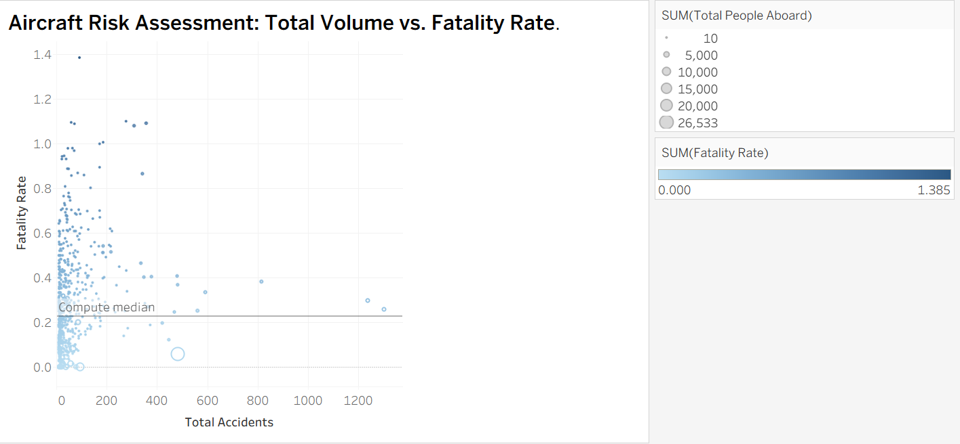
Fleet Safety Landscape: The Risk Distribution Map
Summary:
This visualization uses the Total Accidents (Volume) on the X-axis and the Fatality Rate (Risk) on the Y-axis. It visually defines the "Buy Zone" (bottom quadrants) and the "Avoid Zone" (top quadrants).
Interpretation:
Buy Zone: Models with low risk (low on the Y-axis) are prioritized. Models low on the Y-axis and high on the X-axis (e.g., high-volume Cessnas) are proven, survivable workhorses.
Avoid Zone: Models high on the Y-axis represent unacceptable catastrophic risk and must be excluded regardless of volume.

Slide 8
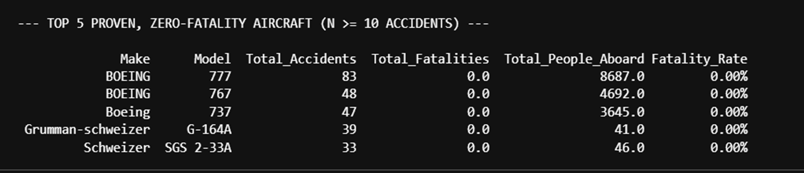
Conclusions: Three Concrete Acquisition Recommendations
Conclusion Summary: The analysis successfully established a quantitative safety framework. Safety performance varies dramatically across aircraft models and must be prioritized over cost or availability.
Key Finding: The primary finding is the identification of multiple aircraft models with a 0.0% Fatality Rate across a significant number of accidents (N >=10).
Recommendation 1 (The Buy List): Prioritize Zero-Fatality, Proven Safety Performers
Details for R1: The highest safety priority must be placed on aircraft models that have demonstrated a 0.00% Fatality Rate. These aircraft represent the absolute lowest risk to personnel and should form the backbone of the initial fleet.

Slide 9
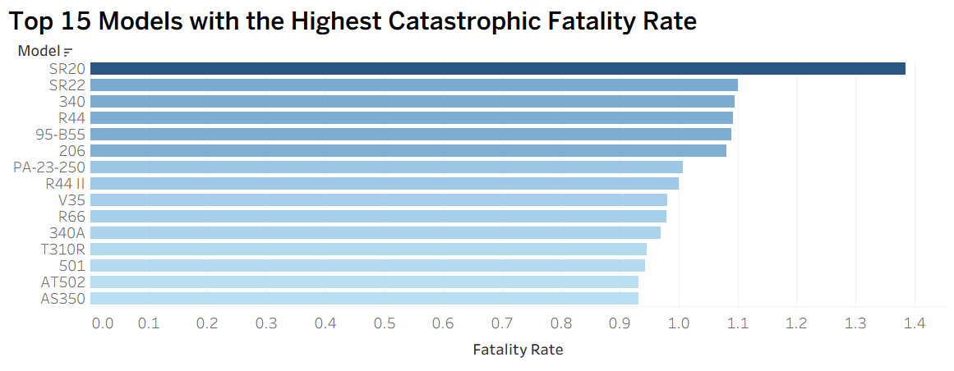
Recommendation Strategy: Scaling and Mitigation
Recommendation 2 (The Volume Strategy): | Focus on High-Volume, Survivable-Accident Manufacturers
Details for R2 | For broader fleet expansion, evaluate the bulk of aircraft from major manufacturers (e.g., Cessna, Piper). Their high volume of accidents is countered by generally low Fatality Rates, indicating failure events are often survivable.
Action for R2 | Use the Risk Distribution Map (Slide 7) to guide volume purchases toward manufacturers with high accident counts but consistently low fatality rates.
Recommendation 3 (The Avoid List): | Implement a Hard Exclusion List for High-Risk Models
Details for R3 | To maximize safety and minimize long-term liability, a policy must be immediately established to exclude aircraft models that exhibit a significantly higher Fatality Rate than the median.
Action for R3 | Immediately use the high-risk outliers identified in the analysis to create a mandatory exclusion policy, proactively removing exposure to the most severe category of risk.

Slide 10
Thank You!
Email: ngiidaniella@gmail.com
GitHub: @daniellamuli
LinkedIn: linkedin.com/in/daniella-muli/

