Slide 1
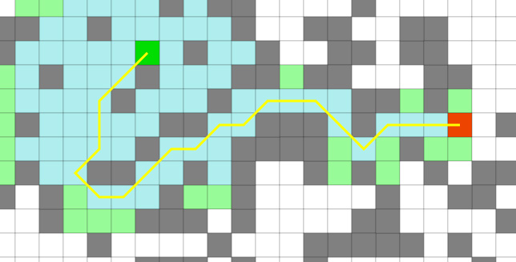
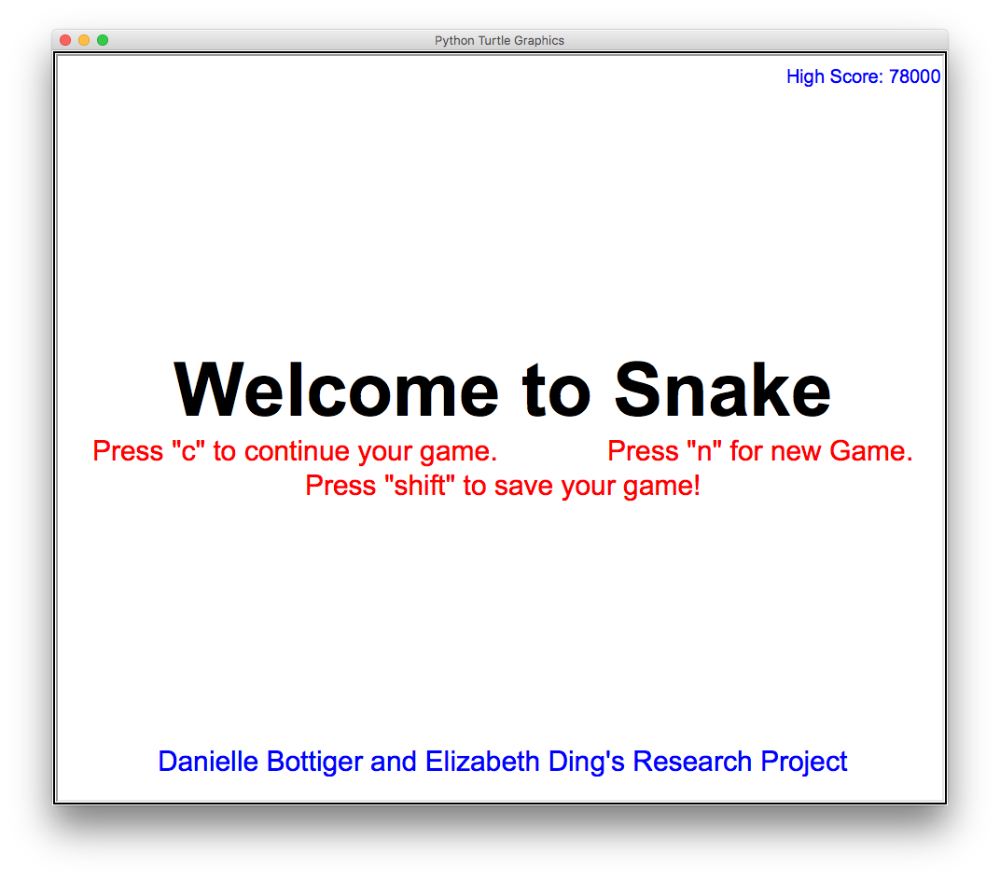
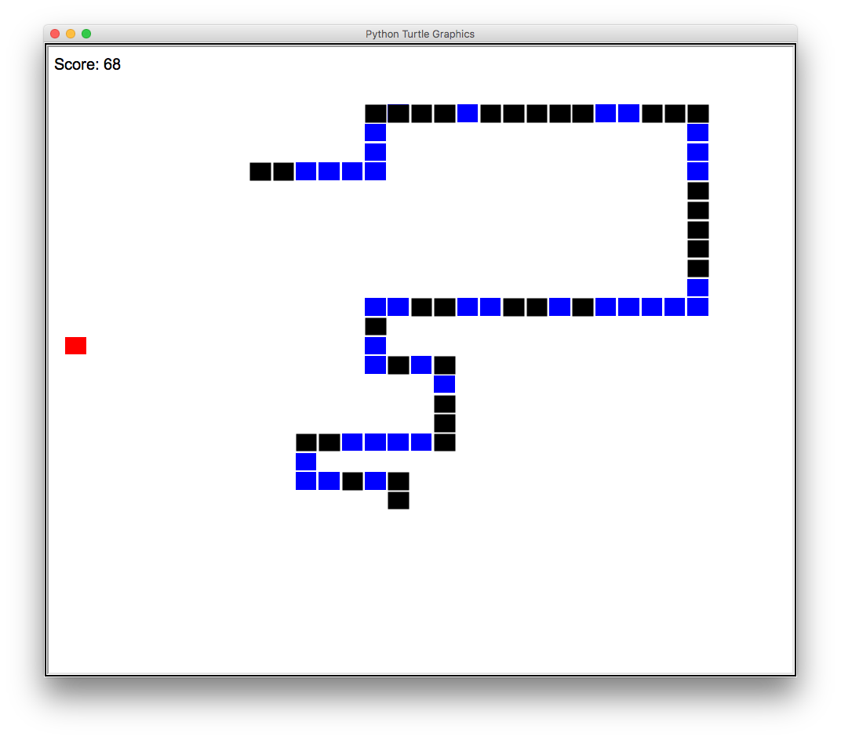


Danielle Bottiger & Elizabeth Ding
Professor Kent Lee & Kiran Tomlinson
S N A K E
Our Goal
Our mission was to work together towards programming a functioning snake game with the extra feature of being able to save a current game and revisit it later. We also strived towards researching and understanding an AI algorithm, such as A*, that would give the snake the ability to think for itself in order to
reach the highest score
possible.
Apple
Snake
Snake’s Turtle Graphics
The apple is a turtle graphic. When the apple’s x and y coordinates are equal to the snake head’s coordinates, the apple respawns on a random point on the screen and the snake gets longer by adding a new part into the snake’s body.
Each square of the snake is a turtle graphic. All the coordinates are stored in a list. A next position point is stored to move the snake along. A head position is used to detect collisions with other parts, the wall, or the apple.
The snake body
appears to move by creating a new turtle graphic at its next position, becoming the new head. The last turtle graphic, the tail, is deleted. Thus, the body’s list is constantly deleting and adding. This happens every frame to create movement.
What We Learned
As we both come from Java-based backgrounds, learning Python was a challenging yet exciting adventure for us. Although it was difficult to adapt to Python, learning stimulating ideas such as turtle graphics and how to incorporate music into our game made it worth it at the end. We also researched how the AI algorithm A* worked by watching videos and reading articles. Aside from the technical aspects, we also learned how to split up assignments in order to take the most efficient route in working together.
Keyboard
The screen listens for key presses to change the direction of the snake or execute other commands. When a key is pressed it calls a certain method, such as move up when the “w” or the “up” key is pressed to move the snake in the upward direction.
In The Future
We originally planned on incorporating a self-made snakeskin graphic into the body of the snake instead of using the flashing blue and black. However, as many difficulties arose when we tried to include the snakeskin image, we decided to remain with the blue and black graphic instead. In the future, we definitely would like to work towards programming a functioning snake game with the snakeskin graphic.
We would also like to continue researching AI, and eventually, incorporate a working search algorithm such as A* into our current snake game.
Music
Loading an Old Game
Save a New
Game
Each frame, the game makes sure that the music is still playing, and that the sounds play when they are supposed to. For example, applause will only play when a new high score is made and the food effect will only play when the snake has reached its apple.
This snake game
has a feature to load an old game and save your game mid-play. When you continue a game, the game reads a text file for the coordinates of the apple and each of the snake’s body parts to load them in the game properly.
When the game
saves, it writes in the save file, overriding the old coordinates with the new ones for a new save. A different text file is used to keep track of a high score. That file is read when the game is opened and updates with new high scores.
“Snake Game in Python Using Turtle Graphics.” Stack Overflow, stackoverflow.com/questions/30050194/snake-game-in-python-using-turtle-graphics.
“23.1. Turtle - Turtle Graphics¶.” 4. More Control Flow Tools - Python 3.6.5 Documentation, docs.python.org/3.1/library/turtle.html.
Computerphile. “A* (A Star) Search Algorithm - Computerphile.” YouTube, YouTube, 15 Feb. 2017, www.youtube.com\watch?v=ySN5Wnu88nE&t=382s.
“AI Learns to Play Snake Using Genetic Algorithm and Deep Learning.” YouTube, YouTube, 7 Dec. 2017, www.youtube.com/watch?v=3bhP7zulFfY.
“Pygame.mixer.music - Pygame v1.9.4.dev0 Documentation.” Pygame.org, www.pygame.org/docs/ref/music.html.

