Slide 1
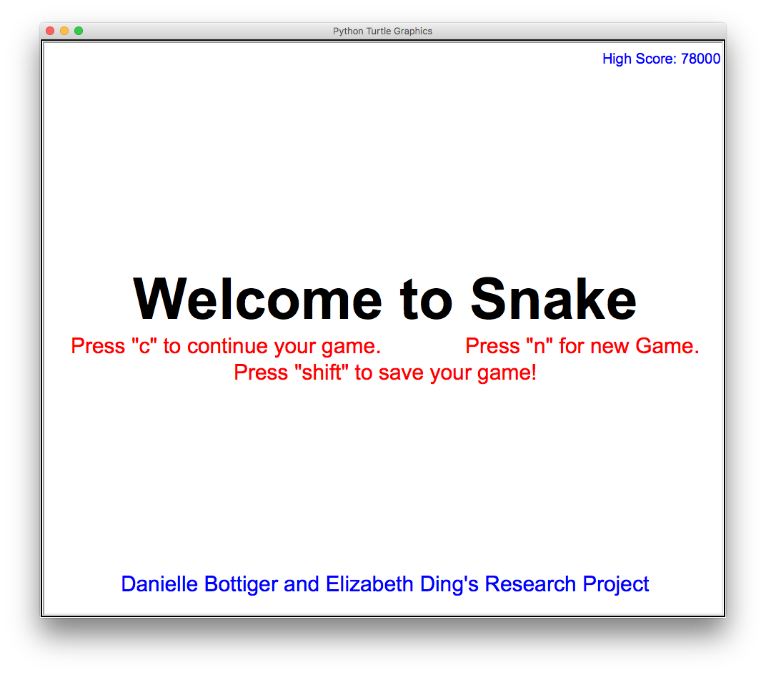
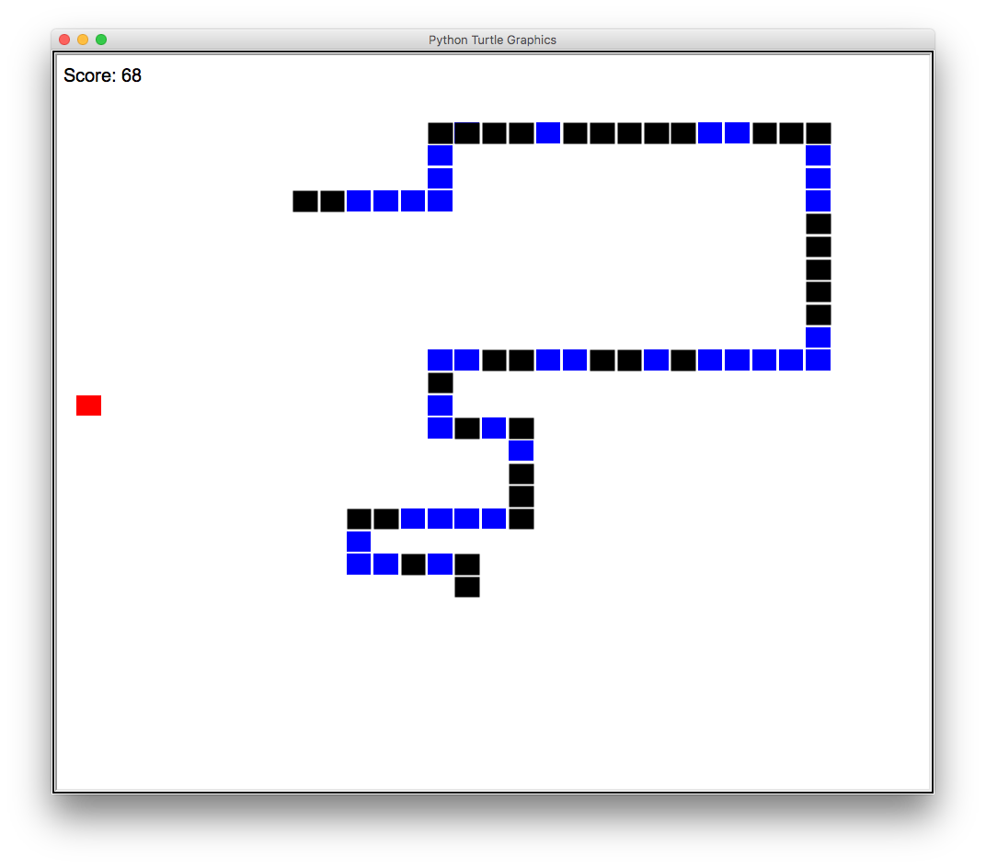
S N A K E
Danielle Bottiger & Elizabeth Ding
Professor Kent Lee & Kiran Tomlinson
Our Mission/Goal
Apple
Snake
Turtle Graphics
The
What We Learned
Keyboard
Music
Menu
Save
In The Future
References

