Slide 1
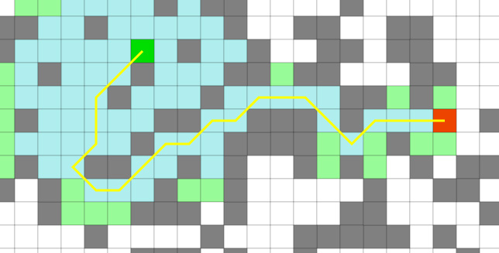
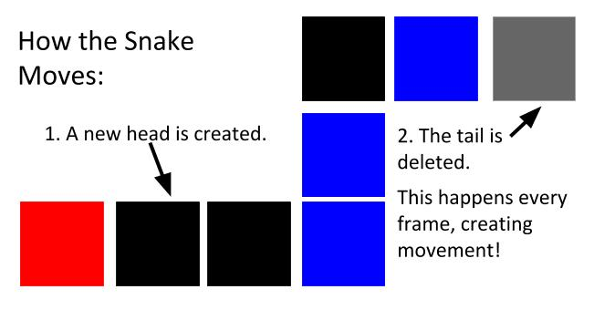
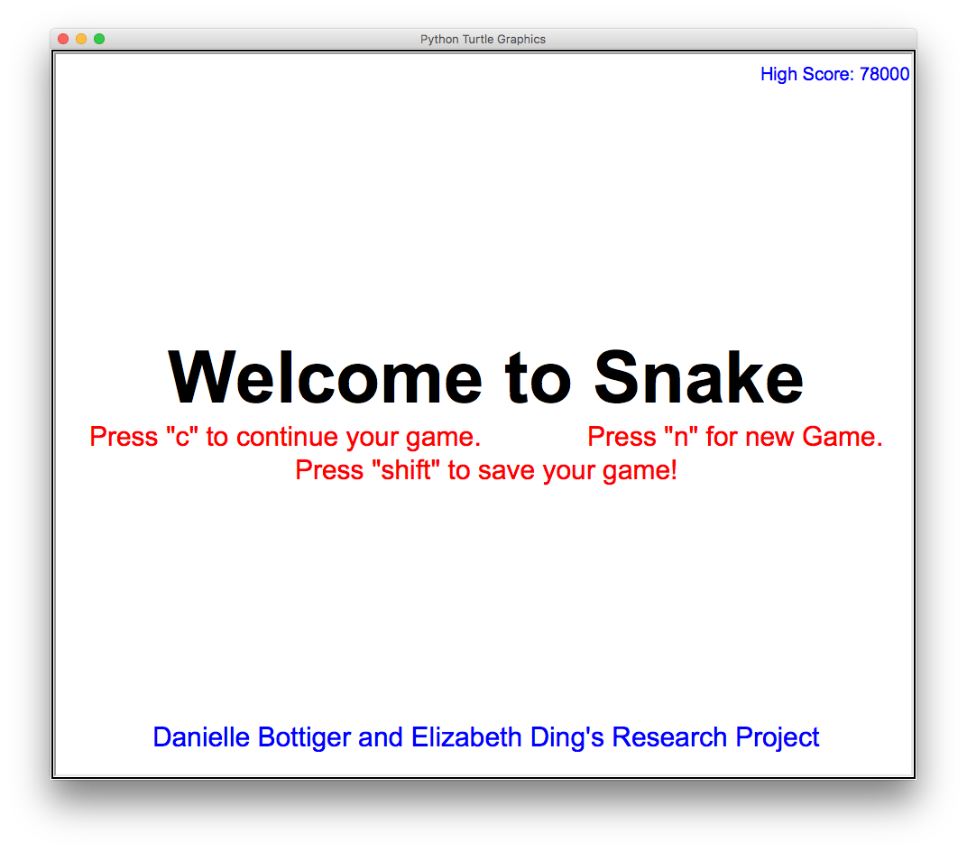
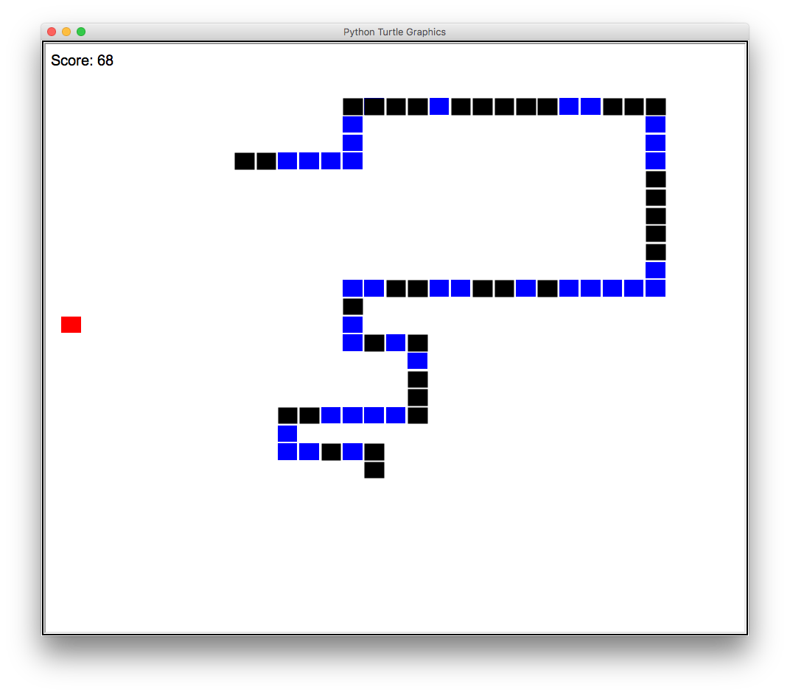


Danielle Bottiger & Elizabeth Ding
Professor Kent Lee & Kiran Tomlinson
S N A K E
Our Goal
Our mission was to work together towards programming a functioning snake game with the extra feature of being able to save a current game and revisit it later. We also strived towards researching and understanding an AI algorithm, such as A*, that would give
the snake the ability to
think for itself in order
to reach the highest
score possible.
Apple
Snake
Snake’s Turtle Graphics
The apple is a turtle graphic. When its x and y coordinates are equal to the snake head’s coordinates, the apple randomly respawns and
the snake gets longer.
Each square of the snake
is a turtle graphic. All the coordinates are stored in a list. A “next position” point is stored to move the snake along. A “head position” is used to detect collisions.
The snake appears to move by creating a new turtle graphic at its “next position”, or the new head. The last turtle graphic, the tail, is deleted. (Visual diagram below)
Below: A* search algorithm
Keyboard
The screen listens for a keyboard press in order to call a correlating method such as moving the snake up when the “w” or the “up” key is pressed.
Our Journey
Although it was difficult grasping Python, learning Turtle graphics, Pygame, and how to put music into our game made it worth it at the end. We also researched how the AI algorithm A*works. Aside from the technical aspects, we learned how to efficiently split up the work and set goals each day.
We planned on using a self-made snake graphic. However, many difficulties arose when we tried to include the graphic, so we decided to remain with the blue and black. In the future, we would like to include the graphic and continue researching AI, maybe even incorporating A* into the game.
Upper Left: Main menu; Upper Right: Gameplay
Music
Loading an Old Game
Save a New
Game
The game makes sure
the background music loops so it never stops and specific sound effects play. For example, applause will only play when a new high score is made.
This feature
lets you load an old game and save your game mid-play. When you continue
a game, it reads a text file for the coordinates of the apple and snake to load them in the game.
When the game
saves, it writes the coordinates of the apple and snake in the save file. Another text file is used to keep track of and read in a high score.
“Snake Game in Python Using Turtle Graphics.” Stack Overflow, stackoverflow.com/questions/30050194/snake-game-in-python-using-turtle-graphics.
“23.1. Turtle - Turtle Graphics¶.” 4. More Control Flow Tools - Python 3.6.5 Documentation, docs.python.org/3.1/library/turtle.html.
Computerphile. “A* (A Star) Search Algorithm - Computerphile.” YouTube, YouTube, 15 Feb. 2017, www.youtube.com\watch?v=ySN5Wnu88nE&t=382s.
“AI Learns to Play Snake Using Genetic Algorithm and Deep Learning.” YouTube, YouTube, 7 Dec. 2017, www.youtube.com/watch?v=3bhP7zulFfY.
“Pygame.mixer.music - Pygame v1.9.4.dev0 Documentation.” Pygame.org, www.pygame.org/docs/ref/music.html.
Koeing, Mike. “SoundBible.com” Free Sound Clips, soundbible.com/.
Below: Original Graphic

