Slide 1
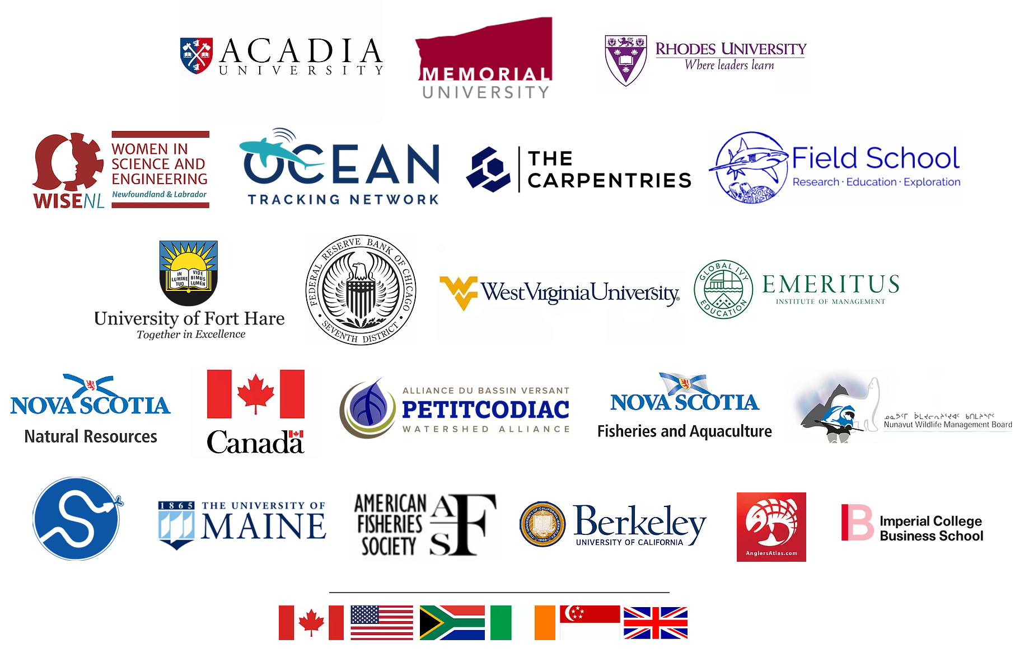











Hello! I’m your instructor, Danielle Quinn
https://github.com/DanielleQuinn/DesignLIFES
10+ years experience in data science and analytics
7+ years experience as a data science educator
certified RStudio Instructor
Background: fisheries & marine ecology
Current research: ecoinformatics
Passamaquoddy Recognition Group Inc.
@daniellequinn88
daniellequinn.org

Slide 2
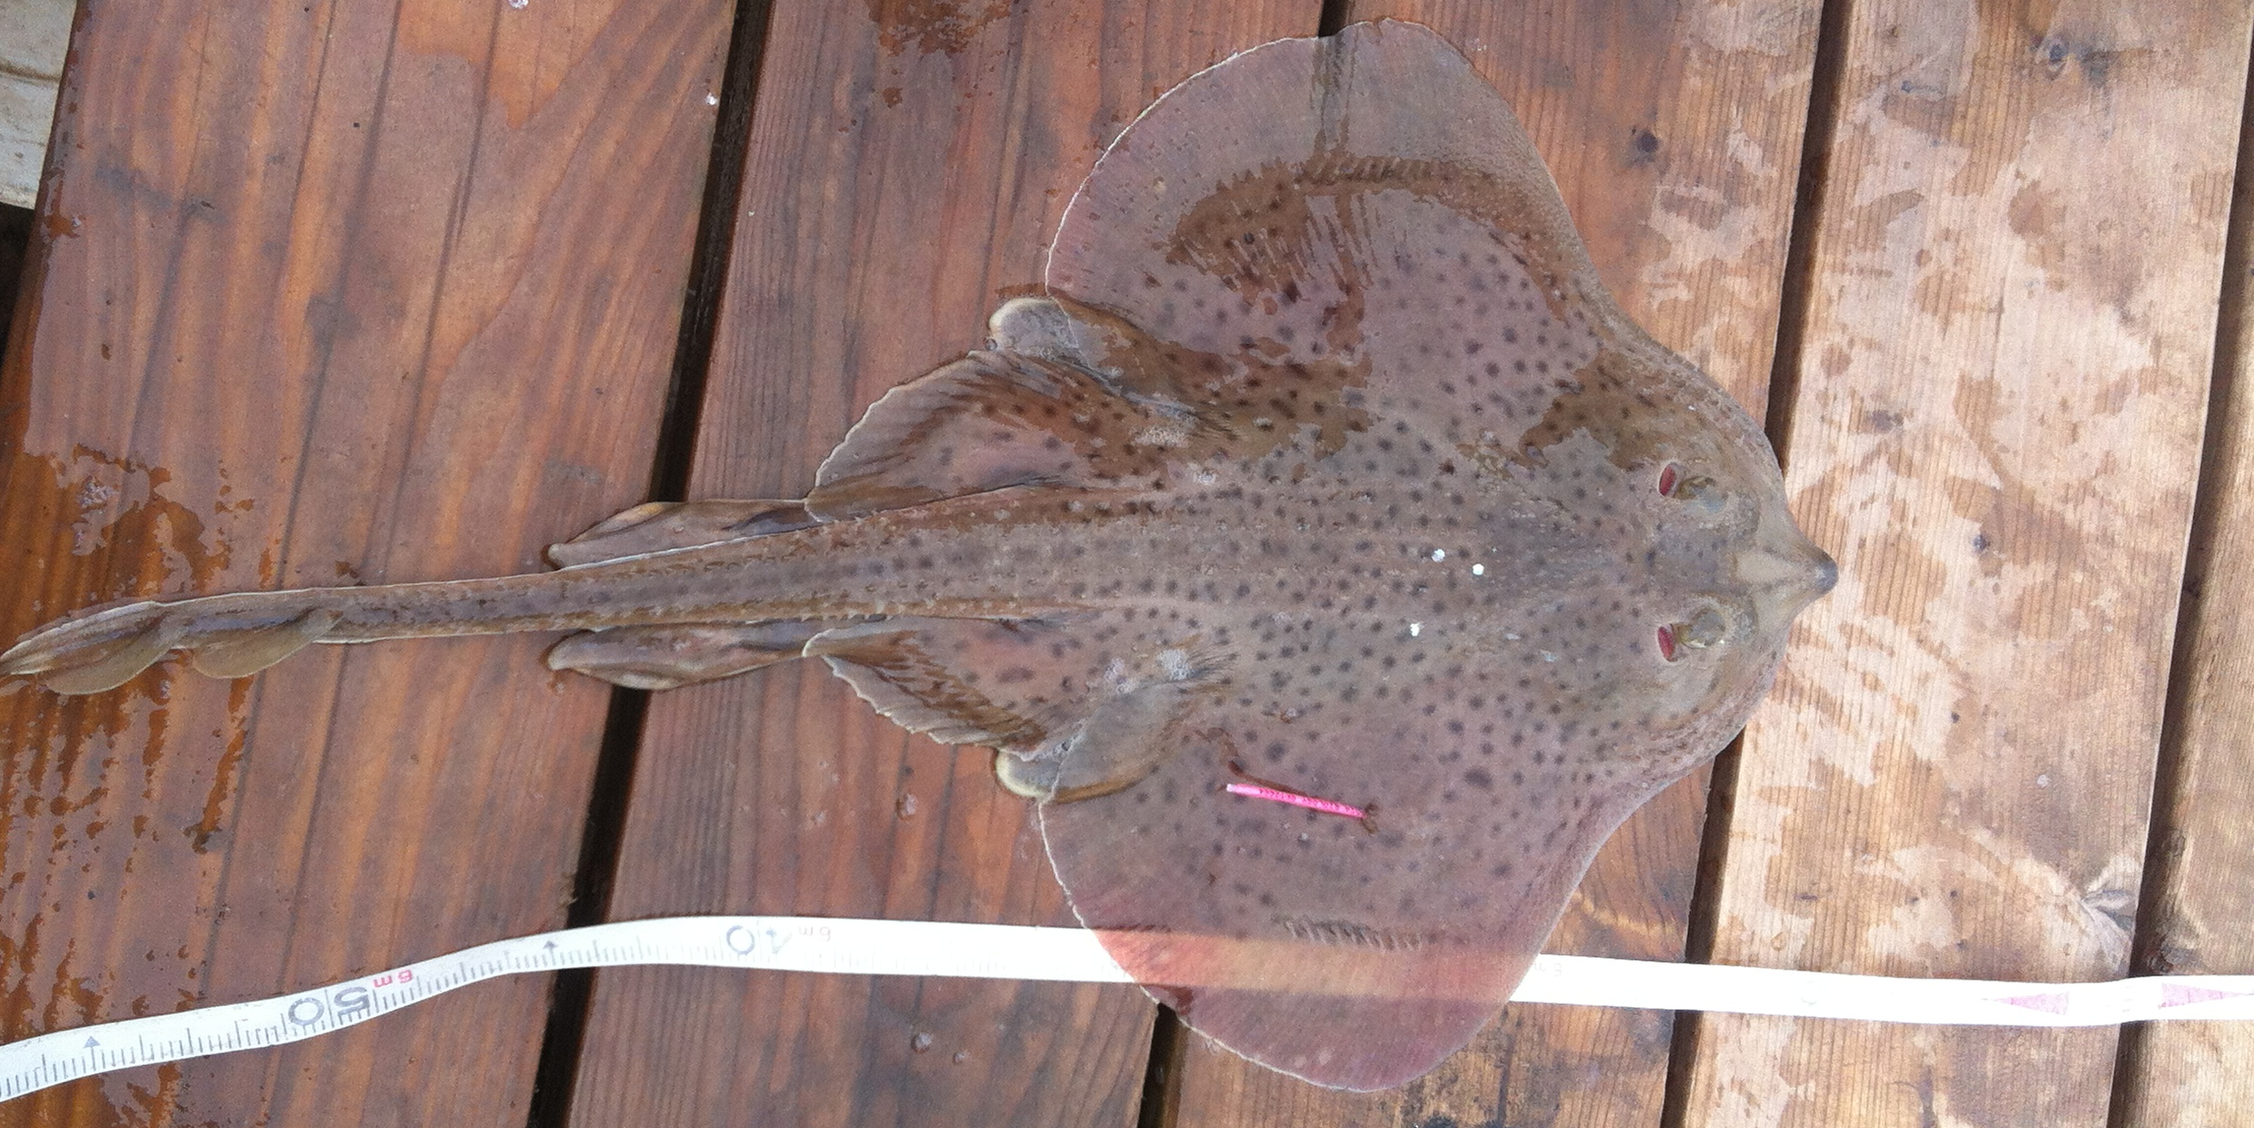
Hello! I’m your instructor, Danielle Quinn
https://github.com/DanielleQuinn/DesignLIFES
Analytics
Community based monitoring
Impact of forestry practices on lynx distribution
Population demographics
Optimizing design/effort of Scarabaeidae sampling
Accessibility
Automated reporting tool for regional biologists
Data portal for fisheries analytics and access
Real time dashboards for metadata analysis
Data cleaning tools for acoustic tagging
Methods
Machine learning for cryptic species
Identifying ecosystem shift dynamics
Quantifying marine social cohesion
10+ years experience in data science and analytics
7+ years experience as a data science educator
certified RStudio Instructor
Background: fisheries & marine ecology
Current research: ecoinformatics
@daniellequinn88
daniellequinn.org

Slide 3
Data Management and R Workflows
Before we begin…
I have R (version >4.0) installed
I have RStudio (version >1.4) installed
I have downloaded the materials from GitHub and saved these files to a folder on my computer that is easy to find
https://github.com/DanielleQuinn/DesignLIFES

Slide 4
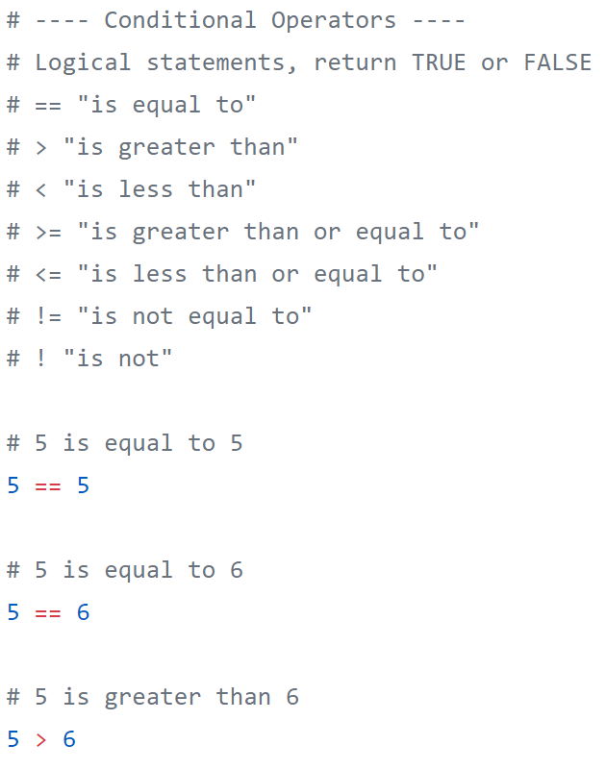
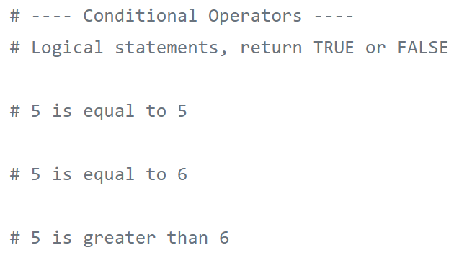
Complete Code: complete with notes and code, use for future reference or to help follow the live-coding
Code Along: an outline, follow along and live-code with me during the workshop

