Slide 1


Introduction to R and R Studio
May 31 2017
Hosted by R-Bar at Memorial University
Notes:
31 May 2017

Slide 2
R-Bar
R-Bar is a weekly scientific programming study group
Tutorials and Workshops
Co-Working Sessions
Demonstrations and Discussions
Notes:
32 slides (24 unique) + 4 exercises

Slide 3
workshop Resources
GitHub Repository
https://github.com/DanielleQuinn/RBarMUN/IntroWorkshop
Complete .R script
Blank (code-along) .R script
This presentation
Shared note space
https://public.etherpad-mozilla.org/p/RBarMUN_Spring2017
R Reference Card
https://cran.r-project.org/doc/contrib/Short-refcard.pdf
Cookbook for R
www.cookbook-r.com
Other Resources

Slide 4
Getting Started with R
RStudio
Learning a new language – “R”
Basic vocabulary
Core concepts
Simple and conditional indexing
It’s all about script clarity!
How to stay organized
# Commenting your code
# ---- Creating Sections ----
Notes:
32 slides (24 unique) + 4 exercises

Slide 5
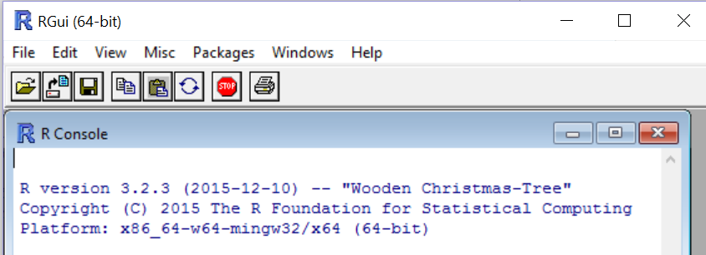

Exercise 1.1
(A) Install R
http://cran.r-project.org/bin/windows/base/
(B) Install RStudio
http://www.rstudio.com
(C) Open CodeAlong1.R or CodeAlong1_BLANK.R
Notes:
RStudio: Not a point and click type of GUI, no drop down menus, etc.
Timing: until everyone is ready (aim for <10 min)

Slide 6
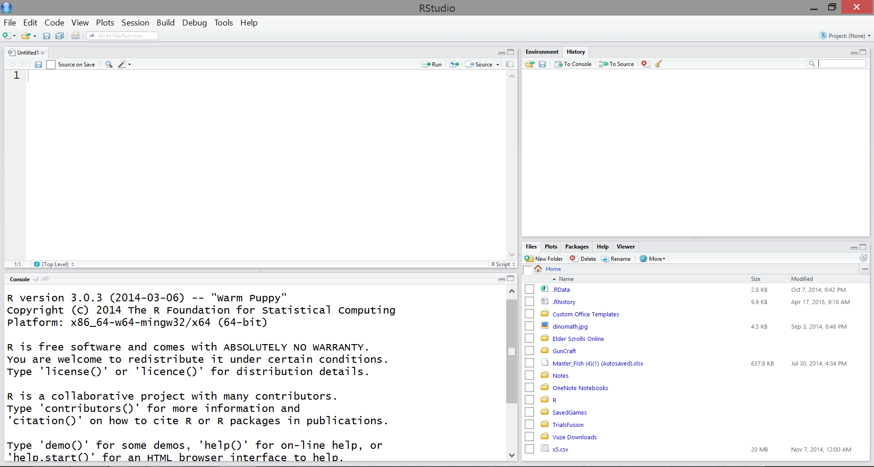
Our first look at rstudio

Slide 7
Our first look at rstudio
Environment
current objects, data, etc.
Source
saved script file used for ongoing projects and analyses
History
recently run code
Plots
Help
Console
(1) output & (2) used for on-the-fly coding, not saved in script file
Packages
collections of functions available for use

Slide 8
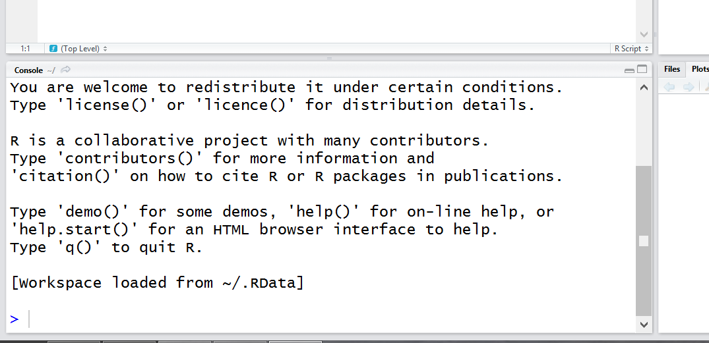
R basics: input and output
> ready
+ waiting
busy
> 5
[1] 5
> 1:10
[1] 1 2 3 4 5
[6] 6 7 8 9 [10] 10
Notes:
> 5
[1] 5
[1] shows position of value
> 1:10 # : means from one to ten
** actually do 1:100 to show positions
If it’s busy, don’t do anything.
If it’s waiting, either hit escape to cancel or figure out what it’s waiting for and do that. (We’ll see an example of this soon)

Slide 9
R basics: R is a calculator
+ addition
- subtraction
* multiplication
/ division
^ exponent
R follows order of operations
8 + 7 x 7 / (2 + 1) – 19
> 8+7*7/(2+1)-19
[1] 5.333333
Start CodeAlong1.R
Notes:
Do this in the console; note that this code isn’t “saved” anywhere, but is accessible via the History tab.

Slide 10
R basics: R is a calculator
+ addition
- subtraction
* multiplication
/ division
^ exponent
R follows order of operations
8 + 7 x 7 / (2 + 1) – 19
> 8+7*7/(2+1)-19
[1] 5.333333
What if I want to deal with more complex mathematical operations?
Notes:
Like a calculator, R can also deal with more complex math operations, like ln, log, and square root. R achieves this using functions. You can easily recognize a function because it has a function name followed by round brackets. Note that R isn’t always straightforward, using log() to find ln and log10() to find log.

Slide 11
R basics: functions
Functions are used to “do things” in R
function(argument)
Notes:
Here’s how functions work. They do things in R. This is how they are set up. Name, brackets, one or more arguments inside the brackets.

Slide 12
R basics: functions
Functions are used to “do things” in R
function(argument)
log() ln
log10() log
sqrt() square root
Notes:
R has specialized functions for standard mathematical functions.
Note: R isn’t always straightforward… uses log() to find ln and log10() to find log10!

Slide 13
R basics: functions
Functions are used to “do things” in R
function(argument)
> sqrt(81) # This finds the square root of 81
[1] 9
Notes:
For example, here we see the function called sqrt. By putting a value inside the round brackets, as an argument, we are telling R to give us the square root of the argument, here 81 gives us 9.

Slide 14
R basics: functions
Functions are used to “do things” in R
function(argument)
> sqrt(81) # This finds the square root of 81
[1] 9
Functions usually only accept specific types of arguments
> sqrt(“a”)
Error in sqrt(“a”): Non-numeric argument to mathematical function.
Notes:
Of course, in this particular function, only numeric values will work – if you tried to find the square root of “a”, R gives you an error report. We’ll go over some of the different types later.

Slide 15
R basics: functions
Functions can be nested
> sqrt(sqrt(81))
[1] 3
Notes:
You can also use functions inside of functions, layering and arranging them however you need!
Make sure that for each function, you have the appropriate open and close brackets. ( )

Slide 16
R basics: functions
Functions can be nested
> sqrt(sqrt(81))
[1] 3
Most functions have multiple arguments that use default values unless otherwise specified
You can build your own functions!
R Reference Card
Notes:
Multiple arguments: we’ll se more of this as we move on.
- not going to learn how to build functions today, as its rather advanced, but if you’d like to learn how, or stumble across a scenario where it is necessary, come see me.

Slide 17
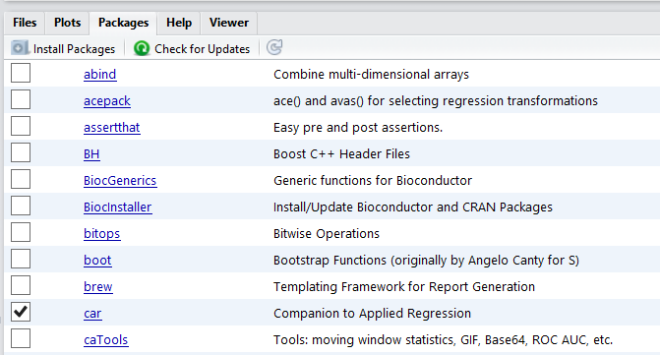
R basics: {packages}
Packages are collections of R functions, data, and compiled code in a well-defined format
Packages are stored in your local library
R comes with a standard set of packages
Other packages can be installed and loaded as needed
To load an installed package, use the function library() or check the appropriate box listed under ‘Packages’ in RStudio
Notes:
Show how to install packages
Show how to load packages: checking the box (car) or by using library(gridExtra). What are the benefits of each?
You will soon find out that if you need multiple packages loaded for your code to work, you don’t want to search your list and check each box every time you want to use your script. Instead, use library() and include it in your script so that they are automatically loaded! (We’ll go back to the ins and outs of this process a little later)

Slide 18
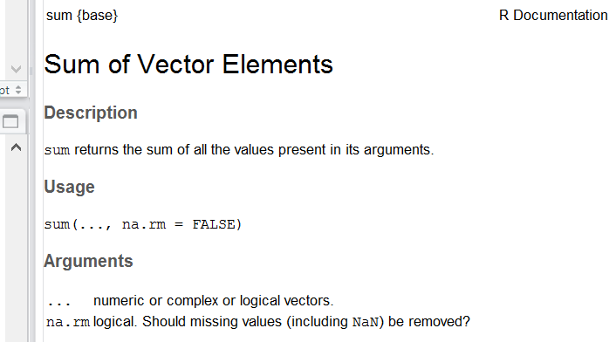
R basics: Help pages
You can access the function’s help file within RStudio
?sum() will search your loaded packages for sum()
??sum() will search through your installed packages for sum() and the keyword “sum”
Notes:
There are thousands of functions, and you won’t always remember what arguments a function is looking for, or how exactly it works. Although there is a vast R community online, you should start your query by looking at the R help page for the function. You can do this directly from Rstudio. Show them sum() and work out how it is done.
Note: multiple arguments, na.rm=FALSE means that the name of that argument is “na.rm” and the default value for the argument is “FALSE”. In the description, we see what the argument does and note that we’re going to be dealing with this specifically, later on.

Slide 19
Exercise 1.2
(A) Use R as a calculator
(B) Practice some simple functions
Try these out; remember that each function needs an argument!
log10()
abs()
(C) Install and load these non-standard packages:
{ggplot2} {lubridate}
{dplyr} {reshape2}
(D) Bring up a help page
mean()
Notes:
Timing: 3 minutes + until packages are loaded

Slide 20
R basics: objects
An object is a stored value or set of values (elements)
An object is a container that holds values and attributes (can be very complex)
Notes:
Quite often, we don’t want to type out a value or a set of values repeatedly. Instead, we want to be able to put these values into a container and give it a name that we can use to quickly call on later.

Slide 21
R basics: objects (scalars)
An object is a stored value or set of values (elements)
An object is a container that holds values and attributes (can be very complex)
> pi
[1] 3.141593
The simplest type of object is a scalar.
It is one dimensional with a length of one.
Notes:
Pi is a built in scalar

Slide 22
R basics: objects (scalars)
An object is a stored value or set of values (elements)
An object is a container that holds values and attributes (can be very complex)
> pi
[1] 3.141593
> myval<-5+10 # Create an object called myval, which contains the value of 5 + 10
> myval # Return the value of the object myval
[1] 15
The simplest type of object is a scalar.
It is one dimensional with a length of one.
Notes:
The <- assigns a value
Note that = does the same thing, but best practice is to use <- … we can get into it if you like, but I’m asking you to just trust me on that. It is for a couple very good reasons, but everyone will have their own opinion and coding habits.

Slide 23
R basics: objects (vectors)
An object is a stored value or set of values (elements)
An object is a container that holds values and attributes (can be very complex)
> letters
[1] “a” “b” “c” “d” ...
The most common type of object is a vector.
It is one dimensional with a length > one.
Notes:
Letters is a built-in vector

Slide 24
R basics: objects (vectors)
An object is a stored value or set of values (elements)
An object is a container that holds values and attributes (can be very complex)
> letters
[1] “a” “b” “c” “d” ...
> mycols<-c(“red”,“blue”,“yellow”,“green”)
> mycols
[1] “red” “blue” “yellow” “green”
The most common type of object is a vector.
It is one dimensional with a length > one.
Notes:
c() is a simple function that essentially combines or concatenates values

Slide 25
R basics: data classes
Vectors can only contain one class of data (“atomic”)
Variables can have various classes
num are numbers with decimals (e.g. 10.3)
int are integers (e.g. 10)
chr are character strings (e.g. “a”, “small”)
factor text or numbers stored as text, with unique levels
Hierarchical structure of data classes

Slide 26
R basics: data classes
Check and convert data classes
> mycols
[1] “red” “blue” “yellow” “green”
> class(mycols) # What class is mycols?
[1] “character”
> as.factor(mycols) # View it as a factor
[1] red blue yellow green
Levels: blue green red yellow

Slide 27
R basics: data classes
> mycounts<-c(1, 6, 13, 2, ‘about 5’, 2)
> mean(mycounts) # Average mycounts
[1] NA
Warning message: In mean.default(mycounts): argument is not numeric or logical: returning NA
> class(mycounts) # What class is mycounts?
[1] “character”
> as.numeric(mycounts)
[1] 1 6 13 2 NA 2
Warning message: NAs introduced by coercion

Slide 28
R basics: nas
NAs are automatically inserted into blank cells in your dataset upon importing
Cells that contain NA are also coerced to NA
> ncounts<-as.numeric(mycounts)
> mean(ncounts) # Average ncounts
[1] NA
# Most functions have an argument specifically used to ignore NAs
> max(ncounts, na.rm=TRUE) # Default na.rm=FALSE
[1] 4.8
Consider: “Should the value be a 0 or an NA?”

Slide 29
best practices: Objects
When naming objects:
Short, but easily recognizable
Avoid capitals, limit punctuation
Consistent format
Good: meanage, heights_2013 , heights_2014
Bad: a, a2, AverageCarapaceLengthOfCrabsIn2013
Good:
> object1<-5
Bad:
> “red”->object2
> object3=14

Slide 30
Exercise 1.3
Create a scalar called myname that contains your first name
Create a vector called mybirthday that contains three numeric elements; your day, month, and year of birth
Create a vector called test that contains both numeric and character elements. What does class() tell you about test?
Convert test to a factor and call it ftest. Now convert ftest to a numeric object called ntest. What do you notice about ntest?
Notes:
3 minutes

Slide 31
R basics: Indexing
Positional attributes designated by [ ]
Included in output
> 1:100
[1] 1 2 3 4 5 6 7
[8] 8 9 10 11 12
[13] 13 14 15 16 ...
Used to query objects
object[indexing]
Knowing how many dimensions the object has will tell you how many index values to include!

Slide 32
R basics: indexing
Our object mycols is a vector; one dimensional
# View mycols
> mycols
[1] “red” “blue” “yellow” ”green”
When indexing, we give it one positional value or one set of values
# View element in position 3 in mycols
> mycols[3]
[1] “yellow”

Slide 33
R basics: indexing
Our object mycols is a vector; one dimensional
# View mycols
> mycols
[1] “red” “blue” “yellow” ”green”
When indexing, we give it one positional value or one set of values
# View elements in positions 2 to 4 in mycols
> mycols[2:4]
[1] “blue” “yellow” “green”

Slide 34
R basics: indexing
Our object mycols is a vector; one dimensional
# View mycols
> mycols
[1] “red” “blue” “yellow” ”green”
When indexing, we give it one positional value or one set of values
# View elements in positions 1, 3 and 4 in mycols
> mycols[c(1,3,4)]
[1] “red” “yellow” “green”
> mycols[-2]
> “red” “yellow” “green”

Slide 35
R basics: conditional indexing
What if we don’t know the positional values of the elements we want to look at? We use conditional or logical statements!
# Are elements of mycols equal to “blue”?
> mycols==“blue”
[1] FALSE TRUE FALSE FALSE
A==5 asks “does A equal 5?”
A=5 sets the value of A to 5

Slide 36
R basics: conditional indexing
What if we don’t know the positional values of the elements we want to look at? We use conditional or logical statements!
# Are elements of mycols equal to “blue”?
> mycols==“blue”
[1] FALSE TRUE FALSE FALSE
We need to find a numeric value to use for indexing.
# Which elements of mycols equal to “blue”?
> which(mycols==“blue”)
[1] 2
Now there are two options; hard coding versus soft coding.

Slide 37
R basics: conditional indexing
Hard Coding
# Show me elements of mycols equal to “blue”
> which(mycols==“blue”)
[1] 2
> mycols[2]
[1] “blue”
Soft Coding
# Show me elements of mycols equal to “blue”
> mycols[which(mycols==“blue”)]
[1] “blue”
> mycols[mycols==“blue”]
[1] “blue”

Slide 38
R basics: conditional indexing
# View elements in mycols that are either “blue” or
“green”
> mycols[mycols %in% c(“blue”,”green”)]
[1] “blue” “green”
# View elements in mycols that are not equal to “red”
> mycols[!mycols==“red”]
[1] “blue” “yellow” “green”

Slide 39
R basics: conditional indexing
# Create a vector called one_ten containing all integers from 1 to 10
> one_ten<-1:10
# View elements greater than or equal to 8
> one_ten[one_ten>=8]
[1] 8 9 10
# View elements less than 5 and greater than 2
> one_ten[one_ten<5 & one_ten>2]
> [1] 3 4
# View elements less than 3 or greater than 9
> one_ten[one_ten<3 | one_ten>9]
> [1] 1 2 10

Slide 40
Exercise 1.4
(A) Create an object called numvals consisting of a vector of numeric elements generated from a function; try using either seq() or rnorm()
(B) Take a good look at your object
Try out these functions:
length() max() sort()
unique() min() quantile()
(C) Find all values of numvals greater than the average
(D) Find all values of numvals that are in the top 10%. Store these values in an object called topvals
(Hint: quantile() .. change a default argument!)
End CodeAlong1.R
Notes:
5 minutes

Slide 41
best practices: R SCRIPT
Always #comment your code! Always. Seriously… ALWAYS.
R doesn’t try to read or interpret #comments; use them to keep track of what you are doing and why.
Your code should have well defined sections, such as:
Description
Set Working Directory
Load Packages
Import Data
To create collapsible sections and a drop-down menu in RStudio, use:
# ---- Section Title Here ----
You need to be aware of what objects exist in the Environment, and remember that order matters!

