Slide 1


Introduction to R and R Studio
Part II
June 7 2017
Hosted by R-Bar at Memorial University

Slide 2
workshop Resources
GitHub Repository
https://github.com/DanielleQuinn/RBarMUN
Complete and blank .R scripts
This presentation
Demonstration data file
Shared note space
https://public.etherpad-mozilla.org/p/RBarMUN_Spring2017
Lubridate Tutorial
http://daniellequinn.github.io/RLessons
Software Carpentry – Data Organization in Spreadsheets
http://www.datacarpentry.org/spreadsheet-ecology-lesson
Other Resources

Slide 3
Data wrangling in R
Data quality is key!
Preparing a flat file
Importing data
Tips for data quality assurance
Dealing with data frames
Indexing with rows and columns
Modifying data frames in R
Efficient data exploration
Formatting dates using {lubridate}
Summarizing data using {dplyr}

Slide 4
Best Practices: Spreadsheets
Avoid dealing with frustrating issues later by following some simple rules now:
Single flat file (at least for now…)
Everything lowercase with no punctuation
Each column uniquely and simply named
Individual column for each component of date/time
No data? Leave it blank or use NA … but be consistent!
Create a variable key
Save as a .txt or .csv

Slide 5
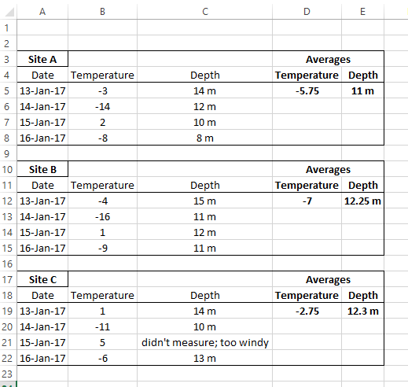
Spreadsheet organization
What’s wrong with this data sheet?

Slide 6
Spreadsheet organization
What’s wrong with this data sheet?
site should be a variable
remove capitals and punctuation
each column needs unique header
calculations included in flat file
units included in cells
date components should be separated
missing data should be blank or NA

Slide 7
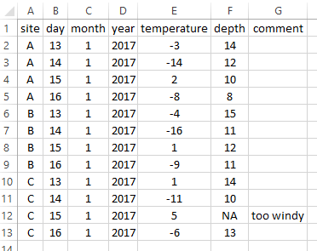
Spreadsheet organization
What’s wrong with this data sheet?

Slide 8
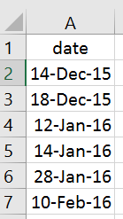
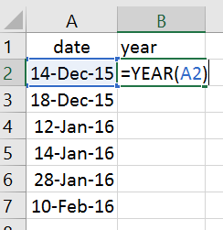
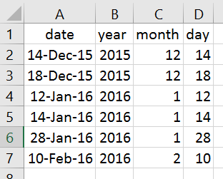
Best Practices: dates & times
Separate columns for each date and time component
Store as numeric values

Slide 9
Working directory
The working directory is the location (folder) that R is going to communicate with when importing files, exporting figures, etc.
getwd() # Prints your current working directory; no arguments needed
setwd(dir) # Defines your working directory; dir argument needed
the path to the directory (folder) that you want R to communicate with, as a character string (quotes)
# Example: defines my working directory to be a folder on my Desktop called RBarMUN
setwd(“C:/Users/danie/Desktop/RBarMUN”)

Slide 10
Getting started
Make sure that you have a directory in an appropriate location (i.e. NOT your Downloads folder!) Save your dataset as a .txt in this directory (Remember that some features, such as formulas, may be lost when converted)
Open a new .R script, create a section called “Set Working Directory”, and set your working directory to the appropriate folder (OR, save the CodeAlong script in the directory and follow along)
setwd(“C:/Users/danie/Desktop/RBarMUN”)
Load packages (for later) {dplyr} and {lubridate}
Import your data! In a perfect world…
mydata<-read.delim(“sampledata.txt”)
creates an object (container) called mydata which contains your flat file (spreadsheet) sampledata.txt as a data frame with rows and columns

Slide 11
Problems importing data
Error Message: Error in file(file, “rt”) : cannot open the connection In addition: Warning message: In file(file, “rt”): cannot open file ‘sample’: No such file or directory
Issue: R can’t find your file in the working directory you specified
Check: Did you set your working directory correctly?
Did you spell the filename correctly?
Did you include “.txt” in your filename?
Did you save your file as a .txt in the correct folder?
Troubleshooting: Use list.files() to see a list of all the files available in your current working directory

Slide 12
Problems importing data
Error Message: None
Issue: The dataset just doesn’t look right!
Check: Is your spreadsheet set up right?
no merged cells
no extra rows (i.e. first row are variable names, data begins on second row) or blank rows
no spaces or punctuation in variable names (may or may not cause issues, depending on specific circumstances)
Excel can be finicky, and “activate” empty cells in extra rows and/or columns. Do you see columns “X.1”, “X.2”?
if you don’t have headers (column names) in your dataset, you need to change the header argument from TRUE (default) to FALSE
mydata<-read.delim(“filename.txt”, header=FALSE)

Slide 13
Data Quality / Exploration
To look at a data frame:
View(x) spreadsheet of data frame in new tab
dim(x) dimensions (rows, columns)
head(x) output the first six rows
str(x) structure of each variable
summary(x) summary of each variable
Columns have unique names – these are variable names
names(x) gives you variable (column) names
Note: The argument x here is the name of the data frame object
head(x=mydata) or head(mydata)

Slide 14

Common data issues
Problem: My factor levels are incorrect; there should be 2 levels
Explanation: Most likely, either an entry is followed by a space (“male” vs “male ”), capitalization is inconsistent (“male” vs “Male”), or you have blank values (NA), which act as a third level.
Potential Solutions:
Find and remove white spaces:
data$sex<-gsub(“ ”, “”,data$sex)
Convert everything to lowercase:
data$sex<-tolower(data$sex)

Slide 15
Common data issues
Problem: My numeric values aren’t numeric
We’ll come back to this in a moment …

Slide 16
Notes about data frames
Each column of a data frame is a vector

Slide 17
1. each column is a vector
Each column (variable) is denoted by $
mydata$length outputs the contents of the column called length in the object mydata (which is a data frame) as a vector
What do we know about vectors?
Vectors are atomic (they can only contain one class of data)

Slide 18
Common data issues
Problem: My numeric values aren’t numeric
Explanation: Somewhere in the column (vector), there is a value that is being recognized as a character; likely due to a space following a number, or a non numeric entry (i.e. “approx. 4”)
Potential Solutions:
Find and remove white spaces, then convert to a number:
data$values<-as.numeric(gsub(“ ”, “”,data$values))
Check for non-numeric entries:
unique(data$values)

Slide 19
1. each column is a vector
Each column (variable) is denoted by $
mydata$length outputs the contents of the column called length in the object mydata (which is a data frame) as a vector
Indexing works the same way as any other vector; to see the 5th element of the vector mydata$length, use mydata$length[5]
One dimensional
One value
Exercise 1: Conditional Indexing
Create an object called adultlengths that contains all values of the length column that are greater than 10
What do we know about vectors?
Vectors are atomic (they can only contain one class of data)
Vectors are one dimensional with a length > one
What about NA values?

Slide 20
Notes about data frames
Each column of a data frame is a vector
Data frames are two dimensional (row, column)

Slide 21
2. Data frames are 2d
How does that change the way we index a data frame?
We need to provide two values (rows and columns)
R uses [row,column] assignment
mydata[1,2] outputs the value of row 1, column 2
mydata[1:5,c(1:3,6)] outputs rows 1 to 5 and columns 1, 2, 3, and 6
You can leave a dimension blank to select all rows or columns
mydata[,3] outputs all rows and column 3
mydata[1:5,] outputs rows 1 to 5 and all columns
Two dimensional
Two values

Slide 22
2. Data frames are 2d
How does that change the way we index a data frame?
We need to provide two values (rows and columns)
R uses [row,col] assignment
mydata[1,2] outputs the value of row 1, column 2
Exercise 2: Conditional Indexing (Data Frames)
Create an object called adultdata that contains records (i.e. all columns) of individuals with a length greater than 10
# Why does this give you an error?
mydata[mydata$length>10]

Slide 23
Modifying data frames
What if I want to add a new variable (i.e. create a new column)?
mydata$ratio<-mydata$length/mydata$weight
What if I want to change an existing variable?
# Rather than eggs representing the number of eggs, we want it to represent presence (1) and absence (0) of eggs
mydata$eggs[mydata$eggs>0]<-1
# Females with no eggs should be 0, but males should all be NA
mydata$eggs[mydata$sex==“m”]<-NA
Note: The package {car} has a function called recode() extremely useful in complex variable recoding!

Slide 24
Formatting Dates {lubridate}
Dates are a constant P.i.t.A. in R – I blame Excel.
Essentially, dates need to be reformatted within R to avoid being interpreted as nonsense factors, characters or integers and instead be interpreted as POSIX
Numerous approaches; I prefer using dmy() and/or dmy_hms() from the lubridate package
www.daniellequinn.github.io/RLessons
Notes:
UPDATE

Slide 25
lubridate::dmy()
The function dmy() is fairly flexible in terms of what kind of argument it requires – but it’s wise to be consistent!
Use an argument that is a character vector where each element has the following format: “dd-mm-yyyy”
Step 1: Create a character vector from the year, month, and day columns of mydata using the paste() function and place it in an object called myvec
myvec<-paste(mydata$day, mydata$month, mydata$year, sep=“-”)
What character should be used to separate each component?

Slide 26
lubridate::dmy()
The function dmy() is fairly flexible in terms of what kind of argument it requires – but it’s wise to be consistent!
Use an argument that is a character vector where each element has the following format: “dd-mm-yyyy”
Step 1: Create a character vector from the year, month, and day columns of mydata using the paste() function and place it in an object called myvec
myvec<-paste(mydata$day, mydata$month, mydata$year, sep=“-”)
Step 2: Use the object myvec as the argument for dmy() and place the resulting vector in an object called mydates
mydates<-dmy(myvec)
Step 3: Create a new column called date which contains the vector of formatted dates mydates
mydata$date<-mydates

Slide 27
lubridate::dmy()
The function dmy() is fairly flexible in terms of what kind of argument it requires – but it’s wise to be consistent!
Use an argument that is a character vector where each element has the following format: “dd-mm-yyyy”
Alternatively: Nest all of these steps into a single line of code!
mydates<-dmy(paste(mydata$day, mydata$month, mydata$year, sep=“-”))
Exercise 3: Formatting Date Time
Use dmy_hms() to create a column in mydata called datetime that contains both date and time information.
Note: If R experiences an error, it will stop running the piece of code, and report the error to you. If you receive a warning, it means that the code ran successfully, but you need to check the warning using warning() to be sure it ran correctly.
When using dmy() or dmy_hms() you may see a warning “___failed to parse”. This means that somewhere in your dataset a portion of your date (day, month, etc.) was missing and the overall date becomes NA.

Slide 28
Summary Stats: methods
Data analysis often begins with generating summary statistics
There are many simple ways to summarize your data!
# Counts
table(mydata$year)
table(mydata$year, mydata$sex)
# Statistics
library(doBy)
summaryBy(weight~year+sex, data=mydata)
summaryBy(weight~year+sex, data=mydata, FUN=min)
Each method has pros and cons, and your use will change depending on the situation
However…
Notes:
UPDATE

Slide 29
Summary stats: {dplyr}
{dplyr} is a package developed by Hadley Wickham for summarizing data in a flexible and customizable way without worrying about indexing or looping
filter() simplified conditional indexing
select() simplified conditional indexing
group_by() stratify by a variable
summarise() apply flexible summary statistics
%>% “pipe”; pass results on left to functions on right

Slide 30
Summary stats: {dplyr}
# Subset mydata to look only at males
# Option 1 (indexing)
mydata[mydata$sex==“m”,]
# Option 2 (dplyr)
mydata%>%
filter(sex==“m”)

Slide 31
Summary stats: {dplyr}
# Subset mydata to only year and length columns
# Option 1 (indexing)
mydata[,c(“year”, ”length”)]
# Option 2 (dplyr)
mydata%>%
select(year, length)

Slide 32
Summary stats: {dplyr}
# Find the mean length, by year
# Option 1 (indexing/looping)
year<-unique(mydata$year)
mlength<-c()
for(i in year)
{
mlength.in<-mean(mydata$length[mydata$year==i], na.rm=TRUE)
mlength<-c(mlength, mlength.in)
}
table1<-data.frame(year, mlength)
# Option 2 (dplyr)
table1<-mydata %>%
group_by(year) %>%
summarise(mlength=mean(length, na.rm=TRUE)) %>%
data.frame()

Slide 33
Exercise 2.2
(A) Use {dplyr} to generate a summary table of the mean weights of individuals with a length greater than 10, by both sex and year, along with the standard deviation around those means
year<-unique(mydata$year)
sex<-c()
mweight<-c()
sdweight<-c()
for(i in year)
{
for(ii in unique(mydata))
{
sex.in<-as.character(ii)
sex<-c(sex, sex.in)
x<-mydata$weight[mydata$length>10 &
!is.na(mydata$length) &
mydata$year==i &
mydata$sex==ii]
mweight.in<-mean(x, na.rm=TRUE)
mweight<-c(mweight, mweight.in)
sdweight.in<-sd(x, na.rm=TRUE)
sdweight<-c(sdweight, sdweight.in)
}
}
table2<-data.frame(year, sex, mweight, sdweight)

Slide 34
Summary stats: overview
Indexing / looping, table(), summaryBy(), and {dplyr} all have strengths and weaknesses.
You’ll likely end up using all of them at some point, depending on the circumstances.
 | Simple | Flexible | Efficient
Indexing/Looping | x | ☺☺☺ | xx
table() | ☺☺☺ | x | ☺☺
summaryBy() | ☺ | ☺ | ☺
{dplyr} | ☺☺ | ☺☺ | ☺☺☺

