Slide 1


Introduction to R and R Studio
Part II
June 7 2017
Hosted by R-Bar at Memorial University

Slide 2
workshop Resources
GitHub Repository
https://github.com/DanielleQuinn/RBarMUN
Complete and blank .R scripts
This presentation
Demonstration data file
Shared note space
https://public.etherpad-mozilla.org/p/RBarMUN_Spring2017
Lubridate Tutorial
http://daniellequinn.github.io/RLessons/FormattingDates/FormattingDates.html
Software Carpentry – Data Organization in Spreadsheets
http://www.datacarpentry.org/spreadsheet-ecology-lesson
Other Resources

Slide 3
Data wrangling in R
Data quality is key!
Preparing a flat file
Importing data
Tips for data quality assurance
Dealing with data frames
Indexing with rows and columns
Modifying data frames in R
Efficient data exploration
Formatting dates using {lubridate}
Summarizing data using {dplyr}
Notes:
32 slides (24 unique) + 4 exercises

Slide 4
Best Practices: Spreadsheets
Avoid dealing with frustrating issues later by following some simple rules now:
Single flat file (at least for now…)
Everything lowercase with no punctuation
Each column uniquely and simply named
Individual column for each component of date/time
No data? Leave it blank or use NA … but be consistent!
Create a variable key
Save as a .txt or .csv

Slide 5
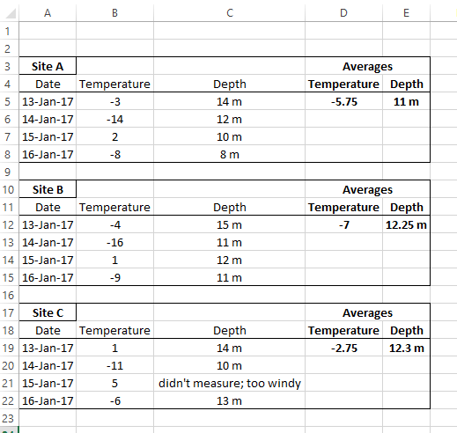
Spreadsheet organization
What’s wrong with this data sheet?

Slide 6
Spreadsheet organization
What’s wrong with this data sheet?
site should be a variable
remove capitals and punctuation
each column needs unique header
calculations included in flat file
units included in cells
date components should be separated
missing data should be blank or NA

Slide 7
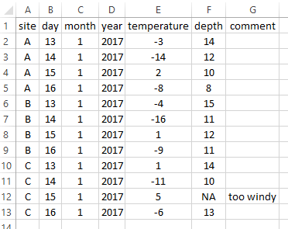
Spreadsheet organization
What’s wrong with this data sheet?

Slide 8
Working directory
The working directory is the location (folder) that R is going to communicate with when importing files, exporting figures, etc.
getwd() # Prints your current working directory; no arguments needed
setwd(dir) # Defines your working directory; dir argument needed
the path to the directory (folder) that you want R to communicate with, as a character string (quotes)
# Example: defines my working directory to be a folder on my Desktop called RBarMUN
setwd(“C:/Users/danie/Desktop/RBarMUN”)

Slide 9
Getting started
Make sure that your course materials are saved in an appropriate location (i.e. NOT your Downloads folder!)
Save your dataset as a .txt in the same folder as above (Remember that some features, such as formulas, may be lost when converted)
Open a new .R script, create a section called “Set Working Directory”, and set your working directory to the appropriate folder
setwd(“C:/Users/danie/Desktop/RBarMUN”)
Import your data! In a perfect world…
mydata<-read.delim(“sampledata.txt”)
View(mydata) # View data in new tab
Start RBarMUN_CodeAlong2.R or your own script
Notes:
To Do: Create mydata.txt that has the common data issues described in the following slides (NOT the importing issues)

Slide 10
Problems importing data
Error Message: Error in file(file, “rt”) : cannot open the connection In addition: Warning message: In file(file, “rt”): cannot open file ‘sample’: No such file or directory
Issue: R can’t find your file in the working directory you specified
Check: Did you set your working directory correctly?
Did you spell the filename correctly?
Did you include “.txt” in your filename?
Did you save your file as a .txt in the correct folder?
Troubleshooting: Use list.files() to see a list of all the files available in your current working directory.

Slide 11
Problems importing data
Error Message: None
Issue: The dataset just doesn’t look right!
Check: Is your spreadsheet set up right?
no merged cells
no extra rows (i.e. first row are variable names, data begins on second row) or blank rows
no spaces or punctuation in variable names (may or may not cause issues, depending on specific circumstances)
Excel can be finicky, and “activate” empty cells in extra rows and/or columns. Do you see columns “X.1”, “X.2”?
if you don’t have headers (column names) in your dataset, you need to change the header argument from TRUE (default) to FALSE
mydata<-read.delim(“filename.txt”, header=FALSE)

Slide 12
Data frames: basics
To look at a data frame:
View() spreadsheet of data frame in new tab
str() structure of each variable
summary() summary of each variable
dim() dimensions (rows, columns)
head() output the first six rows
Columns have unique names – these are variable names
names() gives you variable (column) names
Notes:
MOVE MODES TO R BASICS

Slide 13
Exercise 1.5
Ensure you have:
a new .R script
your working directory set under a “Set Working Directory” section
your .txt data file imported into R
Confirm that your data was imported correctly
Correct number and names of variables (columns)?
Correct number of observations (rows)?
Check for obvious data entry errors
Does the data mode of each variable make sense?
Do the summary statistics of each variable make sense?
View(mydata) str(mydata) summary(mydata)
dim(mydata) head(mydata) names(mydata)
Notes:
whitespaces (e.g. 5 versus 5_ will be read as two different values)
upper and lower case characters are read differently

Slide 14
Common data issues
Problem: My numeric values aren’t numeric
Explanation: Somewhere in the column (vector), there is a value that is being recognized as a character; likely due to a space following a number, or a non numeric entry (i.e. “approx. 4”)
Solutions:
Find and remove white spaces:
data$values<-as.numeric(gsub(“ ”, “”,data$values))
Check for non-numeric entries:
unique(data$values)

Slide 15

Common data issues
Problem: My factor levels are incorrect; there should be 2 levels
Explanation: Most likely, either an entry is followed by a space (“male” vs “male ”), capitalization is inconsistent (“male” vs “Male”), or you have blank values (NAs), which act as a third level.
Solutions:
Find and remove white spaces:
data$sex<-as.numeric(gsub(“ ”, “”,data$sex))
Convert everything to lowercase:
data$sex<-tolower(data$sex)

Slide 16
Data frames: structure
Concept 1: Each column of a data frame is a vector
Concept 2: Data frames are two dimensional (row, column)

Slide 17
1. each column is a vector
Each column is labelled as a variable and is denoted by $
mydata$length outputs the contents of the column called length in the data frame object mydata as a vector
Indexing works the same way as any other vector; to see the 5th element of the vector mydata$length, use mydata$length[5]

Slide 18
1. each column is a vector
Each column is labelled as a variable and is denoted by $
mydata$length outputs the contents of the column called length in the data frame object mydata as a vector
Indexing works the same way as any other vector; to see the 5th element of the vector mydata$length, use mydata$length[5]
Vector, 1D
One value

Slide 19
1. each column is a vector
Each column is labelled as a variable and is denoted by $
mydata$length outputs the contents of the column called length in the data frame object mydata as a vector
Indexing works the same way as any other vector; to see the 5th element of the vector mydata$length, use mydata$length[5]
# Output a subset of the mydata$length vector where length > 10
mydata$length[mydata$length>10]

Slide 20
2. Two dimensional
Need to give it two values when indexing; indicate both the rows and columns of interest
R uses [row,col] assignment
mydata[1,2] outputs the value of row 1, column 2

Slide 21
2. Two dimensional
Need to give it two values when indexing; indicate both the rows and columns of interest
R uses [row,col] assignment
mydata[1,2] outputs the value of row 1, column 2
Data frame, 2D
Two values

Slide 22
2. Two dimensional
Need to give it two values when indexing; indicate both the rows and columns of interest
R uses [row,col] assignment
mydata[1,2] outputs the value of row 1, column 2
mydata[1:5,c(1:3,6)] outputs rows 1 to 5 and columns 1, 2, 3, and 6
You can leave one value blank to select all
mydata[,3] outputs all rows and column 3
mydata[1:5,] outputs rows 1 to 5 and all columns

Slide 23
2. Two dimensional
Need to give it two values when indexing; indicate both the rows and columns of interest
# Output a subset of the mydata data frame where length > 10
mydata[mydata$length>10]
# Why does this give you an error?

Slide 24
Data frames: modifying variables
What if I want to add a new variable (i.e. create a new column)?
mydata$ratio<-mydata$length/mydata$weight
What if I want to change an existing variable?
# Rather than eggs representing the number of eggs, we want it to represent presence (1) and absence (0) of eggs
mydata$eggs[mydata$eggs>0]<-1
# Females with no eggs should be 0, but males should all be NA
mydata$eggs[mydata$sex==“m”]<-NA
Note: The package {car} has a function called recode() extremely useful in complex variable recoding!

Slide 25
Exercise 1.6
Using what we’ve learned about indexing:
Create a subset of mydata that contains only males captured in 2013
Find the average length of females in mydata
End RBarMUN_CodeAlong2.R
Notes:
whitespaces (e.g. 5 versus 5_ will be read as two different values)
upper and lower case characters are read differently

Slide 26
Dates
Dates are a constant P.i.t.A. in R – I blame Excel.
Essentially, dates need to be reformatted within R to avoid being interpreted as nonsense factors, characters or integers and instead be interpreted as POSIX
Numerous approaches; I prefer using dmy() and/or dmy_hms() from the lubridate package
www.daniellequinn.github.io/RLessons/FormattingDates

Slide 27
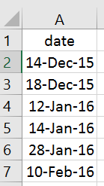
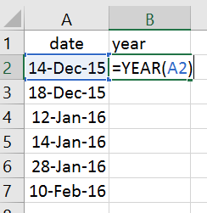
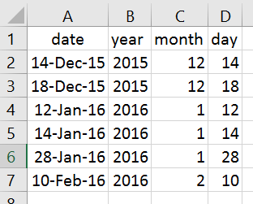
best practices: DATes
Separate columns for each date and time component
Store as numeric values

Slide 28
DatEs: lubridate::dmy()
The function dmy() is fairly flexible in terms of what kind of argument it requires
But, it’s always wise to be consistent; use an argument that is a character string in the following format: “dd-mm-yyyy”
Step 1: Ensure that you have a single column for each date/time component (or use the provided dataset date_data.txt)
exdata<-read.delim(date_data.txt)
Step 2: Use the paste() function to create a vector of class character
dvec<-paste(exdata$day, exdata$month, exdata$year, sep=“-”)
Step 3: Wrap this vector with dmy() and use it to create a new column
exdata$date<-dmy(dvec)
Start RBarMUN_CodeAlong3.R

Slide 29
Exercise 2.1
(A) Use dmy_hms() to create a column in exdata called datetime that contains both date and time information.
(B) Go to your own .R script and format dates and/or datetimes using your own data
Note: If R experiences an error, it will stop running the piece of code, and report the error to you. If you receive a warning, it means that the code ran successfully, but you need to check the warning using warning() to be sure it ran correctly.
When using dmy() or dmy_hms() you may see a warning “___failed to parse”. This means that somewhere in your dataset a portion of your date (day, month, etc.) was missing and the overall date becomes NA.
Notes:
20 slides + 3 exercises

Slide 30
Summary Stats: methods
Data analysis often begins with generating summary statistics
There are many simple ways to summarize your data!
# Counts
table(mydata$year)
table(mydata$year, mydata$sex)
# Statistics
library(doBy)
summaryBy(weight~year+sex, data=mydata)
summaryBy(weight~year+sex, data=mydata, FUN=min)
Each method has pros and cons, and your use will change depending on the situation
However…
Notes:
base : : table( )
doBy : : summaryBy( )
dplyr : : summarize( )

Slide 31
Summary stats: {dplyr}
{dplyr} is a package developed by Hadley Wickham for summarizing data in a flexible and customizable way without worrying about indexing or looping
filter() simplified conditional indexing
select() simplified conditional indexing
group_by() stratify by a variable
summarise() apply flexible summary statistics
%>% “pipe”; pass results on left to functions on right

Slide 32
Summary stats: {dplyr}
# Subset mydata to look only at males
# Option 1 (indexing)
mydata[mydata$sex==“m”,]
# Option 2 (dplyr)
mydata%>%
filter(sex==“m”)

Slide 33
Summary stats: {dplyr}
# Subset mydata to only year and length columns
# Option 1 (indexing)
mydata[,c(“year”, ”length”)]
# Option 2 (dplyr)
mydata%>%
select(year, length)

Slide 34
Summary stats: {dplyr}
# Find the mean length, by year
# Option 1 (indexing/looping)
year<-unique(mydata$year)
mlength<-c()
for(i in year)
{
mlength.in<-mean(mydata$length[mydata$year==i], na.rm=TRUE)
mlength<-c(mlength, mlength.in)
}
table1<-data.frame(year, mlength)
# Option 2 (dplyr)
table1<-mydata %>%
group_by(year) %>%
summarise(mlength=mean(length, na.rm=TRUE)) %>%
data.frame()

Slide 35
Exercise 2.2
(A) Use {dplyr} to generate a summary table of the mean weights of individuals with a length greater than 10, by both sex and year, along with the standard deviation around those means
year<-unique(mydata$year)
sex<-c()
mweight<-c()
sdweight<-c()
for(i in year)
{
for(ii in unique(mydata))
{
sex.in<-as.character(ii)
sex<-c(sex, sex.in)
x<-mydata$weight[mydata$length>10 &
!is.na(mydata$length) &
mydata$year==i &
mydata$sex==ii]
mweight.in<-mean(x, na.rm=TRUE)
mweight<-c(mweight, mweight.in)
sdweight.in<-sd(x, na.rm=TRUE)
sdweight<-c(sdweight, sdweight.in)
}
}
table2<-data.frame(year, sex, mweight, sdweight)
Notes:
20 slides + 3 exercises

Slide 36
Summary stats: overview
Indexing / looping, table(), summaryBy(), and {dplyr} all have strengths and weaknesses.
You’ll likely end up using all of them at some point, depending on the circumstances.
 | Simple | Flexible | Efficient
Indexing/Looping | x | ☺☺☺ | xx
table() | ☺☺☺ | x | ☺☺
summaryBy() | ☺ | ☺ | ☺
{dplyr} | ☺☺ | ☺☺ | ☺☺☺

