Slide 1


Dealing with data in rstudio
RBarMUN
1 October 2018

Slide 2
Objectives
Best practices of data organization
Best practices of spreadsheet design
Introduction to directory structure
Importing data in R
Working with data frames
Conditional operators
Using {dplyr} to manipulate data frames
Notes:
Data organization / spreadsheet design – 15 min
Directory structure / importing data – 10 min
Working with data frames – 10 min
Conditional operators – 10 min
{dplyr} – 15 min (just select, filter, and if time, pipes, group_by, and summarise?)

Slide 3
How many people have used spreadsheets in their research? How many people have been frustrated with spreadsheets?

Slide 4
Spreadsheets are great for
Data entry
Organizing data
Simple quality control

Slide 5
Problems with spreadsheets
Analyses are a lot of manual work
Difficult to replicate your steps
Very difficult to retrace the steps used by others
Generating figures involves point and click
Generating tables is not ideal (formatting, calculations)

Slide 6
Good data organization is the foundation of any research project
Notes:
We’ll focus on data entry and organization; the steps that happen before you use R

Slide 7
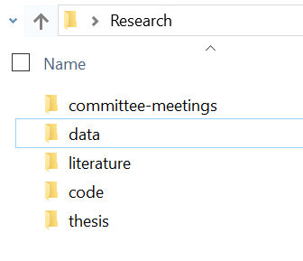
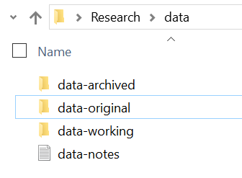
Data organization
data-original your original dataset, as a read-only file
data-working your most up to date cleaned dataset
data-archived any old versions of your working data, with the date it was archived
data-notes description of all your changes

Slide 8
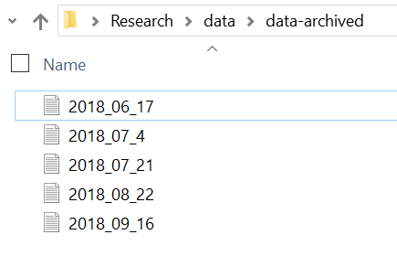
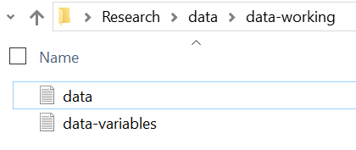
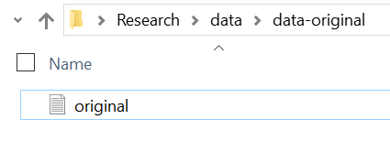
Data organization

Slide 9
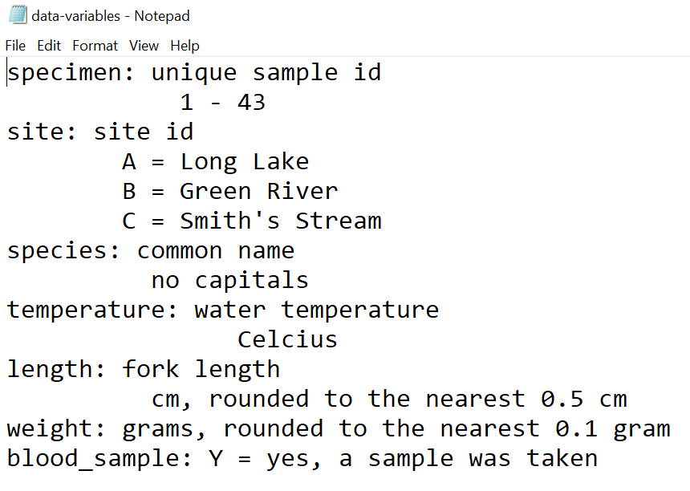
Data organization
data-variables a description of each variable in your data set, including units of measurement

Slide 10
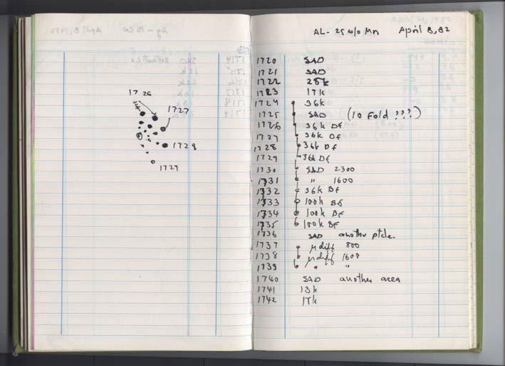
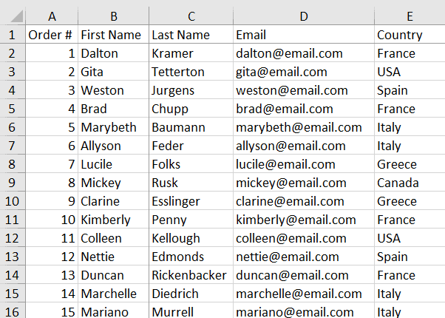
Spreadsheet design
≠
The most common mistake is treating spreadsheets like a lab notebook:
Relying on context
Including notes in the margins
Using spatial layout to convey meaning
Humans can (sometimes) interpret this, computers can’t.

Slide 11
The 5 golden rules of spreadsheet design
Keep your raw data raw
Each variable goes in a column
Each observation goes in one row
Each cell only contains ONE piece of information
Export in a universal file format

Slide 12
Create a folder on your desktop called RBarMUN
Download the data set from: https://bit.ly/2OrchyG (click “download”)
Open the file using any spreadsheet program (Excel, LibreOffice, etc.)
Convert it to a tab delimited (.txt) file called gapminder.txt and save it in your RBarMUN folder
Notes:
< ~ 5 minutes to do this and take a break >

Slide 13
Extra Slides

Slide 14


Working directory
The working directory is the location (folder) that R is going to communicate with when importing files, exporting figures, etc.
C:/Users/danie/Desktop/RBarMUN
Windows
Mac
C:
/
“root” directory
Users
danie
Desktop
RBarMUN

Slide 15
Problems importing data
Error Message: Error in file(file, “rt”) : cannot open the connection In addition: Warning message: In file(file, “rt”): cannot open file ‘sample’: No such file or directory
Issue: R can’t find your file in the working directory you specified
Check: Did you set your working directory correctly?
Did you spell the filename correctly?
Did you include “.txt” in your filename?
Did you save your file as a .txt in the correct folder?
Troubleshooting: Use list.files() to see a list of all the files available in your current working directory.

Slide 16
Common data issues
Problem: My numeric values aren’t numeric
Explanation: Somewhere in the column (vector), there is a value that is being recognized as a character; likely due to a space following a number, or a non numeric entry (i.e. “approx. 4”)
Solutions:
Check for non-numeric entries:
unique(data$values)
Find and remove white spaces:
data$values <- gsub(“ ”, “”, data$values)
Convert to numeric
data$values <- as.numeric(data$values)

Slide 17

Common data issues
Problem: My factor levels are incorrect; there should be 2 levels
Explanation: Most likely, either an entry is followed by a space (“male” vs “male ”), capitalization is inconsistent (“male” vs “Male”), or you have blank values (NAs), which act as a third level.
Solutions:
Check for incorrect values:
unique(data$sex)
Find and remove white spaces:
data$sex <- gsub(“ ”, “”, data$sex))
Convert everything to lowercase:
data$sex <- tolower(data$sex)

