Slide 2
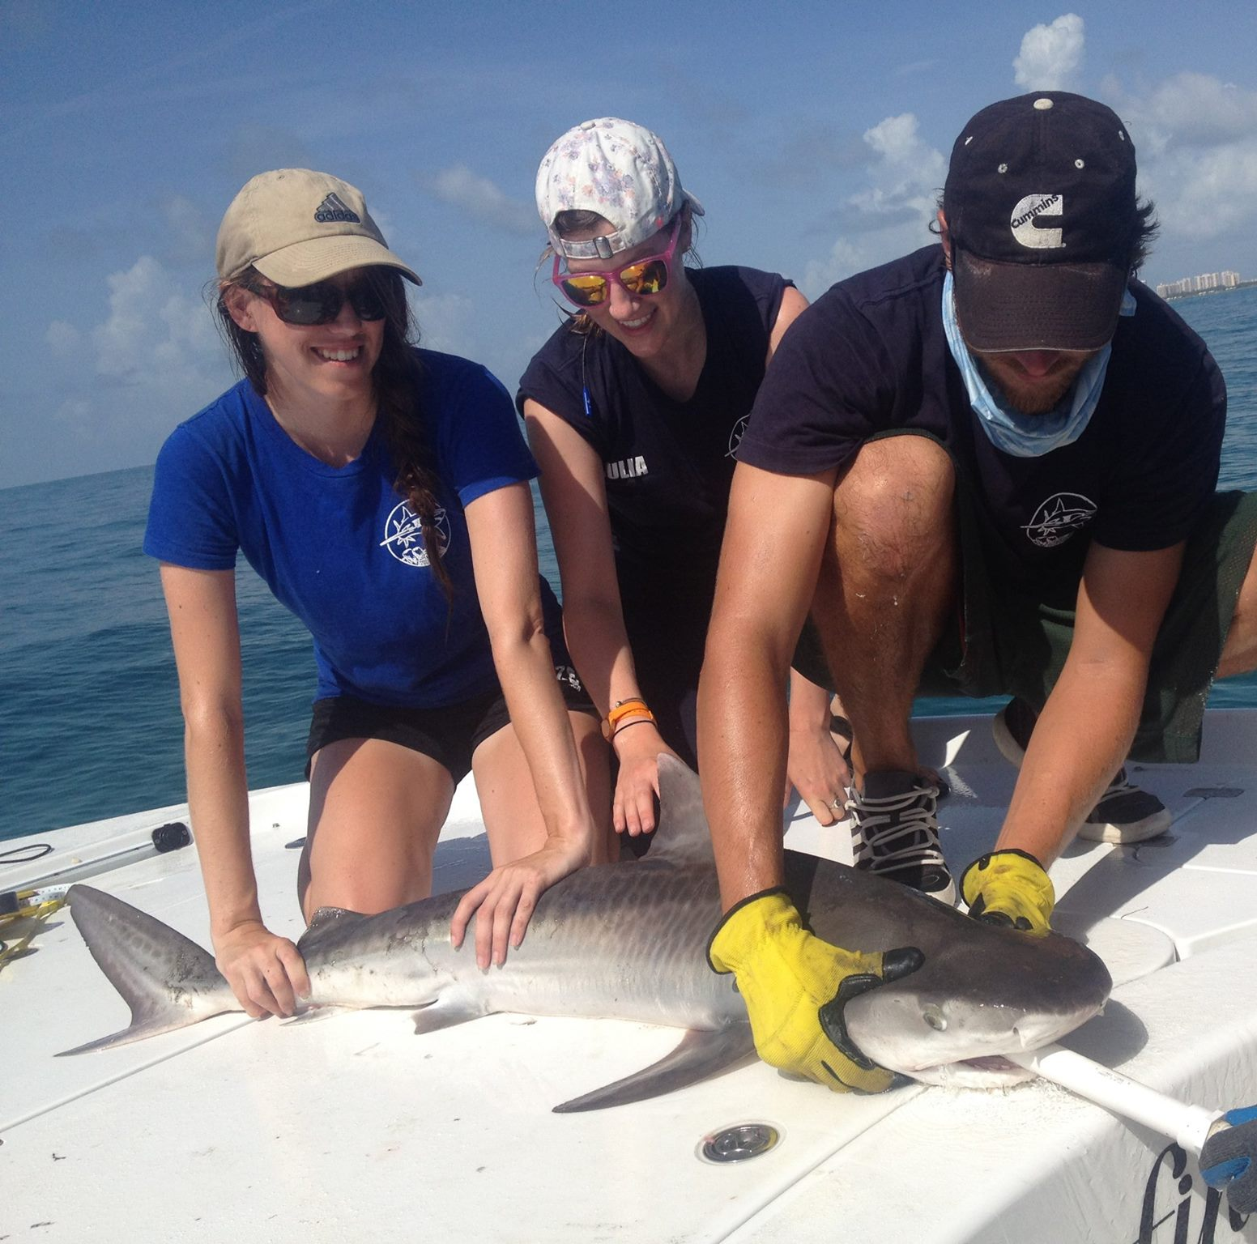
How do we use coding to study sharks?

Slide 3
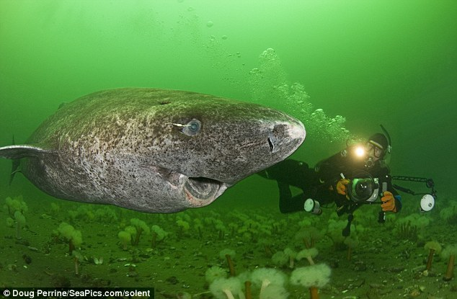
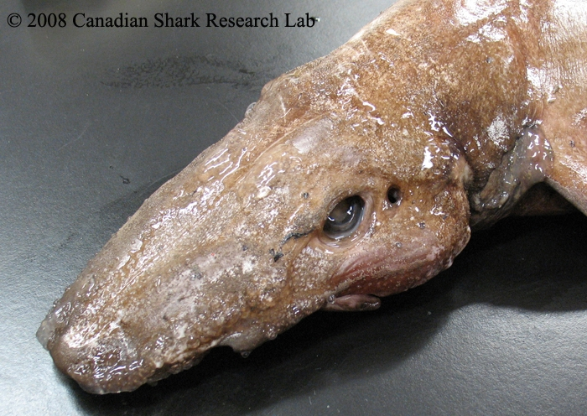
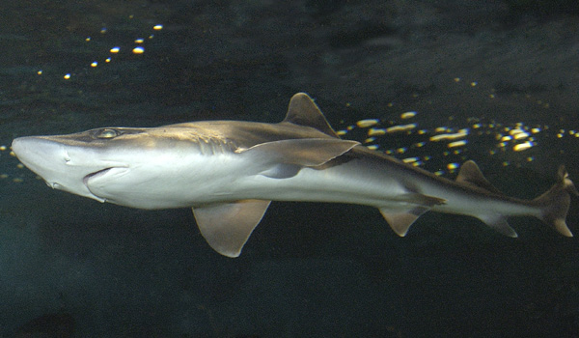
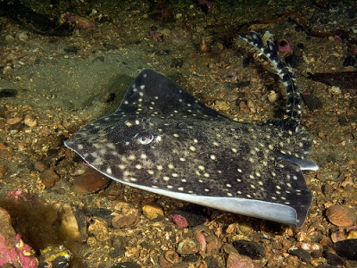
Greenland Shark
Deep-Water Catshark
Black Dogfish Shark
Spinytail Skate
Notes:
(Spiny dogfish photo used…)

Slide 4
What do we want to learn?
How many shark species live in our area?
How many of each of our study species can we find?
Where does each species live?
Do they migrate to different places in different seasons?
We need to collect data!

Slide 5
What is “data” ?
Data = Information!

Slide 6
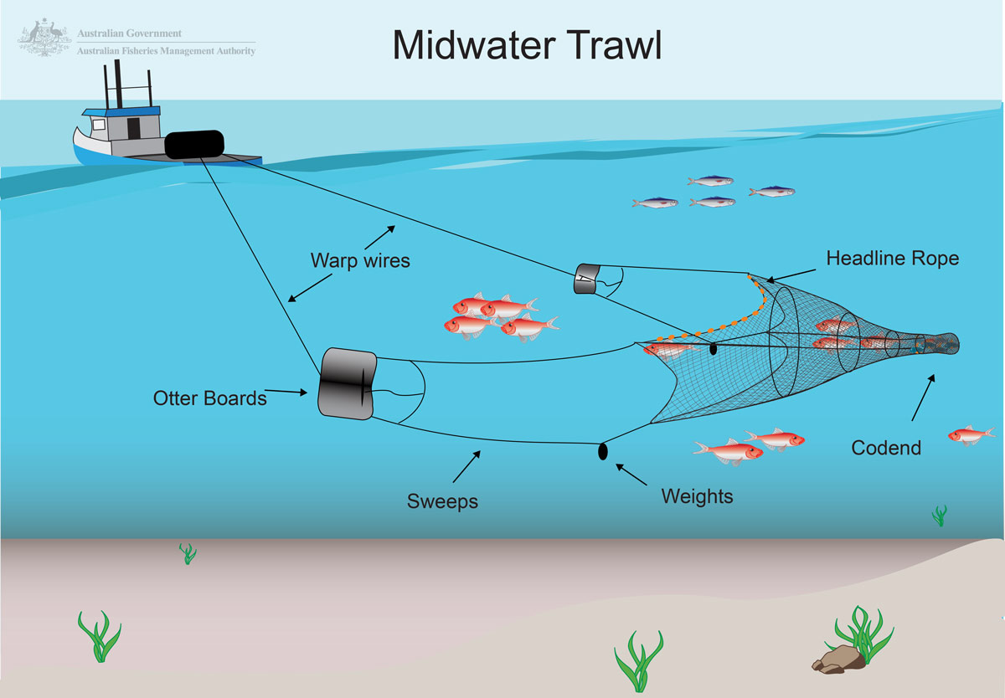
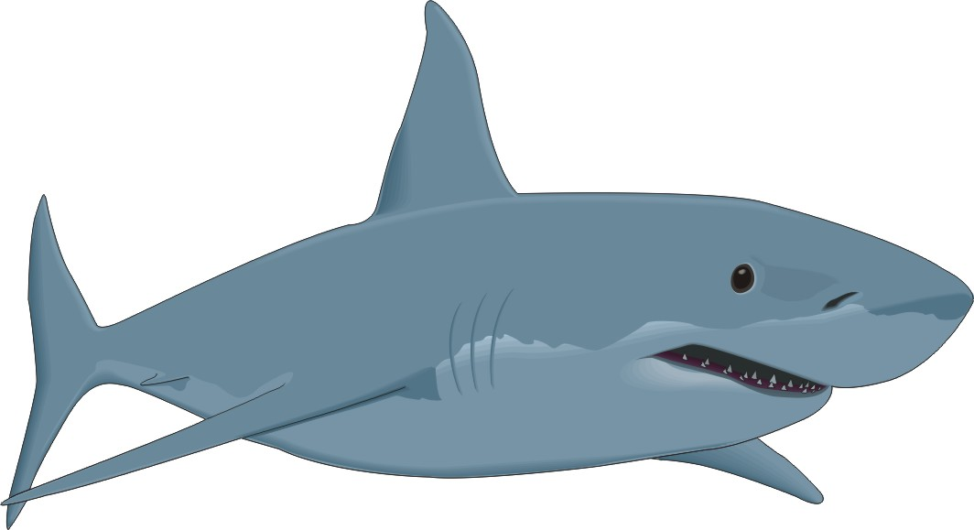
Collecting Data

Slide 7
Collecting Data
Fishing Data:
What year was it?
What season was it?
How deep was the water?
Shark Data:
What kind of shark was it?
How many of each kind did we catch?

Slide 8
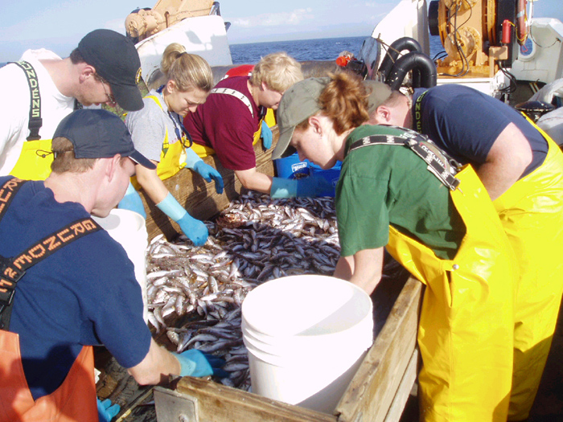
4
“visualizing data”
3
2
1
What year? | What season? | How deep? | What species?
2010 | Spring | 100 m | Spiny Dogfish
2010 | Spring | 800 m | Greenland Shark
2010 | Spring | 300 m | Spiny Dogfish
2010 | Spring | 600 m | Spinytail Skate
2010 | Spring | 300 m | Spiny Dogfish
2010 | Spring | 50 m | Spiny Dogfish
2010 | Spring | 1000 m | Deep Water Catshark
2010 | Spring | 700 m | Spinytail Skate
2010 | Spring | 900 m | Deep Water Catshark
Notes:
(a) Greenland (b) dogfish (c) skate (d) catshark
Which method is easier to see how many we caught of each species? They’re both pretty easy.
It’s pretty easy for us to count how many of each species we caught. But …

Slide 9
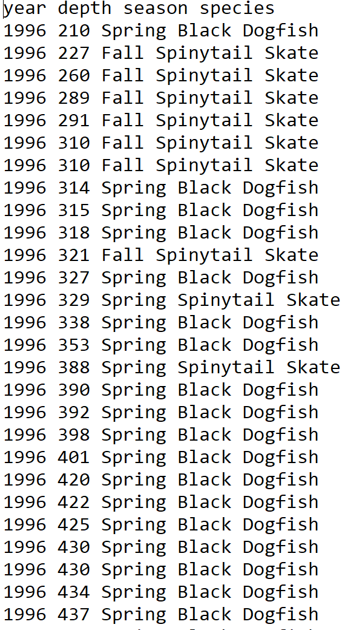
Notes:
What if we had more data? Now it’s pretty tough to count them!

Slide 10
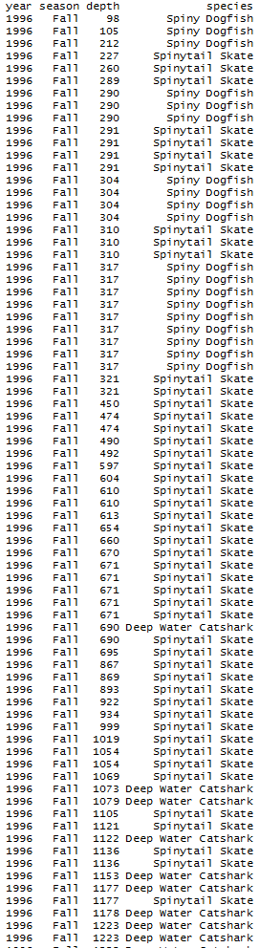
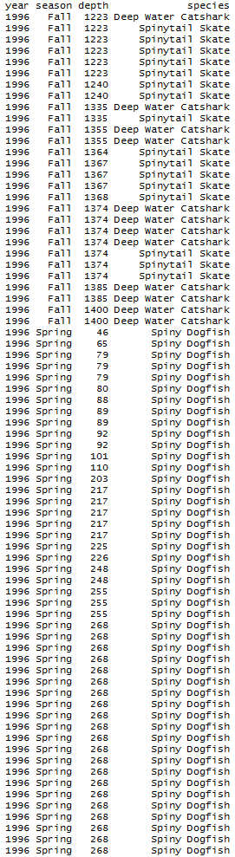
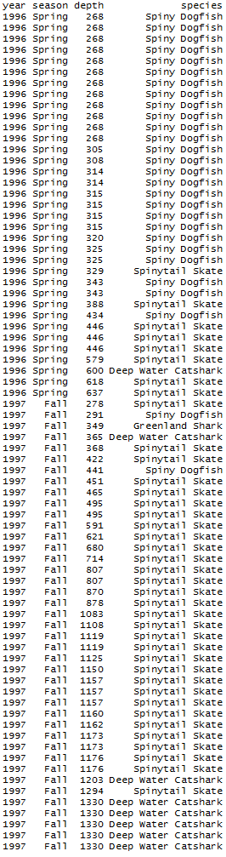
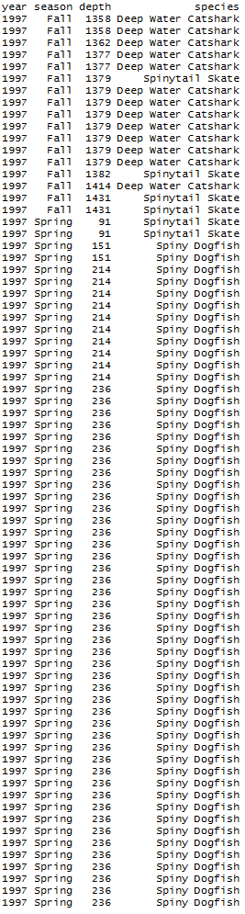
We can use coding!
Notes:
What if we had WAY more data?! There’s no way we can sit and count every single one of these! Instead, we can using coding to count each species and make a graph to see which species we caught the most of!

