Slide 1
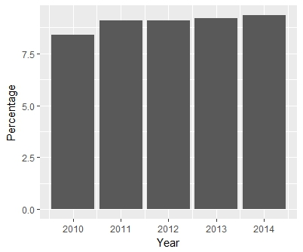
Newsworthy: diabetes coverage by television news (2010 to 2016)
Danielle R. Reed, Ph.D.
The prevalence of diabetes has doubled since 1994 and grew from 8.4% in 2010 to 9.3% in 2014 (Figure 1). Nearly 1 in 10 adult American has diabetes.
Figure 1. US national prevalence of diabetes by year as reported by the CDC, average of statewide prevalence reported as a percentage. The last year that data are available from the CDC is 2014.
Is this rise in diabetes viewed by decision makers in national network television as newsworthy?
Data Source: Centers for Disease Control and Prevention.
National Center for Health; Division of Health Interview Statistics;
Data from the National Health Interview Survey. Statistics

Slide 2
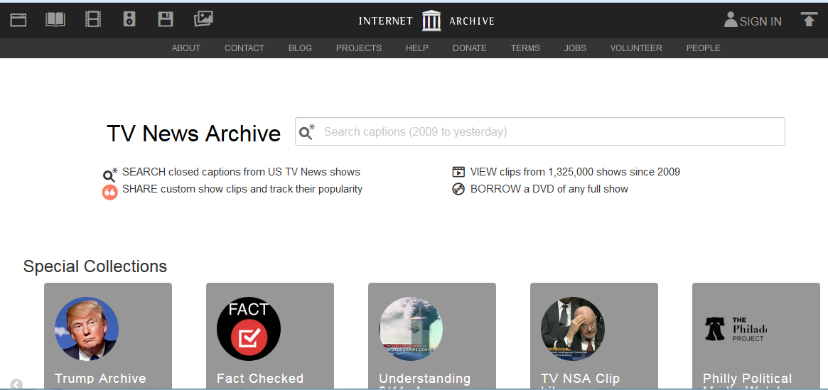
Method. Using the TV News Archive and analysis by the GDELT Project, I retrieved the number of times ‘diabetes’ was mentioned on network news from affiliated stations, e.g., WUSA in Washington DC from the years 2010 to 2016. Data were limited to two cities (San Francisco and Washington DC).
Analysis by the GDELT Project using data from the Internet Archive Television News Archive.

Slide 3
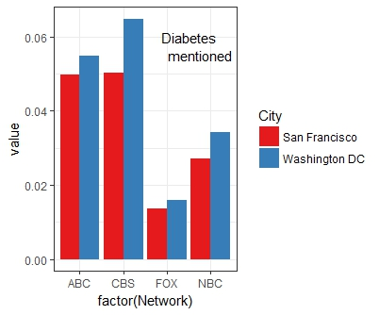
First message. FOX news mentioned ‘diabetes’ least, followed by NBC, ABC and CBS. The differences among cities were small relative to the differences among networks.
Figure 2. Network affiliates differed in the amount of diabetes reporting. The y-axis (value) is the percentage of sentences with the word “diabetes” read on the national news televised by network affiliates. For example, a value of 0.01 would mean that every 1 in 10000 sentences contained the word diabetes.
Networks differed markedly [F(3, 19720)=196.0, p=2.0x10⁻⁷) whereas there was less difference between cities [F(1,19720)=27.9, p=1.2 x10⁻⁶). Diabetes was mentioned more often on some networks than others depending on city [(F3, 19720)=3.48, p=0.015).

Slide 4
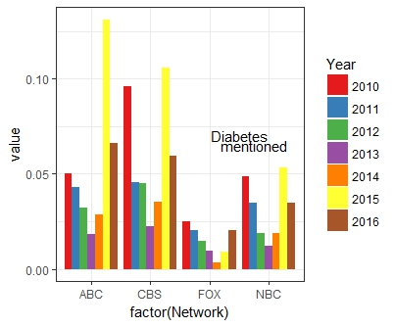
Second message. Some national news affiliates made almost no mention of diabetes during some years, e.g., FOX network in 2014
Figure 3. Diabetes reporting on network news affiliates differs by year. y-axis (value; see Figure 2). Network news reports of diabetes differ by year [F(6, 19700)=208, p<2.0 x 10⁻¹⁶) and network [F(3,19700)=128.0, p<2.0 x 10⁻¹⁶ with an interaction between year and network [F(18, 19700)=24.9, p<2.0 x 10⁻¹⁶)

