Slide 1
RNA-seq analysis II
Quantification
Differential expression
Yue Jiang
Data Scientist, Juno Therapeutics
Former grad student in Prof. Hiroaki Matsunami’s lab@Duke (2010-2015)

Slide 2
Outline
Mapping
me talking
EM algorithm to assign ambiguously mapped reads to transcripts
Differential expression analysis
me talking
demo
Misc
workflow organization
reproducible analysis
resources
Click here! https://github.com/Yue-Jiang/achems

Slide 3
Common workflow
Assign reads to annotated transcripts
Quantify transcript abundance
Differential expression (DE) analysis
…

Slide 4
Assign reads to transcripts / genes
Alignment
STAR
bowtie2
bwa
…
Pseudo / Quasi alignment
kallisto
salmon
sailfish
RapMap (just the mapping part)
…

Slide 5
Pseudo / Quasi alignment
Fast and light weight
Doesn’t find where on the transcript a read is mapped to
Good for quantification, can’t do de novo assembly
Good for model organisms with well defined genome annotation

Slide 6
RNA-seq quantification: handling ambiguously mapped reads
All based on the same EM algorithm with variations in model specification details
RSEM
Cufflinks
express(-D)
kallisto
…
There are many possible combinations. To get started, would recommend
STAR + RSEM
or kallisto

Slide 7
The algorithm: a toy example
5 reads
3 transcripts
Transcript relative abundance
red | green | blue
1/3 | 1/3 | 1/3
Probability of read assigning to transcript
 | red | green | blue
a | ? | ? | ?
b | ? | ? | ?
c | ? | ? | ?
d | ? | ? | ?
e | ? | ? | ?
Pachter 2011

Slide 8
Update read assignment
Transcript relative abundance
red | green | blue
1/3 | 1/3 | 1/3
Probability of read assigning to transcript
 | red | green | blue
a | 1/3 | 1/3 | 1/3
b | 0 | 1/2 | 1/2
c | 1/2 | 0 | 1/2
d | 1 | 0 | 0
e | 1/2 | 1/2 | 0
Pachter 2011

Slide 9
Update transcript abundance
Transcript relative abundance
red | green | blue
0.467 | 0.267 | 0.267
Probability of read assigning to transcript
 | red | green | blue
a | 1/3 | 1/3 | 1/3
b | 0 | 1/2 | 1/2
c | 1/2 | 0 | 1/2
d | 1 | 0 | 0
e | 1/2 | 1/2 | 0
Pachter 2011

Slide 10
Update read assignment
Transcript relative abundance
red | green | blue
0.467 | 0.267 | 0.267
Probability of read assigning to transcript
 | red | green | blue
a | 0.467 | 0.267 | 0.267
b | 0 | 1/2 | 1/2
c | 0.636 | 0 | 0.364
d | 1 | 0 | 0
e | 0.636 | 0.364 | 0
Pachter 2011

Slide 11
Go on and on

Slide 12

When to stop?
Well, until we converge (Improvement in log likelihood is sufficiently small)
The transcript abundance estimates will change very little if you were to continue
This way, we are trying to jointly solve for the most likely transcript abundance and read assignment
The estimates we find are guaranteed better than some other estimates
But not guaranteed THE BEST

Slide 13
RPM, RPKM, FPKM, TPM
RPM (reads per million reads)
T = Total reads in sample
RPM_{i}: # reads for Transcript_{i} / T * 1000,000
RPKM (reads per kilobase per million reads)
normalizes the raw count by transcript length and sequencing depth
RPKM_{i} = RPM_{i} / effective length of Transcript_{i}
FPKM (fragments per kilobase per million reads)
RPKM extended to paired end reads
if paired then only one of the mates is counted
TPM (transcripts per million transcripts)
RPK_{i} = # reads for Transcript_{i} / effective length of Transcript_{i}
TPM_{i} = RPK_{i} / sum(RPK_{i}) * 1000,000
just RPKM or FPKM scaled again

Slide 14
Differential expression analysis
GLM for count data
DESeq2
EdgeR
EBSeq
EBSeqHMM (time course)
Linear model for log transformed TPM / FPKM
limma (microarray like)
sleuth (use with kallisto)

Slide 15
Common additional analysis
clustering
hierarchical clustering
Dimensionality reduction
PCA
NMF
t-SNE (esp. single cell)
Gene ontology, pathway analysis

Slide 16
Workflow organization: putting them together
commercial software, e.g. ArrayStudio
shell script
snakemake (python like syntax)
 | flexible | scalable | cost | GUI
shell scripts | yes | not much | free | no
Snakemake | yes | yes | free | no
ArrayStudio | kind of | yes | $$$ | yes
http://www.annotathon.org/courses/ABD/practical/snakemake/snake_intro.html

Slide 17
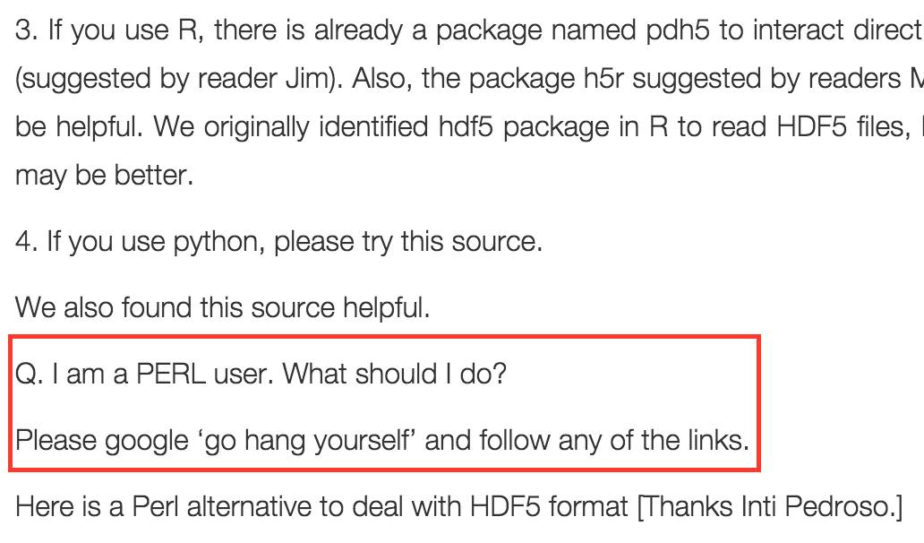
Reproducible analysis
R: R markdown
python: Jupyter (IPython) notebook
We’ll see an example for R markdown soon. The picture is irrelevant☺
http://homolog.us/Tutorials/index.php?p=2.6&s=5

Slide 18
Useful resources
Tutorials:
https://galaxyproject.org/tutorials/rb_rnaseq/
Workflows:
https://www.bioconductor.org/help/workflows/rnaseqGene/
snakemake: https://snakemake.readthedocs.io/en/stable/
R libraries:
DESeq2
EdgeR
NMF
Rtsne
tidyverse (dplyr, tidyr etc https://www.rstudio.com/wp-content/uploads/2015/02/data-wrangling-cheatsheet.pdf)
superheat
conda for package management
anaconda: https://www.continuum.io/downloads
bioconda: https://bioconda.github.io/
save the hustle of having to compile binaries by yourself!

