Slide 1
Final Project:
DB Games
By Dan Rose and Bikash Khatiwoda

Slide 2
Our Site Has:
A login and signup system
A leaderboard with all the users
Games to play
A point system for when you play the games

Slide 3
Development
Languages we used
PHP for the login and point system
Html for the website look
CSS to make the design look nice
Responsibilities
Bikash
Made the CSS for the website
Worked on most of the HTML
Daniel
Created the login system with PHP
Created the leaderboard with PHP

Slide 4
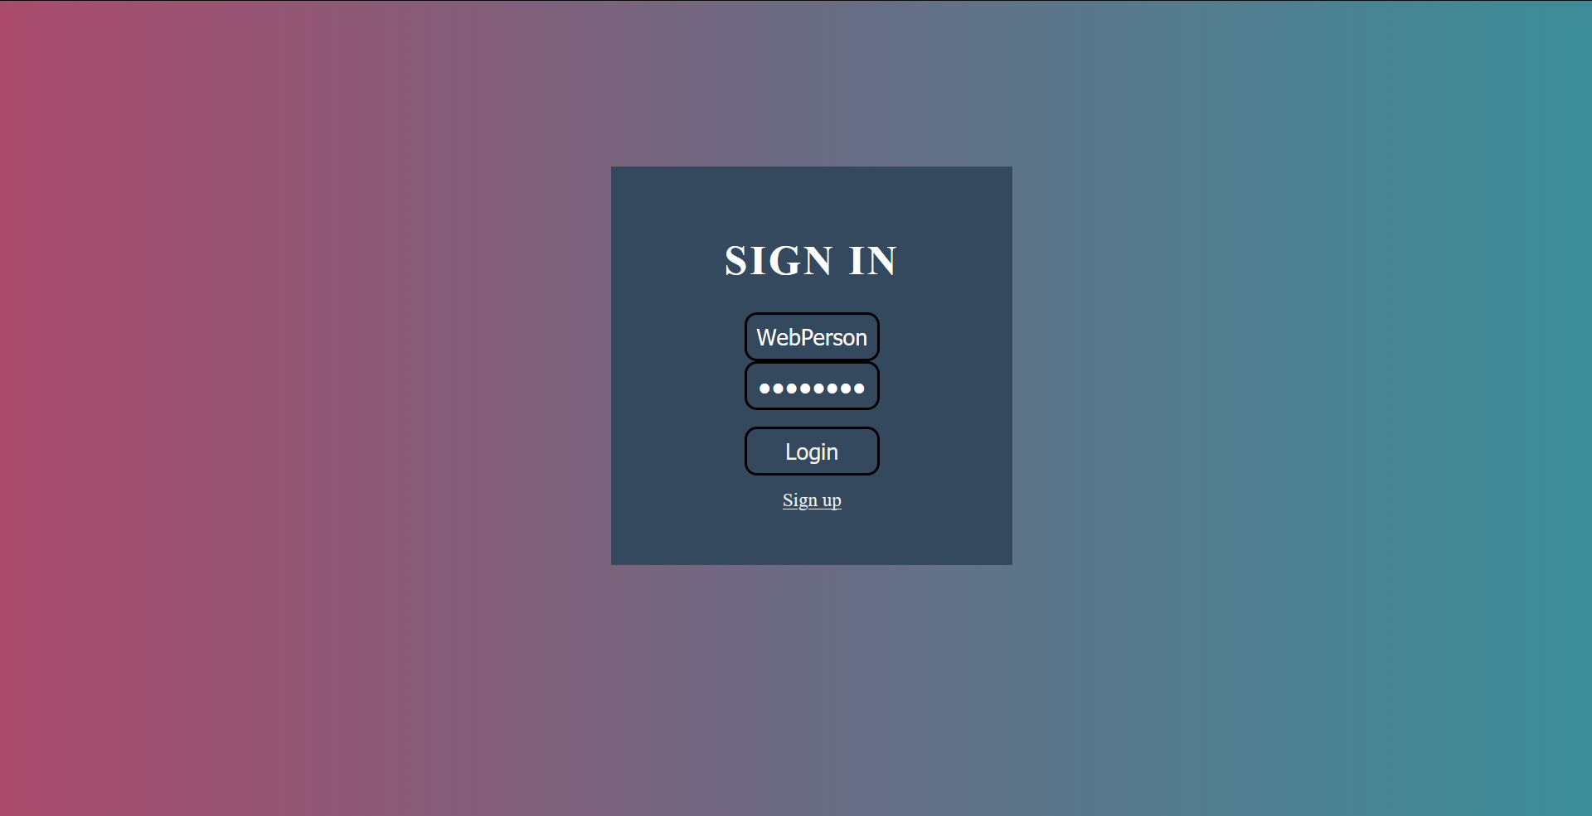
Login Page

Slide 5

Sign Up Page

Slide 6
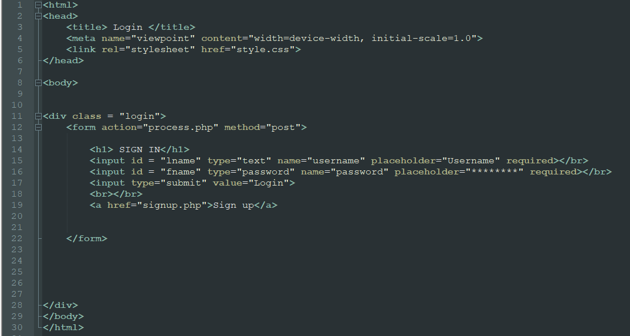
Login.php

Slide 7
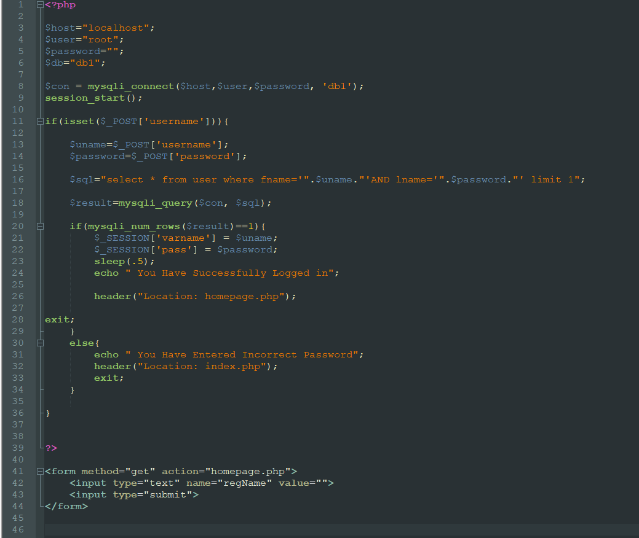
Process.php

Slide 8
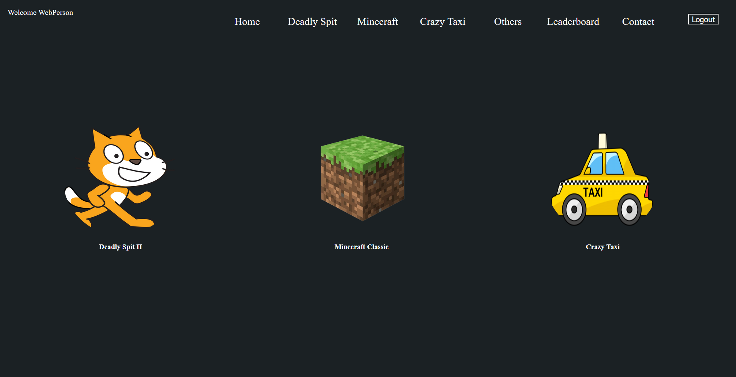
Home Page

Slide 9
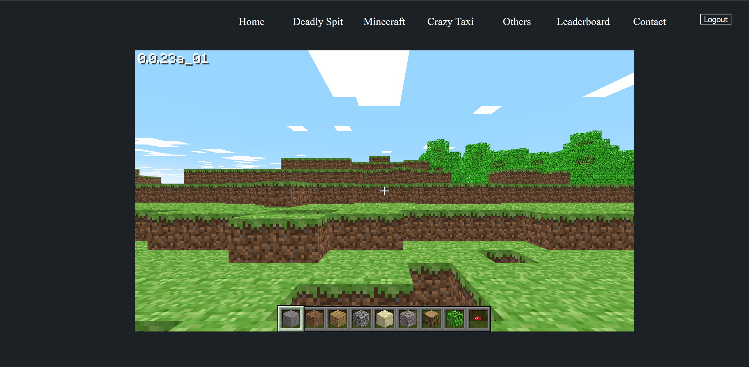
Game Page

Slide 10
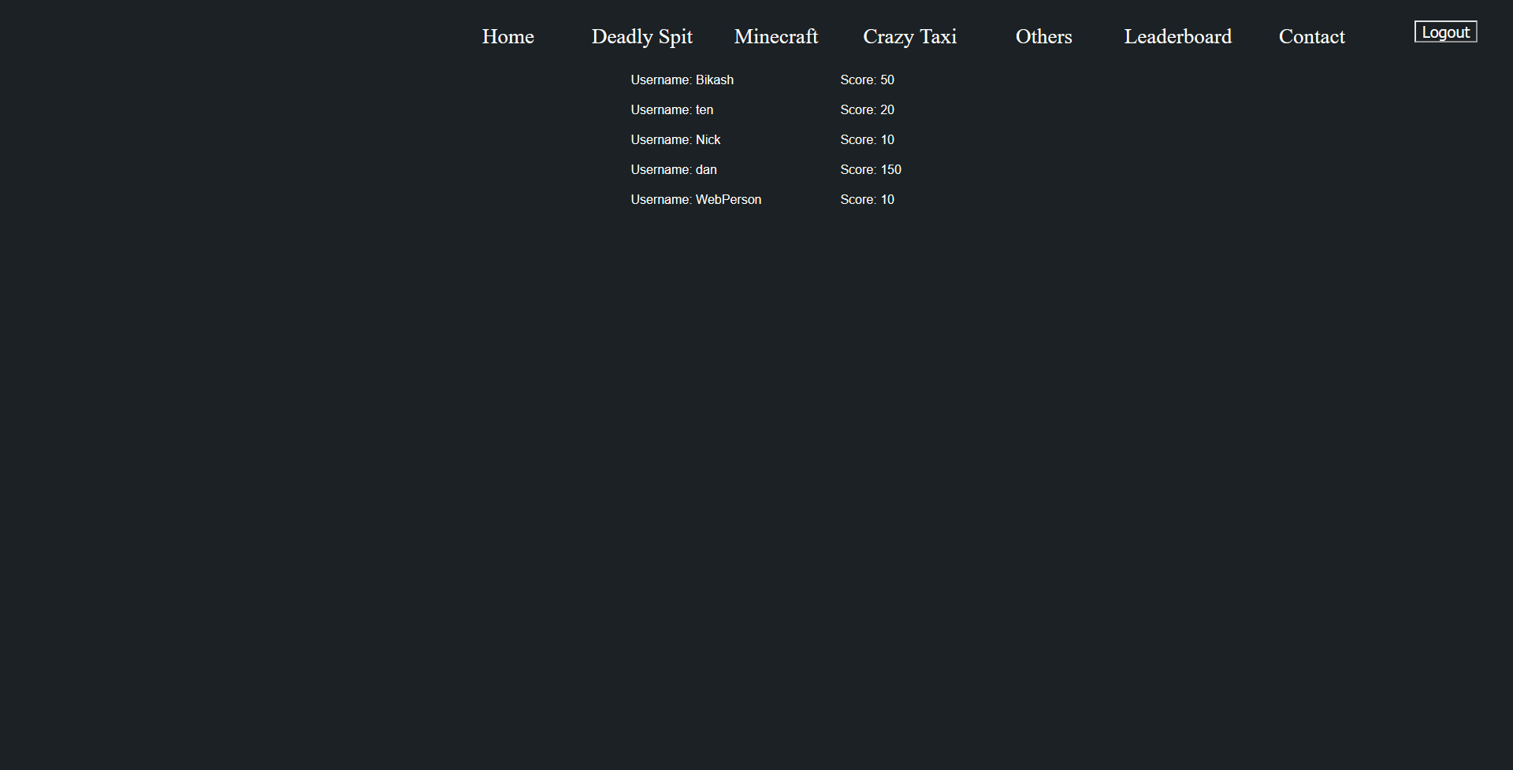
Leaderboard

Slide 11
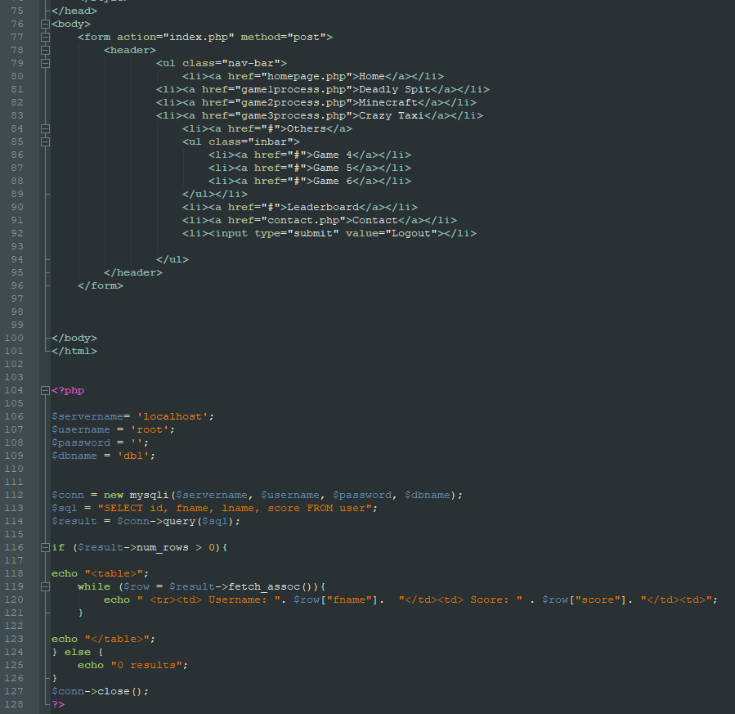
Leaderboard.php

