Slide 1
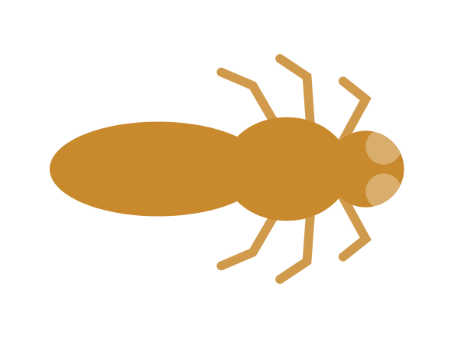
CAPSTONE PROJECT PHASE B · 26-1-R-22
Predicting Where a Fly Will Be,
a Fraction of a Second From Now
A learned motion-prediction model for autonomous fly tracking
Yaniv Bodaga · Daniel Lachmakov
Advisors: Dr. Dan Lemberg · Mrs. Elena Kramer
github.com/Danielon05423/Drosophila_Trajectory_Prediction
Notes:
Phase B of the autonomous predictive tracking and laser neutralisation project. This phase answers one question: can a learned model predict a fly's short-horizon motion better than physics? Everything downstream depends on the answer.

Slide 2
MOTIVATION
Why is it worth chasing a single fly?
1
A vector, not a nuisance.
Waste to food in minutes.
2
Nothing targets one fly.
Traps wait. Sprays flood the room.
3
Aim ahead, or miss.
One body length every 150 ms.
It all rests on predicting the next 50 milliseconds.
Notes:
SAY: 1. Houseflies and fruit flies move between waste and food surfaces within minutes. In food processing, hospital wards and lab animal facilities, a single fly landing on a single surface is a contamination event — the risk is mechanical transmission, not annoyance. 2. Traps only work on species attracted to the bait and wait for the insect to come to them. Sprays treat an entire volume including surfaces that should not be treated. A swatter needs a person in the room watching. None can be pointed at one insect on demand. 3. A sense-decide-actuate loop costs tens of milliseconds. A walking fly at 16 mm/s clears its own body length in about 150 ms; a flying one is far faster. Aim at the measured position and you are guaranteed to aim behind it. CLOSE: so the whole Phase A architecture rests on one unproven capability, and that is what Phase B isolates and tests.

Slide 3
THE PROBLEM
Flies do not move the way tracking systems assume
Fast and irregular
Reactive tracking lags
Classical models assume smoothness
Turns in tens of milliseconds, with no warning.
Error = loop latency × speed. Always behind.
Kalman and straight-line extrapolation break on turns.
The question this phase answers
Can a learned model predict where a fly will be, a fraction of a second ahead, more accurately than assuming it keeps going in a straight line?
By how much? Over what horizon? For which kinds of movement?
Notes:
Three reasons the problem is hard. Expand each briefly. Fast and irregular: direction changes happen on a timescale of tens of milliseconds and are not announced in the preceding motion. Reactive lag: by the time a controller responds to where the fly was, it is somewhere else; the miss distance is loop latency times speed. Smoothness: Kalman filters and linear extrapolation assume the next state is a small perturbation of the current one — a good description of a fly between turns and a bad one during them. FRAMING TO STRESS: the question is a comparison, not a capability. 'A network can predict fly motion' is not a useful claim — at a short enough horizon a straight-line guess is very hard to beat. Answered on 326 real flies.

Slide 4
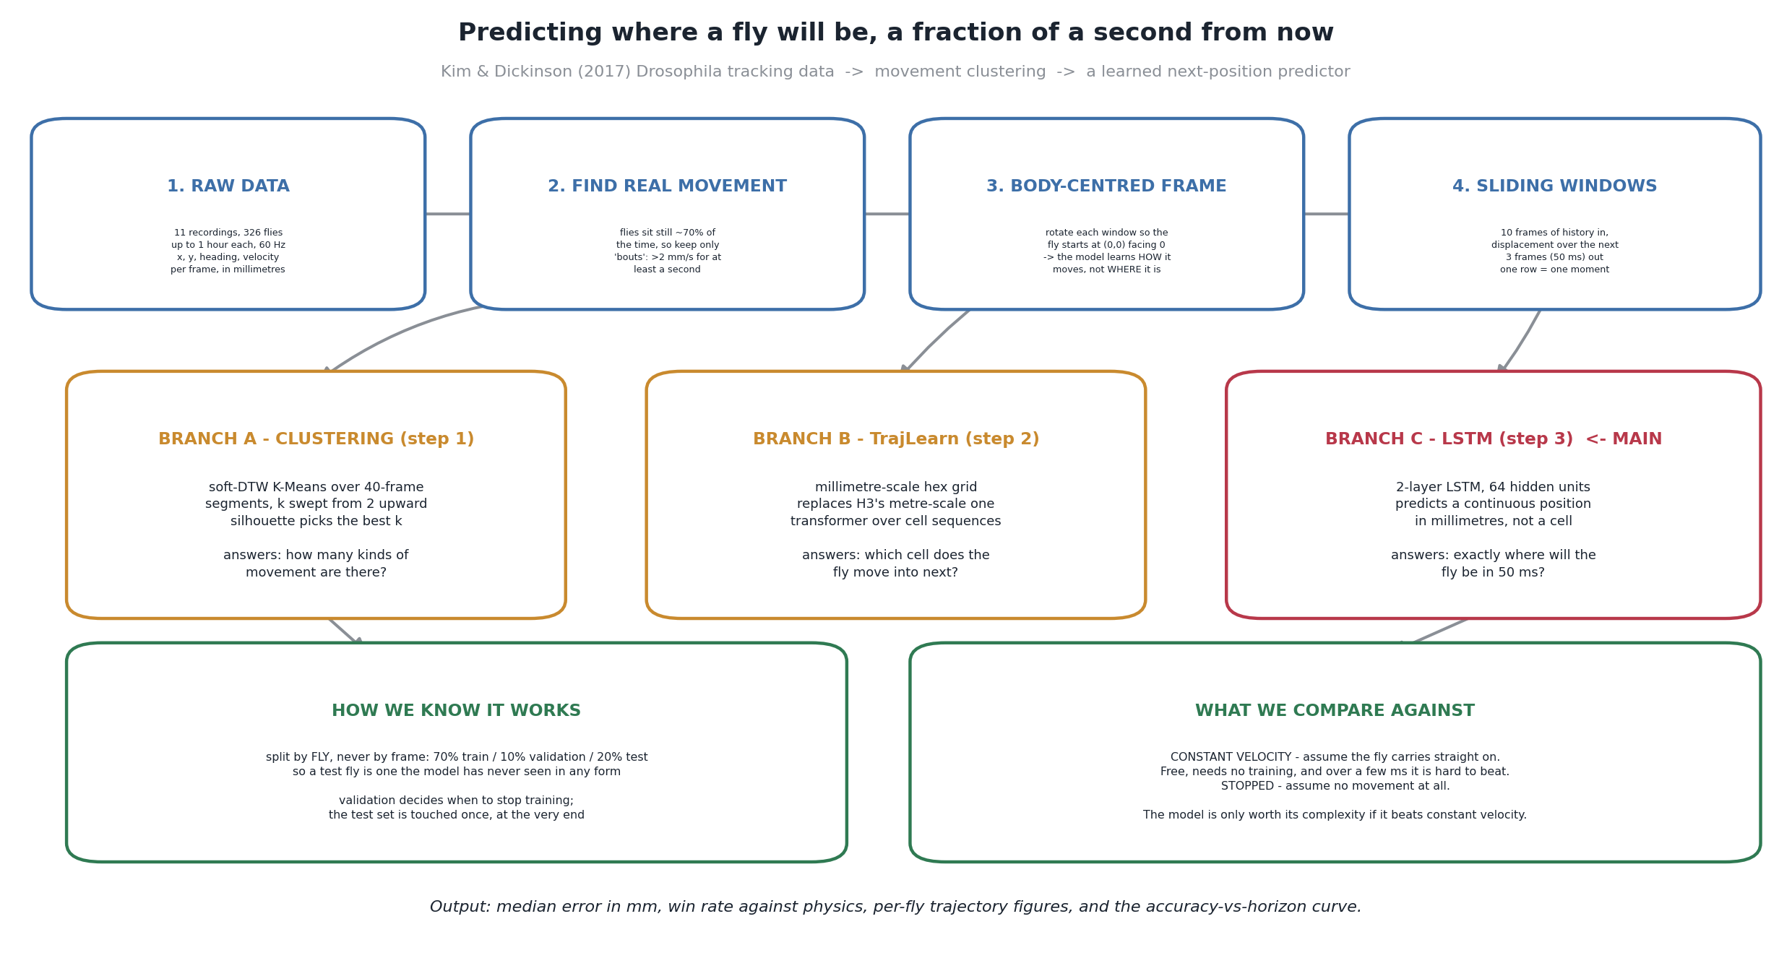
APPROACH
From raw tracking data to a trained predictor
Branch C — the continuous LSTM — answers the project's question.
4
Notes:
Walk left to right along the top row, then drop to the branches. Raw data: 11 recordings, 326 flies, up to an hour each at 60 Hz. Find real movement: flies sit still about 70% of the time, so we keep only bouts. Body-centred frame: rotate each window so the fly starts at (0,0) facing 0 — the model learns HOW it moves, not WHERE it is. Sliding windows: 10 frames in, 3 frames out. Then three branches. A answers 'how many kinds of movement are there'. B was the Phase A plan and answers 'which cell next'. C is ours and answers 'exactly where in 50 ms'. Bottom row: split by fly, and always compare against physics.

Slide 5
THE DATA
Kim & Dickinson (2017): free-walking Drosophila trajectories
326
11
60 Hz
≈ 70 M
2.6 GB
flies
recordings
frame rate
frames
raw CSV
Column | Unit | What we do with it
fly | id | Restarts in every file — remapped to a global id
time(s) | s | Fixed 60 Hz, so Δt = 16.7 ms
position_x, position_y | mm | Never an input — only differences of it
velocity_x, velocity_y | mm/s | Gives speed, and the constant-velocity baseline
heading(radians) | rad | Wrapped to ±π — unwrapped before use
velocity_heading(rad/s) | rad/s | Turn rate: a model input, and a robustness axis
Nothing here is usable as-is. Three problems, three fixes — next slide.
5
Notes:
Eight columns per frame, 11 recordings, 326 flies, ~70 million frames. Each file has three stacked blocks: experimental conditions, an arena table, then the per-frame fly table. The loader finds the 'fly,time(s)' header line and starts there. Fly ids are zero-based and restart in every file, so without global remapping 326 flies would silently collapse into far fewer and the by-fly split would be corrupted. The trajectories were Kalman-smoothed by the original authors — so our ground truth is itself a filtered estimate with a positional noise floor around 0.02 mm. That matters when we quote 0.023 mm later. Conditions vary: large or small arena, yeast / sucrose / water, light or dark, different strains — so this is not one homogeneous condition.

Slide 6
PREPARING THE DATA
What we changed before anything was trained
1
Global fly identities
2
Derived features
Per-file ids remapped → 326 distinct flies.
Speed, unwrapped heading, turn rate.
3
Normalise to a common origin
4
Body-centred targets
Translate to (0,0), rotate by −heading₀. Every fly starts the same.
Forward / sideways, not arena x / y.
5
Movement bouts only
6
Sliding windows
68% of frames barely move. Keep > 2 mm/s for ≥ 1 s → 27%.
10 frames in (167 ms), 3 frames out (50 ms).
Steps 3 and 4 are the ones that matter: without them the network learns this arena, not fly motion.
6
Notes:
STEP 3 is the one to dwell on. Every window is translated so its first frame sits at (0,0) and rotated by minus the measured heading at that frame, so every fly starts at the same point pointing the same way and two windows can be compared by shape. We rotate by the recorded heading rather than an angle estimated from two consecutive positions, which would be far noisier at this scale. STEP 4 is the reason it generalises: an absolute-position target lets the network learn that flies in THIS arena linger near THIS wall — real structure in the benchmark, useless for a different camera. A body-centred displacement target forces it to learn how a fly turns and accelerates. STEP 5: median frame-to-frame displacement is about 0.02 mm and 68% of frames move under 0.1 mm. Evaluating on all frames mostly measures 'the fly is still sitting there'. Filtering made our numbers worse and the experiment meaningful. IF ASKED: bouts are found on a five-frame rolling median of speed, so one dip does not fragment a real bout.

Slide 7
THE ALGORITHM
Why a small recurrent network, and not the alternatives
Kalman / constant velocity
Assumes locally linear dynamics. Exactly what a turn breaks.
Rejected as the model — kept as the baseline
TrajLearn Transformer (the Phase A plan)
Predicts a discrete cell. At 60 Hz it learns “same cell again” — 95% accurate, zero information.
Tried, then set aside
2-layer LSTM, 64 units
Continuous millimetres. Carries state across the window. ≈ 70k parameters.
Chosen
The deciding argument was the data, not the literature.
Notes:
EXPECT THE QUESTION: why not a Transformer? TrajLearn is well matched to problems like vehicle trajectory forecasting — discrete state space, and the interesting uncertainty is about which route is taken. Ours is the opposite: a single continuous target at sub-millimetre precision. We did implement it: replaced its metre-scale H3 geographic grid with a millimetre-scale hex grid, matched its vocabulary and embedding format so its training code ran unmodified. Then found that at 60 Hz in a 65–170 mm arena the fly stays in the same hexagon for most consecutive frames, so the model scores above 95% next-token accuracy by predicting 'the same cell again'. Filtering fixes the score but the question it answers is 'which cell next', and discretising destroys the sub-0.1 mm precision an actuator needs. LSTM: recurrence carries a turn already in progress into the next step. 70k parameters is the right capacity for 326 flies — a Transformer is far too data-hungry here.

Slide 8
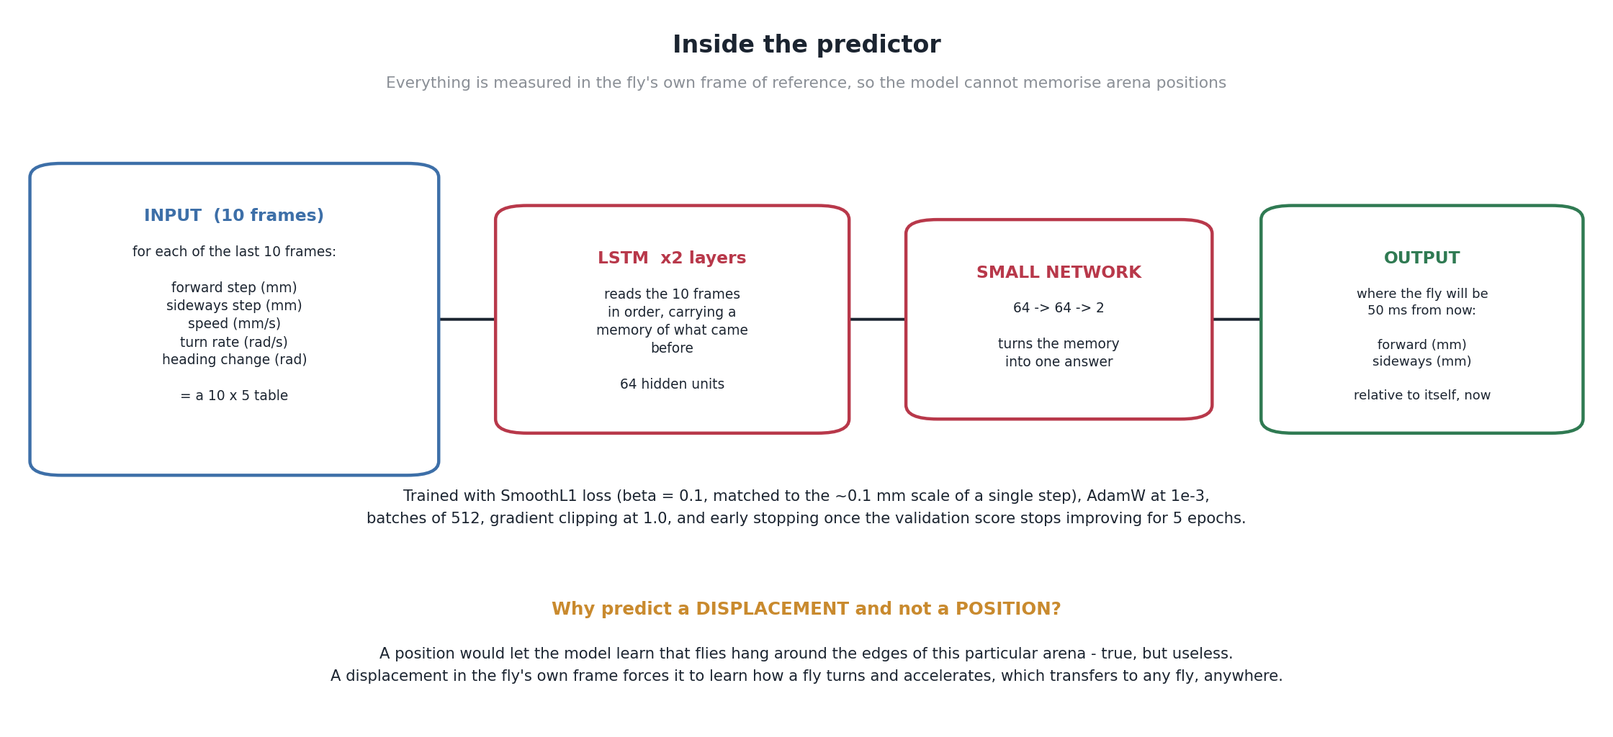
THE MODEL
Inside the predictor
SmoothL1 (β = 0.1) · AdamW 1e-3 · batch 512 · early stopping after 5 flat epochs.
8
Notes:
Five features per frame, ten frames in, two numbers out. The output is a DISPLACEMENT in the fly's own frame, not a position. Read the orange box at the bottom out loud if the audience looks unconvinced — it is the single most important design decision in the project. Beta of 0.1 in the SmoothL1 loss is matched to the roughly 0.1 mm scale of one step; the default of 1.0 would put almost every target in the quadratic region and reduce the loss to MSE at a scale where it is insensitive. That was one of two real bugs we found. About 70k parameters — small enough to eventually run at frame rate.

Slide 9
SAMPLING RATE
Would a faster camera have helped? 60 Hz vs. 815 Hz
 | 60 Hz dataset used | 240 Hz | 500 Hz | 815 Hz our intended rig
Frame interval | 16.7 ms | 4.2 ms | 2.0 ms | 1.2 ms
Fly moves per frame (at 7 mm/s) | 0.117 mm | 0.029 mm | 0.014 mm | 0.009 mm
vs. the tracker's noise floor (≈ 0.02 mm) | 6× above | 1.5× above | below it | well below it
Frames in the 50 ms horizon | 3 | 12 | 25 | 41
Frames for the same 167 ms of history | 10 | 40 | 84 | 136
Raw corpus, 326 flies | 2.6 GB | 10 GB | 22 GB | 35 GB
Relative training cost | 1× | 4× | 8× | 14×
Past ≈ 250 Hz the fly moves less per frame than the tracker's own noise. More frames, no more information.
Derived from the 60 Hz statistics — nothing was recorded at 240, 500 or 815 Hz.
9
Notes:
BE EXPLICIT: this is a derivation from the 60 Hz statistics, not a measurement. We never recorded at these rates. The decisive row is the third one. Above roughly 250 Hz the distance a walking fly covers between frames falls below the positional noise of the tracker itself, so extra frames contribute measurement error rather than information — unless spatial resolution improves too, which is a property of the sensor and optics, not the frame rate. Meanwhile cost rises on every axis: to keep the same 167 ms of context the input grows from 10 frames to 136, so training cost goes up roughly fourteen-fold, and the corpus goes from 2.6 GB to 35 GB. CONCLUSION: 60 Hz was not a compromise for the MODELLING question. A high-speed camera would be worth it for a different reason — lower sensing latency once there is a real-time loop, where 1.2 ms of capture delay against 16.7 ms is a direct gain against the 50 ms budget. Pair it with a higher-resolution sensor if the data is also for training.

Slide 10
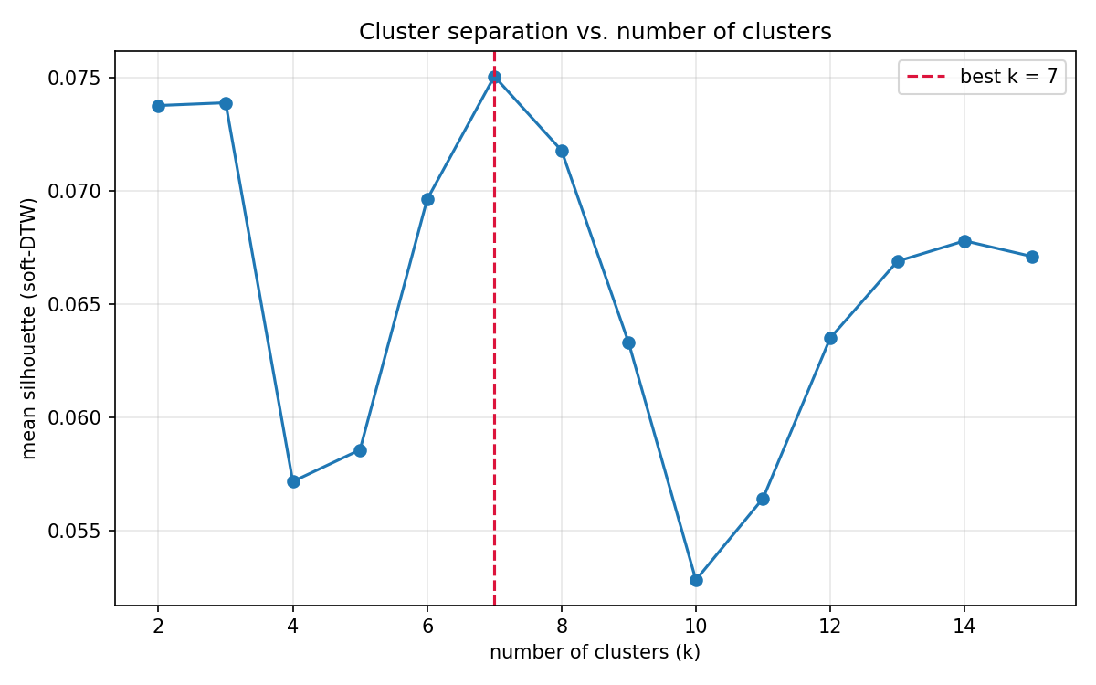
STEP 1
How many kinds of fly movement are there?
4,890 segments of 40 frames, 15 per fly
Soft-DTW K-Means, k swept 2 → 15
Best k = 7, silhouette 0.075
Low score = the finding, not a failure
10
Notes:
MAKE THE LOW-SCORE POINT PROPERLY. Silhouette measures how much better a segment fits its own cluster than the nearest alternative. Values approaching 1 need genuinely separated groups. Fly movement is a continuum — turns of every sharpness, speeds of every magnitude — so a modest but reproducible peak tells us the seven clusters are convenient labels carved out of a continuum, not natural categories. That is why we use them as a STRESS TEST of the predictor later, not as a routing mechanism. IF ASKED: scored on a stratified sample of up to 1,200 segments for tractability; the full-set clustering at k=7 gives 0.077.

Slide 11
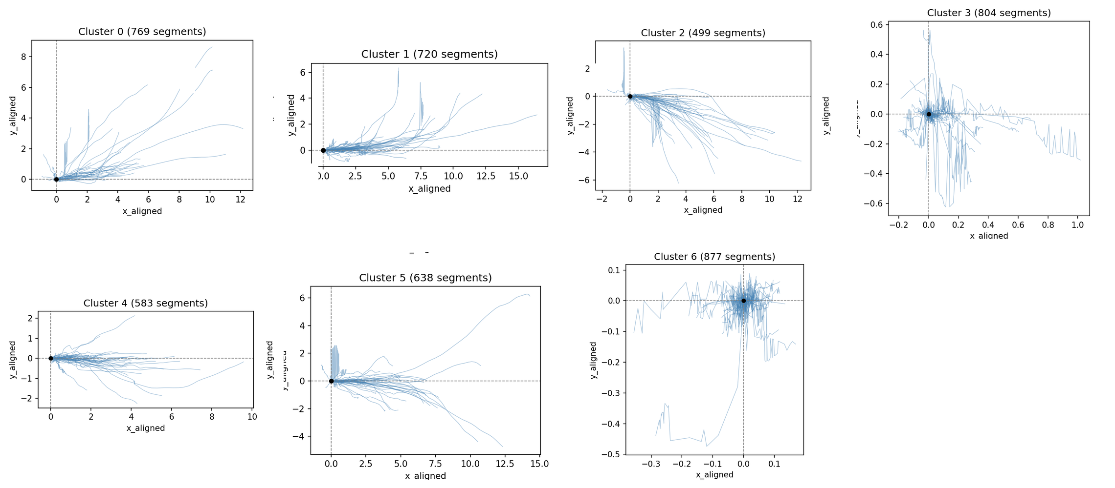
STEP 1
The seven movement types, drawn in the fly's own frame
Straight runs (0, 1, 5) · sweeping turns (2, 4) · near-stationary jitter (3, 6). Note the axis scales.
11
Notes:
This is the normalisation from the data-prep slide made visible — every panel starts at the same origin facing the same direction, which is the only reason these shapes are comparable. POINT AT THE AXIS SCALES: clusters 0, 1, 5 run out to 10-15 mm; clusters 3 and 6 span less than a millimetre. Same duration, wildly different distance. That spread is the continuum argument: sharpness of turn and speed vary smoothly, which is why the silhouette is low and why we treat these as labels rather than behaviours.

Slide 12
METHOD
Testing it honestly
Split by fly, never by frame
228 train / 33 validation / 65 test. A test fly is never seen in any form.
Two baselines, every time
Constant velocity, and stopped. Same windows, same metrics.
Two metrics, always together
Median error in mm, and win rate over individual moments.
Validation decides when to stop. Test is touched once, at the very end.
Notes:
DEFEND THE BY-FLY SPLIT. Consecutive windows of the same fly overlap heavily, so a frame-level split would put near-duplicate rows on both sides of the boundary and inflate every number on the following slides. The uncomfortable part: nothing in the training or validation curves would have looked wrong. CONSTANT VELOCITY is the honest competitor — it costs nothing to compute, it is what a system with no model would do, and at short horizons it is genuinely strong. The learned model is only worth its complexity if it beats this. STOPPED is a diagnostic, not a competitor: it quantifies how much of any method's apparent accuracy is just the fly being slow. MEDIAN not mean, because a handful of extreme moments would dominate and could flatter either method. WIN RATE because a method can have a better median while losing most individual comparisons.

Slide 13
THE RESULT
At 50 ms ahead, the model beats simple physics by
81.2%
median prediction error 0.023 mm (LSTM) vs. 0.122 mm (constant velocity) vs. 0.390 mm (stopped)
Closer to the truth than physics on 95.3% of individual test moments — and the single worst test fly still wins 88.8% of the time.
Notes:
0.023 mm is roughly a hundredth of a fly's body length. The worst-fly number matters more than the average: it says the result is not carried by a few easy flies.

Slide 14
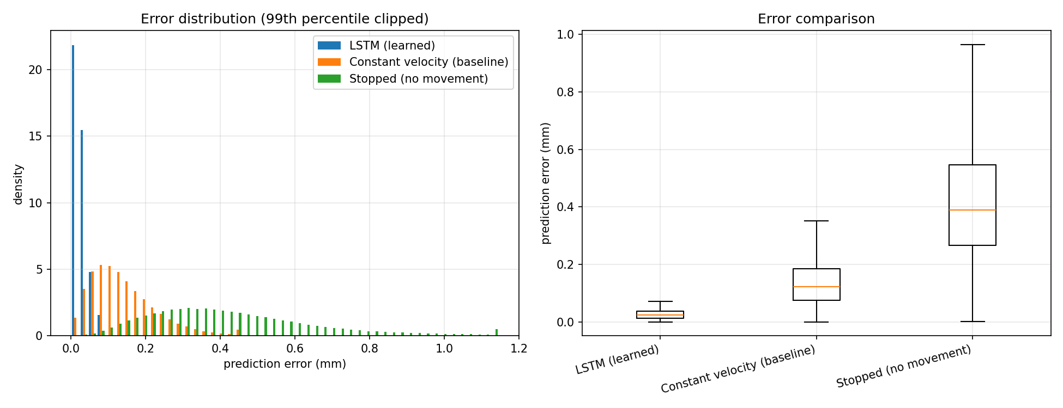
EVIDENCE
Not just a better average — a better distribution
The model's whole distribution sits inside the baseline's lower quartile.
14
Notes:
State plainly: this is not a small shift in the mean with overlapping spreads. The learned model's worst typical moments are better than the baseline's best typical moments — its whole box sits inside the baseline's lower quartile. The green 'stopped' distribution is the diagnostic: it shows how much of the apparent accuracy is just the fly being slow. It is far worse than both, which is what we want to see.

Slide 15
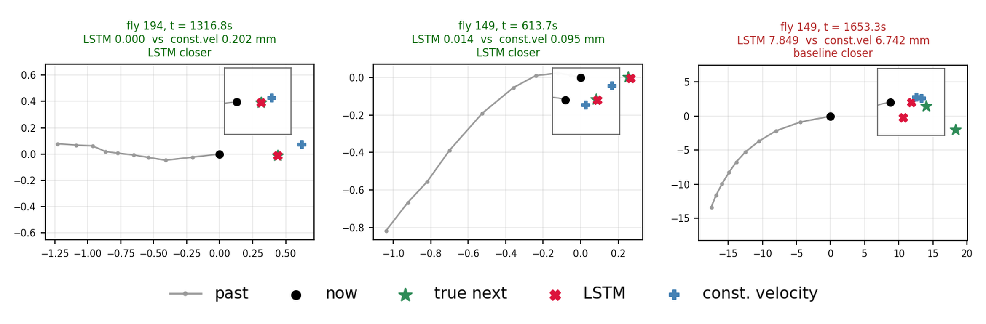
EVIDENCE
Three individual moments: two wins and a failure
Each panel: one instant, one test fly, in the fly's own frame. Grey = where it came from; the inset zooms in.
15
Notes:
Three moments picked from the twelve the pipeline draws. Walk through them left to right. LEFT — fly 194, a typical easy case: the fly is moving almost straight, the model lands essentially on the true point (0.000 mm) and constant velocity is 0.202 mm out. Note the inset: at full scale the markers would sit on top of each other, so every panel zooms in. MIDDLE — fly 149, a curving path. This is where the model earns its place: physics carries the heading straight on and misses by 0.095 mm, the model follows the bend and is 0.014 mm out. RIGHT — the same fly, later, and we lose. A sharp sustained turn: the model overshoots by 7.8 mm against the baseline's 6.7 mm. Both are catastrophic in application terms. SHOW THIS ONE DELIBERATELY. It is the shape of the residual error — failures are not spread evenly, they are concentrated in high-curvature manoeuvres where the preceding 167 ms genuinely does not determine the next 50.

Slide 16
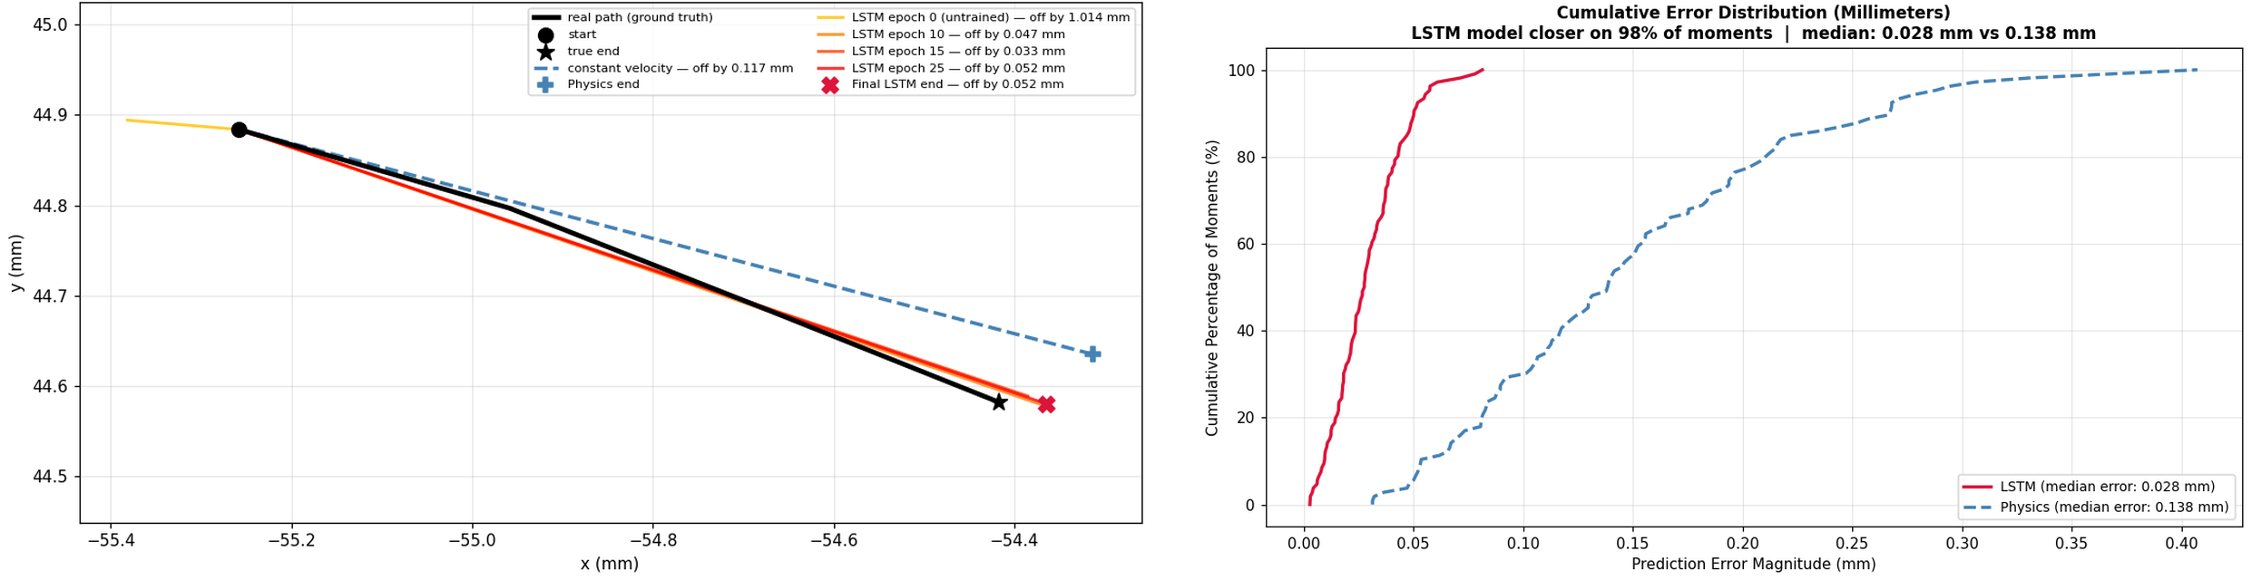
EVIDENCE
One held-out fly, end to end
Where it ends up
How often it wins
Why it wins
Untrained: 1.014 mm off. Trained: 0.052 mm. Physics: 0.117 mm.
Closer on 98% of this fly's moments — median 0.028 vs 0.138 mm.
Physics cuts the corner. The model tracks the curve.
Fly 48, never seen in training. One of 326 per-fly figures — every fly, every split.
16
Notes:
The aggregate numbers are easier to trust once you can watch a single fly. TOP PANEL: black is the real path over this fly's most active stretch. The dashed blue line is constant velocity, which drifts off the curve and ends 0.117 mm short. The orange line is the model BEFORE any training — 1.014 mm off, wildly wrong. The red lines are epochs 10, 15 and 25, all sitting essentially on top of the true path. So on one fly you can see the same story as the epoch-progression slide: untrained the model is worse than doing nothing, trained it tracks the real curve where physics cuts the corner. BOTTOM PANEL: the cumulative error distribution for this fly. Read it as 'what fraction of moments were at least this accurate'. The model reaches 100% by about 0.08 mm; physics is still climbing at 0.40 mm. Closer on 98% of moments, median 0.028 against 0.138. IF ASKED why this fly: it is a normal held-out test fly, not the best one. The worst test fly in the whole set still wins 88.8% of its moments. We generate this figure for all 326 flies, so any of them can be inspected.

Slide 17
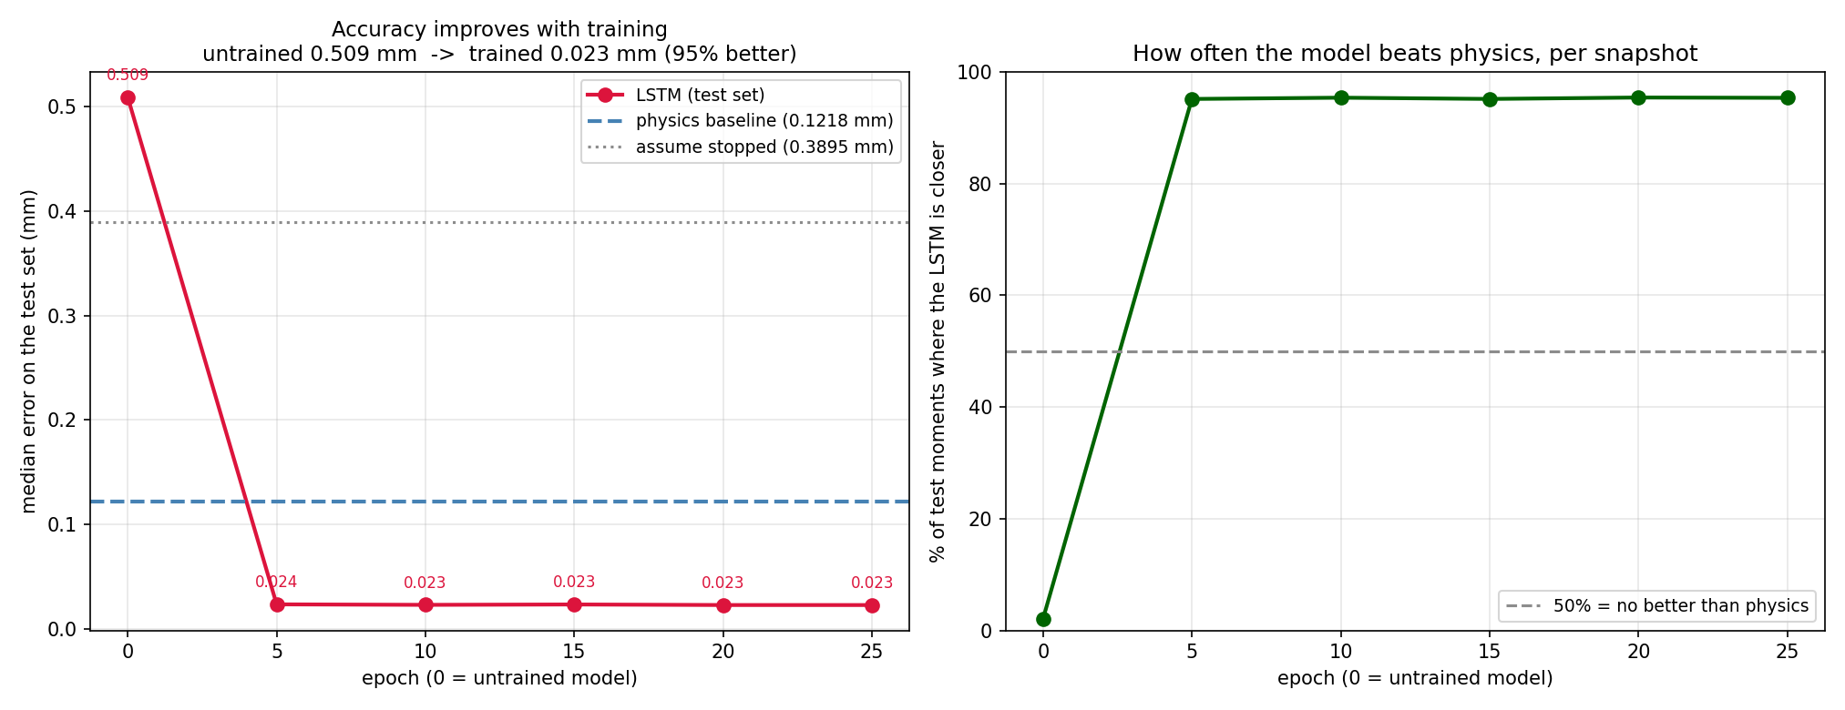
EVIDENCE
Does training actually help? Measured, not assumed
Untrained: 0.509 mm — worse than assuming the fly is stopped. Trained: 0.023 mm.
17
Notes:
We snapshot the full model at epoch 0, 5, 10, 15, 20, 25 and score every snapshot on the SAME held-out test flies. The only variable changing between these points is how long the model trained — that turns 'it improves with training' from a claim into a measurement. The untrained snapshot is also a control: at 0.509 mm it is worse than assuming the fly is stopped, and it beats physics on about 2% of moments. That confirms the pipeline is not leaking the answer. Convergence is essentially complete within five epochs, which suggests the architecture is not capacity-limited on this data — so this is a lower bound, not a ceiling.

Slide 18
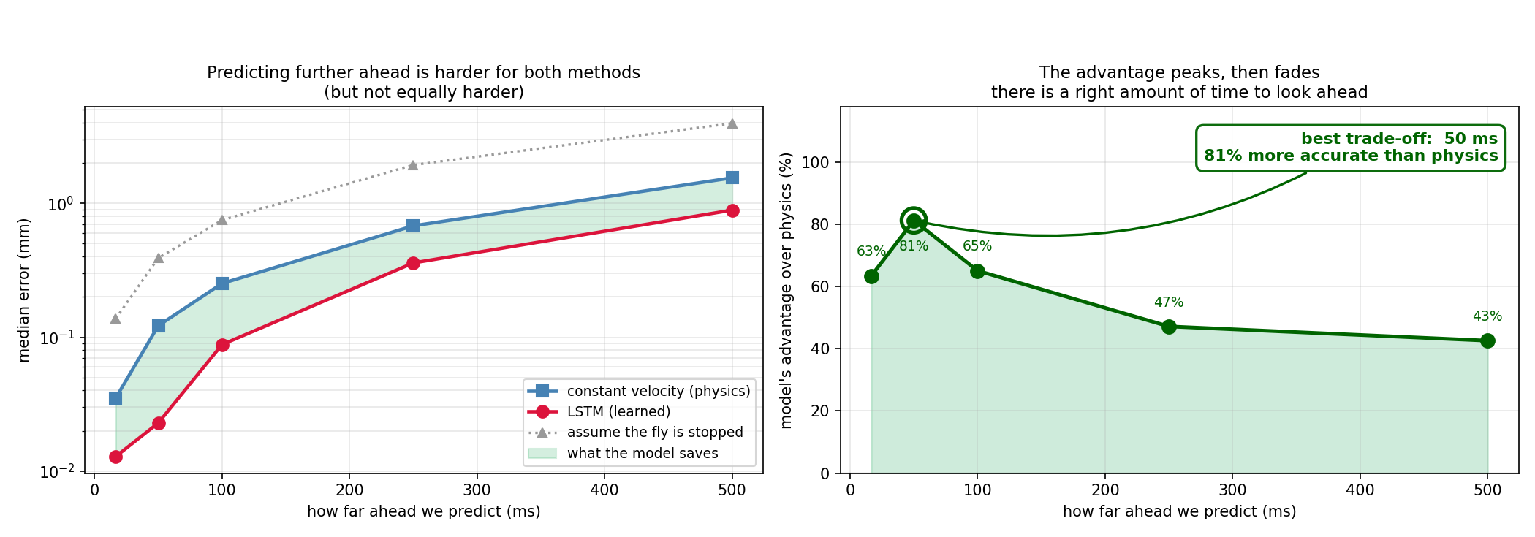
KEY FINDING
Why 50 ms? The advantage peaks there
63% at 17 ms · 81% at 50 ms · 43% at 500 ms. Five models, one per horizon.
18
Notes:
Five separate models, one per horizon, each retrained and re-evaluated on the same held-out flies. This is what shows 50 ms was not picked after the fact. THE PHYSICAL READING: at very short horizons the fly has barely had time to change what it was doing, so 'keep going straight' is nearly correct and there is little to add. At long horizons the future depends on decisions the fly has not made yet, which are not in the preceding 167 ms, so neither method can see far enough. In between there is a window where the next move is already determined by dynamics visible in recent history but is no longer a straight continuation of it. That is where learning pays, and for this species at this sampling rate it is centred on 50 ms. THIS IS A DESIGN OUTPUT: 50 ms is the latency budget any real-time control loop built on this would have to hit.

Slide 19
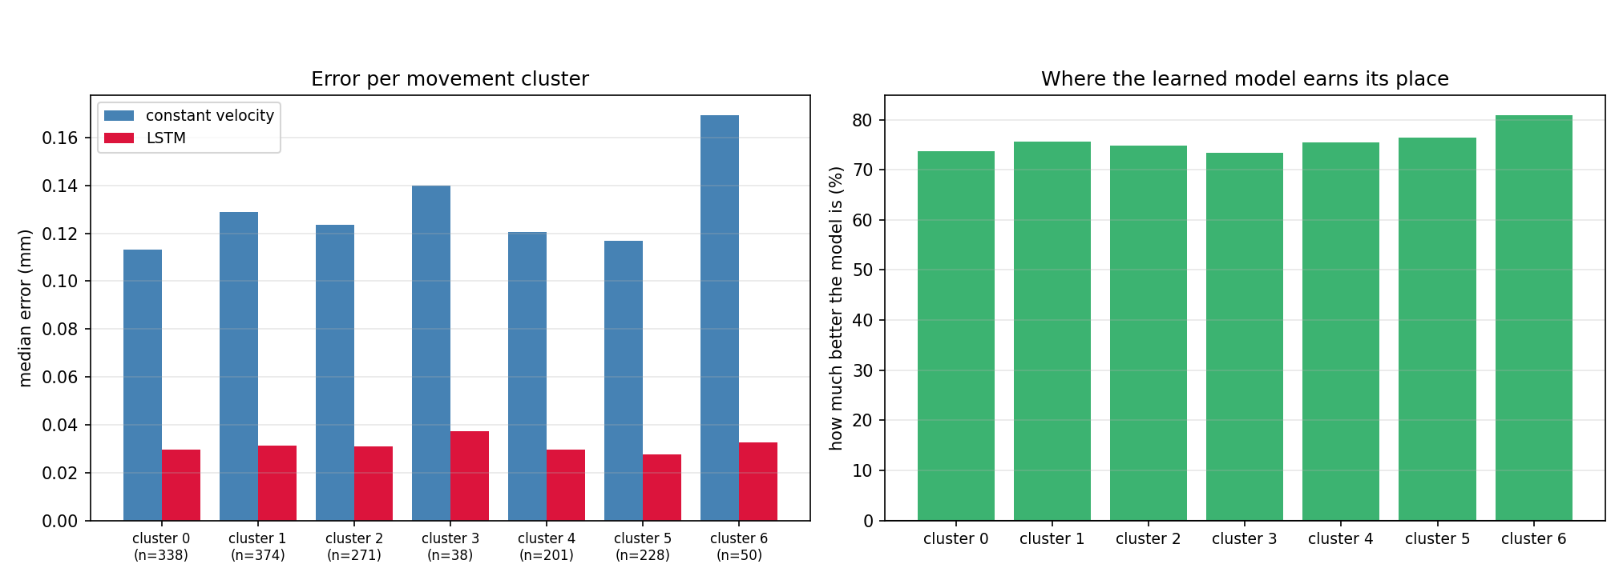
ROBUSTNESS
It helps on every kind of movement, not just one
73% to 81% improvement across all seven movement types.
19
Notes:
This connects Step 1 to Step 3. If the improvement lived in one cluster, the model would be exploiting one behaviour rather than learning motion. The baseline's error varies a lot between clusters — about 0.11 mm on the easiest to 0.17 mm on the hardest — while the model stays between about 0.028 and 0.037 throughout. So the difficulty the clusters expose is difficulty for PHYSICS; the model is comparatively indifferent to it. CAVEAT TO OFFER BEFORE THEY ASK: support is uneven, from 38 to 374 test moments, so the two smallest clusters deserve caution. The largest advantage is on cluster 6, one of the smallest and the most erratic.

Slide 20
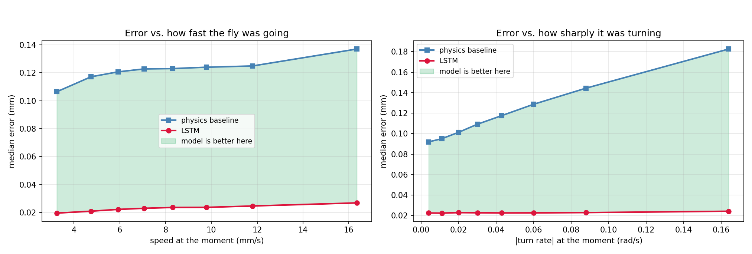
ROBUSTNESS
And across every speed and every turn rate
Baseline doubles as the fly turns harder. The model stays flat near 0.022 mm.
20
Notes:
THE RIGHT PANEL is the clearest single picture in the deck of why a learned model earns its place. Across the speed range the baseline degrades gently, 0.107 to 0.137 mm, while the model goes 0.020 to 0.027. Across turn rate the divergence is much sharper: the baseline roughly doubles, 0.092 to 0.182 mm, while the model stays essentially flat near 0.022. That widening gap is the linear-dynamics assumption failing exactly as predicted at the start of the talk, and the model absorbing the failure. For the application this is the FAVOURABLE case: the moments when a fly turns hardest are precisely the moments a reactive system misses.

Slide 21
CONCLUSIONS
Did we meet the Phase A success criteria?
Phase A criterion | Status | Evidence
Accurate motion prediction | Met | 81.2% lower median error · 95.3% win rate
Robustness and generalisation | Met | 73–81% across all 7 clusters · worst fly still 88.8%
Adaptability to diverse motion | Met | Flat across speed and turn rate, where physics doubles
Noise tolerance (dataset level) | Met | Rotation-invariant features · reported against the 0.02 mm floor
Real-time hardware integration | Not done | Out of scope for this phase — no camera, interlock or actuation
Four of five met and measured. The fifth we did not attempt — it needs the physical system.
21
Notes:
These are the criteria WE set in Phase A, answered with evidence rather than assertion. Be straight about the fifth: we did not do it. This component predicts motion and nothing else — there is no camera, no safety interlock, no actuator. Integrating it with hardware was outside what we set out to do here. USEFUL LINE: what we can hand over is the specification. The horizon sweep says the loop has a 50 ms budget, and within it the prediction is worth roughly a five-fold reduction in aiming error over a reactive system.

Slide 22
Thank you
Questions?
Yaniv Bodaga · Daniel Lachmakov | Advisors: Dr. Dan Lemberg · Mrs. Elena Kramer
Notes:
Likely questions: why not a Transformer; why the silhouette is so low; why 50 ms; what happens on a different species or camera.

