Slide 1
Investigating Methods of Controlling Algebraic Connectivity
Daniel Rodrigues, December 11th

Slide 2
Part of a Three Project Series
CS 229r: This Paper
CS 286
Extension
1
Investigating Methods of Controlling Algebraic Connectivity
2
Dictating Algebraic Connectivity as a Topology in Networked Multi-Agent Systems
3
Using Multi-Path Routing to Identify Malicious Agents in Consensus

Slide 3
Introduction

Slide 4
Project Motivation & Problem Statement
Can we enable a system engineer or real-time supervisor to constrain the algebraic connectivity (i.e. Fiedler value) of a mobile multi-agent system by augmenting a flock’s network topology?
$λ_{2}$ = 5.00
$λ_{2}$ = 0.38

Slide 5
Project Motivation & Problem Statement
Instance: Given an undirected graph $G=(V,E)$ and a non-negative threshold $t_{1}$ and $t_{2}$.
Question: Is there a subset $B⊆E$ such that the graph $H=(V,E-B)$ satisfies $t_{1}≤λ_{2}(H)≤t_{2}$.
$λ_{2}$ = 5.00
$λ_{2}$ = 0.38

Slide 6
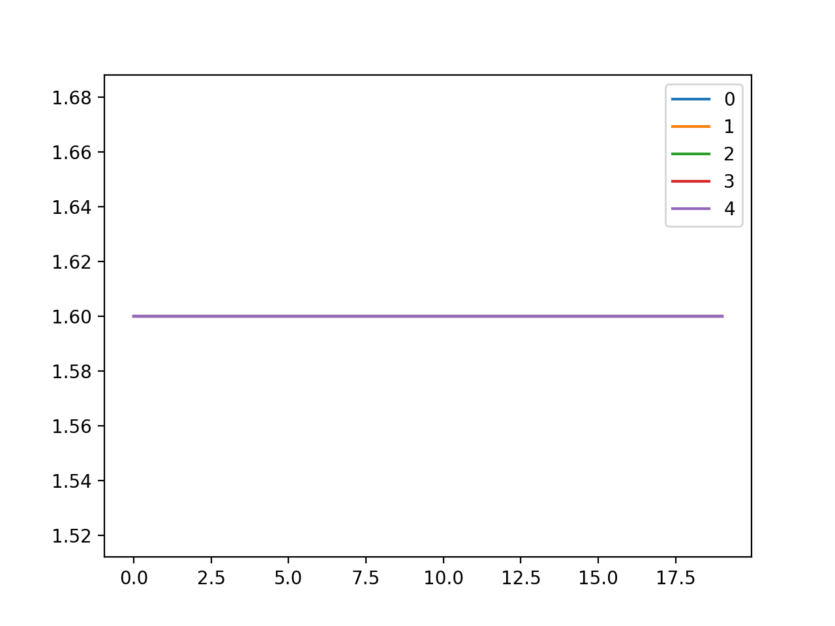
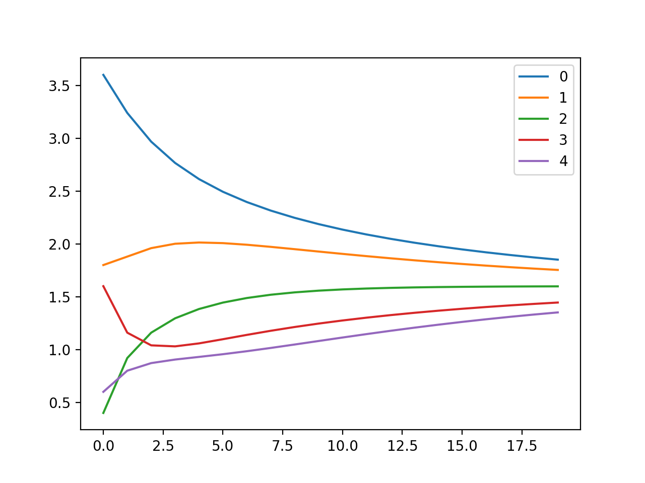
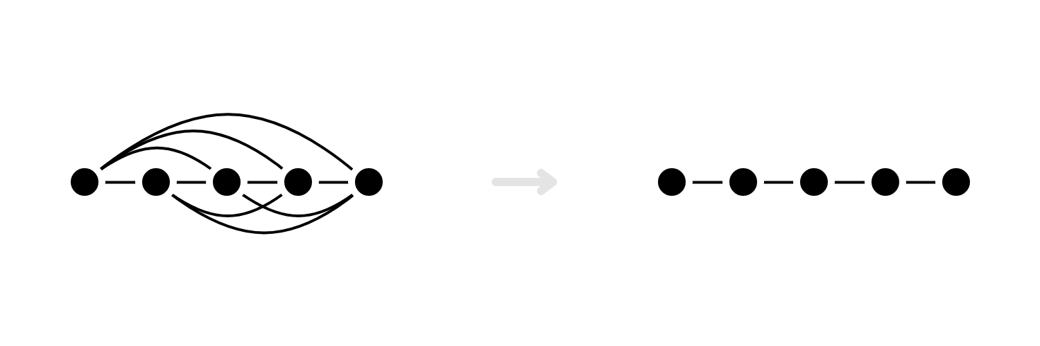
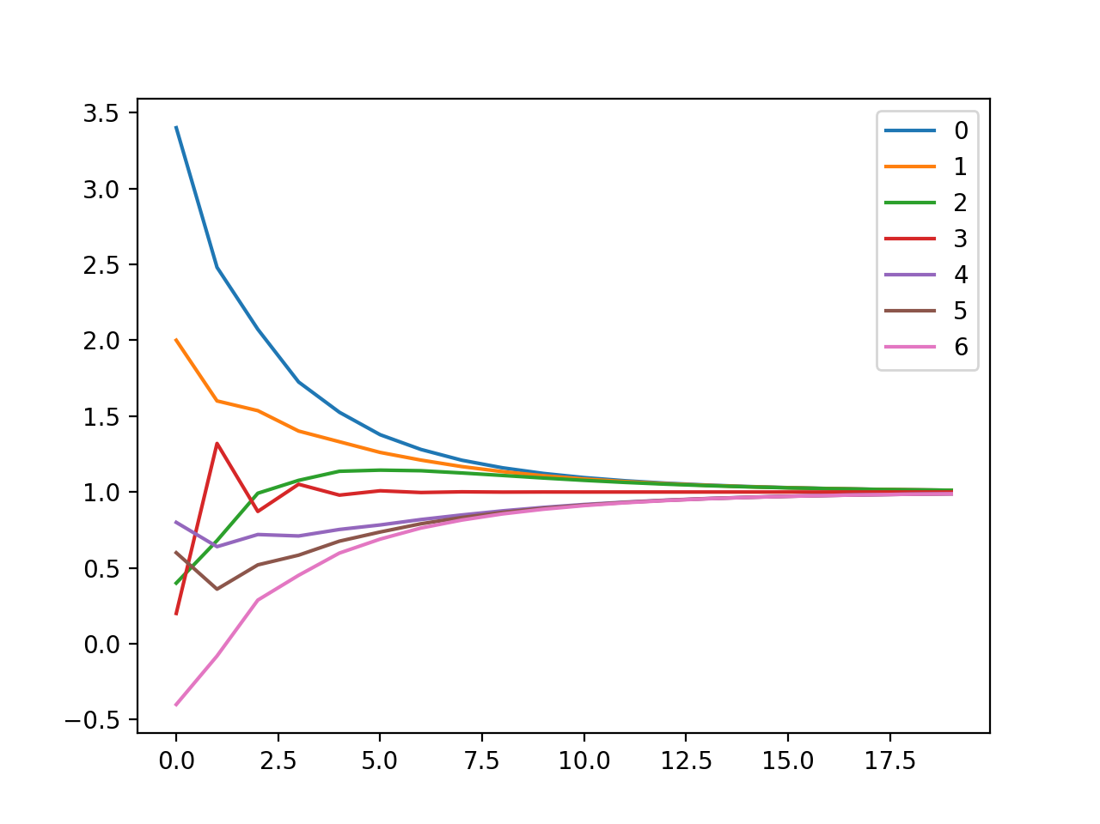
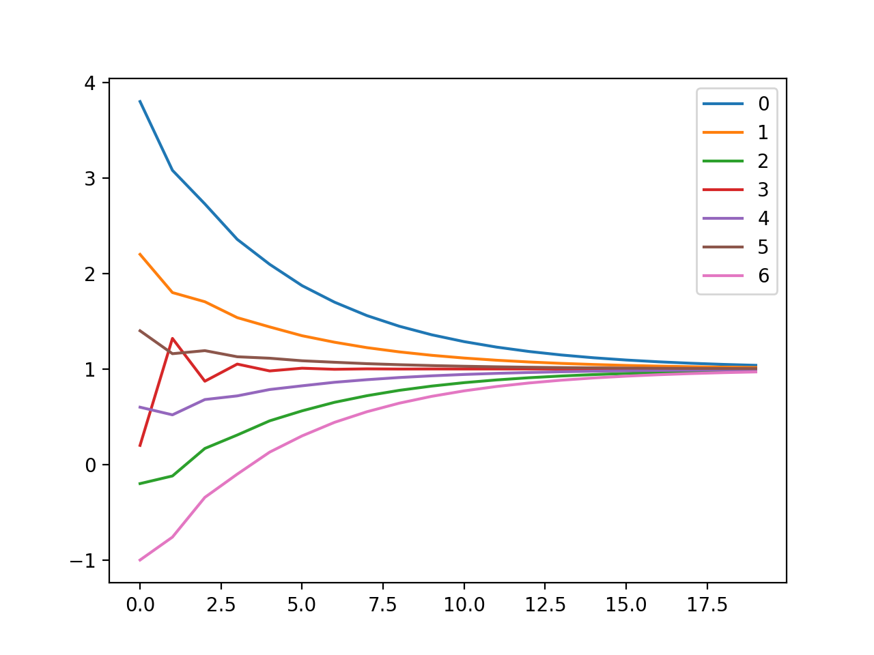
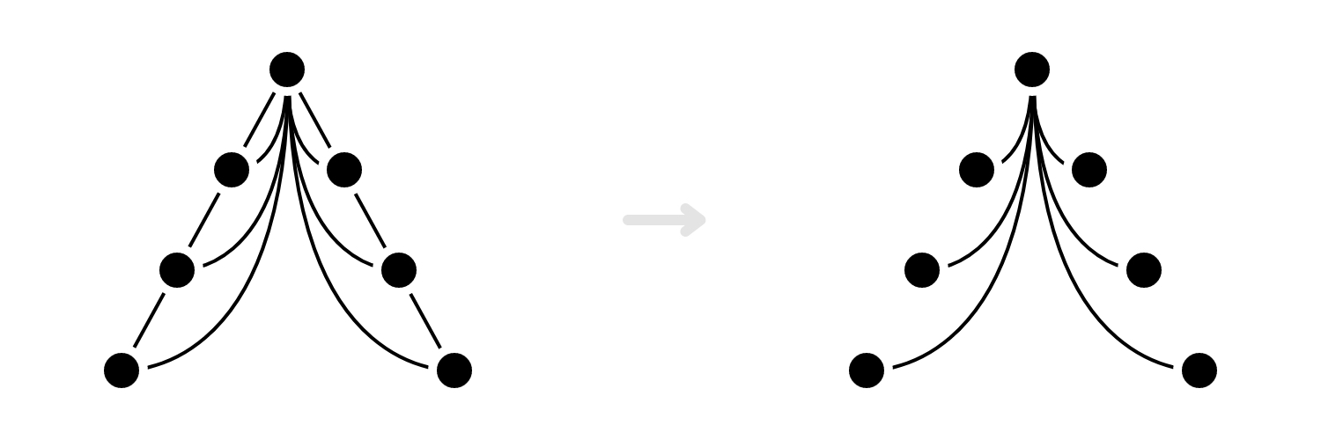
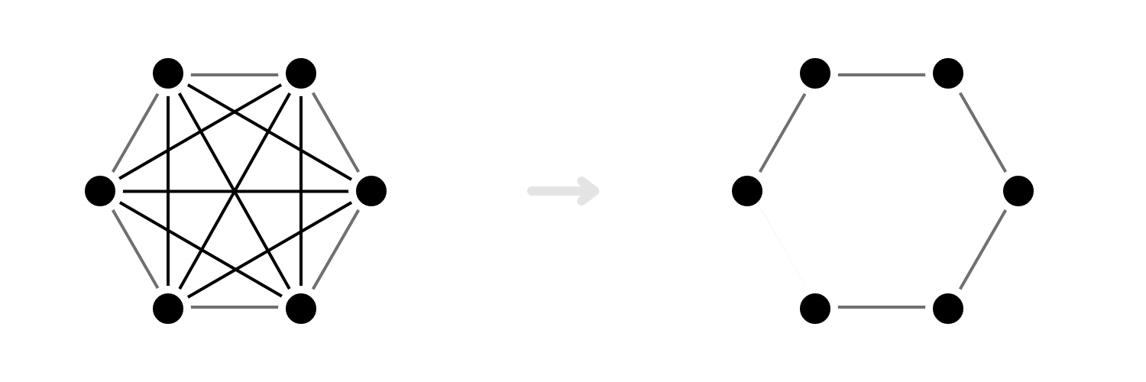
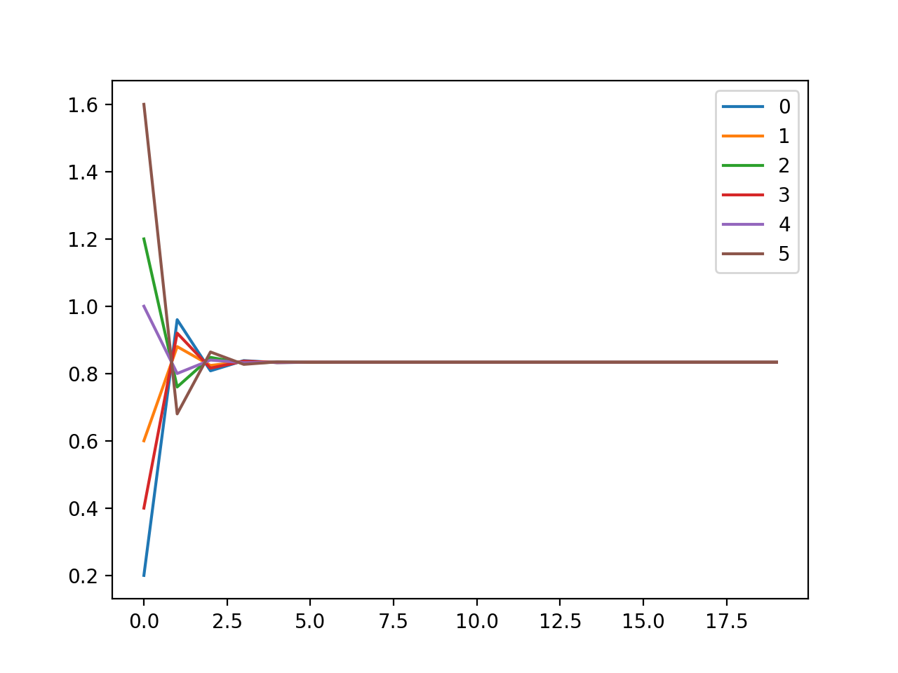
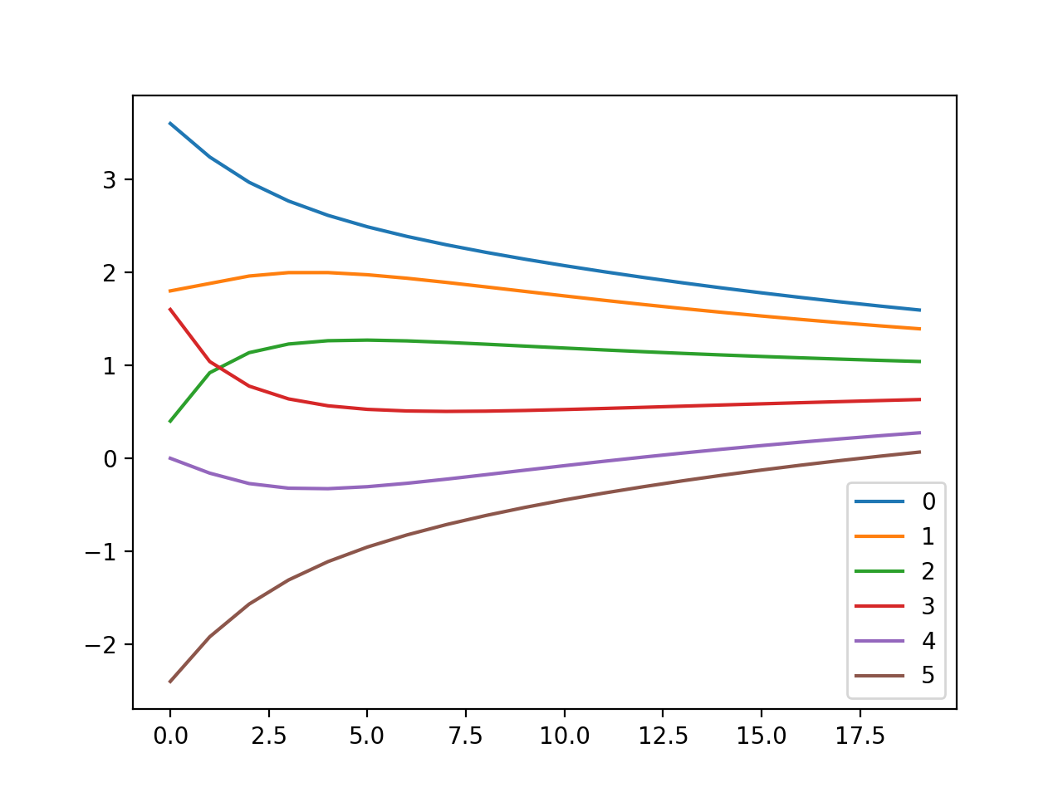
Baseline Results
Line Formation
Wedge Formation
Circle Formation
Takeaways: A less connected graph converges slower (obviously).
Which edges are chosen can significantly affect convergence time.

Slide 7
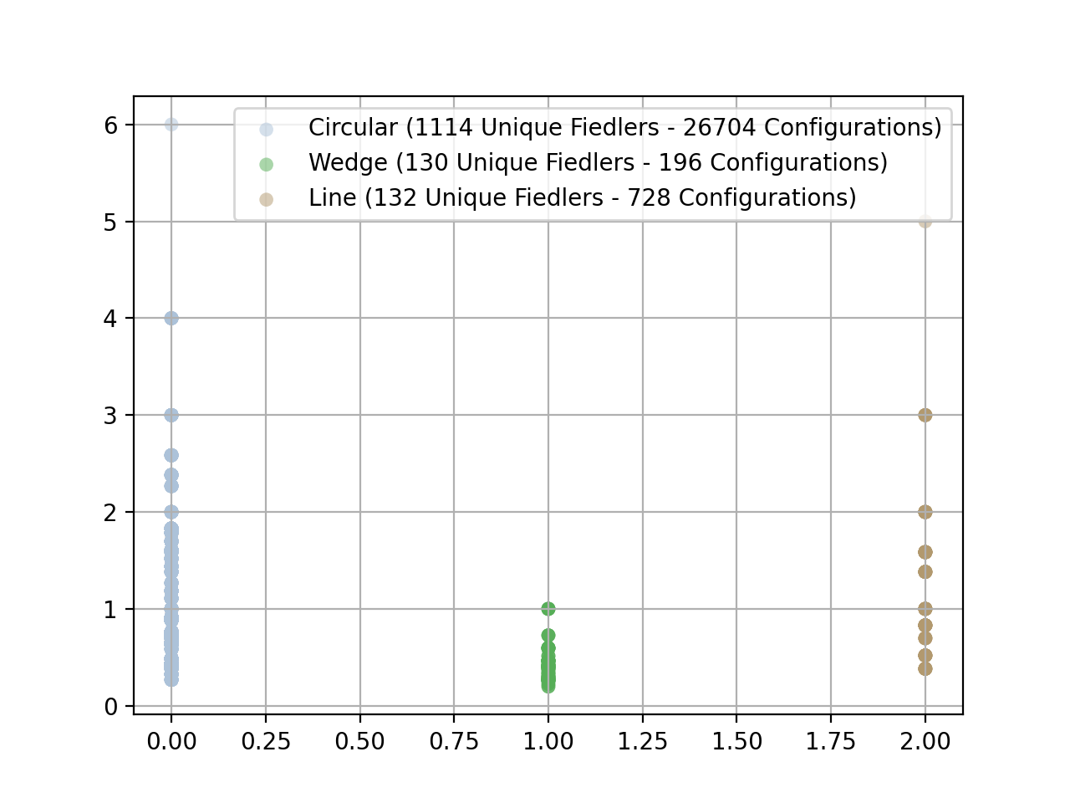
Configuration and Result Space Size
Line Formation
Wedge Formation
Circle Formation

Slide 8
Control Over Connectivity Reduction
$λ_{2}$ = 1.00
x
x
x
x
$λ_{2}$ = 0.60
$λ_{2}$ = 0.73
$λ_{2}$ = 1.00
$λ_{2}$ = 0.60
Deterministic
Proposed Algorithms
Randomized

Slide 9
Experimental Studies

Slide 10
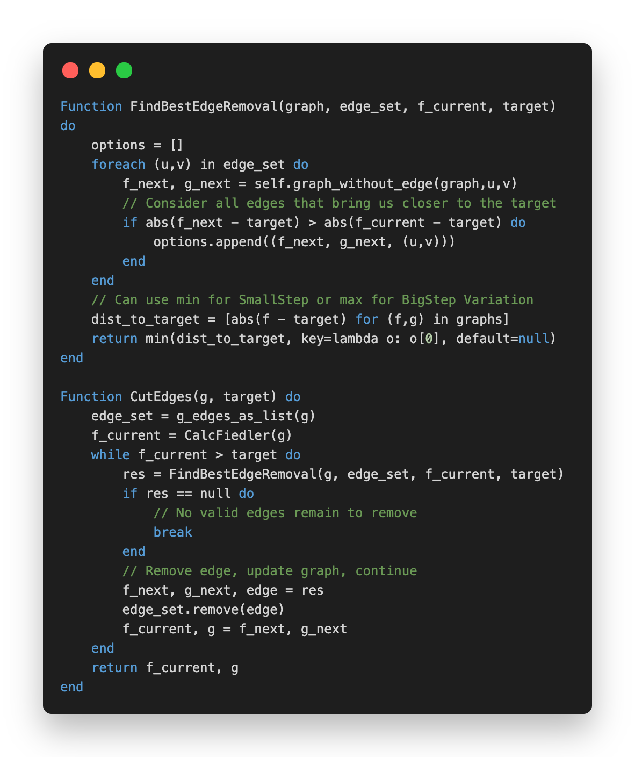
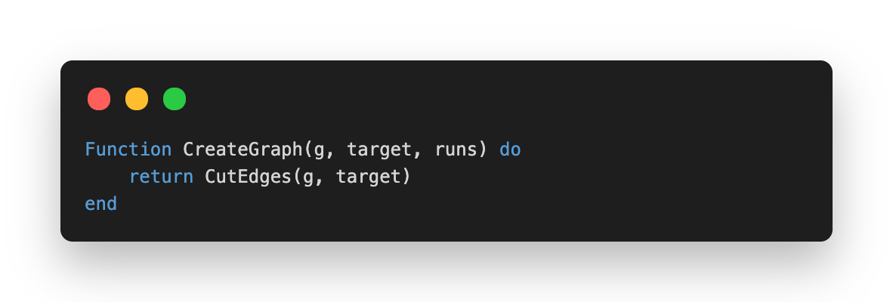
Deterministic Algorithm
Removes an Edge with Min/Max Fiedler Impact
Input:
$G$ Original Graph
$λ_{2}^{′}$ Target Fiedler
Output:
$λ_{2}(G^{′})$ Reached Fiedler
$G^{′}$ Augmented Graph
Flags:
Allow Disconnect
One/Two Sided Bound

Slide 11
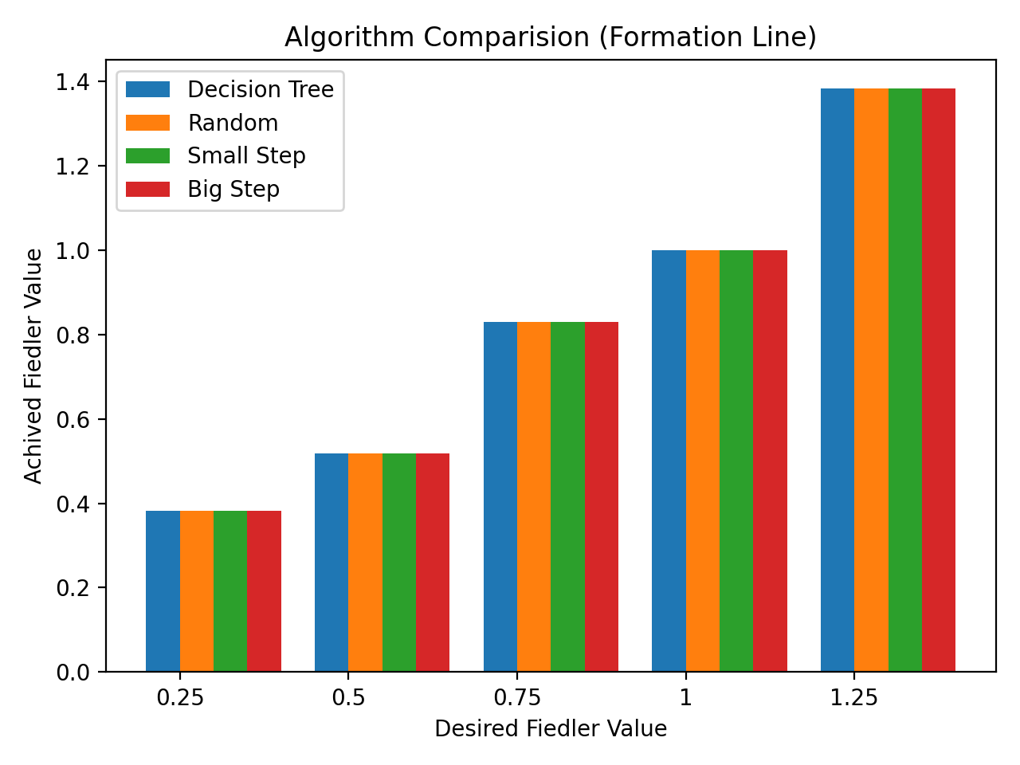
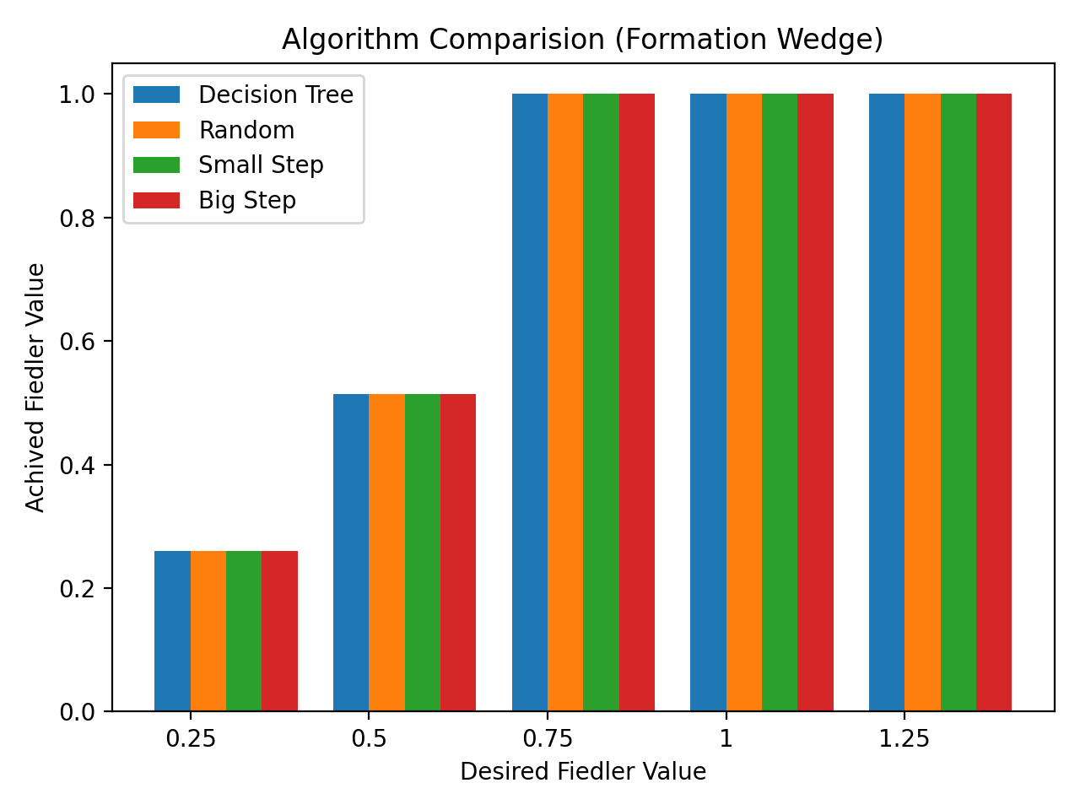
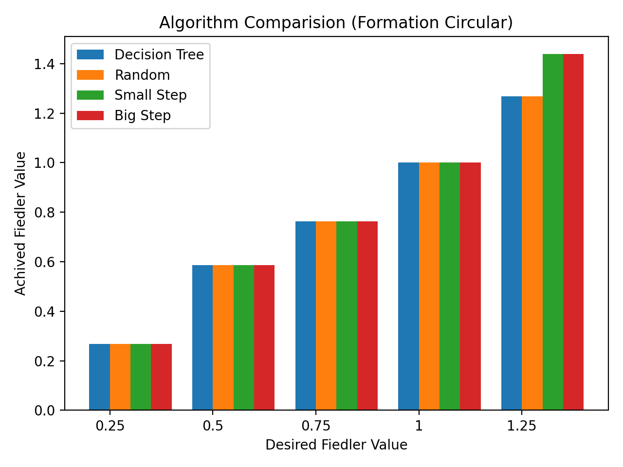
Results

Slide 12
Algorithms
Baseline
Exhaustive Search
First Round
Deterministic-Fiedler
Second Round
Second Round
Deterministic-Leverage
Deterministic-Gradient
Chosen
Randomized-Fiedler

Slide 13
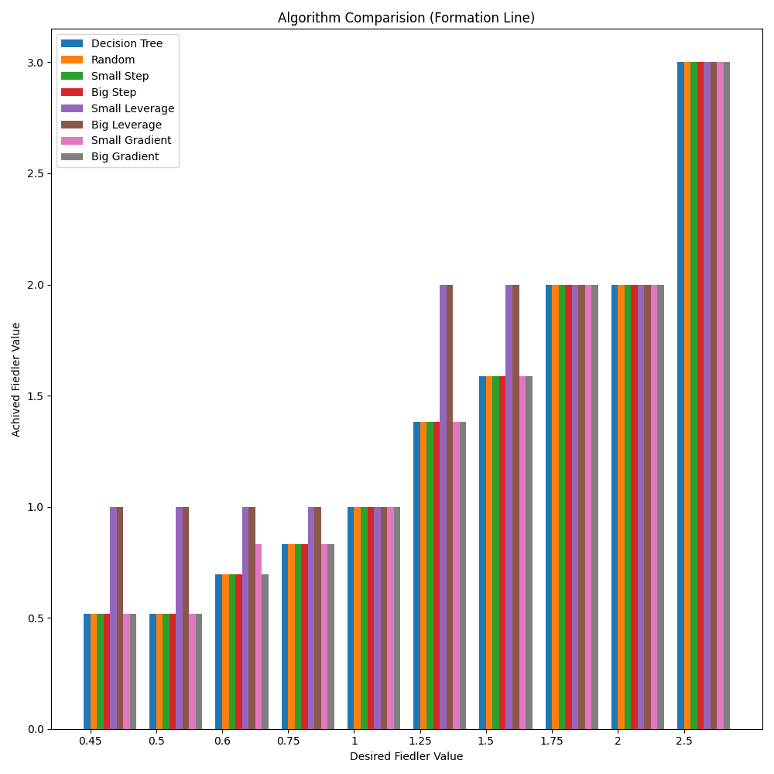
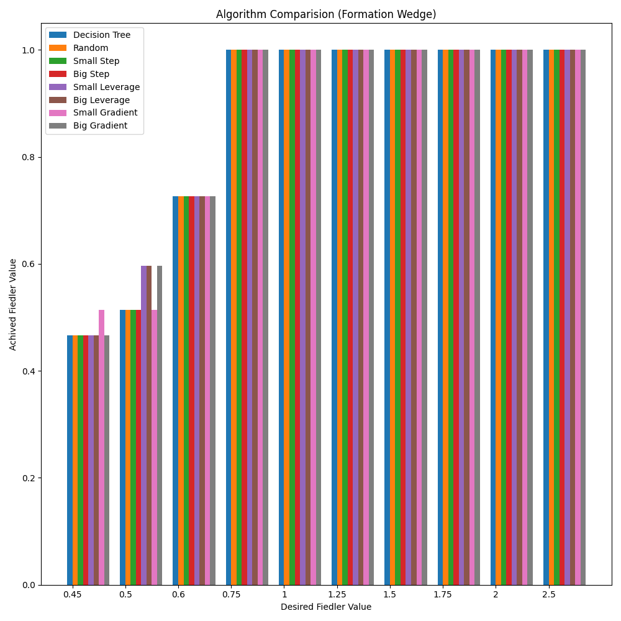
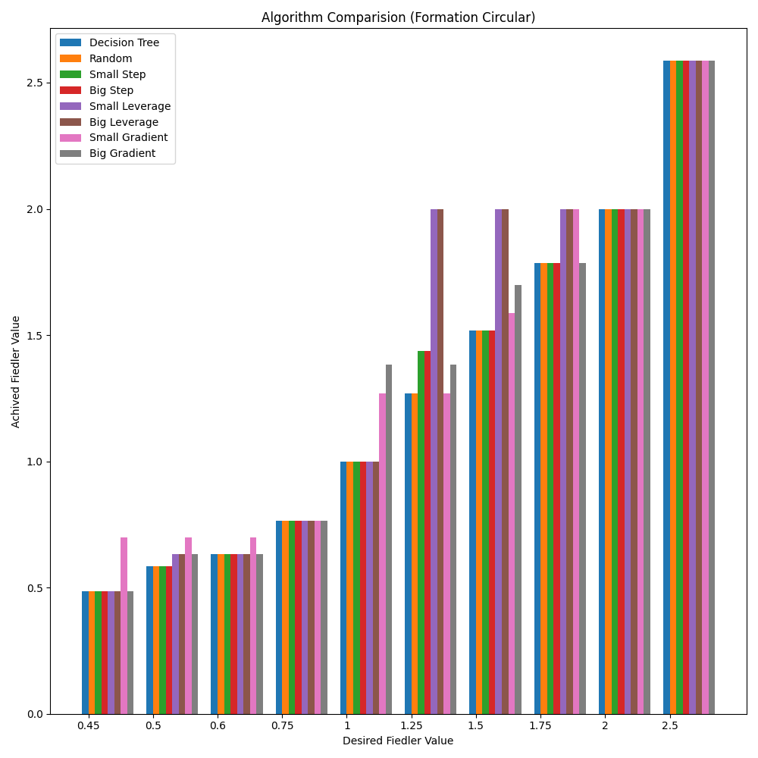
Results

Slide 14
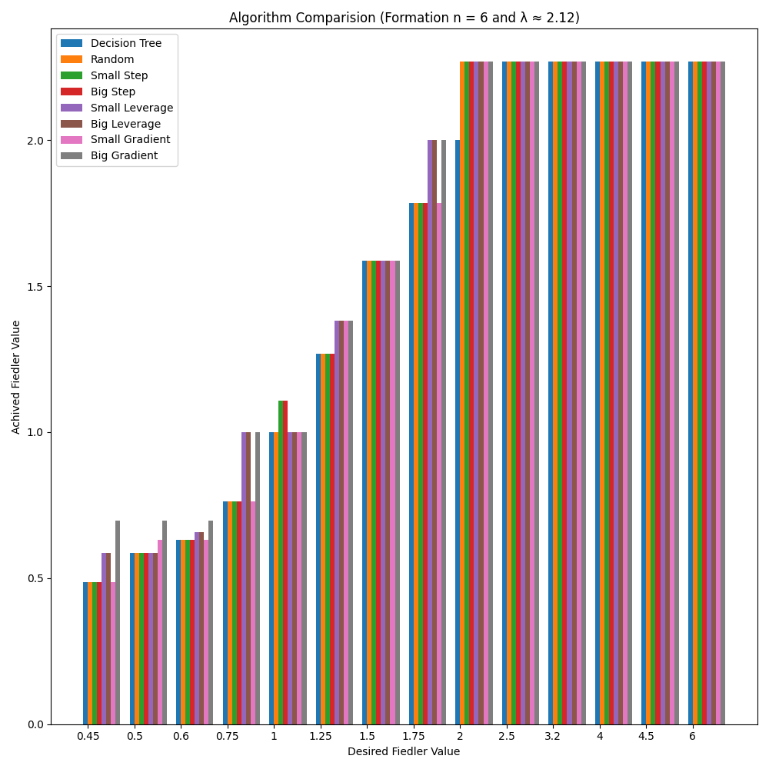
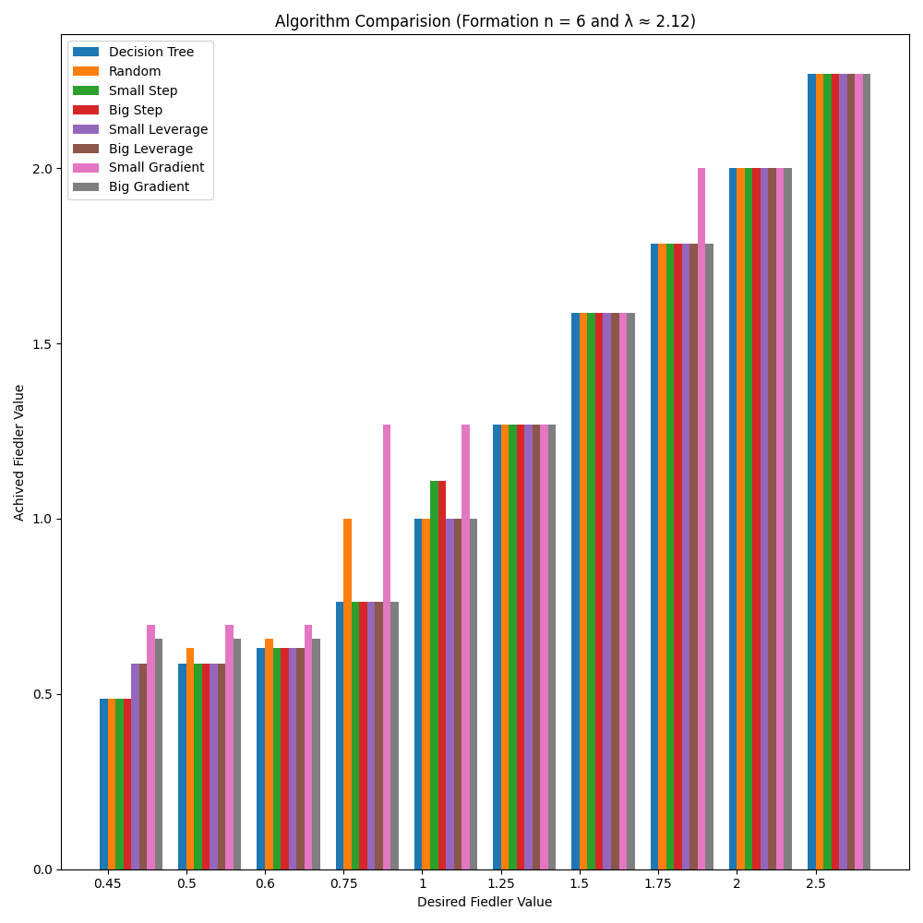
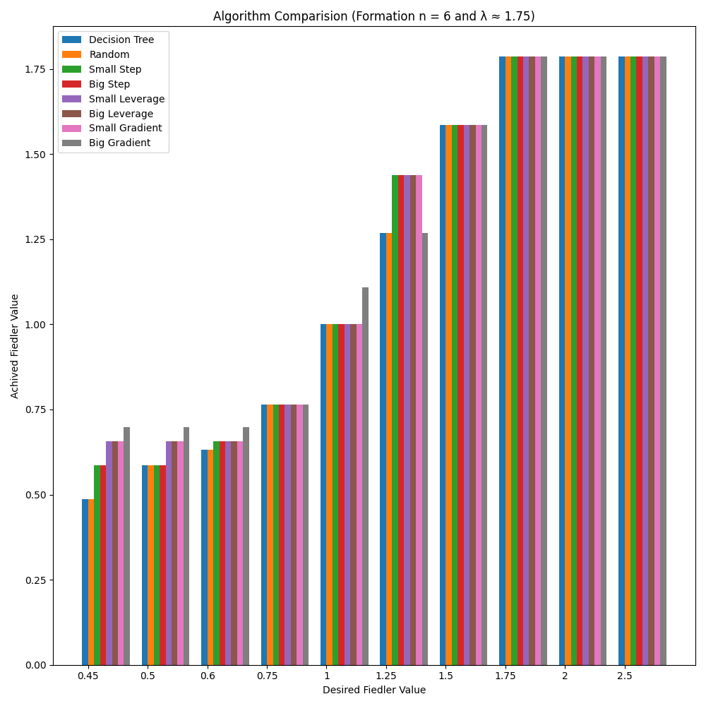
Results
*~11/27 Tests (n >= 5)
*Lowered Amplification
Decision Tree is Expo(E) - Proposed Algorithms are Poly(E)
Takeaways: In our simulations, all algorithms had similar performance.
Randomized tends to perform best.

Slide 15
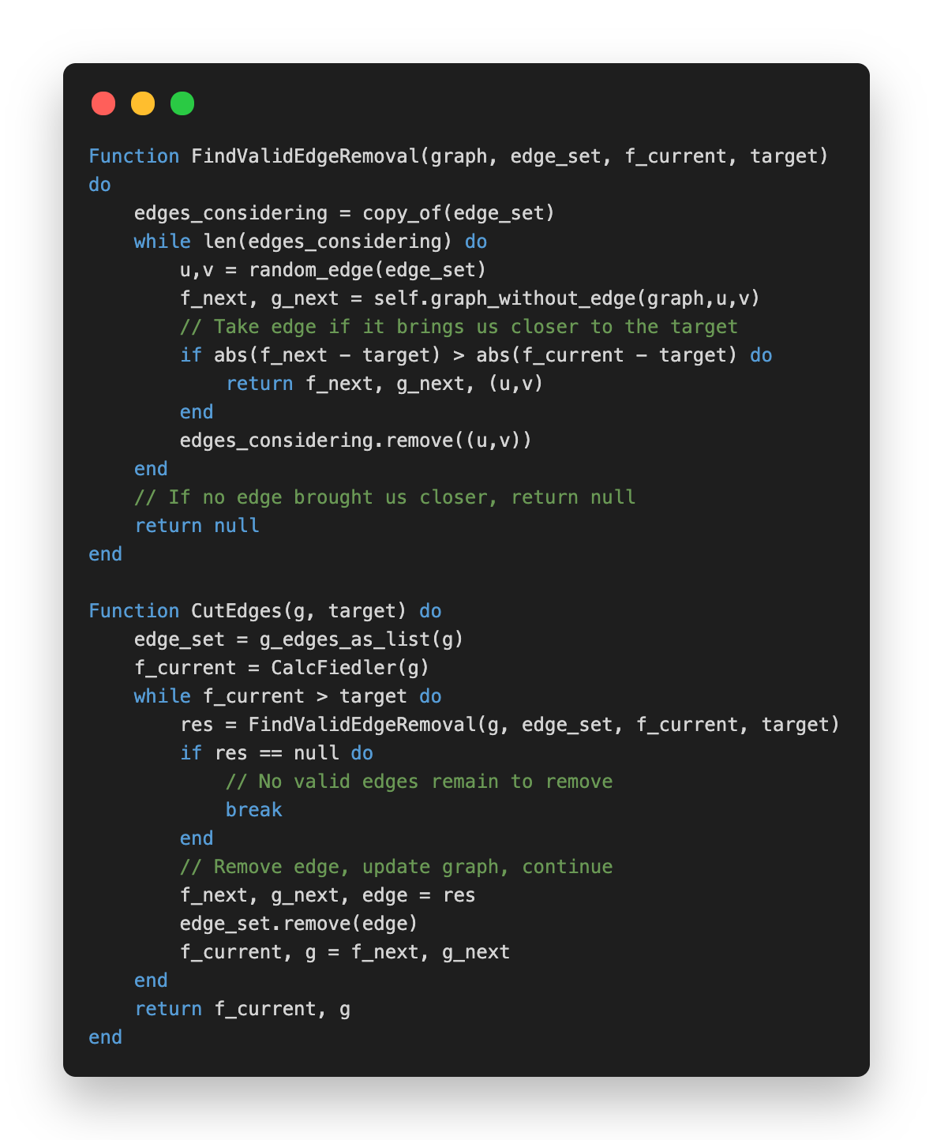
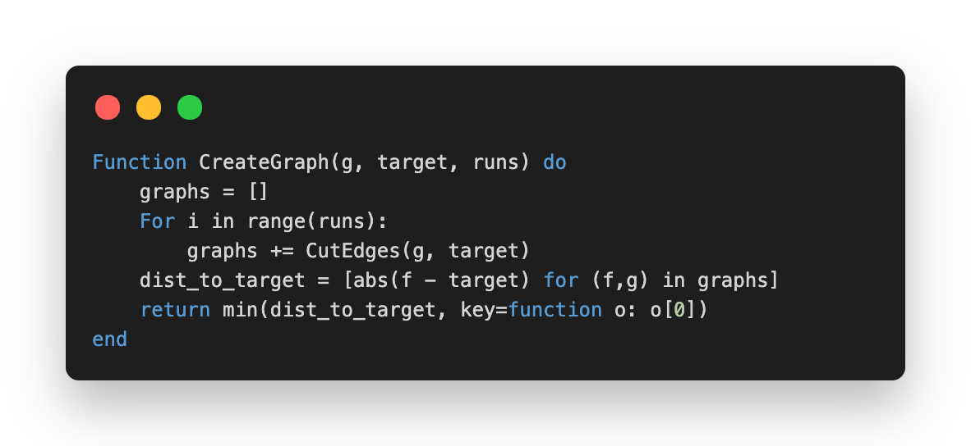
Randomized Algorithm
Removes a Random Valid Edge
Input:
$G$ Original Graph
$λ_{2}^{′}$ Target Fiedler
$r$ Amplification Runs
Output:
$λ_{2}(G^{′})$ Reached Fiedler
$G^{′}$ Augmented Graph
Flags:
Allow Disconnect
One/Two Sided Bound

Slide 16

Maximum Algebraic Connectivity Augmentation
Damon Mosk-Aoyama. 2008. Maximum algebraic connectivity augmentation is NP-hard.
Instance: Given an undirected graph $G=(V,E)$, a non-negative integer $k$, and a non-negative threshold $t$.
Question: Is there a subset $A⊆E^{C}$ of size $|A|≤k$ such that the graph $H=(V,E∪A)$ satisfies $λ_{2}(H)≥t$.
NP: $λ_{2}(H)≥t$ verifiable in polynomial time.
NP-Hard: Reduction from 3-colorability.
NP-Complete

Slide 17
A Harder Version of Our Problem
Instance: Given an undirected graph $G=(V,E)$, a subset $A⊆E$, a non-negative integer $k$, and a non-negative threshold $t_{1}$ and $t_{2}$.
Question: Is there a subset $B⊆(E-A)$ of size $|B|≥k$ such that the graph $H=(V,E-B)$ satisfies $t_{1}≤λ_{2}(H)≤t_{2}$.
NP: $λ_{2}(H)≥t$, $B⊆E$, and $|B|≥k$ verifiable in polynomial time.
NP-Hard: Reduction from the “maximum algebraic connectivity augmentation problem”.
NP-Complete

Slide 18
Future Works
Is the original question we proposed NP-Hard?
What about reducing weights on graphs?
What about optimizing the number of removed edges to meet the threshold?
Can we split a graph into separate components with desired Fiedler values (same or different)?

Slide 19
Networking and Robotic Applications
Problem: Can we enable a system engineer or real-time supervisor to constrain the algebraic connectivity (i.e. Fiedler value) of a mobile multi-agent system by augmenting a flock’s network topology?
Solution: Selecting and maintaining a subset of edges in a graph as to dictate the final graph’s algebraic connectivity (i.e. Fiedler value).
Environment & Limitations
Network Efficiency
Consensus & Resilience
Reducing Transmission Noice or Network Traffic Per Time Unit
More Efficient Information Distribution Through Broadcasting (Rather than Routing)
Controlling the Speed of Consensus or Identifying Malicious Agents Through Multi Path Routing

Slide 20
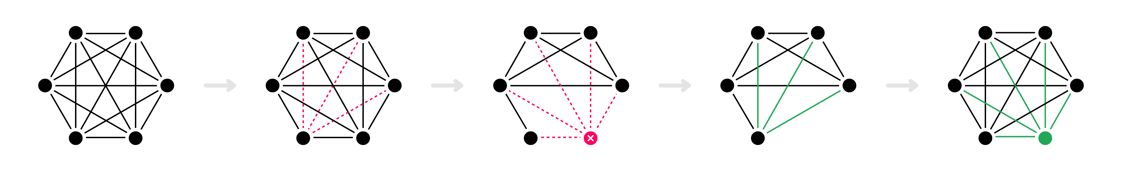
Continuing This Line of Work
CS 229r: This Paper
CS 286
Extension
1
Investigating Methods of Controlling Algebraic Connectivity
2
Dictating Algebraic Connectivity as a Topology in Networked Multi-Agent Systems
3
Using Multi-Path Routing to Identify Malicious Agents in Consensus

Slide 21
Thank You!
Any Questions?

