Slide 1


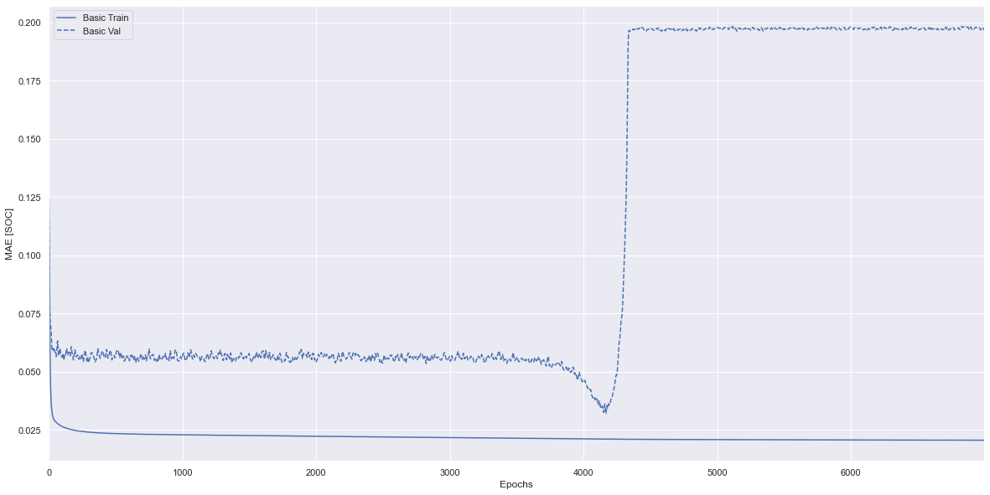
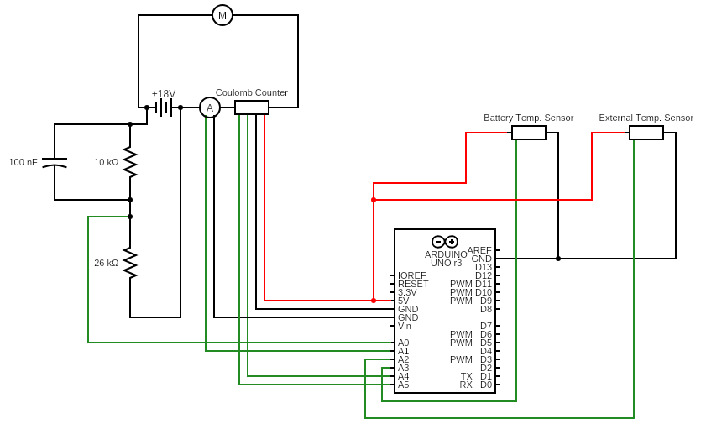
Battery Monitoring System & State of Charge Estimation Models
D. Woodhall
Graph of Epochs against MAE
Introduction
Comparison of Models
wwwwwwwwww
State of Charge (SoC) estimation in Li-ion batteries can be done using several methods.
The most promising of these incorporate machine learning or deep learning techniques.
4 Models were made to find the optimal result.
The proposed models were constructed and the minimum mean absolute error for the un-tuned models calculated.
The Kalman Filter involves a different predictive process, it’s used to smooth out any fluctuations in measurements from the BMS sensors so is not included in the results.
Aims
To design a BMS and produce a robust SoC estimation model.
Preliminary Results
Model Type | MAE
Random Forest Regression | 14.19%
Support Vector Regression | 10.44%
Neural Network | 9.86%
Proposed Models
Four models were proposed as potential solutions to the SoC estimation problem:
Kalman Filter
Random Forest Regression
Support Vector Regression
Neural Network
Final Results of the Neural Network
Conclusions from Preliminary Results
The preliminary results show that the Neural Network performed the best out of the three models with a minimum un-tuned MAE of 9.86%.
The Neural Network was chosen to be tuned to further decrease the MAE for the model.
Hidden Layers | Nodes | Epochs | MAE | Validated MAE
1 | 4 | 4200 | 3.10% | 6.96%
Dataset
The dataset used to train the SoC models included various drive cycles performed on a Panasonic 18650PF Li-ion battery by Dr. Phillip Kollmeyer at McMaster University [1].
Conclusions
Tuning the Neural Network
The Neural Network was concluded to be the best model to estimate SoC due to it having the lowest MAE.
The final validated MAE for the Neural Network was 6.96%.
Improvements to the Neural Network could be made by adding an LSTM layer.
The Neural Network can account for noise in measurements without the need for a Kalman Filter.
BMS Circuit
The Neural Network was tuned by varying two parameters:
The number of hidden layers in the network
The number of nodes per hidden layer
The number of epochs
Optimal values:
Hidden layers = 1
Nodes = 4
Number of epochs = 4200
The model was then validated on previously unseen data to give the final MAE.
References
[1] P. Kollmeyer, “Panasonic 18650PF Li-ion Battery Data”, 21 June 2018. Available: https://data.mendeley.com/datasets/wykht8y7tg/1

