Slide 1
Python Tic-Tac-Toe game

Slide 2
Love is a game of Tic-Tac-Toe,
Constantly waiting
For the next x or o
(Lang Leav)

Slide 3
1.
History of this game

Slide 4
Origin
Tic-tac-toe originated from the ancient Roman Empire around the first century BCE, and it was called Terni Lapilli. The rules of the game differs as each player only had three pieces, moving around the empty spaces to keep playing. First print reference of the game appears in Britain with the name "Noughts and Crosses" in 1864. The name "tic-tac-toe" is renamed from "Noughts and Crosses" in the 20th century USA

Slide 5
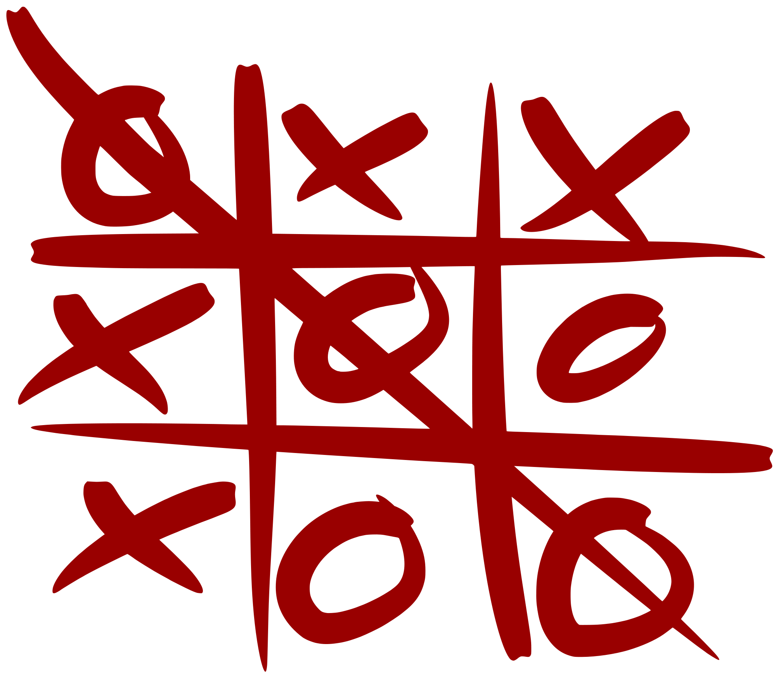
The Game
Tic-tac-toe is a two player game that takes turn marking spaces on a 3 by 3 grid, and the objective of the game is to place three connecting marks in a horizontal, vertical, or diagonal row.

Slide 6
255,168
Although Tic-tac-toe appear simplistic to play, it contains 138 terminal board positions and 255,168 possible ways these terminal board positions is obtained.

Slide 7
The concept
It isn’t as simple as you think…

Slide 8

What I used:
Python
Python is an interpreted, high-level, general-purpose programming language
Tkinter
Tkinter is Python's de-facto standard GUI (Graphical User Interface) package. It is a thin object-oriented layer on top of Tcl/Tk.

Slide 9
Game modes:
1V1
To play against your friend during boring lessons.
Against computer
To play against invincible AI created using the Minimax algorithm.

Slide 10
The whole process briefly
Main window
Storing moves,
Determining the winner
Minimax AI
At first, I had to learn how to create desktop applications with GUI. In order to do that, I’ve spent many hours learing a completely new thing for me, which was called Tkinter.
It was very difficult to find a way to generate buttons and the whole board at first. But then, together with Nurbol, we found out that the game board could be represented as a two-dimensional array.
The second step was to understand how to set Button values to players’ letters and to find an algorithm for checking if player won.
Also, I’ve created the congratulation window and restart buttons.
The most difficult step was to write an AI that would never lose. So, I’ve decided that using Minimax algorithm would be the best way to implement it.

Slide 11
The Minimax
Minimax is a kind of backtracking algorithm that is used in decision making and game theory to find the optimal move for a player, assuming that your opponent also plays optimally. It is widely used in two player turn-based games such as Tic-Tac-Toe, Backgammon, Mancala, Chess, etc. algorithm that is used in decision making and game theory to find the optimal move for a player, assuming that your opponent also plays optimally. It is widely used in two player turn-based games such as Tic-Tac-Toe, Backgammon, Mancala, Chess, etc.

Slide 12
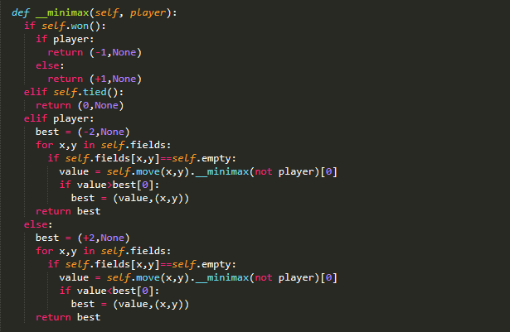
In Minimax the two players are called maximizer and minimizer. The maximizer tries to get the highest score possible while the minimizer tries to do the opposite and get the lowest score possible.
Place your screenshot here

