Slide 1
Simple game about D. Trump.
Created by: Daniil Aleshin
Aidarova Aiperi
Meerlan Tynarbekov

Slide 2

What is Pygame?
Pygame is a third party module designed for creating 2D games with python. It has very simple and intuitive syntax that can allows us to create powerful games quickly. Pygame uses surfaces for drawing. This means whenever we want to draw something to the screen it must be converted to a surface. There are many methods and functions within pygame that can do this easily for us.

Slide 3
Installing Pygame
Installing pygame can be as easy as: 1. Opening your command prompt 2. Typing pip install pygame
Creating a Window
After we import pygame it is a good idea to initialize it, like so:
import pygame pygame.init()

Slide 4
Once we've done that we need to setup a windows that will represent our game.
import pygame pygame.init() win = pygame.display.set_mode((500, 500)) # This line creates a window of 500 width, 500 height

Slide 5
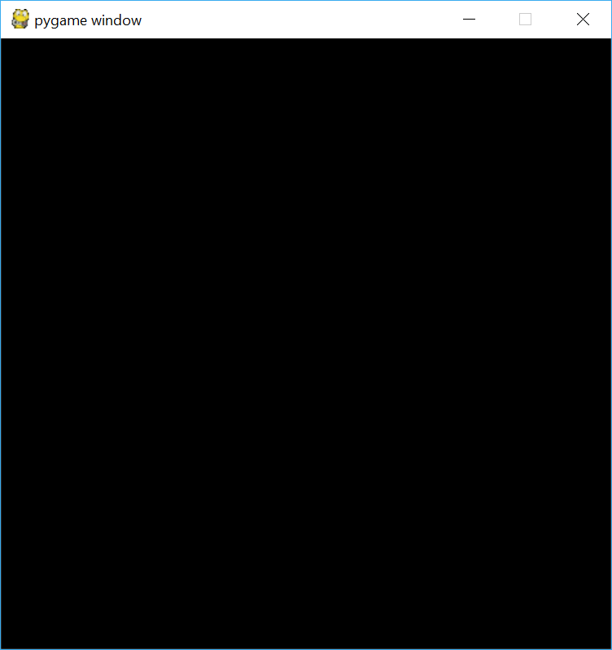
Now when we run the program we get something that looks like this

Slide 6
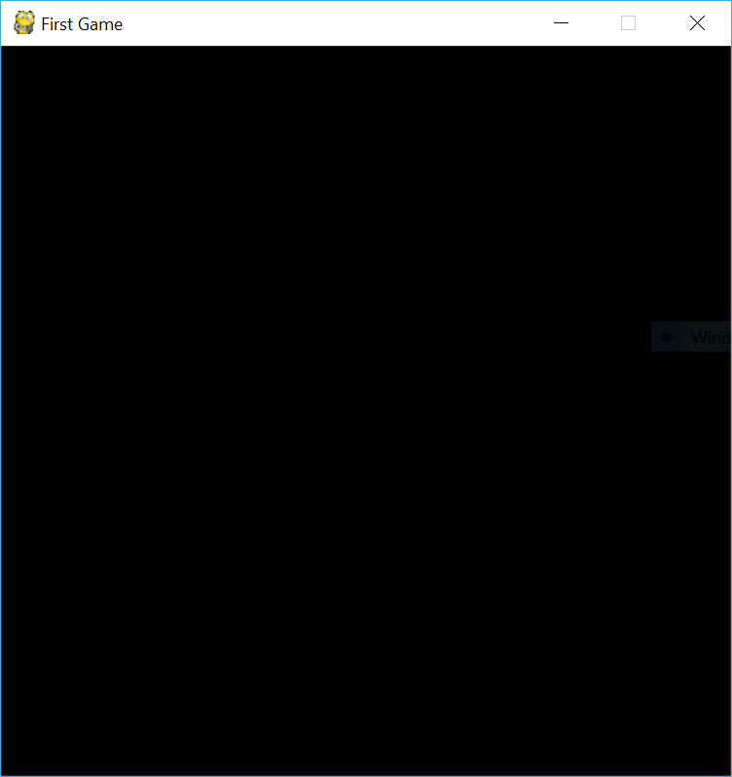
This is great but we'd like to give our game a more creative name than "pygame window". To do this we can type the following.
pygame.display.set_caption("First Game")

Slide 7
Moving a Character
We are going to start by defining a few variables to represent our character.
x = 50 y = 50 width = 40 height = 60 vel = 5

Slide 8
Now we are going to setup our main-loop or game-loop. All games have some sort of loop that executes constantly. This loop is responsible for tasks such as checking for events (such as keyboard events or collision), moving objects, updating the display and eventually ending the game. In our game we will use a while loop.
Inside the loop we will implement a time delay so we can control the speed of the game. We will also start by checking for some specific events.

Slide 9
import pygame pygame.init() win = pygame.display.set_mode((500,500)) pygame.display.set_caption("First Game") x = 50 y = 50 width = 40 height = 60 vel = 5 run = True while run: pygame.time.delay(100) # This will delay the game the given amount of milliseconds. In our casee 0.1 seconds will be the delay for event in pygame.event.get(): # This will loop through a list of any keyboard or mouse events. if event.type == pygame.QUIT: # Checks if the red button in the corner of the window is clicked run = False # Ends the game loop pygame.quit() # If we exit the loop this will execute and close our game

Slide 10
Now we can draw a rectangle to the screen to represent our character. We will draw the rectangle in the main loop so that it is constantly redrawn each time we loop.
import pygame pygame.init() win = pygame.display.set_mode((500,500)) pygame.display.set_caption("First Game") x = 50 y = 50 width = 40 height = 60 vel = 5 run = True while run: pygame.time.delay(100) for event in pygame.event.get(): if event.type == pygame.QUIT: run = False pygame.draw.rect(win, (255,0,0), (x, y, width, height)) #This takes: window/surface, color, rect pygame.display.update() # This updates the screen so we can see our rectangle pygame.quit()

Slide 11
Now we can start checking for events so that we can move our character.
import pygame pygame.init() win = pygame.display.set_mode((500,500)) pygame.display.set_caption("First Game") x = 50 y = 50 width = 40 height = 60 vel = 5 run = True while run: pygame.time.delay(100) for event in pygame.event.get(): if event.type == pygame.QUIT: run = False keys = pygame.key.get_pressed() # This will give us a dictonary where each key has a value of 1 or 0. Where 1 is pressed and 0 is not pressed. if keys[pygame.K_LEFT]: # We can check if a key is pressed like this if keys[pygame.K_RIGHT]: if keys[pygame.K_UP]: if keys[pygame.K_DOWN]: pygame.draw.rect(win, (255,0,0), (x, y, width, height)) pygame.display.update() pygame.quit()

Slide 12
Inside the if statements we will change the value of the variables x and y to move the character. This brings me to the coordinate system. In pygame the top left corner of the screen is (0,0) and the bottom right is (width, height). This means to move up we subtract from the y of our character and to move down we add to the y.
import pygame pygame.init() win = pygame.display.set_mode((500,500)) pygame.display.set_caption("First Game") x = 50 y = 50 width = 40 height = 60 vel = 5 run = True while run: pygame.time.delay(100) for event in pygame.event.get(): if event.type == pygame.QUIT: run = False keys = pygame.key.get_pressed() if keys[pygame.K_LEFT]: x -= vel if keys[pygame.K_RIGHT]: x += vel if keys[pygame.K_UP]: y -= vel if keys[pygame.K_DOWN]: y += vel pygame.draw.rect(win, (255,0,0), (x, y, width, height)) pygame.display.update() pygame.quit()

Slide 13
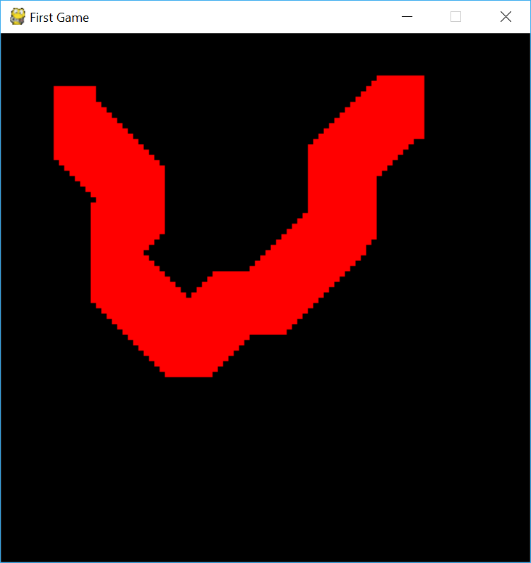
Now when we run the program and start moving our rectangle we can still see all of the previous rectangles.

Slide 14
To fix this we simply have to draw over the previous shape before redrawing another one. We can use window.fill(color) to do this.
import pygame pygame.init() win = pygame.display.set_mode((500,500)) pygame.display.set_caption("First Game") x = 50 y = 50 width = 40 height = 60 vel = 5 run = True while run: pygame.time.delay(100) for event in pygame.event.get(): if event.type == pygame.QUIT: run = False keys = pygame.key.get_pressed() if keys[pygame.K_LEFT]: x -= vel if keys[pygame.K_RIGHT]: x += vel if keys[pygame.K_UP]: y -= vel if keys[pygame.K_DOWN]: y += vel win.fill((0,0,0)) # Fills the screen with black pygame.draw.rect(win, (255,0,0), (x, y, width, height)) pygame.display.update() pygame.quit()
And now we can move our character around!

Slide 15
Setting Boundaries
In the last tutorial we created a rectangle that we could move around the screen using the arrow keys. However, when we reach the end of the screen the rectangle is still allowed to continue to move. To stop this we need to set up some boundaries and check that our rectangle is within them before moving it again.
To do this we can simply check the x and y coordinates of the rectangle against the dimensions of the screen. When we do this we need to remember that when we draw something in pygame we draw from the top left hand corner of the object. This means the top left corner will be our x and y values while the top right corner will be (x + width, y) and the bottom left will be (x, y + height).

Slide 16
import pygame pygame.init() win = pygame.display.set_mode((500,500)) pygame.display.set_caption("First Game") x = 50 y = 50 width = 40 height = 60 vel = 5 run = True while run: pygame.time.delay(100) for event in pygame.event.get(): if event.type == pygame.QUIT: run = False keys = pygame.key.get_pressed() if keys[pygame.K_LEFT] and x > vel: # Making sure the top left position of our character is greater than our vel so we never move off the screen. x -= vel if keys[pygame.K_RIGHT] and x < 500 - vel - width: # Making sure the top right corner of our character is less than the screen width - its width x += vel if keys[pygame.K_UP] and y > vel: # Same principles apply for the y coordinate y -= vel if keys[pygame.K_DOWN] and y < 500 - height - vel: y += vel win.fill((0,0,0)) pygame.draw.rect(win, (255,0,0), (x, y, width, height)) pygame.display.update() pygame.quit()
Now our character can not move off the screen!

Slide 17
Jumping
To jump we need to set up a few variables.
# These go near the top of your program, outside the while loop isJump = False jumpCount = 10
Now we are going to check to see if the user hits the space bar. If they do we will change isJump to True and start jumping.
# Goes inside the while loop, under event for moving down if keys[pygame.K_SPACE]: isJump = True

Slide 18
import pygame pygame.init() win = pygame.display.set_mode((500,500)) pygame.display.set_caption("First Game") x = 50 y = 50 width = 40 height = 60 vel = 5 isJump = False jumpCount = 10 run = True while run: pygame.time.delay(100) for event in pygame.event.get(): if event.type == pygame.QUIT: run = False keys = pygame.key.get_pressed() if keys[pygame.K_LEFT] and x > vel: # Making sure the top left position of our character is greater than our vel so we never move off the screen. x -= vel if keys[pygame.K_RIGHT] and x < 500 - vel - width: # Making sure the top right corner of our character is less than the screen width - its width x += vel if not(isJump): # Checks is user is not jumping if keys[pygame.K_UP] and y > vel: # Same principles apply for the y coordinate y -= vel if keys[pygame.K_DOWN] and y < 500 - height - vel: y += vel if keys[pygame.K_SPACE]: isJump = True else: # This is what will happen if we are jumping win.fill((0,0,0)) pygame.draw.rect(win, (255,0,0), (x, y, width, height)) pygame.display.update() pygame.quit()

Slide 19
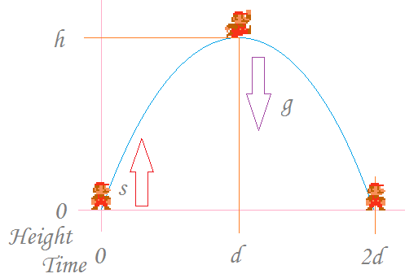
We are now going to start writing the code for making the character jump. We are going to implement a quadratic formula for our jumping. This is because ideally we would like our jump to be smooth and look something like this:
Inside of the else we will paste the following.
if jumpCount >= -10: y -= (jumpCount * abs(jumpCount)) * 0.5 jumpCount -= 1 else: # This will execute if our jump is finished jumpCount = 10 isJump = False # Resetting our Variables
And now our character can jump!

Slide 20
Character Animation
After we've downloaded our images we can start getting ready to anime our character.
The first step is to create a few variables which will be used to determine which way we are facing and keep track of the current image we are showing.
# This goes outside the while loop, near the top of our program left = False right = False walkCount = 0
Now we need to load our images. To load an image in pygame we use pygame.image.load(path). Since we need to load so many images we will be storing some of them in lists for easier accessing later on.
This is the code to load all of our images (I recommend you copy and paste).

Slide 21
# This goes outside the while loop, near the top of the program walkRight = [pygame.image.load('R1.png'), pygame.image.load('R2.png'), pygame.image.load('R3.png'), pygame.image.load('R4.png'), pygame.image.load('R5.png'), pygame.image.load('R6.png'), pygame.image.load('R7.png'), pygame.image.load('R8.png'), pygame.image.load('R9.png')] walkLeft = [pygame.image.load('L1.png'), pygame.image.load('L2.png'), pygame.image.load('L3.png'), pygame.image.load('L4.png'), pygame.image.load('L5.png'), pygame.image.load('L6.png'), pygame.image.load('L7.png'), pygame.image.load('L8.png'), pygame.image.load('L9.png')] bg = pygame.image.load('bg.jpg') char = pygame.image.load('standing.png')
It is often good practice to do all of our drawing from within a function. This means we are going to move our old drawing code that is inside the main loop into a function and make a few modifications.

Slide 22
import pygame pygame.init() win = pygame.display.set_mode((500,500)) pygame.display.set_caption("First Game") walkRight = [pygame.image.load('R1.png'), pygame.image.load('R2.png'), pygame.image.load('R3.png'), pygame.image.load('R4.png'), pygame.image.load('R5.png'), pygame.image.load('R6.png'), pygame.image.load('R7.png'), pygame.image.load('R8.png'), pygame.image.load('R9.png')] walkLeft = [pygame.image.load('L1.png'), pygame.image.load('L2.png'), pygame.image.load('L3.png'), pygame.image.load('L4.png'), pygame.image.load('L5.png'), pygame.image.load('L6.png'), pygame.image.load('L7.png'), pygame.image.load('L8.png'), pygame.image.load('L9.png')] bg = pygame.image.load('bg.jpg') char = pygame.image.load('standing.png') x = 50 y = 50 width = 40 height = 60 vel = 5 isJump = False jumpCount = 10 left = False right = False walkCount = 0 def redrawGameWindow(): global walkCount win.blit(bg, (0,0)) # This will draw our background image at (0,0) pygame.display.update() run = True while run: pygame.time.delay(100) for event in pygame.event.get(): if event.type == pygame.QUIT: run = False keys = pygame.key.get_pressed() if keys[pygame.K_LEFT] and x > vel: x -= vel if keys[pygame.K_RIGHT] and x < 500 - vel - width: x += vel if not(isJump): if keys[pygame.K_SPACE]: isJump = True else: if jumpCount >= -10: y -= (jumpCount * abs(jumpCount)) * 0.5 jumpCount -= 1 else: jumpCount = 10 isJump = False redrawGameWindow() pygame.quit()

Slide 23
Now we are going to set our left and right variables appropriately from inside the main loop.
import pygame pygame.init() win = pygame.display.set_mode((500,500)) pygame.display.set_caption("First Game") walkRight = [pygame.image.load('R1.png'), pygame.image.load('R2.png'), pygame.image.load('R3.png'), pygame.image.load('R4.png'), pygame.image.load('R5.png'), pygame.image.load('R6.png'), pygame.image.load('R7.png'), pygame.image.load('R8.png'), pygame.image.load('R9.png')] walkLeft = [pygame.image.load('L1.png'), pygame.image.load('L2.png'), pygame.image.load('L3.png'), pygame.image.load('L4.png'), pygame.image.load('L5.png'), pygame.image.load('L6.png'), pygame.image.load('L7.png'), pygame.image.load('L8.png'), pygame.image.load('L9.png')] bg = pygame.image.load('bg.jpg') char = pygame.image.load('standing.png') x = 50 y = 50 width = 40 height = 60 vel = 5 isJump = False jumpCount = 10 left = False right = False walkCount = 0 def redrawGameWindow(): global walkCount win.blit(bg, (0,0)) # This will draw our background image at (0,0) pygame.display.update() run = True while run: pygame.time.delay(100) for event in pygame.event.get(): if event.type == pygame.QUIT: run = False keys = pygame.key.get_pressed() if keys[pygame.K_LEFT] and x > vel: x -= vel left = True right = False elif keys[pygame.K_RIGHT] and x < 500 - vel - width: x += vel left = False right = True else: # If the character is not moving we will set both left and right false and reset the animation counter (walkCount) left = False right = False walkCount = 0 if not(isJump): if keys[pygame.K_SPACE]: isJump = True right = False left = False walkCount = 0 else: if jumpCount >= -10: y -= (jumpCount * abs(jumpCount)) * 0.5 jumpCount -= 1 else: jumpCount = 10 isJump = False redrawGameWindow() pygame.quit()

Slide 24
And finally we can start working on drawing our character to the screen.def redrawGameWindow(): # We have 9 images for our walking animation, I want to show the same image for 3 frames # so I use the number 27 as an upper bound for walkCount because 27 / 3 = 9. 9 images shown # 3 times each animation. global walkCount win.blit(bg, (0,0)) if walkCount + 1 >= 27: walkCount = 0 if left: # If we are facing left win.blit(walkLeft[walkCount//3], (x,y)) # We integer divide walkCounr by 3 to ensure each walkCount += 1 # image is shown 3 times every animation elif right: win.blit(walkRight[walkCount//3], (x,y)) walkCount += 1 else: win.blit(char, (x, y)) # If the character is standing still pygame.display.update()

Slide 25
The last thing we need to do is change our framerate.
To do this we are going to create a clock object using clock = pygame.time.Clock() outside of our main loop and write clock.tick(27) inside our main loop.
You may notice when running the program that the background does not cover the entire screen, to fix this simply change there screen height to 480.
pygame.display.set_mode((500, 480))

Slide 26
Optimized Code
This is what our optimized code looks like.
import pygame pygame.init() win = pygame.display.set_mode((500,480)) pygame.display.set_caption("First Game") walkRight = [pygame.image.load('R1.png'), pygame.image.load('R2.png'), pygame.image.load('R3.png'), pygame.image.load('R4.png'), pygame.image.load('R5.png'), pygame.image.load('R6.png'), pygame.image.load('R7.png'), pygame.image.load('R8.png'), pygame.image.load('R9.png')] walkLeft = [pygame.image.load('L1.png'), pygame.image.load('L2.png'), pygame.image.load('L3.png'), pygame.image.load('L4.png'), pygame.image.load('L5.png'), pygame.image.load('L6.png'), pygame.image.load('L7.png'), pygame.image.load('L8.png'), pygame.image.load('L9.png')] bg = pygame.image.load('bg.jpg') char = pygame.image.load('standing.png') clock = pygame.time.Clock() class player(object): def __init__(self,x,y,width,height): self.x = x self.y = y self.width = width self.height = height self.vel = 5 self.isJump = False self.left = False self.right = False self.walkCount = 0 self.jumpCount = 10 def draw(self, win): if self.walkCount + 1 >= 27: self.walkCount = 0 if self.left: win.blit(walkLeft[self.walkCount//3], (self.x,self.y)) self.walkCount += 1 elif self.right: win.blit(walkRight[self.walkCount//3], (self.x,self.y)) self.walkCount +=1 else: win.blit(char, (self.x,self.y)) def redrawGameWindow(): win.blit(bg, (0,0)) man.draw(win) pygame.display.update() #mainloop man = player(200, 410, 64,64) run = True while run: clock.tick(27) for event in pygame.event.get(): if event.type == pygame.QUIT: run = False keys = pygame.key.get_pressed() if keys[pygame.K_LEFT] and man.x > man.vel: man.x -= man.vel man.left = True man.right = False elif keys[pygame.K_RIGHT] and man.x < 500 - man.width - man.vel: man.x += man.vel man.right = True man.left = False else: man.right = False man.left = False man.walkCount = 0 if not(man.isJump): if keys[pygame.K_SPACE]: man.isJump = True man.right = False man.left = False man.walkCount = 0 else: if man.jumpCount >= -10: neg = 1 if man.jumpCount < 0: neg = -1 man.y -= (man.jumpCount ** 2) * 0.5 * neg man.jumpCount -= 1 else: man.isJump = False man.jumpCount = 10 redrawGameWindow() pygame.quit()
Essentially all we have done here is implement a player class that contains all of the variables we used in the previous tutorials as attributes. It also performs the animation and drawing of the character from within the class.

Slide 27
Projectile Class
The first thing we are going to do is create a projectile class.
class projectile(object): def __init__(self,x,y,radius,color,facing): self.x = x self.y = y self.radius = radius self.color = color self.facing = facing self.vel = 8 * facing def draw(self,win): pygame.draw.circle(win, self.color, (self.x,self.y), self.radius)

Slide 28
Modifying the Player Class
Because we are going to be shooting bullets left or right we need to ensure our character is always facing left or right. This required modifying the player.draw method and adding another attribute of standing to our player.
class player(object): def __init__(self,x,y,width,height): self.x = x self.y = y self.width = width self.height = height self.vel = 5 self.isJump = False self.left = False self.right = False self.walkCount = 0 self.jumpCount = 10 self.standing = True def draw(self, win): if self.walkCount + 1 >= 27: self.walkCount = 0 if not(self.standing): if self.left: win.blit(walkLeft[self.walkCount//3], (self.x,self.y)) self.walkCount += 1 elif self.right: win.blit(walkRight[self.walkCount//3], (self.x,self.y)) self.walkCount +=1 else: if self.right: win.blit(walkRight[0], (self.x, self.y)) else: win.blit(walkLeft[0], (self.x, self.y))

Slide 29
Modifying the Main Loop
We also need to modify our main loop to ensure our character is always facing left or right.
man = player(200, 410, 64,64) run = True while run: clock.tick(27) for event in pygame.event.get(): if event.type == pygame.QUIT: run = False keys = pygame.key.get_pressed() if keys[pygame.K_LEFT] and man.x > man.vel: man.x -= man.vel man.left = True man.right = False man.standing = False # NEW elif keys[pygame.K_RIGHT] and man.x < 500 - man.width - man.vel: man.x += man.vel man.right = True man.left = False man.standing = False # NEW else: main.standing = True # NEW (removed two lines) man.walkCount = 0 if not(man.isJump): if keys[pygame.K_UP]: man.isJump = True man.right = False man.left = False man.walkCount = 0 else: if man.jumpCount >= -10: neg = 1 if man.jumpCount < 0: neg = -1 man.y -= (man.jumpCount ** 2) * 0.5 * neg man.jumpCount -= 1 else: man.isJump = False man.jumpCount = 10 redrawGameWindow()

Slide 30
Setting up The Projectiles
The first step is to create a list which will store all of our bullet objects.
bullets = [] # This goes right above the while loop
Now we are going to add a for loop into our main loop that will move our bullets and remove them if they have left the screen.
# Goes inside the while loop for bullet in bullets: if bullet.x < 500 and bullet.x > 0: bullet.x += bullet.vel # Moves the bullet by its vel else: bullets.pop(bullets.index(bullet)) # This will remove the bullet if it is off the screen

Slide 31
Shooting the Bullet
We are first going to change our jump key to be the up arrow (just change pygame.K_SPACE to pygame.K_UP). Then we are going to create a new if statement that will check if the space bar is clicked. If it is we will create a new bullet, give it a velocity and start moving it.
# Goes inside the while loop, under keys = ... if keys[pygame.K_SPACE]: if man.left: facing = -1 else: facing = 1 if len(bullets) < 5: # This will make sure we cannot exceed 5 bullets on the screen at once bullets.append(projectile(round(man.x+man.width//2), round(man.y + man.height//2), 6, (0,0,0), facing)) # This will create a bullet starting at the middle of the character
And the last thing to do is to draw our bullets inside redrawGameWindow().
def redrawGameWindow(): win.blit(bg, (0,0)) man.draw(win) for bullet in bullets: bullet.draw(win) pygame.display.update()
Now we can fire bullets!

Slide 32
Loading Images
The following lists will be used a class variables to store our images for the enemy. We will place these lists inside of a class that we create in the next step.
walkRight = [pygame.image.load('R1E.png'), pygame.image.load('R2E.png'), pygame.image.load('R3E.png'), pygame.image.load('R4E.png'), pygame.image.load('R5E.png'), pygame.image.load('R6E.png'), pygame.image.load('R7E.png'), pygame.image.load('R8E.png'), pygame.image.load('R9E.png'), pygame.image.load('R10E.png'), pygame.image.load('R11E.png')] walkLeft = [pygame.image.load('L1E.png'), pygame.image.load('L2E.png'), pygame.image.load('L3E.png'), pygame.image.load('L4E.png'), pygame.image.load('L5E.png'), pygame.image.load('L6E.png'), pygame.image.load('L7E.png'), pygame.image.load('L8E.png'), pygame.image.load('L9E.png'), pygame.image.load('L10E.png'), pygame.image.load('L11E.png')]

Slide 33
Enemy Class
Like we've done in the previous tutorials we will use a class to create our enemy. We will start by pasting the code from above into our class. Then we will create the __init__ method and set up some basic attributes for our enemy.
class enemy(object): walkRight = [pygame.image.load('R1E.png'), pygame.image.load('R2E.png'), pygame.image.load('R3E.png'), pygame.image.load('R4E.png'), pygame.image.load('R5E.png'), pygame.image.load('R6E.png'), pygame.image.load('R7E.png'), pygame.image.load('R8E.png'), pygame.image.load('R9E.png'), pygame.image.load('R10E.png'), pygame.image.load('R11E.png')] walkLeft = [pygame.image.load('L1E.png'), pygame.image.load('L2E.png'), pygame.image.load('L3E.png'), pygame.image.load('L4E.png'), pygame.image.load('L5E.png'), pygame.image.load('L6E.png'), pygame.image.load('L7E.png'), pygame.image.load('L8E.png'), pygame.image.load('L9E.png'), pygame.image.load('L10E.png'), pygame.image.load('L11E.png')] def __init__(self, x, y, width, height, end): self.x = x self.y = y self.width = width self.height = height self.path = [x, end] # This will define where our enemy starts and finishes their path. self.walkCount = 0 self.vel = 3

Slide 34
The next method we will add will be the draw() method. This will work similarly to our player classes draw method as we will also be doing animation in here.
# Goes inside the enemy class def draw(self, win): self.move() if self.walkCount + 1 >= 33: # Since we have 11 images for each animtion our upper bound is 33. # We will show each image for 3 frames. 3 x 11 = 33. self.walkCount = 0 if self.vel > 0: # If we are moving to the right we will display our walkRight images win.blit(self.walkRight[self.walkCount//3], (self.x,self.y)) self.walkCount += 1 else: # Otherwise we will display the walkLeft images win.blit(self.walkLeft[self.walkCount//3], (self.x,self.y)) self.walkCount += 1

Slide 35
The next method we add will be the move() method. This will move our enemy every frame. Since we want our enemy to be moving along a path we must figure out how much to move the enemy by and in what direction. We call this move method from our draw class as every time we draw the enemy we want to move first move it to a new position.
# Goes inside the enemy class def move(self): if self.vel > 0: # If we are moving right if self.x < self.path[1] + self.vel: # If we have not reached the furthest right point on our path. self.x += self.vel else: # Change direction and move back the other way self.vel = self.vel * -1 self.x += self.vel self.walkCount = 0 else: # If we are moving left if self.x > self.path[0] - self.vel: # If we have not reached the furthest left point on our path self.x += self.vel else: # Change direction self.vel = self.vel * -1 self.x += self.vel self.walkCount = 0

Slide 36
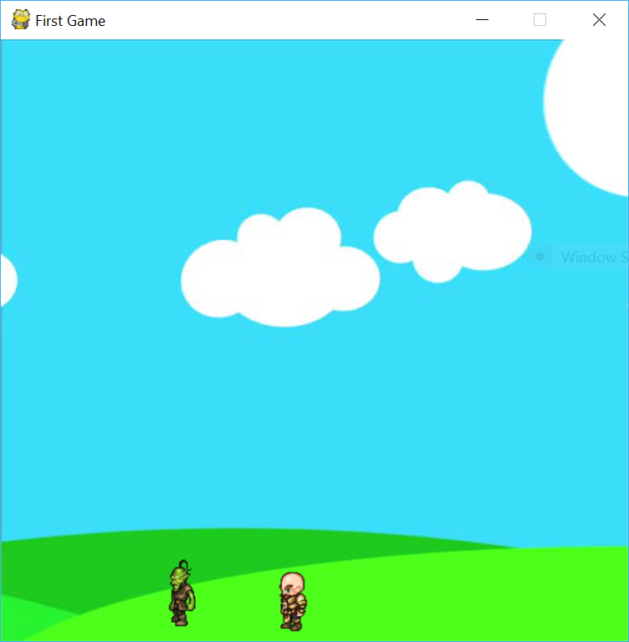
Creating an Enemy
Now that we've created an enemy class we need to create an instance of that class. We will do this the same way we created an instance of our player class (man). Just outside and above our main loop.
goblin = enemy(100, 410, 64, 64, 300)
Now that we've created an instance we need to draw our goblin on the window. We will place the following code inside or redrawGameWindow function.
goblin.draw()
And now our goblin should be appearing on the screen and walking around!

Slide 37
Hit Boxes
The term "hit box" is often used to represent the box around an object which represents its "hittable space". Since we often use complex objects and shapes to depict characters or other items in a game we create a hit box for all of these items. This makes it much easier to check for collision as collision between non-rectangular shapes is extremely complicated. We attempt to make these boxes fit the characters shape as precisely as possible but it is difficult to make them perfect.
We will start by creating hit boxes for all of our objects. Then we check if these boxes collide with one another using some basic math.
The first hit box we define will be for our player class.
# This goes inside the player class in the __init__ method self.hitbox = (self.x + 20, self.y, 28, 60) # The elements in the hitbox are (top left x, top left y, width, height)
Since our player moves we will have to constantly redefine the hit box from within the draw method of our player class. To do this we will simply copy the line from above into the draw method.

Slide 38
Our player class should now look like the following.
class player(object): def __init__(self,x,y,width,height): self.x = x self.y = y self.width = width self.height = height self.vel = 5 self.isJump = False self.left = False self.right = False self.walkCount = 0 self.jumpCount = 10 self.standing = True self.hitbox = (self.x + 17, self.y + 11, 29, 52) # NEW def draw(self, win): if self.walkCount + 1 >= 27: self.walkCount = 0 if not(self.standing): if self.left: win.blit(walkLeft[self.walkCount//3], (self.x,self.y)) self.walkCount += 1 elif self.right: win.blit(walkRight[self.walkCount//3], (self.x,self.y)) self.walkCount +=1 else: if self.right: win.blit(walkRight[0], (self.x, self.y)) else: win.blit(walkLeft[0], (self.x, self.y)) self.hitbox = (self.x + 17, self.y + 11, 29, 52) # NEW pygame.draw.rect(win, (255,0,0), self.hitbox,2) # To draw the hit box around the player

Slide 39
We will repeat this process in the enemy class. And after adding in the hit box we will also define a new method called hit.
class enemy(object): walkRight = [pygame.image.load('R1E.png'), pygame.image.load('R2E.png'), pygame.image.load('R3E.png'), pygame.image.load('R4E.png'), pygame.image.load('R5E.png'), pygame.image.load('R6E.png'), pygame.image.load('R7E.png'), pygame.image.load('R8E.png'), pygame.image.load('R9E.png'), pygame.image.load('R10E.png'), pygame.image.load('R11E.png')] walkLeft = [pygame.image.load('L1E.png'), pygame.image.load('L2E.png'), pygame.image.load('L3E.png'), pygame.image.load('L4E.png'), pygame.image.load('L5E.png'), pygame.image.load('L6E.png'), pygame.image.load('L7E.png'), pygame.image.load('L8E.png'), pygame.image.load('L9E.png'), pygame.image.load('L10E.png'), pygame.image.load('L11E.png')] def __init__(self, x, y, width, height, end): self.x = x self.y = y self.width = width self.height = height self.end = end self.path = [self.x, self.end] self.walkCount = 0 self.vel = 3 self.hitbox = (self.x + 17, self.y + 2, 31, 57) # NEW def draw(self,win): self.move() if self.walkCount + 1 >= 33: self.walkCount = 0 if self.vel > 0: win.blit(self.walkRight[self.walkCount //3], (self.x, self.y)) self.walkCount += 1 else: win.blit(self.walkLeft[self.walkCount //3], (self.x, self.y)) self.walkCount += 1 self.hitbox = (self.x + 17, self.y + 2, 31, 57) # NEW pygame.draw.rect(win, (255,0,0), self.hitbox,2) # Draws the hit box around the enemy def move(self): if self.vel > 0: if self.x + self.vel < self.path[1]: self.x += self.vel else: self.vel = self.vel * -1 self.walkCount = 0 else: if self.x - self.vel > self.path[0]: self.x += self.vel else: self.vel = self.vel * -1 self.walkCount = 0 # NEW METHOD def hit(self): # This will display when the enemy is hit print('hit')

Slide 40
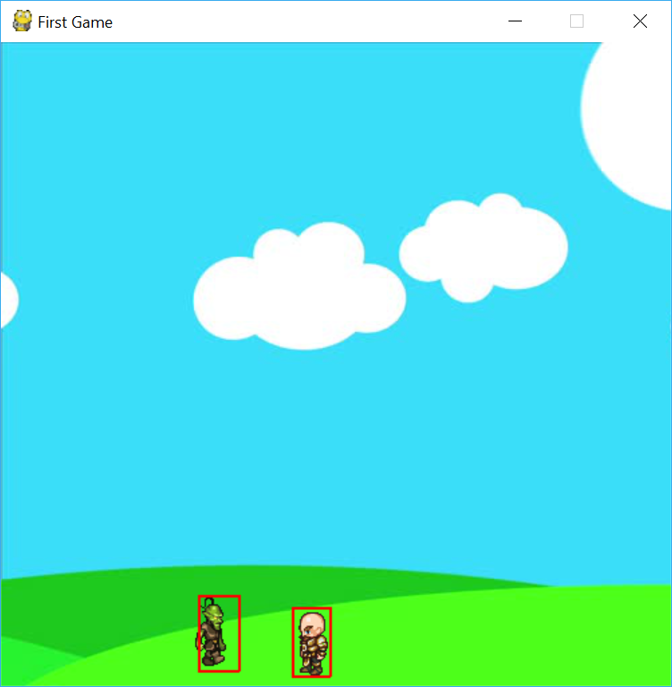
If we run the program we can see the hit boxes for our character.

Slide 41
Collision
The fist collision we will check for is between the bullets and the enemy. Every time we move a bullet we will check if it has collided with the enemy. Since we already have a for loop setup to check if the bullets leave the screen we will do our collision check in there.
We are going to say these objects have collided if the x and y coordinate of the bullet sit inside the hit box of the enemy. We check this with the following code.
if bullet.y - bullet.radius < goblin.hitbox[1] + goblin.hitbox[3] and bullet.y + bullet.radius > goblin.hitbox[1]: # Checks x coords if bullet.x + bullet.radius > goblin.hitbox[0] and bullet.x - bullet.radius < goblin.hitbox[0] + goblin.hitbox[2]: # Checks y coords goblin.hit() # calls enemy hit method bullets.pop(bullets.index(bullet)) # removes bullet from bullet list

Slide 42
Bullet Glitch
There is a small glitch you may have noticed which causes our bullets to stick together or shoot multiple at the same time. To fix this we must do the following.
First we are going to create a variable called shootLoop outside of our main loop.
shootLoop = 0
After that we will place the following code at the top of our while loop.
if shootLoop > 0: shootLoop += 1 if shootLoop > 3: shootLoop = 0
Then we will modify our space bar event check the following way.
if keys[pygame.K_SPACE] and shootLoop == 0: ... # Add the "and shootLoop == 0"

Slide 43
Score
For simplicity we are simply going to be increasing the score each time a bullet hits our goblin/enemy.
We are going to start by creating a variable at the top of our program called score.
score = 0
Next we are going to increment the score from our main loop where we check if the goblin is hit.
# This code exists inside the main loop for bullet in bullets: if bullet.y - bullet.radius < goblin.hitbox[1] + goblin.hitbox[3] and bullet.y + bullet.radius > goblin.hitbox[1]: if bullet.x + bullet.radius > goblin.hitbox[0] and bullet.x - bullet.radius < goblin.hitbox[0] + goblin.hitbox[2]: goblin.hit() score += 1 # NEW CODE bullets.pop(bullets.index(bullet))
We would like to display this score to the screen. To do this we must first create a font object.
font = pygame.font.SysFont("comicsans", 30, True) # The first argument is the font, next is size # and then True to make our font bold
After we create our font we need to render some text and blit it to the screen.
# This should go inside the redrawGameWindow function text = font.render("Score: " + str(score), 1, (0,0,0)) # Arguments are: text, anti-aliasing, color win.blit(text, (390, 10))

Slide 44
Health Bar
What we are going to do now is give our enemy health and a health bar. This way we can see when we should remove it from the screen. To create the health bar we are going to draw two rectangles. One green and one red. We will change the width of the green rectangle (which will overlay the red one) each time the enemy is hit.
To do this we must modify the enemy class like so.
class enemy(object): walkRight = [pygame.image.load('R1E.png'), pygame.image.load('R2E.png'), pygame.image.load('R3E.png'), pygame.image.load('R4E.png'), pygame.image.load('R5E.png'), pygame.image.load('R6E.png'), pygame.image.load('R7E.png'), pygame.image.load('R8E.png'), pygame.image.load('R9E.png'), pygame.image.load('R10E.png'), pygame.image.load('R11E.png')] walkLeft = [pygame.image.load('L1E.png'), pygame.image.load('L2E.png'), pygame.image.load('L3E.png'), pygame.image.load('L4E.png'), pygame.image.load('L5E.png'), pygame.image.load('L6E.png'), pygame.image.load('L7E.png'), pygame.image.load('L8E.png'), pygame.image.load('L9E.png'), pygame.image.load('L10E.png'), pygame.image.load('L11E.png')] def __init__(self, x, y, width, height, end): self.x = x self.y = y self.width = width self.height = height self.end = end self.path = [self.x, self.end] self.walkCount = 0 self.vel = 3 self.hitbox = (self.x + 17, self.y + 2, 31, 57) self.health = 10 # NEW self.visible = True # NEW def draw(self,win): self.move() if self.visible: # NEW if self.walkCount + 1 >= 33: self.walkCount = 0 if self.vel > 0: win.blit(self.walkRight[self.walkCount //3], (self.x, self.y)) self.walkCount += 1 else: win.blit(self.walkLeft[self.walkCount //3], (self.x, self.y)) self.walkCount += 1 pygame.draw.rect(win, (255,0,0), (self.hitbox[0], self.hitbox[1] - 20, 50, 10)) # NEW pygame.draw.rect(win, (0,128,0), (self.hitbox[0], self.hitbox[1] - 20, 50 - (5 * (10 - self.health)), 10)) # NEW self.hitbox = (self.x + 17, self.y + 2, 31, 57) #pygame.draw.rect(win, (255,0,0), self.hitbox,2) def move(self): if self.vel > 0: if self.x + self.vel < self.path[1]: self.x += self.vel else: self.vel = self.vel * -1 self.walkCount = 0 else: if self.x - self.vel > self.path[0]: self.x += self.vel else: self.vel = self.vel * -1 self.walkCount = 0 def hit(self): # ALL NEW if self.health > 0: self.health -= 1 else: self.visible = False print('hit')

Slide 45
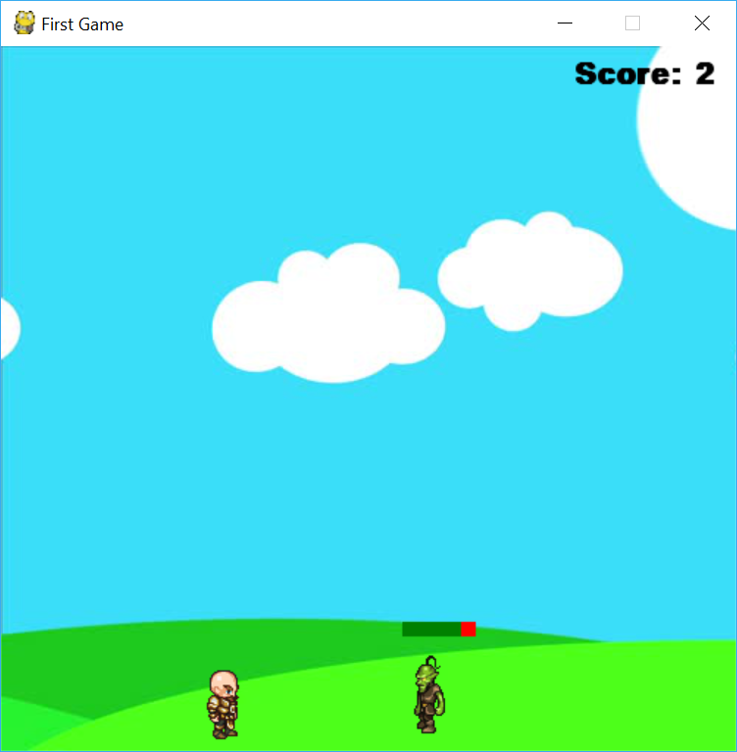
Now we have a health bar that will move down as our goblin is hit.

Slide 46
Loading Sounds & Music
Before we can start using our sounds and music we need to load them.
# This should be placed at the top of our program bulletSound = pygame.mixer.Sound("bullet.wav") hitSound = pygame.mixer.Sound("hit.wav") music = pygame.mixer.music.load("music.mp3")
Playing Music
To have our music play continuously we do the following directly after defining our variable music.
pygame.mixer.music.play(-1) # -1 will ensure the song keeps looping
Playing Sounds
To play a sound we type:
bulletSound.play()
Since we want sounds to play whenever we shoot a bullet or the goblin is hit we will add code in the appropriate places.
Inside the enemy hit method we will play the hit sound.
def hit(): # inside enemy class hitSound.play() ...
Then when we hit the space bar we will play the bullet sound.
# This is inside the main loop if keys[pygame.K_SPACE] and shootLoop == 0: bulletSound.play() ...

Slide 47
Character-Enemy Collision
Now we check for collision between the character and any enemies.
The first thing we will do is add a method "hit" to our player class.
def hit(self): self.x = 60 # We are resetting the player position self.y = 410 self.walkCount = 0 font1 = pygame.font.SysFont('comicsans', 100) text = font1.render('-5', 1, (255,0,0)) win.blit(text, (250 - (text.get_width()/2),200)) pygame.display.update() i = 0 while i < 300: pygame.time.delay(10) i += 1 for event in pygame.event.get(): if event.type == pygame.QUIT: i = 301 pygame.quit() # After we are hit we are going to display a message to the screen for # a certain period of time

Slide 48
Now time to actually check for collision. Since we've already done collision between our bullets and enemy this step will be very similar. We can actually reuse our code from before with a few minor changes.
if man.hitbox[1] < goblin.hitbox[1] + goblin.hitbox[3] and man.hitbox[1] + man.hitbox[3] > goblin.hitbox[1]: if man.hitbox[0] + man.hitbox[2] > goblin.hitbox[0] and man.hitbox[0] < goblin.hitbox[0] + goblin.hitbox[2]: man.hit() score -= 5 # This will go at the top of or main loop.

Slide 49
Project management
15.12.2021-20.12.2021 | 21.12.2021-23.26.2021 | 27.12.2021-30.12.2021
Research and creating an idea(All members) | Coding part(Meerlan mostly, Daniil-assistant, Aiperi-designer) | Presentation part(Presentation created by Daniil, presented by Aiperi)

Slide 50
Thank you for attention

