Slide 1
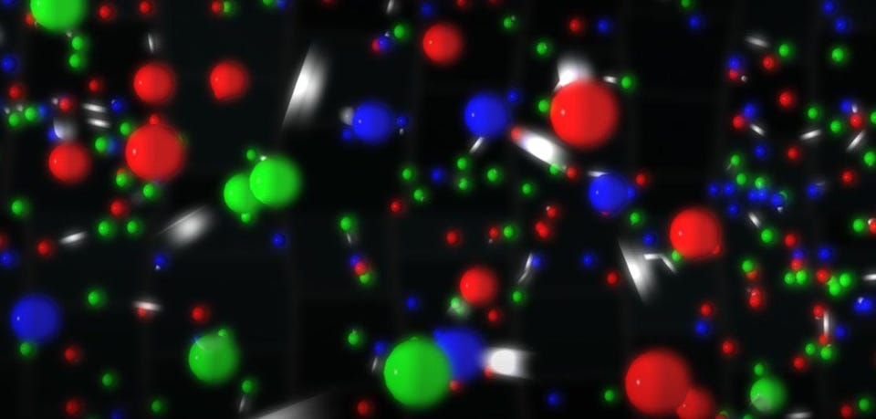
Molecular dynamics with OpenMP
Selikhanovych Daniil

Slide 2
Project purposes
1. To model evolution for a crystal like a system of particles in box with periodic boundary conditions.
2. To find stationary state of this system if exists: limit kinetic and potential energies.
3. To speed up the code using parallel computing and see improvement in performance.
4. To develop open code and results:
https://github.com/Daniil-Selikhanovych/HPC/tree/main/project

Slide 3
Plan
1. Crystal model:
1. Lennard-Jones potential
2. Periodic boundary box
3. Thermostat balance
2. How and what can we compute in parallel for speed up
1. Updating forces and accelerations
2. Updating speeds
3. Updating coordinates
3. Experiment parameters and results

Slide 4
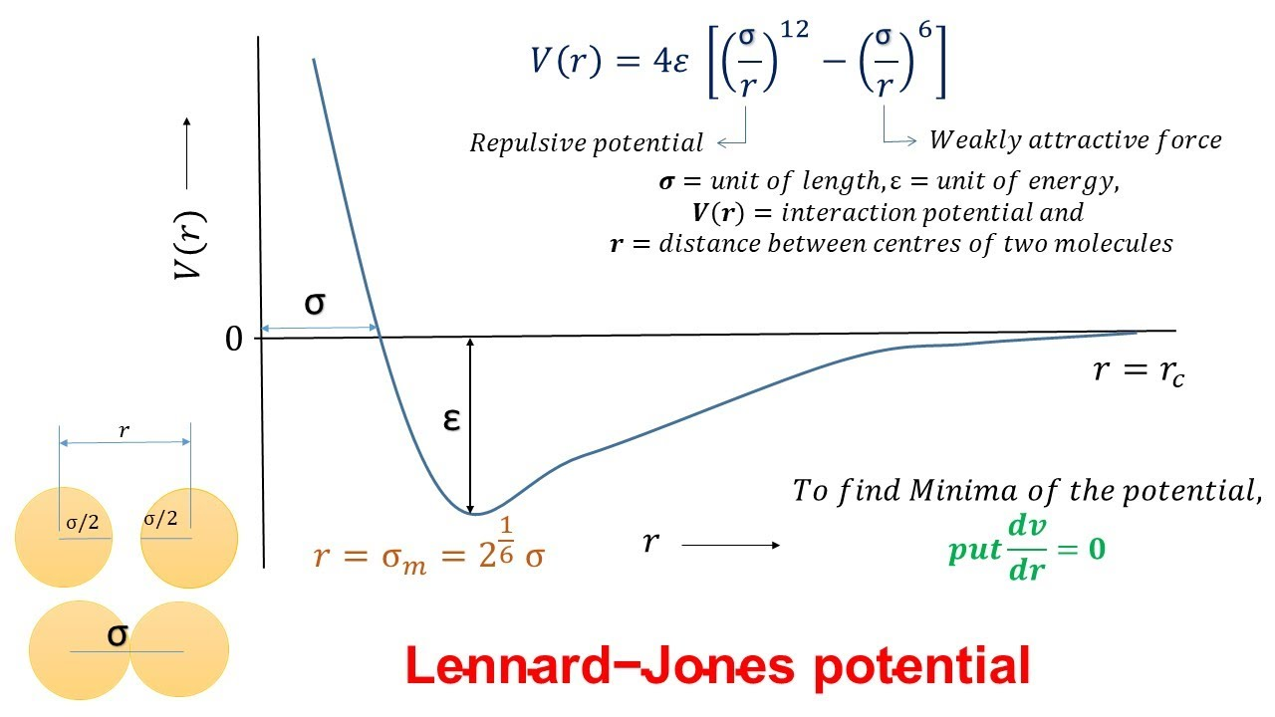
Crystal model

