Slide 1

Pandas

Slide 2

pandas
pandas is a fast, powerful, flexible and easy to use open source data analysis and manipulation tool, built on top of the Python programming language.

Slide 3

dask
Dask is a flexible library for parallel computing in Python.
Dask is composed of two parts:
Dynamic task scheduling optimized for computation. This is similar to Airflow, Luigi, Celery, or Make, but optimized for interactive computational workloads.
“Big Data” collections like parallel arrays, dataframes, and lists that extend common interfaces like NumPy, Pandas, or Python iterators to larger-than-memory or distributed environments. These parallel collections run on top of dynamic task schedulers.
Dask emphasizes the following virtues:
Familiar: Provides parallelized NumPy array and Pandas DataFrame objects
Flexible: Provides a task scheduling interface for more custom workloads and integration with other projects.
Native: Enables distributed computing in pure Python with access to the PyData stack.
Fast: Operates with low overhead, low latency, and minimal serialization necessary for fast numerical algorithms
Scales up: Runs resiliently on clusters with 1000s of cores
Scales down: Trivial to set up and run on a laptop in a single process
Responsive: Designed with interactive computing in mind, it provides rapid feedback and diagnostics to aid humans

Slide 4

Polars
Polars is a lightning fast DataFrame library/in-memory query engine. Its embarrassingly parallel execution, cache efficient algorithms and expressive API makes it perfect for efficient data wrangling, data pipelines, snappy APIs and so much more.

Slide 5

Modin
Modin uses Ray, Dask or Unidist to provide an effortless way to speed up your pandas notebooks, scripts, and libraries. Unlike other distributed DataFrame libraries, Modin provides seamless integration and compatibility with existing pandas code.

Slide 6
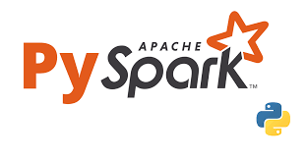
PySpark
PySpark is an interface for Apache Spark in Python. It not only allows you to write Spark applications using Python APIs, but also provides the PySpark shell for interactively analyzing your data in a distributed environment. PySpark supports most of Spark’s features such as Spark SQL, DataFrame, Streaming, MLlib (Machine Learning) and Spark Core.

Slide 7
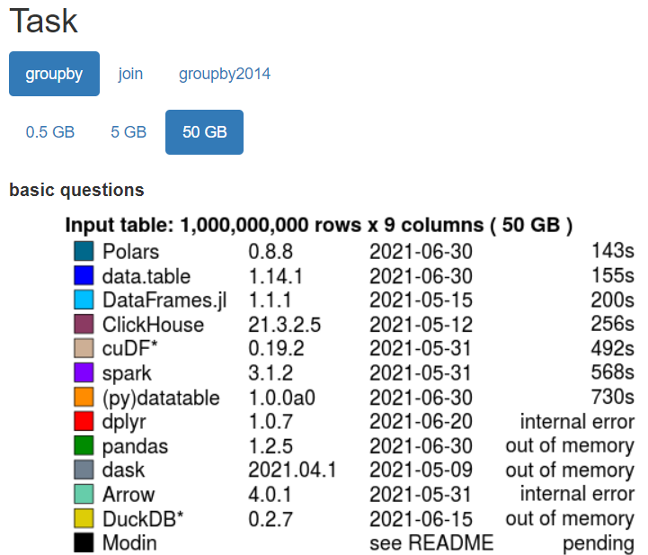
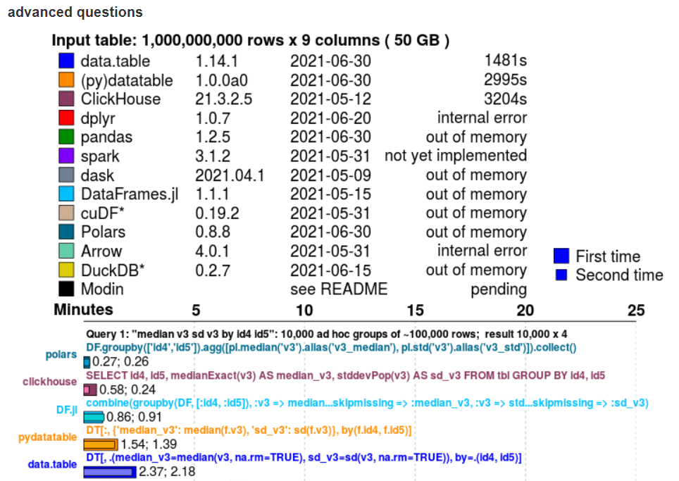
Benchmark

