Slide 1
CSCI 5922 Neural Networks and Deep Learning: Convolutional Nets For Image And Speech Processing
Mike Mozer
Department of Computer Science and Institute of Cognitive Science University of Colorado at Boulder
Notes:
position
audience

Slide 2
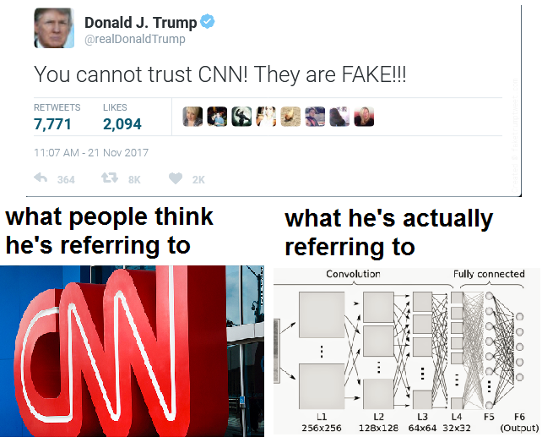

Slide 3
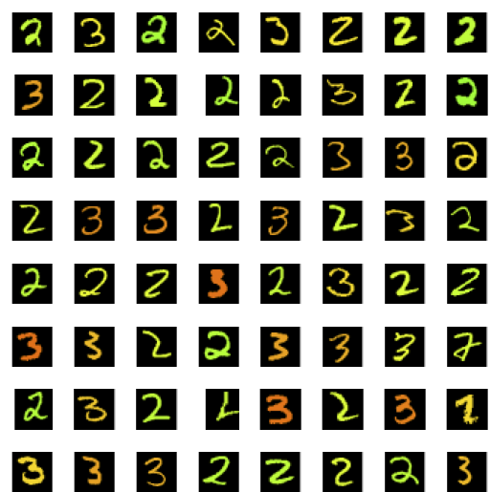
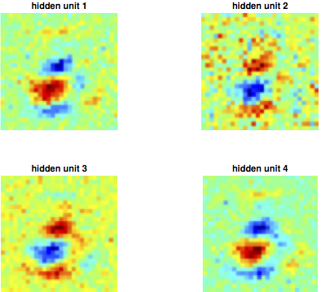
Recognizing Handprinted Digits: 2 Vs. 3
s
Notes:
how many hidden units are needed?

Slide 4
Recognizing An Image
Input is 5x5 pixel array
Simple back propagation net
output
hidden

Slide 5
Recognizing An Object With Unknown Location
Object can appear either in the left image or in the right image
Output indicates presence of object regardless of position
What do we know about the weights?
output
hidden
hidden

Slide 6
Generalizing To Many Locations
Each possible location the object can appear in has its own set of hidden units
Each set detects the same features except in a different location
Locations can overlap
output
hidden
hidden
hidden

Slide 7
Convolutional Neural Net
Each patch of the image is processed by a different set of hidden units
But mapping from patch to hidden is the same everywhere
Achieves translation invariant recognition
Can be convolutional in 2D as well as 1D
output
hidden
hidden
hidden

Slide 8
The Input Layer
Input layer typically represents pixels present
at a given (x,y) location
of a particular color (R, G, B)
3D lattice
height X width X # channels

Slide 9
The Hidden Layer
Each hidden unit (i) is replicated across (x,y) positions of every patch
Instead of drawing pools of hidden, draw one (x,y) map for each hidden unit type (i)
Hidden unit i at (x,y) gets input from a cube of activity from its corresponding input patch
Each hidden unit in a map has the same incoming weights
output
hidden
hidden
hidden

Slide 10
Jargon
Each hidden unit channel
also called map, feature, feature type, dimension
Weights for each channel
also called kernels
Input patch to a hidden unit at (x,y)
also called receptive field

Slide 11
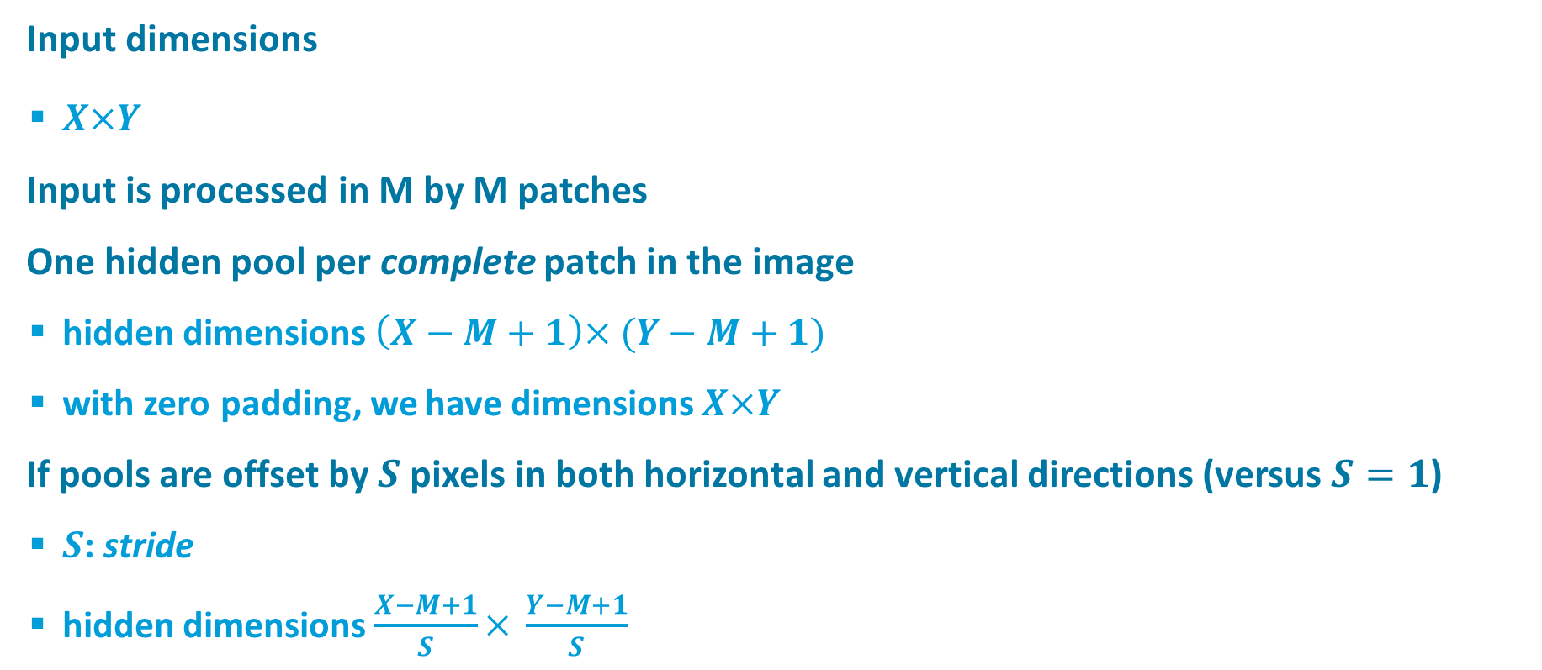
Convolution
Input dimensions
$X×Y$
Input is processed in M by M patches
One hidden pool per complete patch in the image
hidden dimensions $\left(X−M+1\right)× (Y−M+1)$
with zero padding, we have dimensions $X×Y$
If pools are offset by $S$ pixels in both horizontal and vertical directions (versus $S=1$)
$S$: stride
hidden dimensions $\frac{X−M+1}{S}× \frac{Y−M+1}{S}$

Slide 12
Pooling
If all the hidden units are detecting the same features, and we simply want to determine whether the object appeared in any location, we can combine hidden representations
Sum pooling vs. max pooling
output
sum of hidden
hidden
hidden
hidden

Slide 13
Transformation types
Each layer in a convolutional net has a 3D lattice structure
width X height X feature type
Three types of transformations between layers
convolution
activation function (nonlinearity)
sum or max pooling
Full blown convolutional net performs these transformations repeatedly -> Deep net
higher-order feature detectors after convolution
lower spatial resolution after pooling

Slide 14
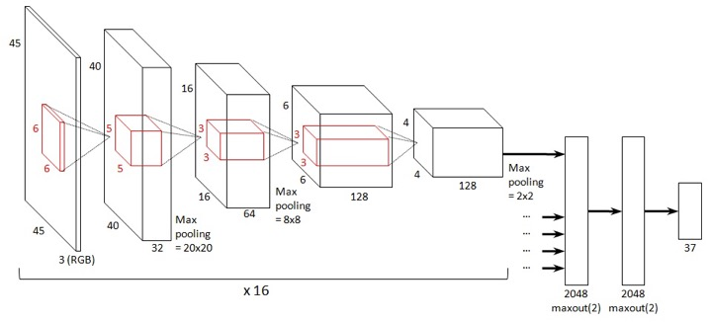
Putting It All Together
source: benanne.github.io

Slide 15
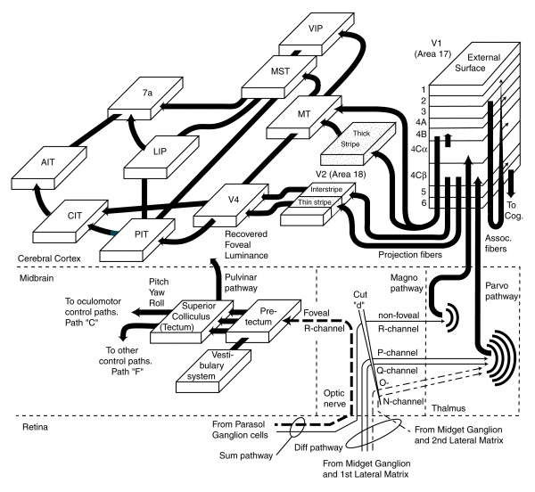
Architecture Of Primate Visual System
Visual hierarchy
Transformation from simple, low-order features to complex, high-order features
Transformation from position-specific features to position-invariant features
source: neuronresearch.net/vision
Notes:
Example of a domain-appropriate bias: CONV NETS FOR VISION
hierarchy of visual layers; simple,
position specific -> position invariant
simple -> complex

Slide 16

Domain-Appropriate Bias Built Into Convolutional Net
Spatial locality
features at nearby locations in an image are most likely to have joint causes and consequences
Spatial position homogeneity
features deemed significant in one region of an image are likely to be significant in others
Spatial scale homogeneity
locality and position homogeneity should apply across a range of spatial scales
source: neuronresearch.net/vision
source: benanne.github.io
Notes:
[END OF SLIDE]
I love the Goodfellow, Bengio, & Courville text
But it says nothing about domain-appropriate bias and how to incorporate knowledge you have into a model.
I love tf/theano/etc. but like all simulation environments, they make it really easy to pick defaults and use generic
domain-independent methods.
ML is really about crafting models to the domain, not tossing unknown data into a generic architecture.
Deep learning seems to mask this issue.

Slide 17
Videos And Demos
LeCun’s work
Yann’s early convolutional nets
LeNet-5
Karpathy Demos
Javascript convolutional net demo

Slide 18
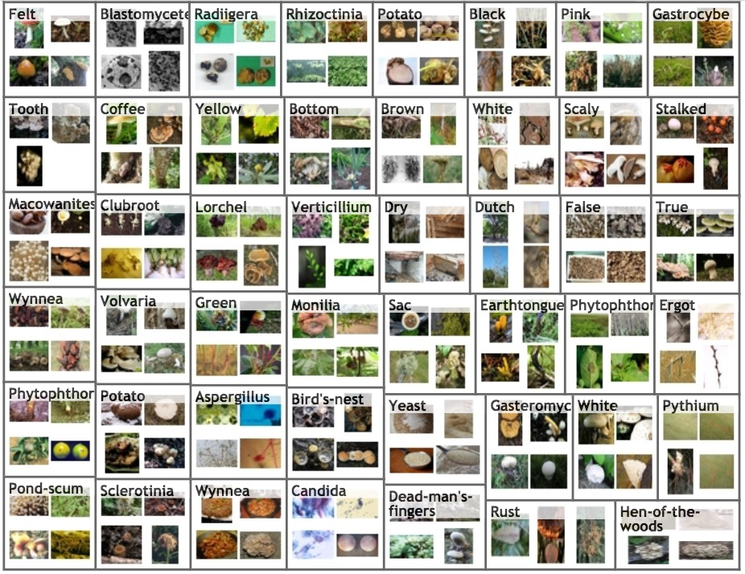
ImageNet
> 15M high resolution images
over 22K categories
labeled by Mechanical Turk workers
E.g., fungi
Notes:
Fungi

Slide 19
ImageNet Large-Scale Visual Recognition Challenge (ILSVRC)
2010-2017
multiple challenges
classification
classification and localization
segmentation
2010 Classification Challenge
1.2 M training images, 1000 categories (general and specific)
200K test images
output a list of 5 object categories in descending order of confidence
two error rates: top-1 and top-5

Slide 20
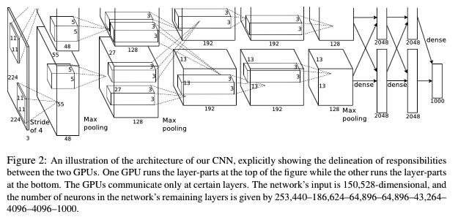
AlexNet (Krizhevsky, Sutskever, & Hinton, 2012)
Architecture
5 convolutional layers, split across two GPUs
2 fully connected layers
1000-way softmax output layer
Trained with SGD for ~ 1 week
650k neurons
60M parameters
630M connections

Slide 21
AlexNet (Krizhevsky, Sutskever, & Hinton, 2012)
Downsampled images
shorter dimension 256 pixels, longer dimension cropped about center to 256 pixels
R, G, B channels
Mean subtraction from inputs
Data set augmentation
we’ll discuss in a subsequent class
includes variations in intensity, color, translation, mirror reflection
Notes:
10 test images: anchored at upper left, upper right, lower left, lower right, and center of image

Slide 22
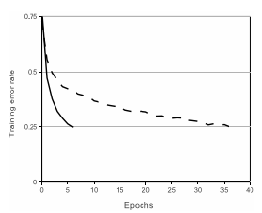
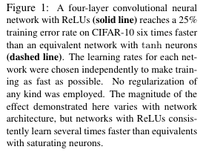

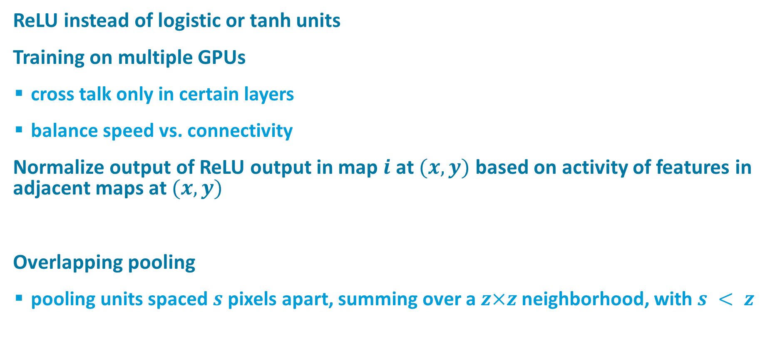
Key Ideas
ReLU instead of logistic or tanh units
Training on multiple GPUs
cross talk only in certain layers
balance speed vs. connectivity
Normalize output of ReLU output in map $i$ at $(x,y)$ based on activity of features in adjacent maps at $(x,y)$
Overlapping pooling
pooling units spaced $s$ pixels apart, summing over a $z×z$ neighborhood, with $s < z$
Notes:
a^i_{x,y} is ReLU output, b is normalized output, k, n, alpha, beta are chosen by cross validation

Slide 23
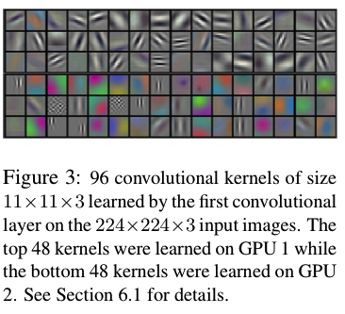

Slide 24
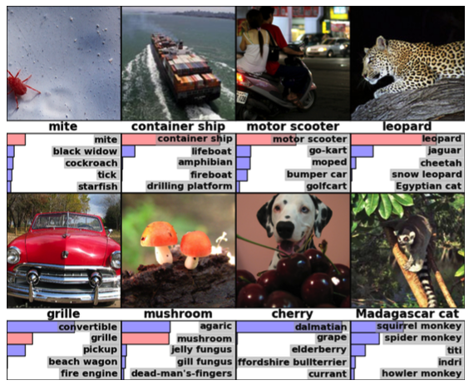

Slide 25
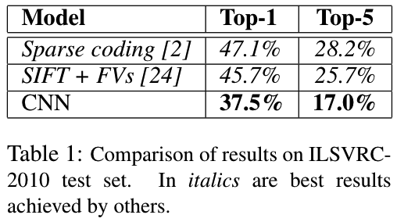
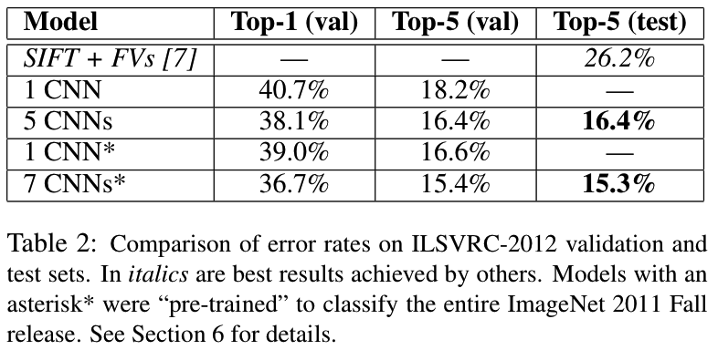
Results
Notes:
2010 competition data set
2012 competition data set

Slide 26
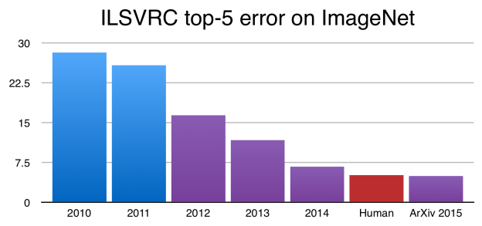
Since 2012
Figure credit: devblogs.nvidia.com
Notes:
Figure 1: The top-5 error rate in the ImageNet Large Scale Visual Recognition Challenge has been rapidly reducing since the introduction of deep neural networks in 2012.
2015 Residual networks (coming soon)

Slide 27
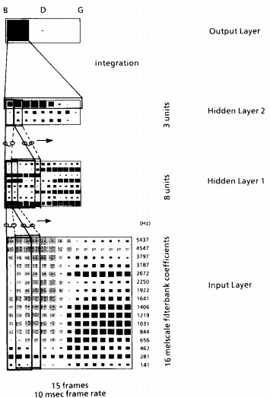
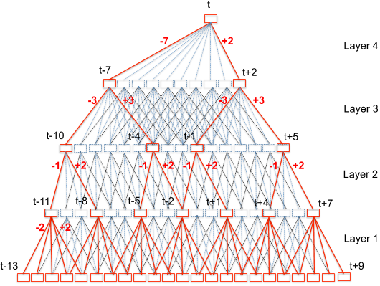
Time-Delay Neural Networks
One dimensional convolution
(Peddinti, Povey & Khudanpur, 2015)
(Waibel et al., 1990)

Slide 28
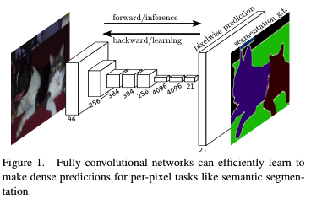
Using Convolutional Nets For Segmentation (Long, Shelhamer, Darrell, 2015)
Determine what objects are where
“what” depends on global information
“where” depends on local information
Notes:
last image is ground truth (GT)

Slide 29
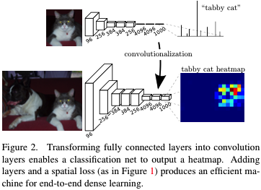
Fully Convolutional Networks
Higher layers of typical convolutional nets are nonspatial
If every layer remains spatial, then output can specify where as well as what (albeit coarsely)

Slide 30
Upsampling
How do we connect coarse output to dense pixels?
Naïve approach
interpolation
Deconvolution approach
if you want to increase resolution by a factor f, use convolution with fractional input stride 1/f

Slide 31
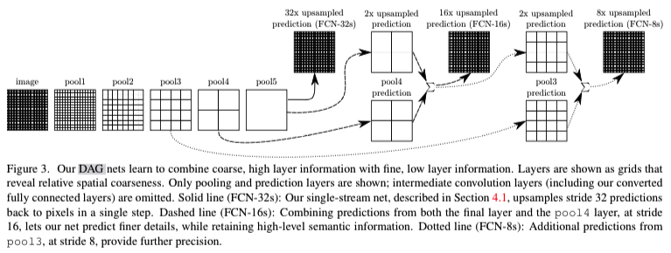
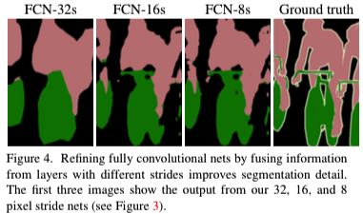
Architecture
Note: pool 5 reflects single pixel in coarse heatmap
Notes:
pool

Slide 32
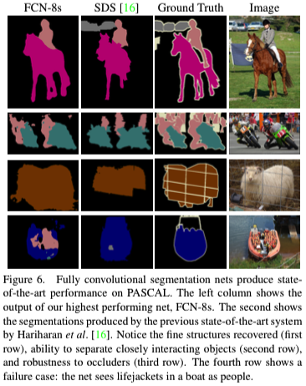
Results
20% relative improvement over state-of-the-art (SDS)
…And runs faster

