Slide 1
Sequence to Sequence Learning

Slide 2
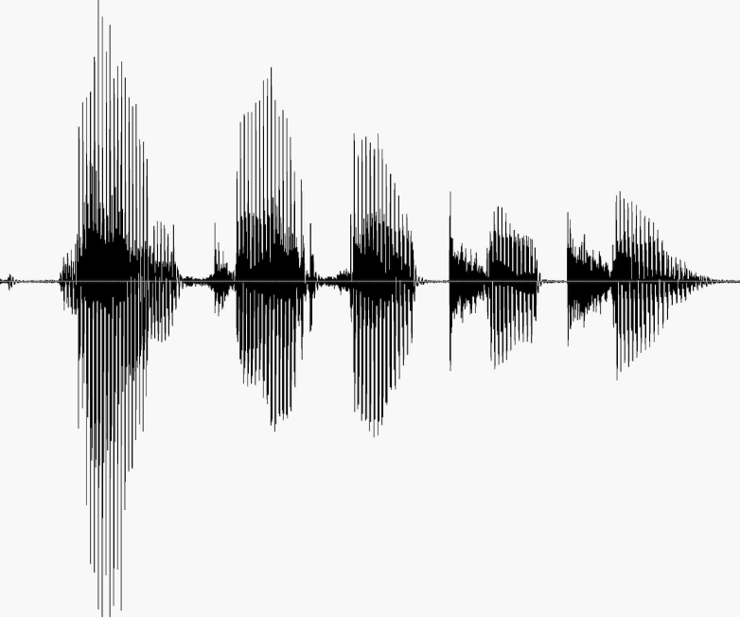
Sequence to Sequence
Speech recognition
http://nlp.stanford.edu/courses/lsa352/

Slide 3

Sequence to Sequence
Machine translation
مرحبا بكم في درس التعلم العميق
Welcome to the deep learning class

Slide 4

Sequence to Sequence
Question answering

Slide 5
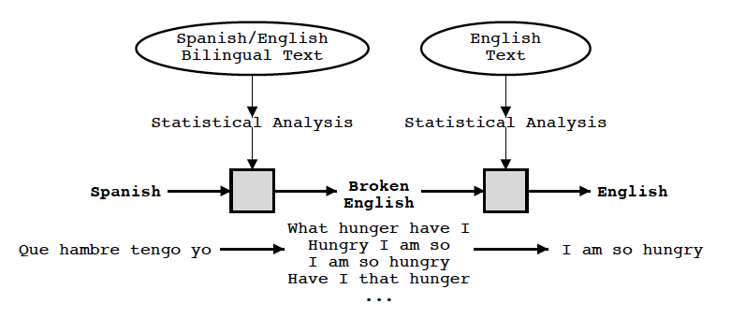
Statistical Machine Translation
Knight and Koehn 2003

Slide 6
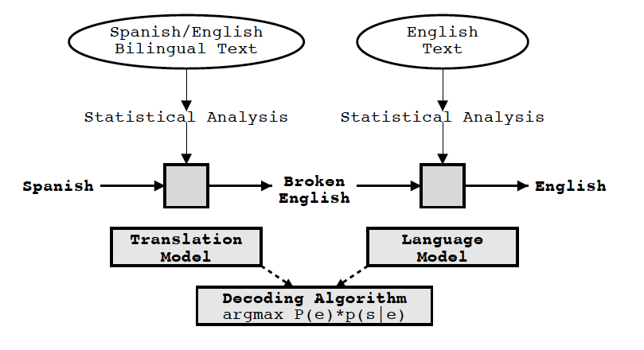
Statistical Machine Translation
Knight and Koehn 2003

Slide 7
Statistical Machine Translation
Components
Translation model
Language Model
Decoding

Slide 8
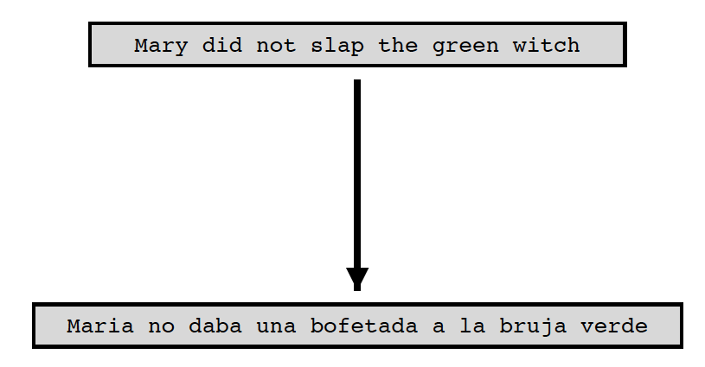
Statistical Machine Translation
Translation model
Learn the P(f | e)
Knight and Koehn 2003

Slide 9
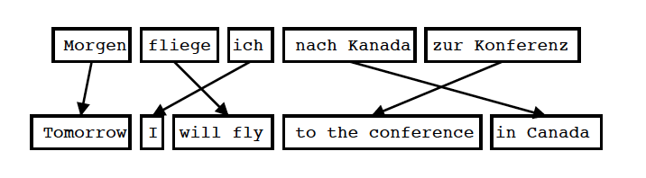
Statistical Machine Translation
Translation model
Input is Segmented in Phrases
Each Phrase is Translated into English
Phrases are Reordered
Koehn 2004

Slide 10
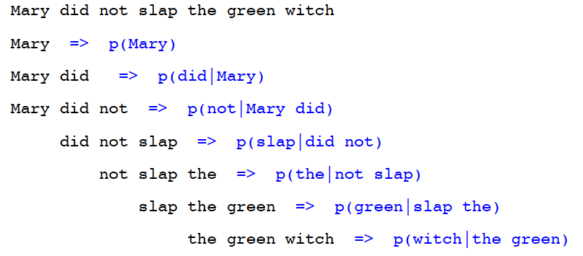
Statistical Machine Translation
Language Model
Goal of the Language Model: Detect good English P(e)
Standard Technique: Trigram Model
Knight and Koehn 2003

Slide 11
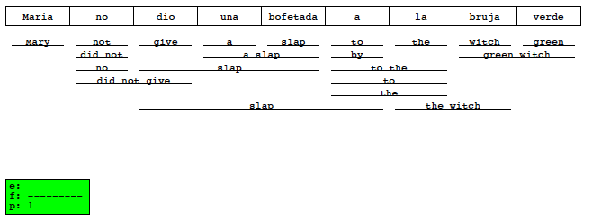
Statistical Machine Translation
Decoding
Goal of the decoding algorithm: Put models to work, perform the actual translation
Koehn 2004

Slide 12
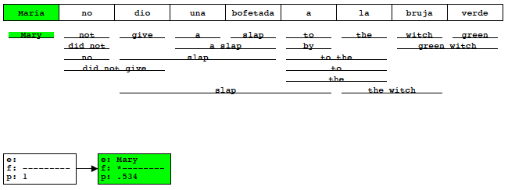
Statistical Machine Translation
Decoding
Goal of the decoding algorithm: Put models to work, perform the actual translation
Koehn 2004

Slide 13
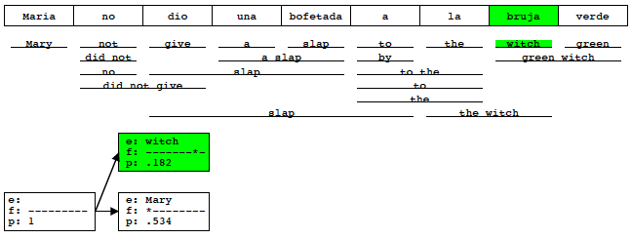
Statistical Machine Translation
Decoding
Goal of the decoding algorithm: Put models to work, perform the actual translation
Koehn 2004

Slide 14
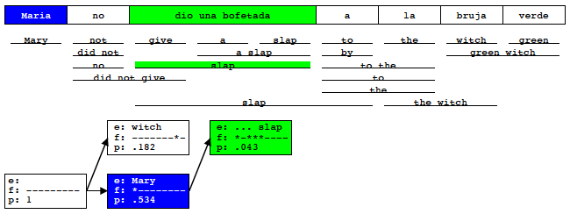
Statistical Machine Translation
Decoding
Goal of the decoding algorithm: Put models to work, perform the actual translation
Koehn 2004

Slide 15
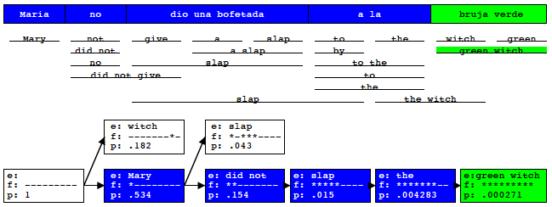
Statistical Machine Translation
Decoding
Goal of the decoding algorithm: Put models to work, perform the actual translation
Koehn 2004

Slide 16
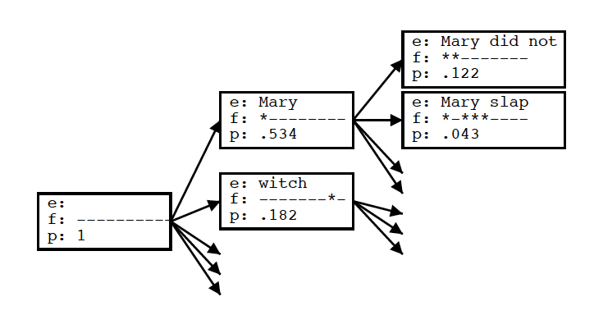
Statistical Machine Translation
Decoding
Goal of the decoding algorithm: Put models to work, perform the actual translation
Koehn 2004

Slide 17
Statistical Machine Translation
Decoding
Goal of the decoding algorithm: Put models to work, perform the actual translation
Prune out Weakest Hypotheses
by absolute threshold (keep 100 best)
by relative cutoff
Future Cost Estimation
compute expected cost of untranslated words

Slide 18
Sutskever et al.,2014
Sequence to Sequence Learning with Neural Networks

Slide 19
Neural Machine Translation
Model
W X Y Z
A B C

Slide 20
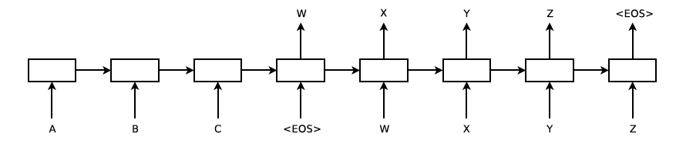
Neural Machine Translation
Model
Sutskever et al. 2014

Slide 21
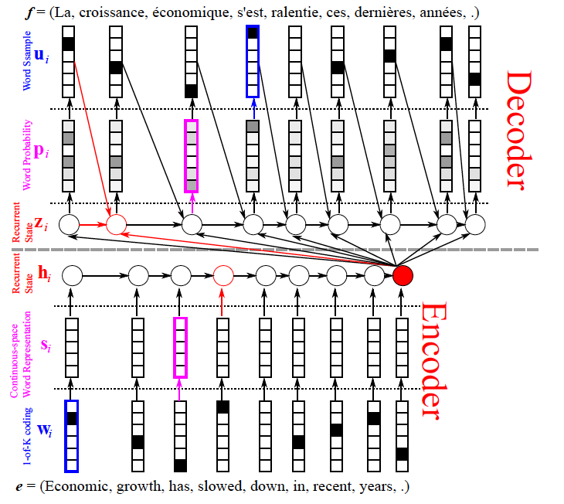
Neural Machine Translation
Model- encoder
Cho: From Sequence Modeling to Translation

Slide 22
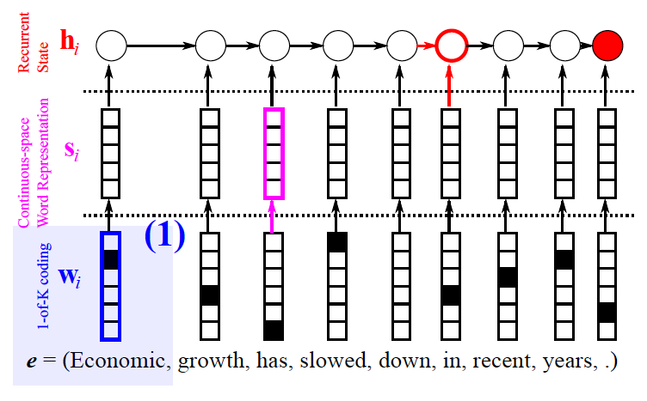
Neural Machine Translation
Model- encoder
Cho: From Sequence Modeling to Translation

Slide 23
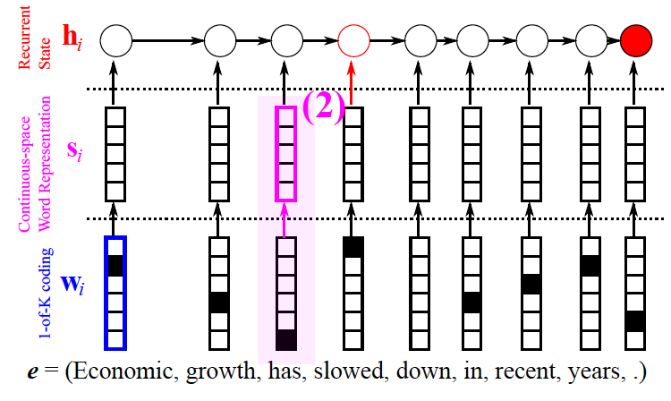
Neural Machine Translation
Model- encoder
Cho: From Sequence Modeling to Translation

Slide 24
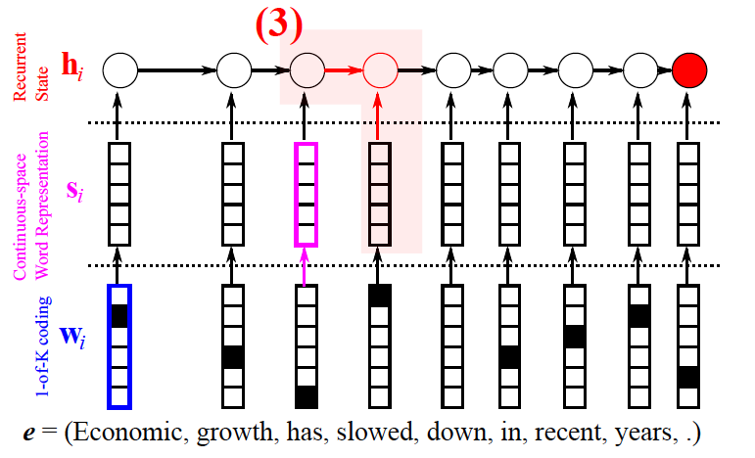
Neural Machine Translation
Model- encoder
Cho: From Sequence Modeling to Translation

Slide 25
Neural Machine Translation
Model- encoder
Cho: From Sequence Modeling to Translation

Slide 26
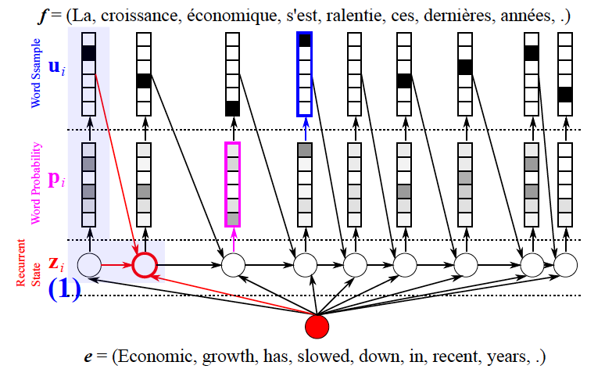
Neural Machine Translation
Model- decoder
Cho: From Sequence Modeling to Translation

Slide 27
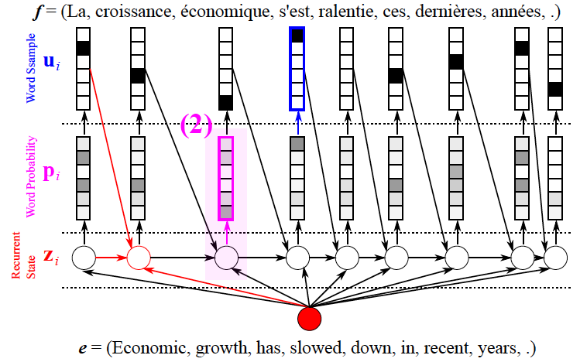
Neural Machine Translation
Model- decoder
Cho: From Sequence Modeling to Translation

Slide 28
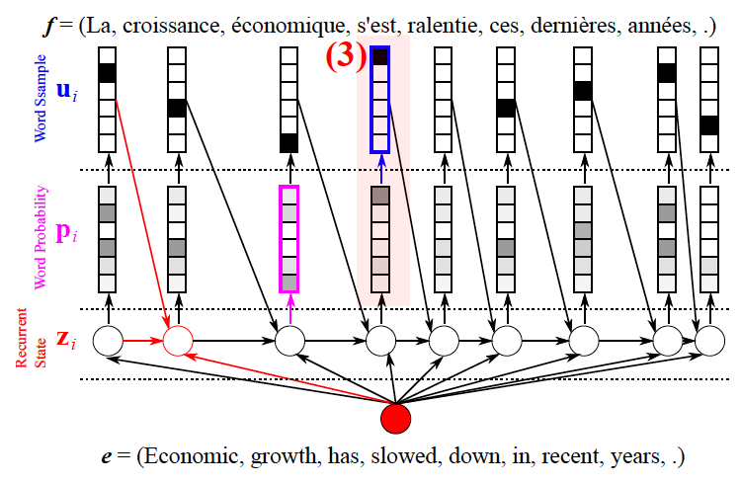
Neural Machine Translation
Model- decoder
Cho: From Sequence Modeling to Translation

Slide 29

Neural Machine Translation
RNN

Slide 30
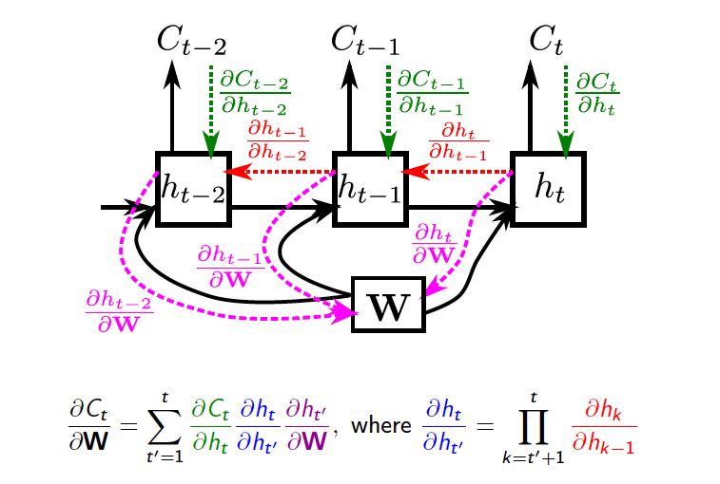
Neural Machine Translation
RNN
Vanishing gradient
Cho: From Sequence Modeling to Translation

Slide 31
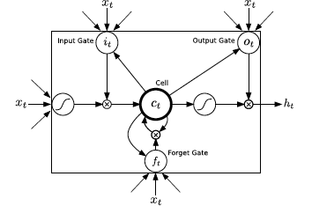
Neural Machine Translation
LSTM
Graves 2013

Slide 32
Neural Machine Translation
LSTM
Problem: Exploding gradient

Slide 33
Neural Machine Translation
LSTM
Problem: Exploding gradient
Solution: Scaling gradient

Slide 34
Sequence to Sequence
Reversing the Source Sentences
Welcome to the deep learning class

Slide 35
Sequence to Sequence
Reversing the Source Sentences
Welcome to the deep learning class

Slide 36
Sequence to Sequence
Results
BLEU score (Bilingual Evaluation Understudy)
Candidate the the the the the the the
Reference 1 the cat is on the mat
Reference 2 there is a cat on the mat
P = m/w= 7/7 = 1
Papineni et al. 2002

Slide 37
Sequence to Sequence
Results
BLEU score (Bilingual Evaluation Understudy)
Candidate the the the the the the the
Reference 1 the cat is on the mat
Reference 2 there is a cat on the mat
P = 2/7
Papineni et al. 2002

Slide 38
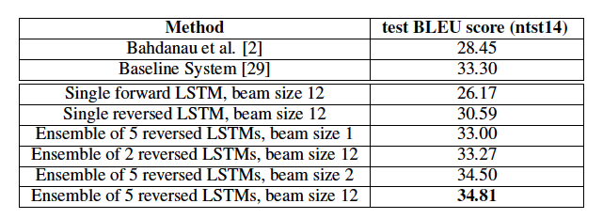
Sequence to Sequence
Results
Sutskever et al. 2014

Slide 39
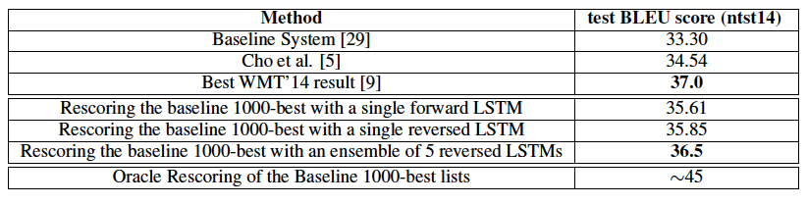
Sequence to Sequence
Results
Sutskever et al. 2014

Slide 40
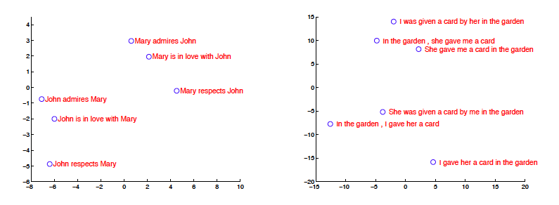
Sequence to Sequence
Model Analysis
Sutskever et al. 2014

Slide 41
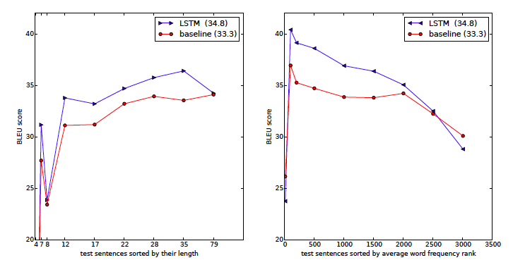
Sequence to Sequence
Long sentences
Sutskever et al. 2014

Slide 42
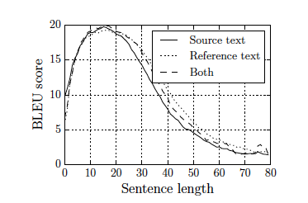
Sequence to Sequence
Long sentences
Cho et al. 2014

Slide 43
Bahdanau et al.,2014
Neural Machine Translation by Jointly Learning to Align and Translate

Slide 44
Sequence to Sequence
Long sentences
Fixed length representation maybe the cause

Slide 45
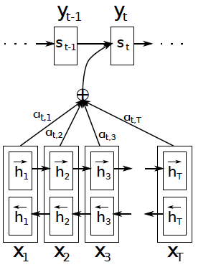

Jointly Learning to Align and Translate
Attention mechanism

Slide 46
Jointly Learning to Align and Translate
Attention mechanism

Slide 47
Jointly Learning to Align and Translate
Attention mechanism

Slide 48
Jointly Learning to Align and Translate
Attention mechanism

Slide 49

Jointly Learning to Align and Translate
Attention mechanism

Slide 50
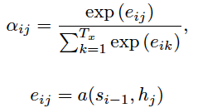
Jointly Learning to Align and Translate
Attention mechanism

Slide 51
Jointly Learning to Align and Translate
Attention mechanism

Slide 52
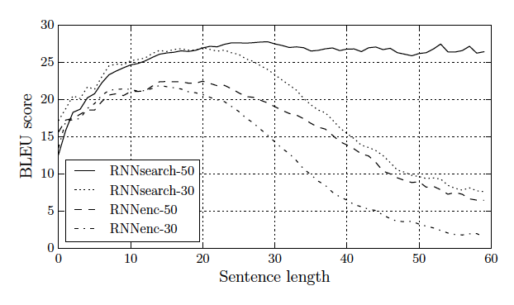
Jointly Learning to Align and Translate
Long sentences
Cho et al. 2014

Slide 53
Vinyals et al., 2015
Grammar as a Foreign Language

Slide 54
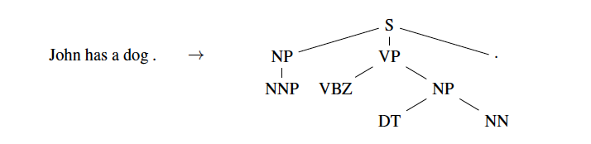
Grammar as a Foreign Language
Parsing tree

Slide 55
Grammar as a Foreign Language
Parsing tree

Slide 56
Grammar as a Foreign Language
Parsing tree

Slide 57
Grammar as a Foreign Language
Parsing tree

Slide 58
Grammar as a Foreign Language
Parsing tree
John has a dog .

Slide 59
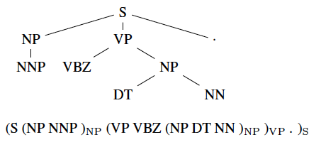
Grammar as a Foreign Language
Converting tree to sequence

Slide 60
Grammar as a Foreign Language
Converting tree to sequence

Slide 61
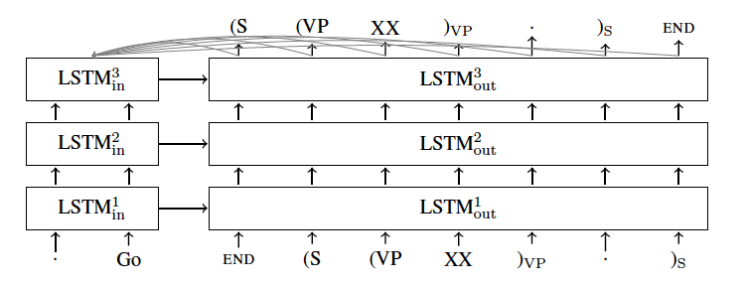
Grammar as a Foreign Language
Model

Slide 62
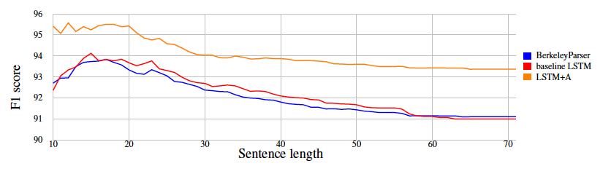
Grammar as a Foreign Language
Results

Slide 63


