Slide 1
Lecture 21: Stacking

Slide 2
Outline
General Review of Methods
Stacking

Slide 4
Module 1: Regression Methods
When is it appropriate to perform a regression method? What regression models have we learned?
Linear Regression (simple, multiple, polynomial, interactions, model selection, Ridge & Lasso, etc...)
k-NN
Regression Trees
What is the main difference between these two types of models (advantages and disadvantages)? When should you use each method?

Slide 5
Module 2: Classification Methods
When is it appropriate to perform a classification method? What classification models have we learned?
Logistic Regression: same details as linear regression apply
k-NN
Discriminant Analysis: LDA/QDA
Classification Trees
SVM
What is the main difference between these two types of models (advantages and disadvantages)? When should you use each method?

Slide 6
Module 3: Ensemble Methods
What does it mean for a model to be an ensemble method?
Bagging Trees
Random Forests
Boosting Models
Neural Networks
Stacking Models (coming today)
What approach does each model take to improve prediction accuracy?

Slide 7
Bags and Forests of Trees (cont.)
Bagging:
create an ensemble of full trees, each trained on a bootstrap sample of the training set;
“average” the predictions
Random forest:
create an ensemble of full trees, each trained on a bootstrap sample of the training set;
in each tree and each split, randomly select a subset of predictors, choose a predictor from this subset for splitting;
average the predictions
Note that the ensemble building aspects of both method are embarrassingly parallel!

Slide 8
Bags and Forests of Trees (cont.)
Boosting:
Iteratively build a model from lots of little models.
Each subsequent model predicts the residuals from the previous model, overweighting the large residuals.
Neural Networks:
Build layers of models based on overly simple “neurons” of models.
Uses back-propagation to efficiently communicate between output of models to update earlier models.
These methods are not as easily parallelizable.

Slide 9
Stacking

Slide 10
Motivation for Stacking
For each of our ensemble methods so far (besides Neural Networks), we have:
Fit the base model on the same type (regression trees, for example).
Combined the predictions in a naïve way.
Stacking is a way to generalize the ensembling approach to combine outputs of various types of model, and improves on the combination as well.

Slide 11
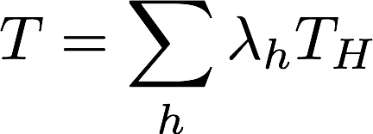
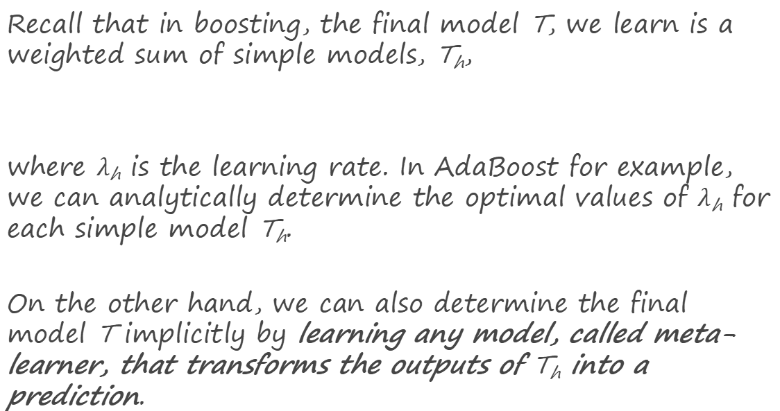
Motivation for Stacking
Recall that in boosting, the final model T, we learn is a weighted sum of simple models, T_{h},
where $λ$_{h} is the learning rate. In AdaBoost for example, we can analytically determine the optimal values of $λ$_{h} for each simple model T_{h}.
On the other hand, we can also determine the final model T implicitly by learning any model, called meta-learner, that transforms the outputs of T_{h} into a prediction.

Slide 12

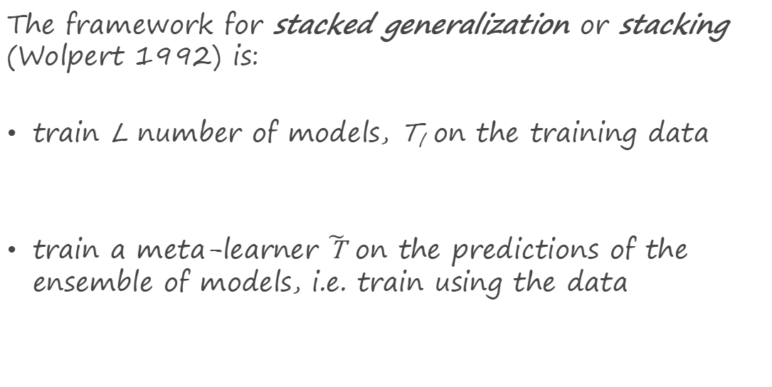
Stacked Generalization
The framework for stacked generalization or stacking (Wolpert 1992) is:
train L number of models, T_{l} on the training data
train a meta-learner $\tilde{\text{T}}$ on the predictions of the ensemble of models, i.e. train using the data

Slide 13
Stacking: an Illustration

Slide 14
Stacked Generalization
Stacking is a very general method,
the models, T_{l}, in the ensemble can come from different classes. The ensemble can contain a mixture of logistic regression models, trees, etc.
the meta-learner, T, can be of any type. Note: we want to train T on the out of sample predictions of the ensemble. For example we train T on
where T_{l}(x_{n}) is generated by training T_{l} on

Slide 15
Stacking: General Guidelines
The flexibility of stacking makes it widely applicable but difficult to analyze theoretically. Some general rules have been found through empirical studies:
models in the ensemble should be diverse, i.e. their errors should not be correlated.
for binary classification, each model in the ensemble should have error rate < 1/2.
if models in the ensemble outputs probabilities, it’s better to train the meta-learner on probabilities rather than predictions.
apply regularization to the meta-learner to avoid overfitting.

Slide 16
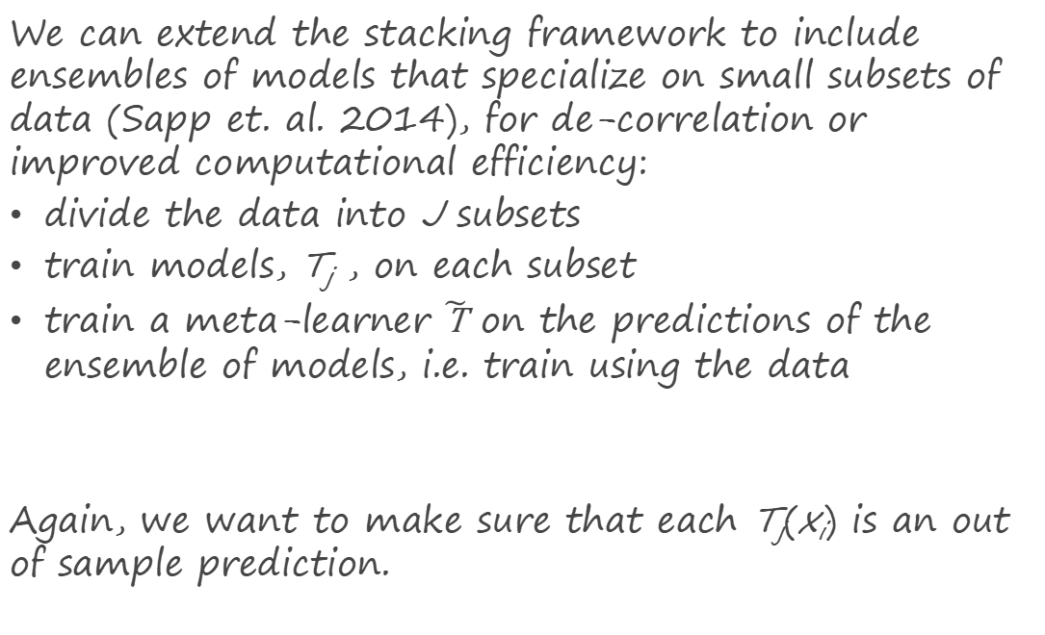
Stacking: Subsemble Approach
We can extend the stacking framework to include ensembles of models that specialize on small subsets of data (Sapp et. al. 2014), for de-correlation or improved computational efficiency:
divide the data into J subsets
train models, T_{j} , on each subset
train a meta-learner $\tilde{\text{T}}$ on the predictions of the ensemble of models, i.e. train using the data
Again, we want to make sure that each T_{j}(x_{i}) is an out of sample prediction.

Slide 17
Stacking in sklearn
Unfortunately, Python does not have stacking algorithms implemented for you ☹
So how can we do it?
We can set it up by ‘manually’ fitting several base models, take the outputs of those models, and fitting the meta model on the outputs of those base models.
It’s a model on models!

