Slide 1
📊 Renovation, Location & Timing: Data-Driven Real Estate Decisions
Analysis of King County Housing Data with PostgreSQL & Python
Presented by: Daniil Sablin
Course: Data Science Bootcamp

Slide 2
Project Objective & Workflow
Client: Charles Christensen Seller
Analyze real estate data from King County
Investigate renovation effects, location ROI, and timing impact
Use PostgreSQL, Python, Pandas, Seaborn, GeoPandas
Export clean data for further modeling
Present insights & recommendations

Slide 3
Dataset & Data Connection
Data Source & SQL Connection
PostgreSQL database with 2 tables:
  king_county_house_details
  king_county_house_sales

Slide 4
Initial Cleaning & Preprocessing
Data Cleaning & Feature Selection
Selected key columns: price, sqft_living, condition, grade, etc.
Handled missing values (e.g. yr_renovated = 0)
Removed duplicates, keep outliyer
Converted dates, created new columns (pps, renovated, year, month)

Slide 5
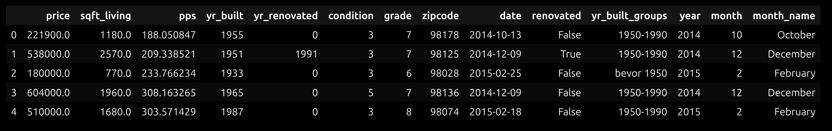
Data Frame

Slide 6
Key Metric: PPS
Price Per Square Foot (PPS)
Created relative price indicator: pps = price / sqft_living
Used for fair comparison across properties

Slide 7
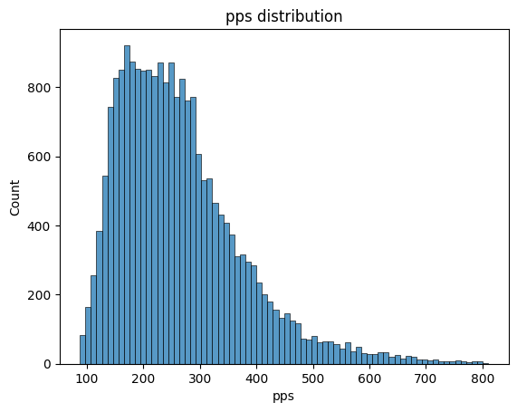

Slide 8
Hypothesis 1: Renovation
Does Renovation Increase PPS?
Compared renovated vs non-renovated houses
Boxplot shows visible price uplift
Renovated homes are ~22.6% more expensive

Slide 9
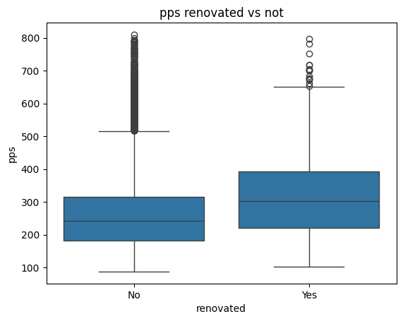

Slide 10
Statistical Significance (T-Test)
Is the Renovation Effect Statistically Significant?
Two-sample T-Test used
p-value < 0.01 → Reject Null Hypothesis
=> Renovation does increase PPS significantly
Result:
T = 12.13
P-value = 3.9 e-31 ✅

Slide 11
Hypothesis 2: Zipcode / Location
Does Location (Zipcode) Impact PPS?
Calculated mean PPS by zip code
Visualized as bar chart and geo map
=> Zipcodes differ by over 300% in PPS

Slide 12
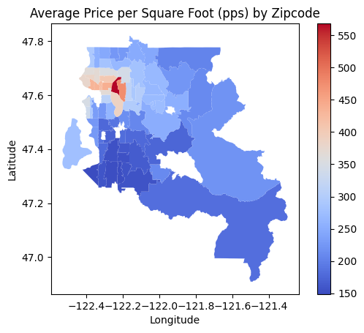

Slide 13
Zipcode Trends Over Time
PPS Trends per Zipcode Over Time
Grouped by zipcode and year
Growth tracked over years
Example: Zip 98148 increased PPS by 18.5%

Slide 14
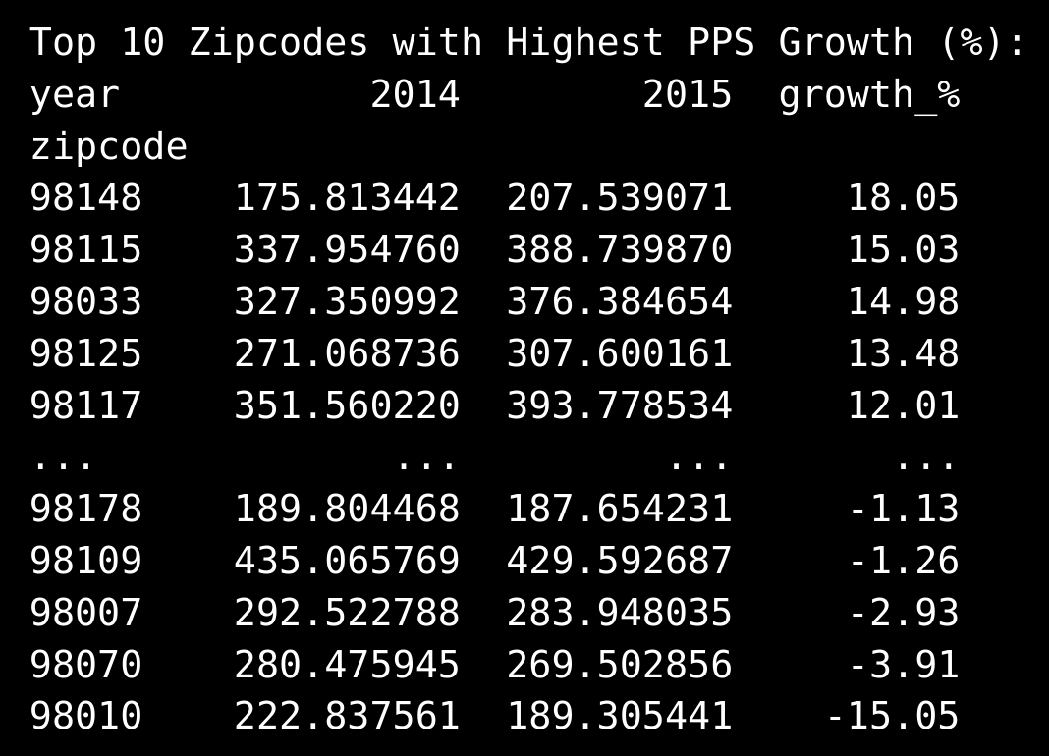

Slide 15
Hypothesis 3: Timing (Month)
Does Selling Month Affect PPS?
Extracted month from sale date
Average PPS varies across months
=> Best month: April; Worst: December
Price difference ≈ 9.5%

Slide 16
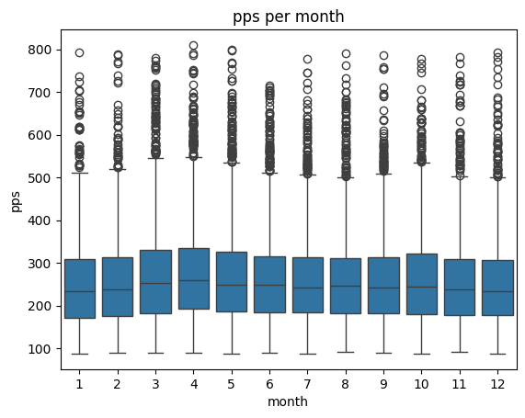

Slide 17
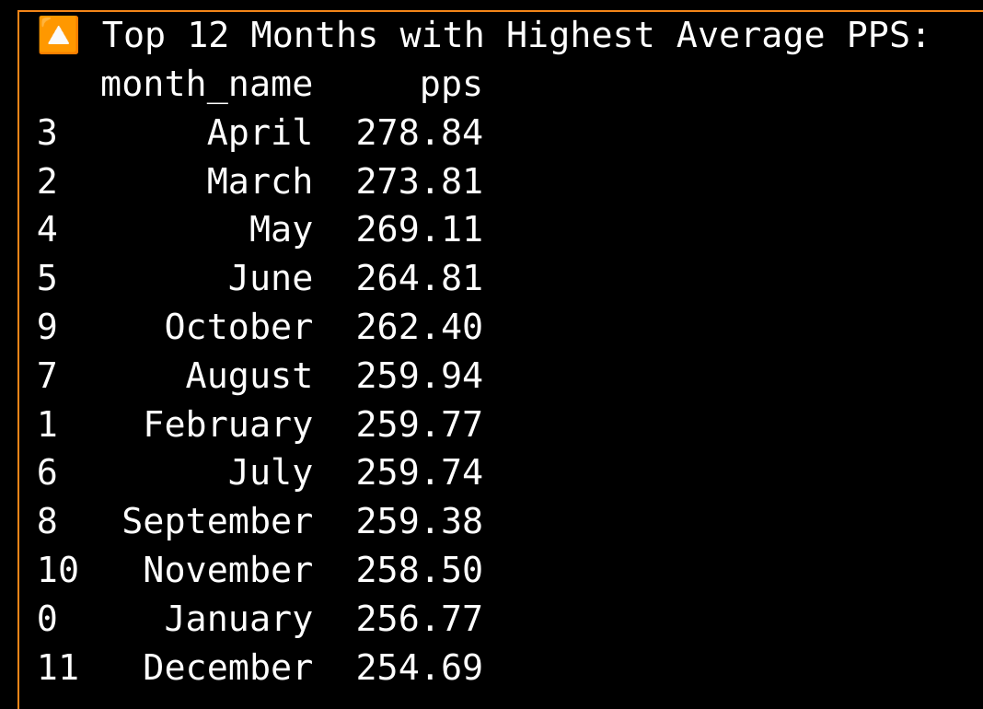

Slide 18
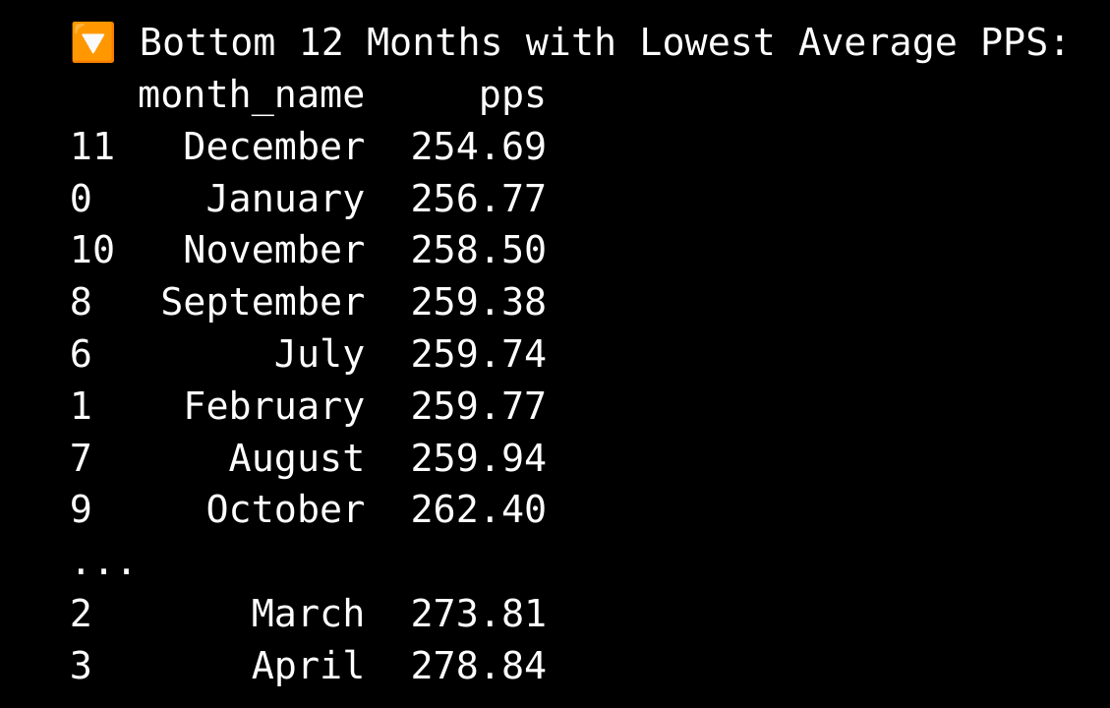

Slide 19
Monthly Trends by Year
Monthly Price Trends (Multiyear)
Pivoted data to show month vs year
Scatterplot confirms seasonality pattern
Spearman correlation used due to skewed distribution

Slide 20
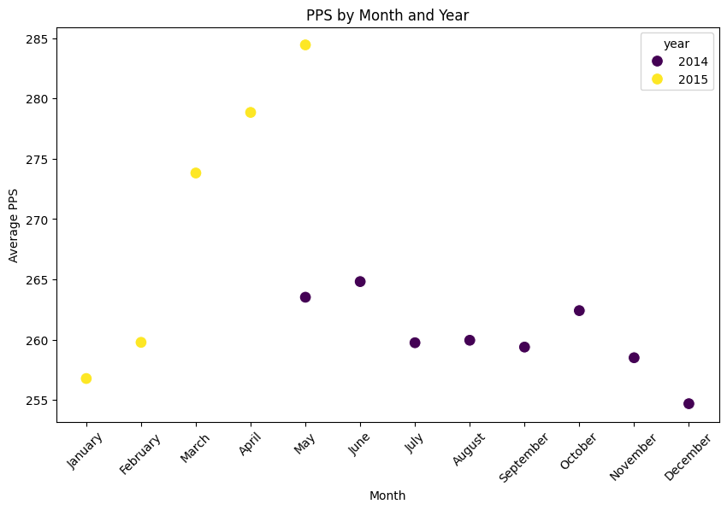

Slide 21
Summary of Findings
Key Insights
✔ Renovated homes sell for 22.6% more
✔ Location matters – zipcode ROI differs by 300%+
✔ Zip 98148 increased PPS by 18.5%
✔ Best timing: Sell in April, buy in December 9.5%
✔ Statistical tests confirm significance of renovation impact

Slide 22
Recommendations
Strategic Real Estate Actions
🛠️ Fix & Flip works best: Buy poor condition, renovate, sell
📍 Invest in zipcodes with high growth (e.g. 98148)
📆 Time your sale for spring (April)
🔄 More data and further investigation are needed e.g. time series analysis and multilinear regression

Slide 23
Questions?
Thank for your Attention! :)

