Slide 1
Customer, technology and data systems reshaping value
BUSINESS ADMINISTRATION · ASSIGNMENT 3 · PHOTO ESSAY
Company A: Carrefour → Company B: Magnum Cash&Carry
Magnum’s discounts create value that its weekly message fails to turn into purchases; AI can close that gap only behind a human check and a Kazakhstan data boundary, so Magnum should adapt Carrefour’s AI copywriting, adopt its data controls and delay its personalisation.
Student | Kniazev Daniil
Group | AIB-2602
Course | Business Administration (BA 1204), Astana IT University
Submitted | October 2026

Slide 2
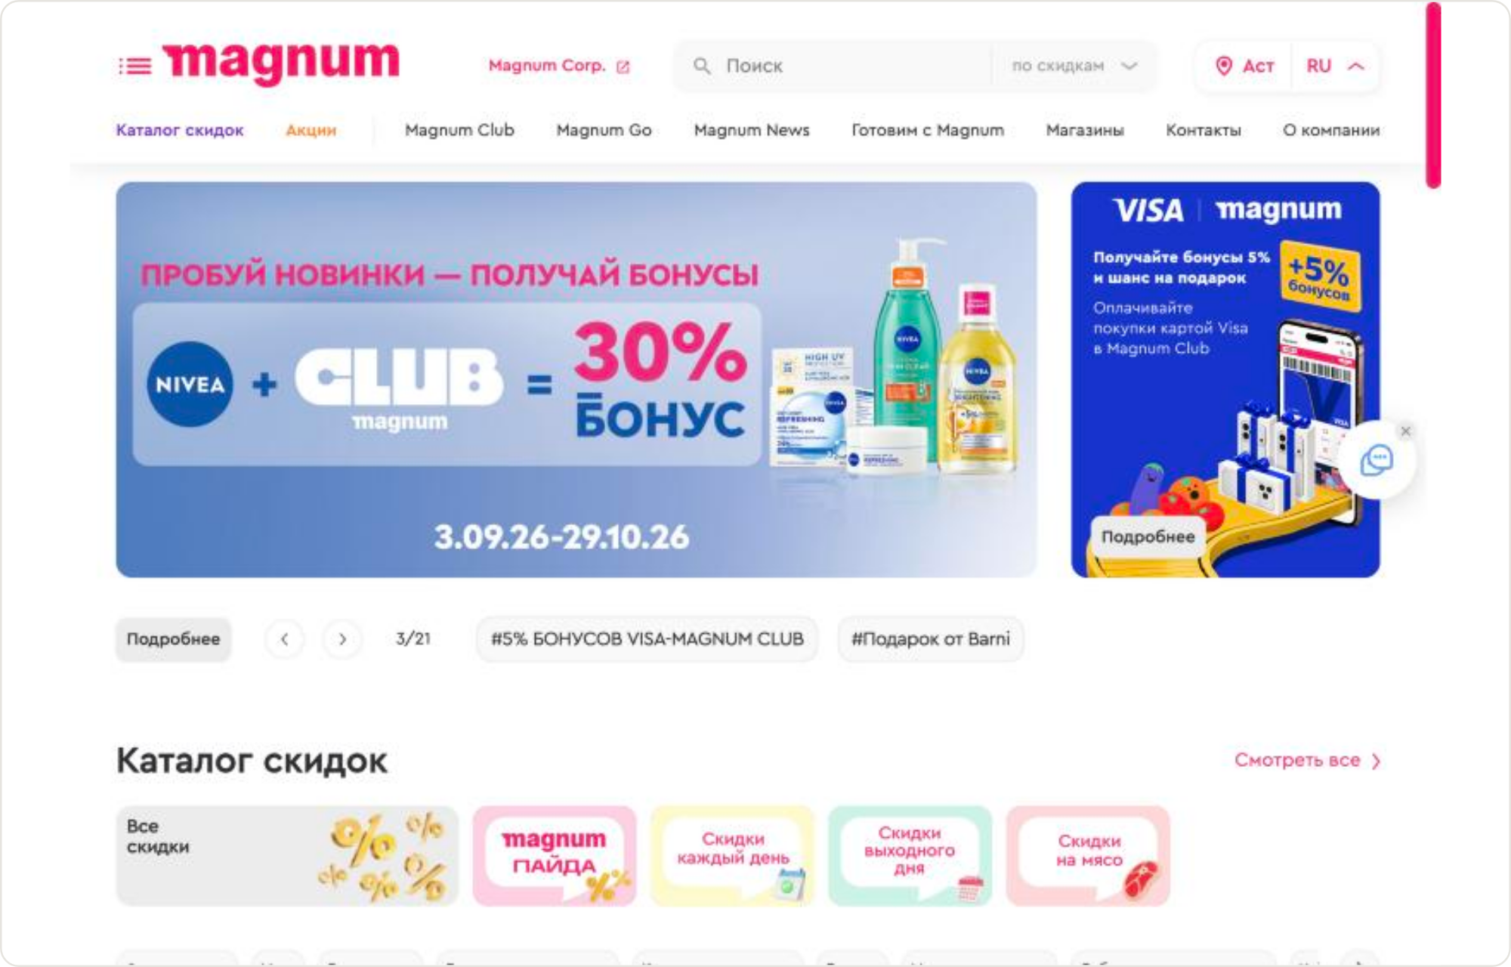
Company B: Magnum Cash&Carry and the value it promises
OPENING VISUAL
1
Magnum sells savings and loyalty: a weekly discount catalogue, Magnum Club bonuses and offers such as a 30% Nivea bonus [28]. With 9.8% annual inflation [4], saving is the core household value. Club membership (2M+) is Magnum’s own figure [24], so the essay relies on customer-facing evidence.

Slide 3
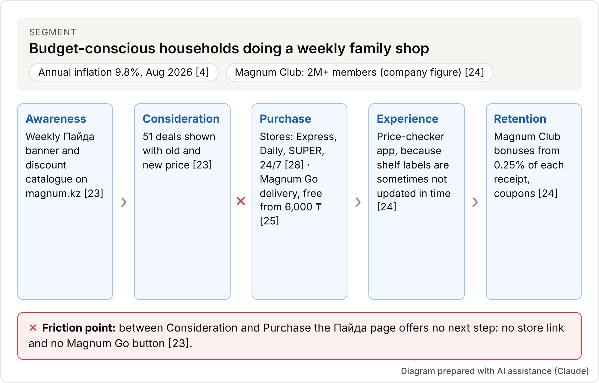
The customer journey and where it breaks
CUSTOMER AND VALUE CREATION
2
Value appears at every stage, but the weak link is between Consideration and Purchase. Shoppers can compare 51 deals [23] yet are not told where or how to buy, despite four store formats [28] and Magnum Go delivery [25]. This gap, not discount depth, is the essay’s problem.

Slide 4
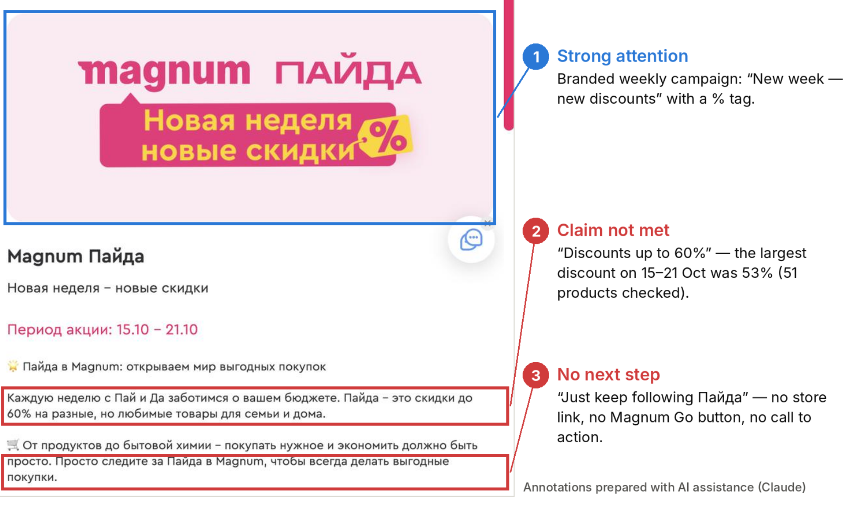
The weekly Пайда page: strong attention, no next step
CUSTOMER AND VALUE CREATION
3
The Пайда page confirms the gap. Its banner earns attention, but the promise of “up to 60%” was not met that week (maximum 53%), and the only instruction is to “keep following Пайда” [23]. For budget shoppers this weakens trust and leaves no next step.

Slide 5
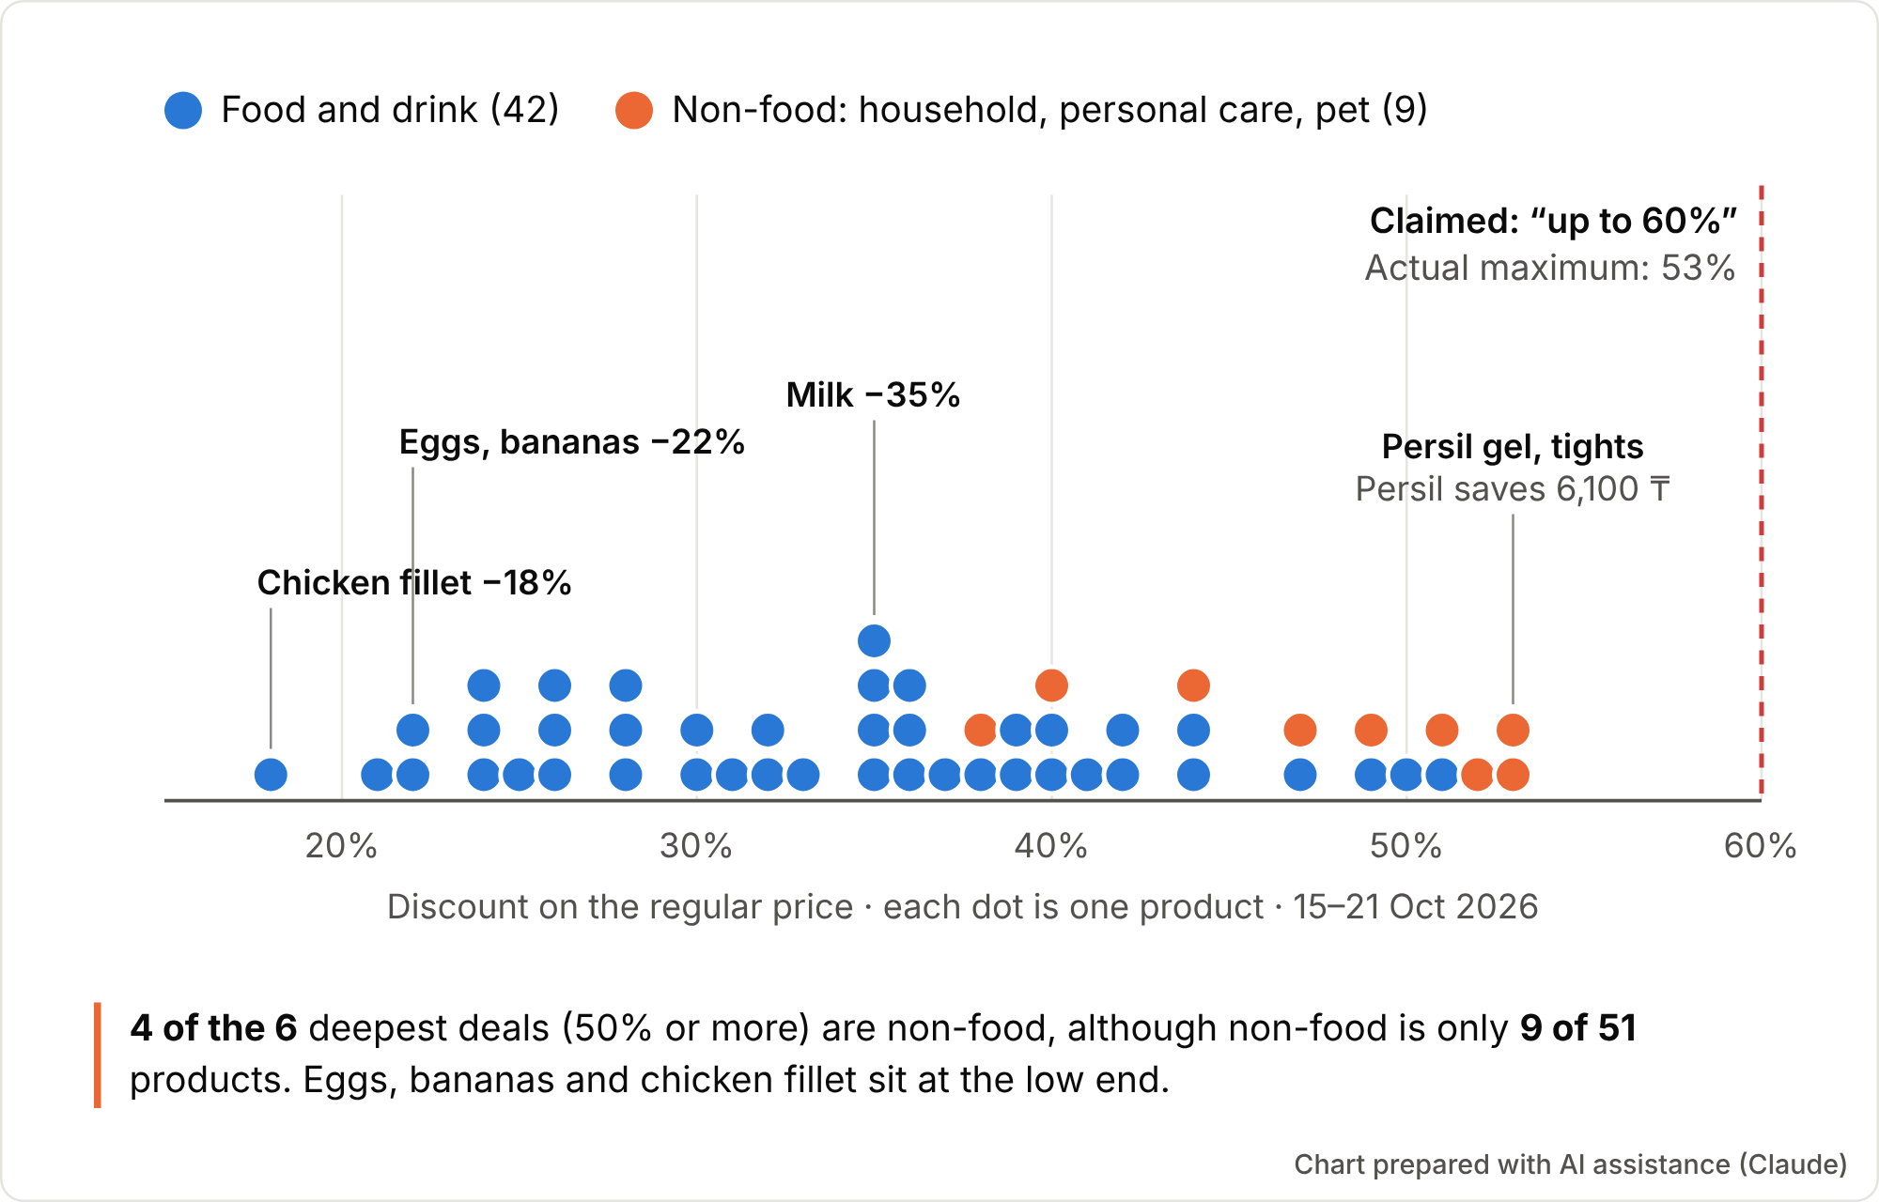
What the 51 Пайда deals actually offer
CUSTOMER AND VALUE CREATION
4
The data refine the insight: four of the six deepest discounts are non-food, while eggs, bananas and chicken fillet sit at 18–22% [23]. The biggest discount is not the most useful one for a family basket, so a tool ranking offers by discount alone would repeat this pattern.

Slide 6
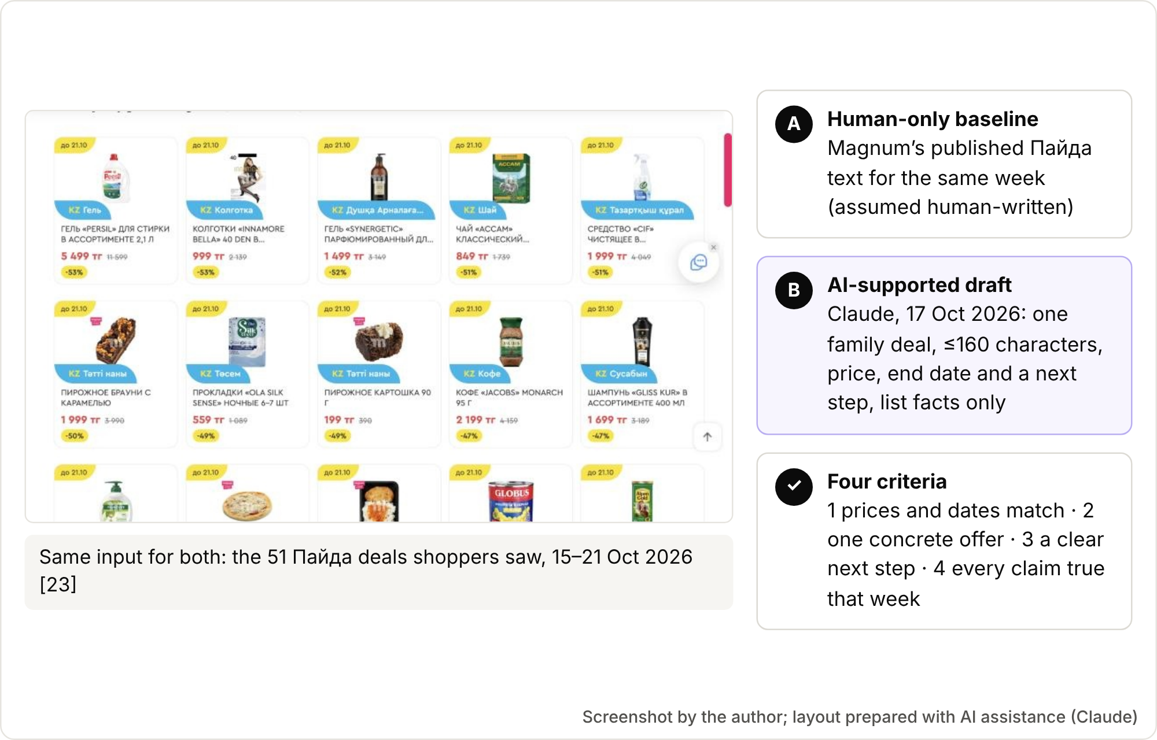
Same task, two approaches: the method
THE AI-SUPPORTED COMPARISON
5
To test whether AI helps, both approaches used the same 51-product list and four criteria [23]. The baseline is Magnum’s published text, assumed human-written; the AI draft followed a prompt restricted to list facts. The method is transparent but small: one week, one message.

Slide 7
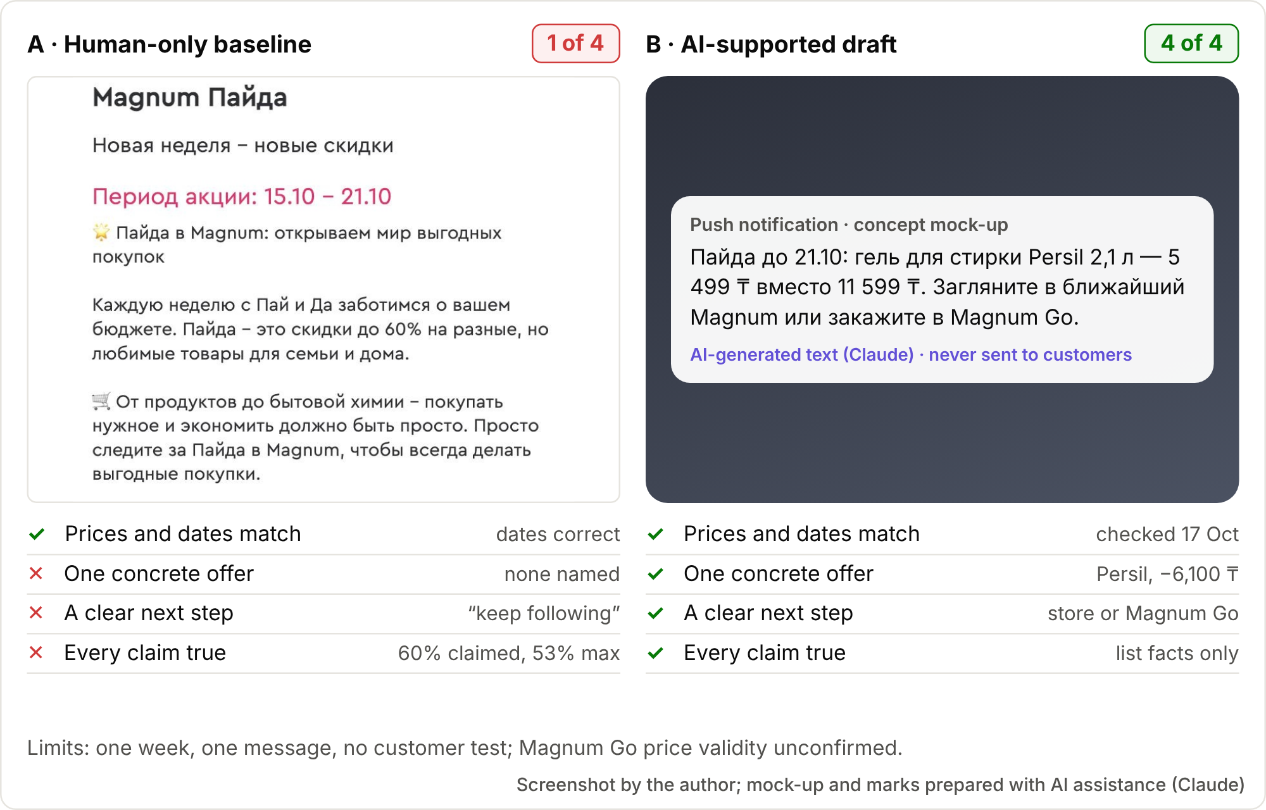
The result: same task, two outputs
THE AI-SUPPORTED COMPARISON
6
The AI draft met all four criteria, the baseline one. AI made the message specific and actionable, but customer response was not tested. The draft also named Magnum Go [25] without confirming Пайда prices apply there [23] and chose a non-food deal, echoing Visual 4. Human review remains essential.

Slide 8
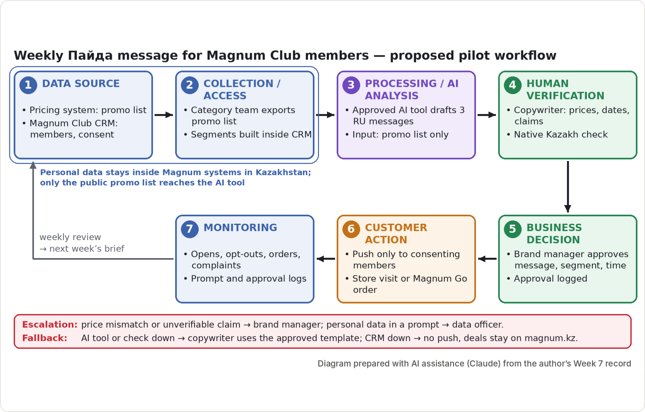
Proposed workflow with a human gate
TECHNOLOGY, DATA AND WORKFLOW
7
The workflow places a human gate before anything reaches customers: AI drafts, a copywriter checks every price and claim, and the brand manager approves. Monitoring feeds the next brief; a manual template keeps campaigns running if the tool fails. This is a proposed pilot, not Magnum’s current system [7], [27].

Slide 9
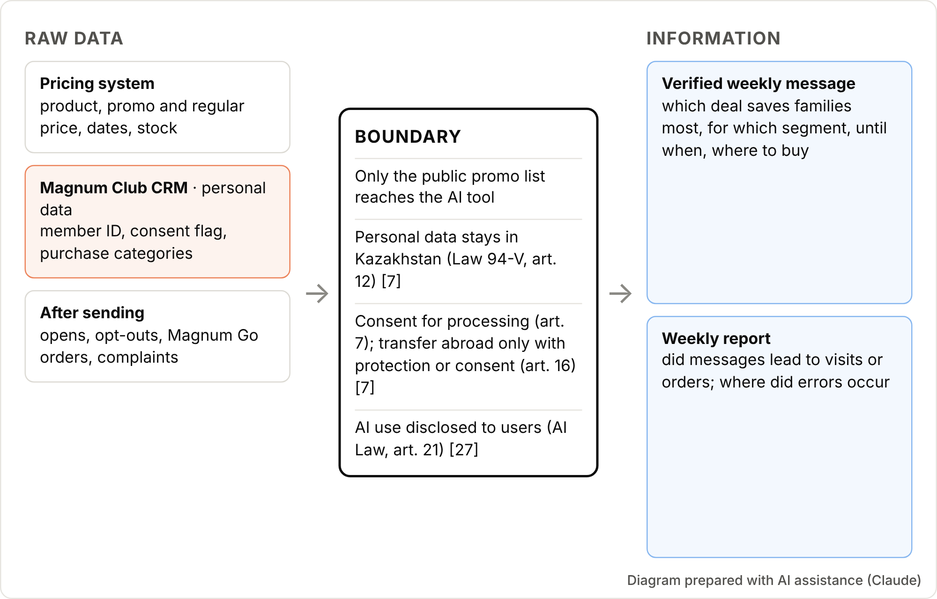
From data to information, inside Kazakhstan’s rules
TECHNOLOGY, DATA AND WORKFLOW
8
The data boundary is a design choice, not paperwork. Only the public promo list reaches the AI tool; member data stays in Kazakhstan under the Personal Data Law’s consent and transfer rules [7]. The AI Law also requires telling users when services use AI [27].

Slide 10
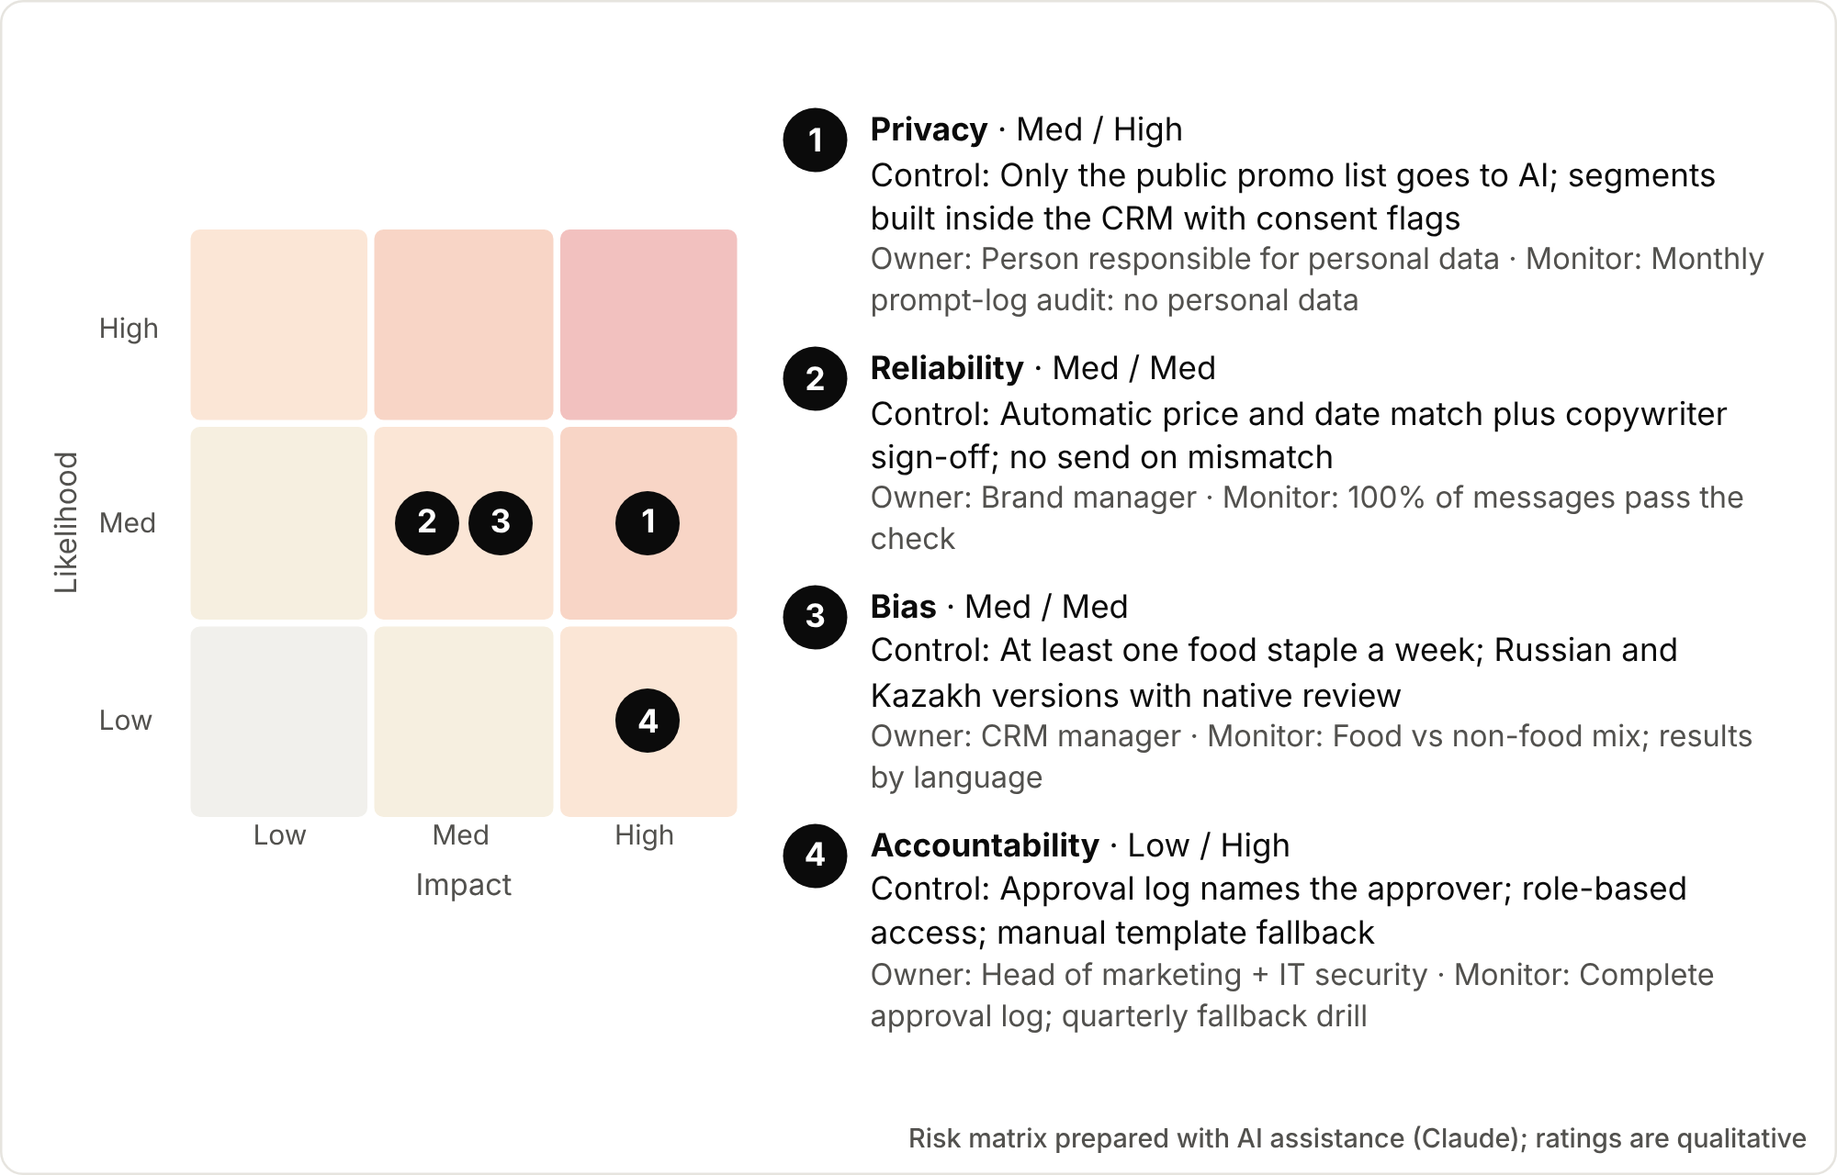
Four risks, each with a control and an owner
GOVERNANCE AND RISK
9
Privacy is the most serious risk: a leak of members’ data cannot be undone, and Kazakh law sets strict conditions [7], [24]. Its control keeps personal data out of prompts. An automatic price check plus sign-off controls reliability; a weekly food-staple rule controls bias. Residual risk: human error and unclear AI-labelling rules [27].

Slide 11
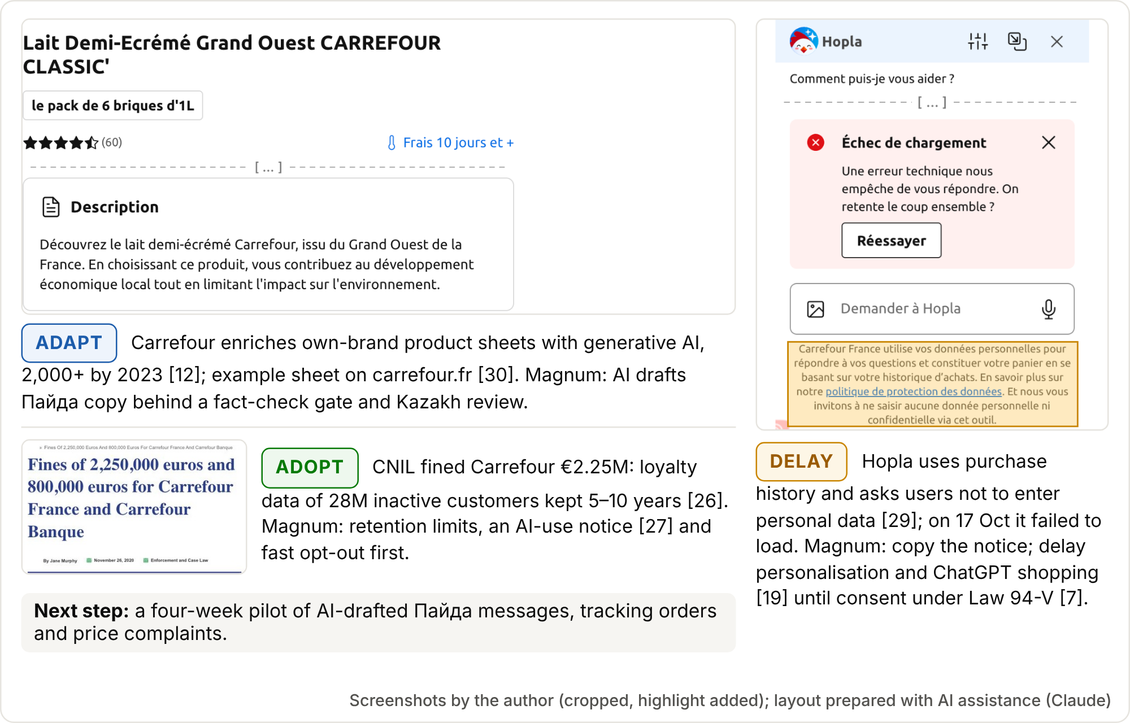
What Magnum should take from Carrefour, and on what terms
CLOSING VISUAL AND TRANSFER VERDICT
10
Carrefour’s Hopla shows the opportunity and the cost [29]. Magnum should adapt AI content generation, used on 2,000+ Carrefour product sheets [12], adding fact checks and Kazakh review; adopt the data controls Carrefour introduced after a €2.25 million CNIL fine [26]; and delay purchase-history personalisation and ChatGPT shopping [19]. Next: a four-week pilot tracking orders and price complaints.

