Slide 1
Sortovacie algoritmy so zložitostou O(n²)
Bubble sort (Time Complexity O(n²), Space Complexity O(1))
Insertion sort (Time Complexity O(n²), Space Complexity O(1))
Selection sort (Time Complexity O(n²), Space Complexity O(1))
Sortovacie algoritmy so zložitostou O(n*log n)
Quick sort (Time Complexity O(n*log n), Space Complexity O(log n) {O(n²)})
Merge sort (Time Complexity O(n*log n), Space Complexity O(1) {O(n*log n)})
Heap sort (Time Complexity O(n*log n), Space Complexity O(n*log n))
Prezentujúci si vyberie aspoň 2 z nich a tie odprezentuje, implementuje ich, predvedie experiment.
Sortovacie algoritmy so zložitostou O(n)
Radix sort
Counting sort
Bucket sort
Prezentujúci si vyberie aspoň 2 z nich a tie odprezentuje, implementuje ich, predvedie experiment.
Notes:
Bubble sort algorithm starts by comparing the first two elements of an array and swapping if necessary, i.e., if you want to sort the elements of array in ascending order and if the first element is greater than second then, you need to swap the elements but, if the first element is smaller than second, you mustn't swap the element. Then, again second and third elements are compared and swapped if it is necessary and this process go on until last and second last element is compared and swapped. This completes the first step of bubble sort.
If there are n elements to be sorted then, the process mentioned above should be repeated n-1times to get required result. But, for better performance, in second step, last and second last elements are not compared becuase, the proper element is automatically placed at last after first step. Similarly, in third step, last and second last and second last and third last elements are not compared and so on.
A figure is worth a thousand words so, acknowledge this figure for better understanding of bubble sort.

Slide 2
Sortovacie algoritmy so zložitostou O(n²)
Bubble sort (Time Complexity O(n²), Space Complexity O(1))
Insertion sort (Time Complexity O(n²), Space Complexity O(1))
Selection sort (Time Complexity O(n²), Space Complexity O(1))
časovo pomalšie algoritmy
jednoduchá myšlienka a pomerne jednoducho naprogramovateľné
nevyžadujú pomocné dátové štruktúry a pomocnú pamäť
nad 1000 prvkov už nie su vhodné, pretože čas rastie kvadraticky
Notes:
Bubble sort algorithm starts by comparing the first two elements of an array and swapping if necessary, i.e., if you want to sort the elements of array in ascending order and if the first element is greater than second then, you need to swap the elements but, if the first element is smaller than second, you mustn't swap the element. Then, again second and third elements are compared and swapped if it is necessary and this process go on until last and second last element is compared and swapped. This completes the first step of bubble sort.
If there are n elements to be sorted then, the process mentioned above should be repeated n-1times to get required result. But, for better performance, in second step, last and second last elements are not compared becuase, the proper element is automatically placed at last after first step. Similarly, in third step, last and second last and second last and third last elements are not compared and so on.
A figure is worth a thousand words so, acknowledge this figure for better understanding of bubble sort.

Slide 3

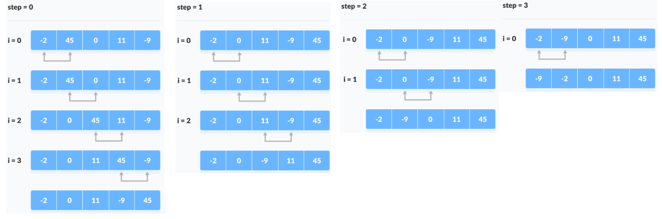
Bubble sort (Time Complexity O(n²), Space Complexity O(1))
(https://www.programiz.com/dsa/bubble-sort)
Notes:
Bubble sort algorithm starts by comparing the first two elements of an array and swapping if necessary, i.e., if you want to sort the elements of array in ascending order and if the first element is greater than second then, you need to swap the elements but, if the first element is smaller than second, you mustn't swap the element. Then, again second and third elements are compared and swapped if it is necessary and this process go on until last and second last element is compared and swapped. This completes the first step of bubble sort.
If there are n elements to be sorted then, the process mentioned above should be repeated n-1times to get required result. But, for better performance, in second step, last and second last elements are not compared becuase, the proper element is automatically placed at last after first step. Similarly, in third step, last and second last and second last and third last elements are not compared and so on.
A figure is worth a thousand words so, acknowledge this figure for better understanding of bubble sort.

Slide 4
Bubble sort (Time Complexity O(n²), Space Complexity O(1))
(https://www.programiz.com/dsa/bubble-sort)
Notes:
Bubble sort algorithm starts by comparing the first two elements of an array and swapping if necessary, i.e., if you want to sort the elements of array in ascending order and if the first element is greater than second then, you need to swap the elements but, if the first element is smaller than second, you mustn't swap the element. Then, again second and third elements are compared and swapped if it is necessary and this process go on until last and second last element is compared and swapped. This completes the first step of bubble sort.
If there are n elements to be sorted then, the process mentioned above should be repeated n-1times to get required result. But, for better performance, in second step, last and second last elements are not compared becuase, the proper element is automatically placed at last after first step. Similarly, in third step, last and second last and second last and third last elements are not compared and so on.
A figure is worth a thousand words so, acknowledge this figure for better understanding of bubble sort.

Slide 5
Bubble sort (Time Complexity O(n²), Space Complexity O(1))
(https://www.programiz.com/dsa/bubble-sort)
Notes:
Bubble sort algorithm starts by comparing the first two elements of an array and swapping if necessary, i.e., if you want to sort the elements of array in ascending order and if the first element is greater than second then, you need to swap the elements but, if the first element is smaller than second, you mustn't swap the element. Then, again second and third elements are compared and swapped if it is necessary and this process go on until last and second last element is compared and swapped. This completes the first step of bubble sort.
If there are n elements to be sorted then, the process mentioned above should be repeated n-1times to get required result. But, for better performance, in second step, last and second last elements are not compared becuase, the proper element is automatically placed at last after first step. Similarly, in third step, last and second last and second last and third last elements are not compared and so on.
A figure is worth a thousand words so, acknowledge this figure for better understanding of bubble sort.

Slide 6
Bubble sort (Time Complexity O(n²), Space Complexity O(1))
(https://www.programiz.com/dsa/bubble-sort)
Notes:
Bubble sort algorithm starts by comparing the first two elements of an array and swapping if necessary, i.e., if you want to sort the elements of array in ascending order and if the first element is greater than second then, you need to swap the elements but, if the first element is smaller than second, you mustn't swap the element. Then, again second and third elements are compared and swapped if it is necessary and this process go on until last and second last element is compared and swapped. This completes the first step of bubble sort.
If there are n elements to be sorted then, the process mentioned above should be repeated n-1times to get required result. But, for better performance, in second step, last and second last elements are not compared becuase, the proper element is automatically placed at last after first step. Similarly, in third step, last and second last and second last and third last elements are not compared and so on.
A figure is worth a thousand words so, acknowledge this figure for better understanding of bubble sort.

Slide 7
Bubble sort (Time Complexity O(n²), Space Complexity O(1))
(https://www.programiz.com/dsa/bubble-sort)
#include <stdio.h>
void bubbleSort(int array[], int size)
{
for (int step = 0; step < size - 1; ++step)
{
for (int i = 0; i < size - step - 1; ++i)
{
if (array[i] > array[i + 1])
{
int temp = array[i];
array[i] = array[i + 1];
array[i + 1] = temp;
}
}
}
}
void printArray(int array[], int size)
{
for (int i = 0; i < size; ++i)
printf("%d ", array[i]);
printf("\n");
}
int main()
{
int data[] = {-2, 45, 0, 11, -9};
int size = sizeof(data) / sizeof(data[0]);
bubbleSort(data, size);
printf("Sorted Array in Ascending Order:\n");
printArray(data, size);
}
Notes:
Bubble sort algorithm starts by comparing the first two elements of an array and swapping if necessary, i.e., if you want to sort the elements of array in ascending order and if the first element is greater than second then, you need to swap the elements but, if the first element is smaller than second, you mustn't swap the element. Then, again second and third elements are compared and swapped if it is necessary and this process go on until last and second last element is compared and swapped. This completes the first step of bubble sort.
If there are n elements to be sorted then, the process mentioned above should be repeated n-1times to get required result. But, for better performance, in second step, last and second last elements are not compared becuase, the proper element is automatically placed at last after first step. Similarly, in third step, last and second last and second last and third last elements are not compared and so on.
A figure is worth a thousand words so, acknowledge this figure for better understanding of bubble sort.

Slide 8

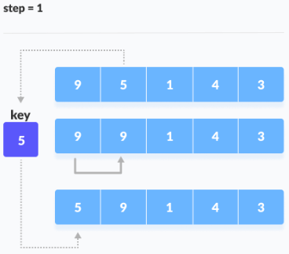
Insertion sort (Time Complexity O(n²), Space Complexity O(1))
(https://www.programiz.com/dsa/insertion-sort)
Notes:
This tutorial is intended to provide you information about what insertion sort algorithm is and how to implement it in programming rather than it's technical stuff, properties and comparision with other sorting algorithm. If you know what insertion sort algorithm is then, visit this page to learn about properties of insertion sort and comparision with other sorting algorithm.
Explanation
Suppose, you want to sort elements in ascending as in above figure. Then,
Step 1: The second element of an array is compared with the elements that appears before it (only first element in this case). If the second element is smaller than first element, second element is inserted in the position of first element. After first step, first two elements of an array will be sorted.
Step 2: The third element of an array is compared with the elements that appears before it (first and second element). If third element is smaller than first element, it is inserted in the position of first element. If third element is larger than first element but, smaller than second element, it is inserted in the position of second element. If third element is larger than both the elements, it is kept in the position as it is. After second step, first three elements of an array will be sorted.
Step 3: Similary, the fourth element of an array is compared with the elements that appears before it (first, second and third element) and the same procedure is applied and that element is inserted in the proper position. After third step, first four elements of an array will be sorted.
If there are n elements to be sorted. Then, this procedure is repeated n-1 times to get sorted list of array.

Slide 9
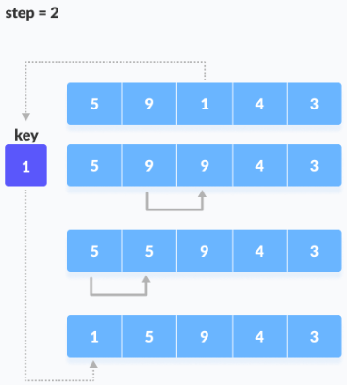
Insertion sort (Time Complexity O(n²), Space Complexity O(1))
(https://www.programiz.com/dsa/insertion-sort)
Notes:
This tutorial is intended to provide you information about what insertion sort algorithm is and how to implement it in programming rather than it's technical stuff, properties and comparision with other sorting algorithm. If you know what insertion sort algorithm is then, visit this page to learn about properties of insertion sort and comparision with other sorting algorithm.
Explanation
Suppose, you want to sort elements in ascending as in above figure. Then,
Step 1: The second element of an array is compared with the elements that appears before it (only first element in this case). If the second element is smaller than first element, second element is inserted in the position of first element. After first step, first two elements of an array will be sorted.
Step 2: The third element of an array is compared with the elements that appears before it (first and second element). If third element is smaller than first element, it is inserted in the position of first element. If third element is larger than first element but, smaller than second element, it is inserted in the position of second element. If third element is larger than both the elements, it is kept in the position as it is. After second step, first three elements of an array will be sorted.
Step 3: Similary, the fourth element of an array is compared with the elements that appears before it (first, second and third element) and the same procedure is applied and that element is inserted in the proper position. After third step, first four elements of an array will be sorted.
If there are n elements to be sorted. Then, this procedure is repeated n-1 times to get sorted list of array.

Slide 10
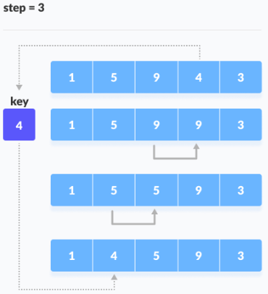
Insertion sort (Time Complexity O(n²), Space Complexity O(1))
(https://www.programiz.com/dsa/insertion-sort)
Notes:
This tutorial is intended to provide you information about what insertion sort algorithm is and how to implement it in programming rather than it's technical stuff, properties and comparision with other sorting algorithm. If you know what insertion sort algorithm is then, visit this page to learn about properties of insertion sort and comparision with other sorting algorithm.
Explanation
Suppose, you want to sort elements in ascending as in above figure. Then,
Step 1: The second element of an array is compared with the elements that appears before it (only first element in this case). If the second element is smaller than first element, second element is inserted in the position of first element. After first step, first two elements of an array will be sorted.
Step 2: The third element of an array is compared with the elements that appears before it (first and second element). If third element is smaller than first element, it is inserted in the position of first element. If third element is larger than first element but, smaller than second element, it is inserted in the position of second element. If third element is larger than both the elements, it is kept in the position as it is. After second step, first three elements of an array will be sorted.
Step 3: Similary, the fourth element of an array is compared with the elements that appears before it (first, second and third element) and the same procedure is applied and that element is inserted in the proper position. After third step, first four elements of an array will be sorted.
If there are n elements to be sorted. Then, this procedure is repeated n-1 times to get sorted list of array.

Slide 11
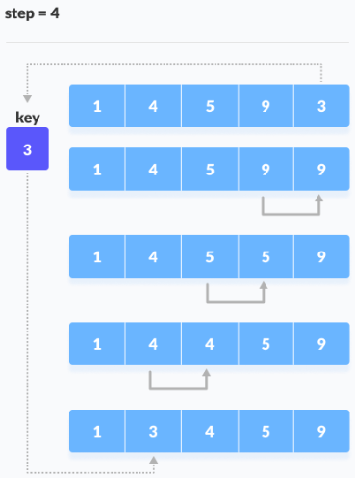
Insertion sort (Time Complexity O(n²), Space Complexity O(1))
(https://www.programiz.com/dsa/insertion-sort)
Notes:
This tutorial is intended to provide you information about what insertion sort algorithm is and how to implement it in programming rather than it's technical stuff, properties and comparision with other sorting algorithm. If you know what insertion sort algorithm is then, visit this page to learn about properties of insertion sort and comparision with other sorting algorithm.
Explanation
Suppose, you want to sort elements in ascending as in above figure. Then,
Step 1: The second element of an array is compared with the elements that appears before it (only first element in this case). If the second element is smaller than first element, second element is inserted in the position of first element. After first step, first two elements of an array will be sorted.
Step 2: The third element of an array is compared with the elements that appears before it (first and second element). If third element is smaller than first element, it is inserted in the position of first element. If third element is larger than first element but, smaller than second element, it is inserted in the position of second element. If third element is larger than both the elements, it is kept in the position as it is. After second step, first three elements of an array will be sorted.
Step 3: Similary, the fourth element of an array is compared with the elements that appears before it (first, second and third element) and the same procedure is applied and that element is inserted in the proper position. After third step, first four elements of an array will be sorted.
If there are n elements to be sorted. Then, this procedure is repeated n-1 times to get sorted list of array.

Slide 12
Insertion sort (Time Complexity O(n²), Space Complexity O(1))
(https://www.programiz.com/dsa/insertion-sort)
#include <stdio.h>
void insertionSort(int array[], int size)
{
for (int step = 1; step < size; step++)
{
int key = array[step];
int j = step - 1;
while (key < array[j] && j >= 0)
{
array[j + 1] = array[j];
--j;
}
array[j + 1] = key;
}
}
void printArray(int array[], int size)
{
for (int i = 0; i < size; i++)
{
printf("%d ", array[i]);
}
printf("\n");
}
int main()
{
int data[] = {9, 5, 1, 4, 3};
int size = sizeof(data) / sizeof(data[0]);
insertionSort(data, size);
printf("Sorted array in ascending order:\n");
printArray(data, size);
}
Notes:
This tutorial is intended to provide you information about what insertion sort algorithm is and how to implement it in programming rather than it's technical stuff, properties and comparision with other sorting algorithm. If you know what insertion sort algorithm is then, visit this page to learn about properties of insertion sort and comparision with other sorting algorithm.
Explanation
Suppose, you want to sort elements in ascending as in above figure. Then,
Step 1: The second element of an array is compared with the elements that appears before it (only first element in this case). If the second element is smaller than first element, second element is inserted in the position of first element. After first step, first two elements of an array will be sorted.
Step 2: The third element of an array is compared with the elements that appears before it (first and second element). If third element is smaller than first element, it is inserted in the position of first element. If third element is larger than first element but, smaller than second element, it is inserted in the position of second element. If third element is larger than both the elements, it is kept in the position as it is. After second step, first three elements of an array will be sorted.
Step 3: Similary, the fourth element of an array is compared with the elements that appears before it (first, second and third element) and the same procedure is applied and that element is inserted in the proper position. After third step, first four elements of an array will be sorted.
If there are n elements to be sorted. Then, this procedure is repeated n-1 times to get sorted list of array.

Slide 13

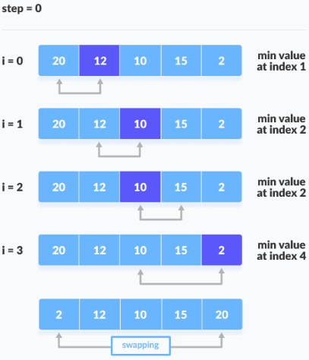
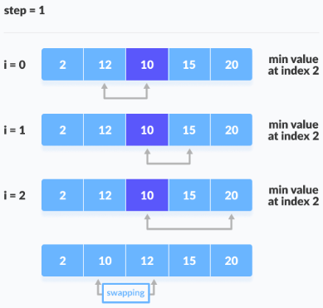
Selection sort (Time Complexity O(n²), Space Complexity O(1))
(https://www.programiz.com/dsa/selection-sort)
Notes:
This tutorial is intended to provide you information about what insertion sort algorithm is and how to implement it in programming rather than it's technical stuff, properties and comparision with other sorting algorithm. If you know what insertion sort algorithm is then, visit this page to learn about properties of insertion sort and comparision with other sorting algorithm.
Explanation
Suppose, you want to sort elements in ascending as in above figure. Then,
Step 1: The second element of an array is compared with the elements that appears before it (only first element in this case). If the second element is smaller than first element, second element is inserted in the position of first element. After first step, first two elements of an array will be sorted.
Step 2: The third element of an array is compared with the elements that appears before it (first and second element). If third element is smaller than first element, it is inserted in the position of first element. If third element is larger than first element but, smaller than second element, it is inserted in the position of second element. If third element is larger than both the elements, it is kept in the position as it is. After second step, first three elements of an array will be sorted.
Step 3: Similary, the fourth element of an array is compared with the elements that appears before it (first, second and third element) and the same procedure is applied and that element is inserted in the proper position. After third step, first four elements of an array will be sorted.
If there are n elements to be sorted. Then, this procedure is repeated n-1 times to get sorted list of array.

Slide 14
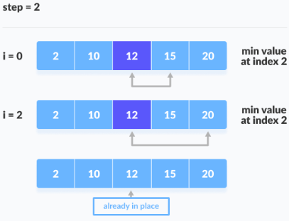
Selection sort (Time Complexity O(n²), Space Complexity O(1))
(https://www.programiz.com/dsa/selection-sort)
Notes:
This tutorial is intended to provide you information about what insertion sort algorithm is and how to implement it in programming rather than it's technical stuff, properties and comparision with other sorting algorithm. If you know what insertion sort algorithm is then, visit this page to learn about properties of insertion sort and comparision with other sorting algorithm.
Explanation
Suppose, you want to sort elements in ascending as in above figure. Then,
Step 1: The second element of an array is compared with the elements that appears before it (only first element in this case). If the second element is smaller than first element, second element is inserted in the position of first element. After first step, first two elements of an array will be sorted.
Step 2: The third element of an array is compared with the elements that appears before it (first and second element). If third element is smaller than first element, it is inserted in the position of first element. If third element is larger than first element but, smaller than second element, it is inserted in the position of second element. If third element is larger than both the elements, it is kept in the position as it is. After second step, first three elements of an array will be sorted.
Step 3: Similary, the fourth element of an array is compared with the elements that appears before it (first, second and third element) and the same procedure is applied and that element is inserted in the proper position. After third step, first four elements of an array will be sorted.
If there are n elements to be sorted. Then, this procedure is repeated n-1 times to get sorted list of array.

Slide 15
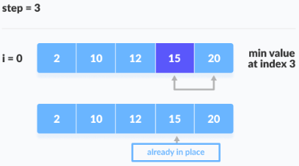
Selection sort (Time Complexity O(n²), Space Complexity O(1))
(https://www.programiz.com/dsa/selection-sort)
Notes:
This tutorial is intended to provide you information about what insertion sort algorithm is and how to implement it in programming rather than it's technical stuff, properties and comparision with other sorting algorithm. If you know what insertion sort algorithm is then, visit this page to learn about properties of insertion sort and comparision with other sorting algorithm.
Explanation
Suppose, you want to sort elements in ascending as in above figure. Then,
Step 1: The second element of an array is compared with the elements that appears before it (only first element in this case). If the second element is smaller than first element, second element is inserted in the position of first element. After first step, first two elements of an array will be sorted.
Step 2: The third element of an array is compared with the elements that appears before it (first and second element). If third element is smaller than first element, it is inserted in the position of first element. If third element is larger than first element but, smaller than second element, it is inserted in the position of second element. If third element is larger than both the elements, it is kept in the position as it is. After second step, first three elements of an array will be sorted.
Step 3: Similary, the fourth element of an array is compared with the elements that appears before it (first, second and third element) and the same procedure is applied and that element is inserted in the proper position. After third step, first four elements of an array will be sorted.
If there are n elements to be sorted. Then, this procedure is repeated n-1 times to get sorted list of array.

Slide 16
Selection sort (Time Complexity O(n²), Space Complexity O(1))
(https://www.programiz.com/dsa/selection-sort)
#include <stdio.h>
void swap(int *a, int *b)
{
int temp = *a;
*a = *b;
*b = temp;
}
void selectionSort(int array[], int size)
{
for (int step = 0; step < size - 1; step++)
{
int min_idx = step;
for (int i = step + 1; i < size; i++)
{
if (array[i] < array[min_idx])
min_idx = i;
}
swap(&array[min_idx], &array[step]);
}
}
void printArray(int array[], int size)
{
for (int i = 0; i < size; ++i)
{
printf("%d ", array[i]);
}
printf("\n");
}
int main()
{
int data[] = {20, 12, 10, 15, 2};
int size = sizeof(data) / sizeof(data[0]);
selectionSort(data, size);
printf("Sorted array in Acsending Order:\n");
printArray(data, size);
}
Notes:
This tutorial is intended to provide you information about what insertion sort algorithm is and how to implement it in programming rather than it's technical stuff, properties and comparision with other sorting algorithm. If you know what insertion sort algorithm is then, visit this page to learn about properties of insertion sort and comparision with other sorting algorithm.
Explanation
Suppose, you want to sort elements in ascending as in above figure. Then,
Step 1: The second element of an array is compared with the elements that appears before it (only first element in this case). If the second element is smaller than first element, second element is inserted in the position of first element. After first step, first two elements of an array will be sorted.
Step 2: The third element of an array is compared with the elements that appears before it (first and second element). If third element is smaller than first element, it is inserted in the position of first element. If third element is larger than first element but, smaller than second element, it is inserted in the position of second element. If third element is larger than both the elements, it is kept in the position as it is. After second step, first three elements of an array will be sorted.
Step 3: Similary, the fourth element of an array is compared with the elements that appears before it (first, second and third element) and the same procedure is applied and that element is inserted in the proper position. After third step, first four elements of an array will be sorted.
If there are n elements to be sorted. Then, this procedure is repeated n-1 times to get sorted list of array.

