Slide 1
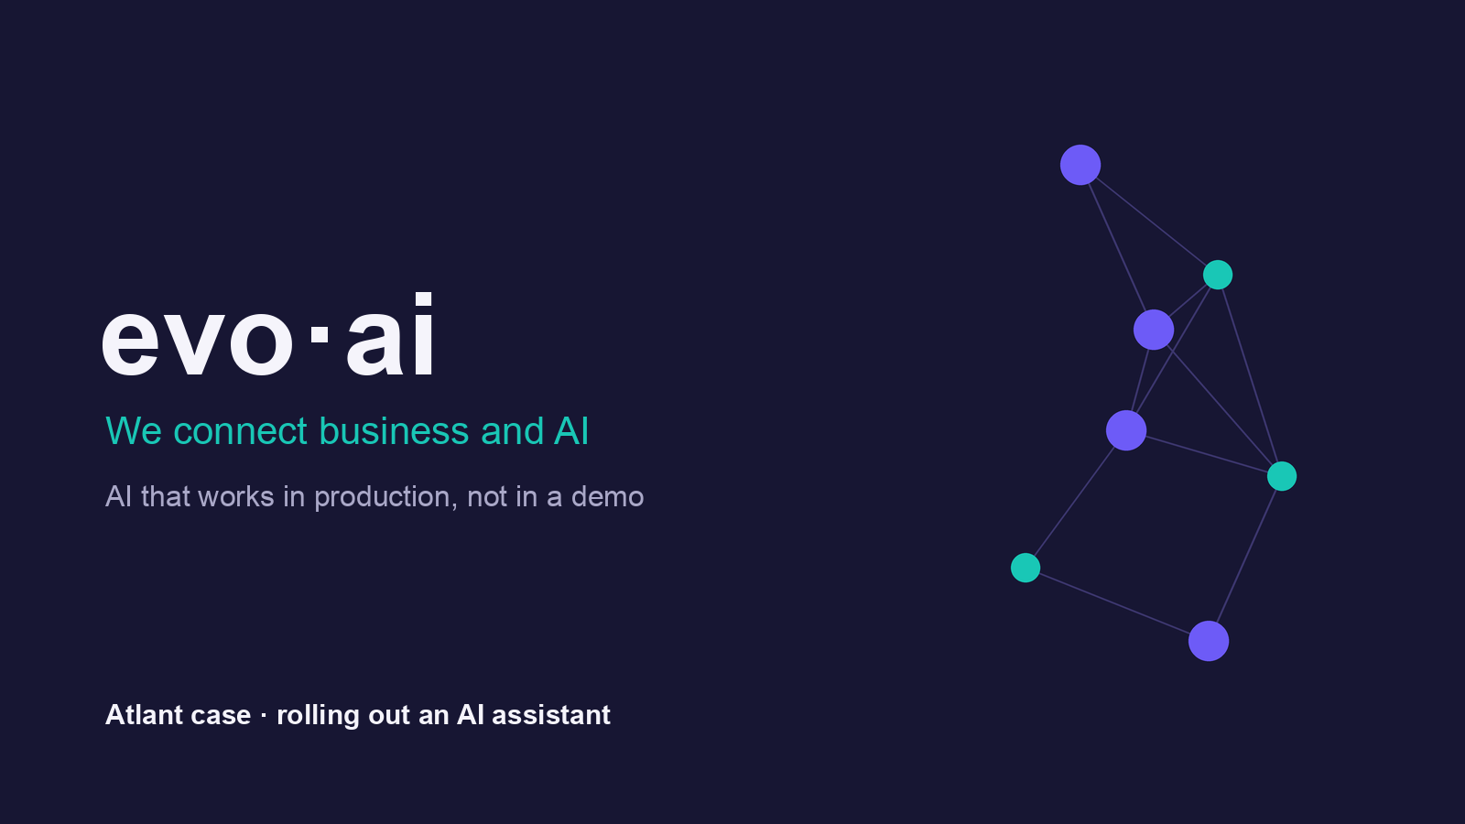

Slide 2
Evo-ai — AI that works in production
• An AI delivery studio: LLM/RAG assistants, document processing, analyst agents.
• We connect business and AI — we tie a specific problem to a specific solution.
• We ship to production, not to a demo. We measure the result in numbers on the acceptance set.
• We only take on work that has a measurable success metric.

Slide 3
The client's problem — Atlant
• Atlant is a manufacturing group. Its support desk is swamped with repetitive requests.
• Operators hunt for the answer in the policies — and different people answer differently.
• Night shifts are uncovered and the request queue keeps growing.
• The goal: speed up handling, remove the inconsistency, take load off the first line.

Slide 4
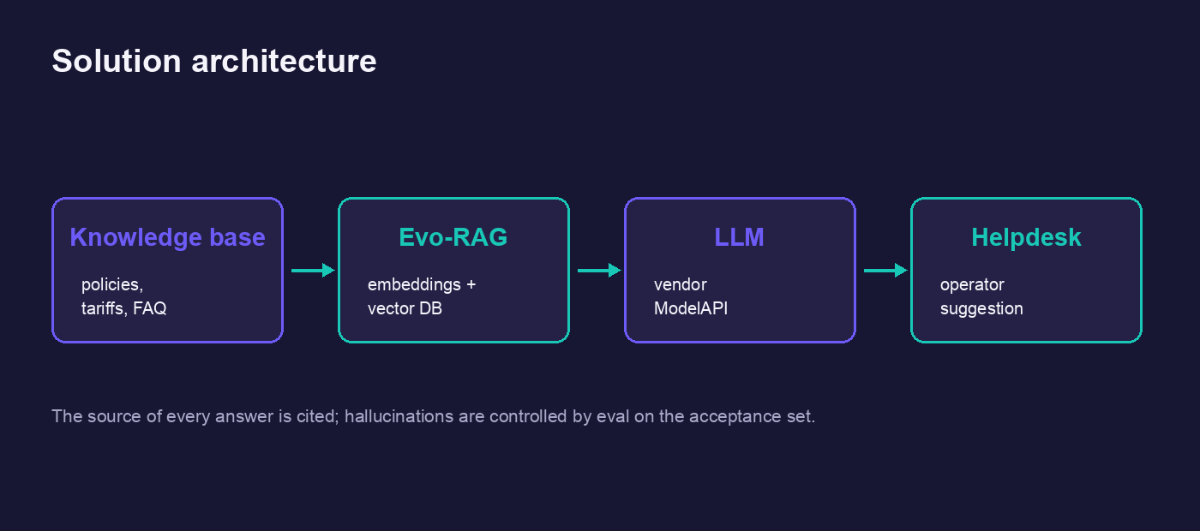
The solution: architecture
Knowledge base → Evo-RAG → LLM (ModelAPI) → a suggestion for the operator in the helpdesk

Slide 5
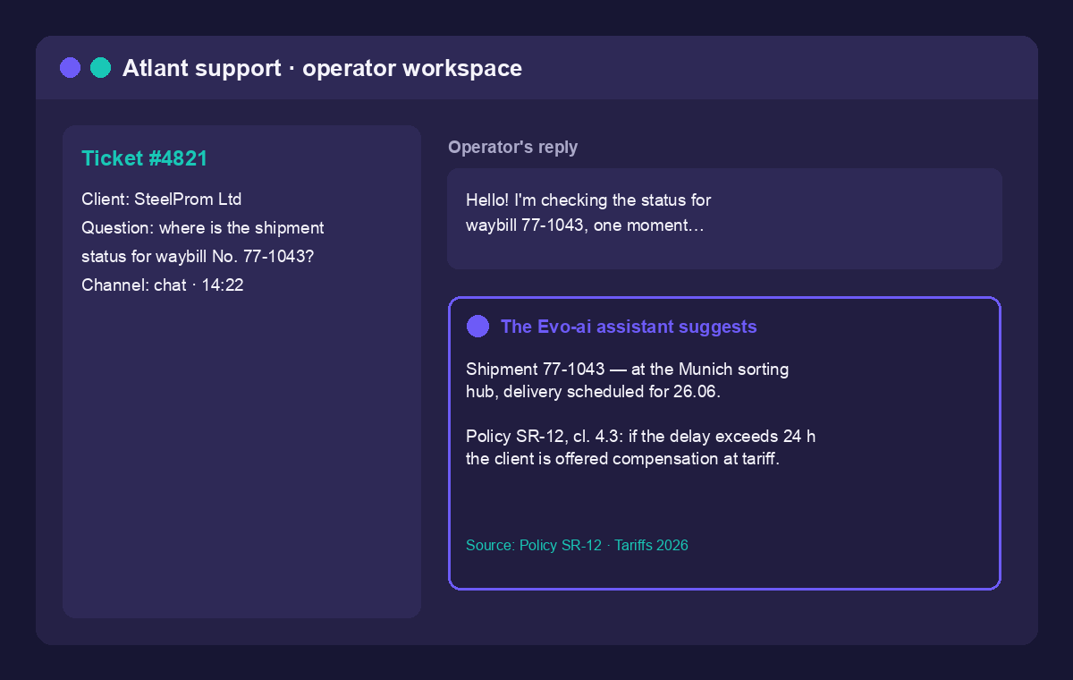
The interface: the assistant prompts the operator
Every answer cites its source — a policy and the tariffs, not thin air

Slide 6
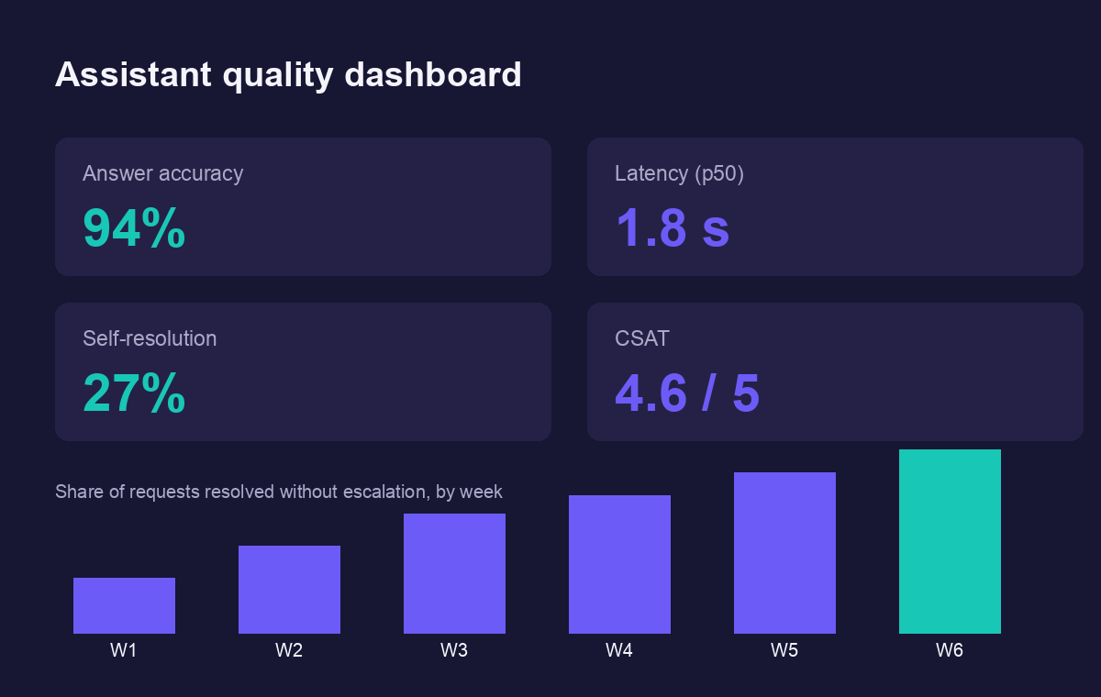
Quality metrics — we measure, we don't take it on trust
Accuracy, latency, self-resolution rate — on the acceptance set

Slide 7
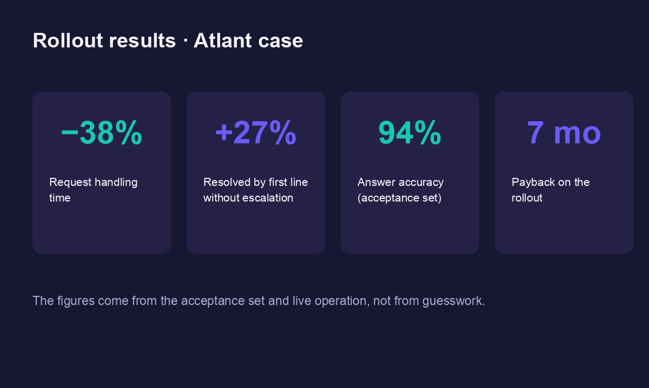
Rollout results — Atlant
−38% handling time · +27% first-line resolution · 94% accuracy · payback in 7 months

Slide 8

Let's connect your business and AI
• Our flagship is the AI support assistant. The first logistics rollout is project Hermes.
• Want the same result in your business? Write to us — we'll cost it out for your case.
• hello@evo-ai.example · evo-ai.example

