Slide 1

Chapel 1.31/1.32 Release Notes: GPU Support
Chapel Team
June 22, 2023 / September 28, 2023

Slide 2
GPU Support Outline
Background
Features
Portability
Performance
Next Steps
Notes:
Use this for the deck’s top-level outline
Can also use it for a sub-outline within a topic with multiple parts, if/when we have any of those

Slide 3
Background

Slide 4
GPU Support
Background
We are adding native GPU support to Chapel
A highly desired feature, given the potential to be a clean and portable way of programming GPUs
GPUs are more and more common in supercomputers
Over 95% of the compute capability on Frontier (currently #1 on the top-500) comes from its GPUs
In earlier releases, we’ve…
…moved from an idea (1.23), to a demo (1.24), to a user-accessible feature on NVIDIA GPUs (1.25), …
…to being able to drive multiple GPUs on one locale (1.26), and then multiple locales (1.27).
We started to focus on performance and portability during 1.29 / 1.30
1.31 / 1.32: continued push on performance and portability, responded to uptick in user requests
Performance: optimizations impacting many benchmarks, ability to use Chapel tasks with GPUs
Portability: AMD/NVIDIA parity, initial support for CUDA 12/ROCm 5, new cpu-as-device mode
Community: new users trying out GPU support, significant increase in GitHub interactions
Also new features for users and capabilities for developers

Slide 5
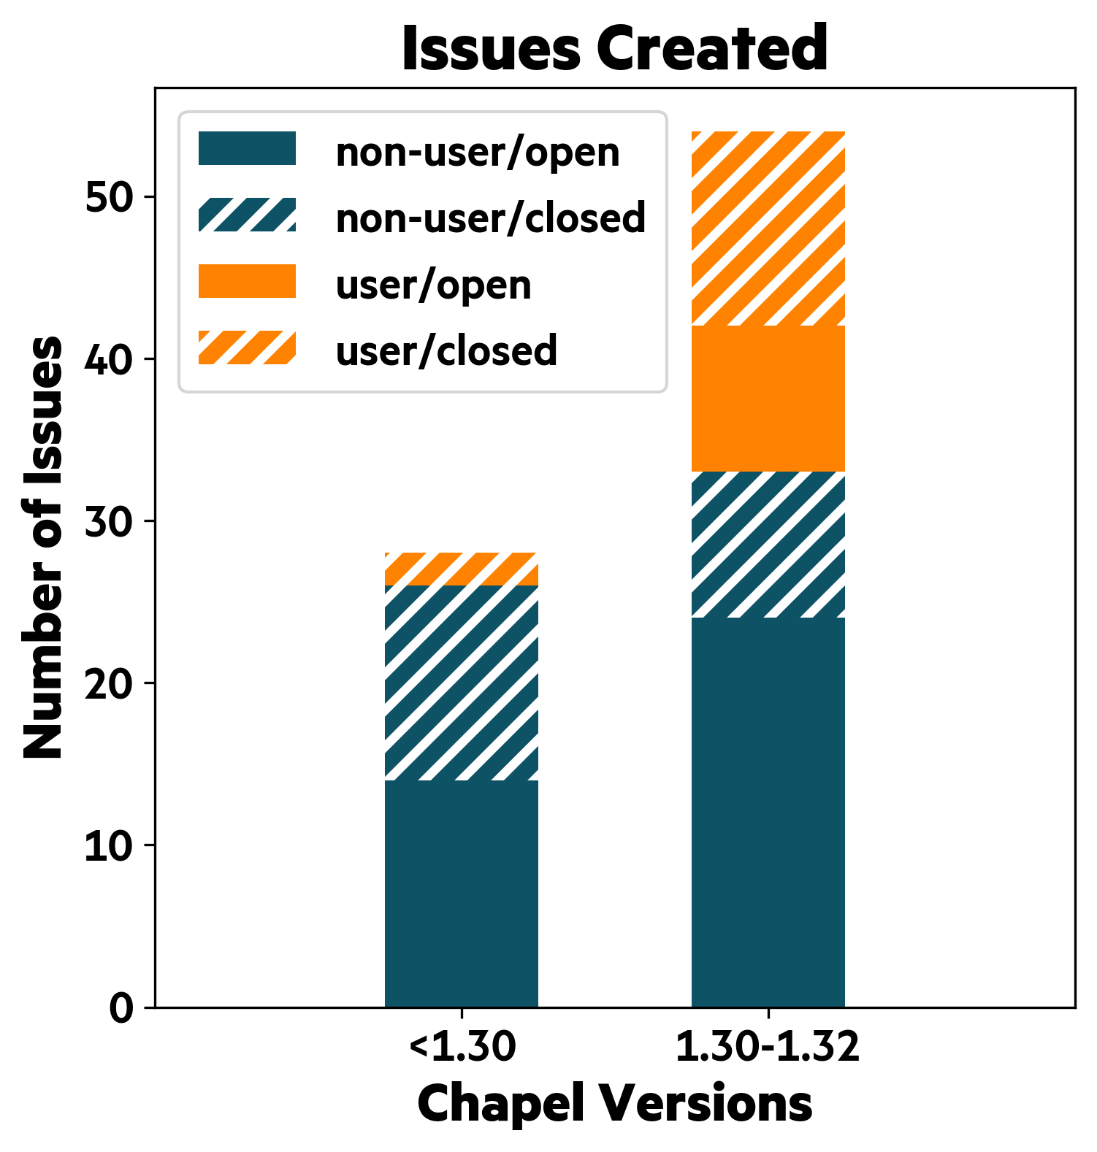
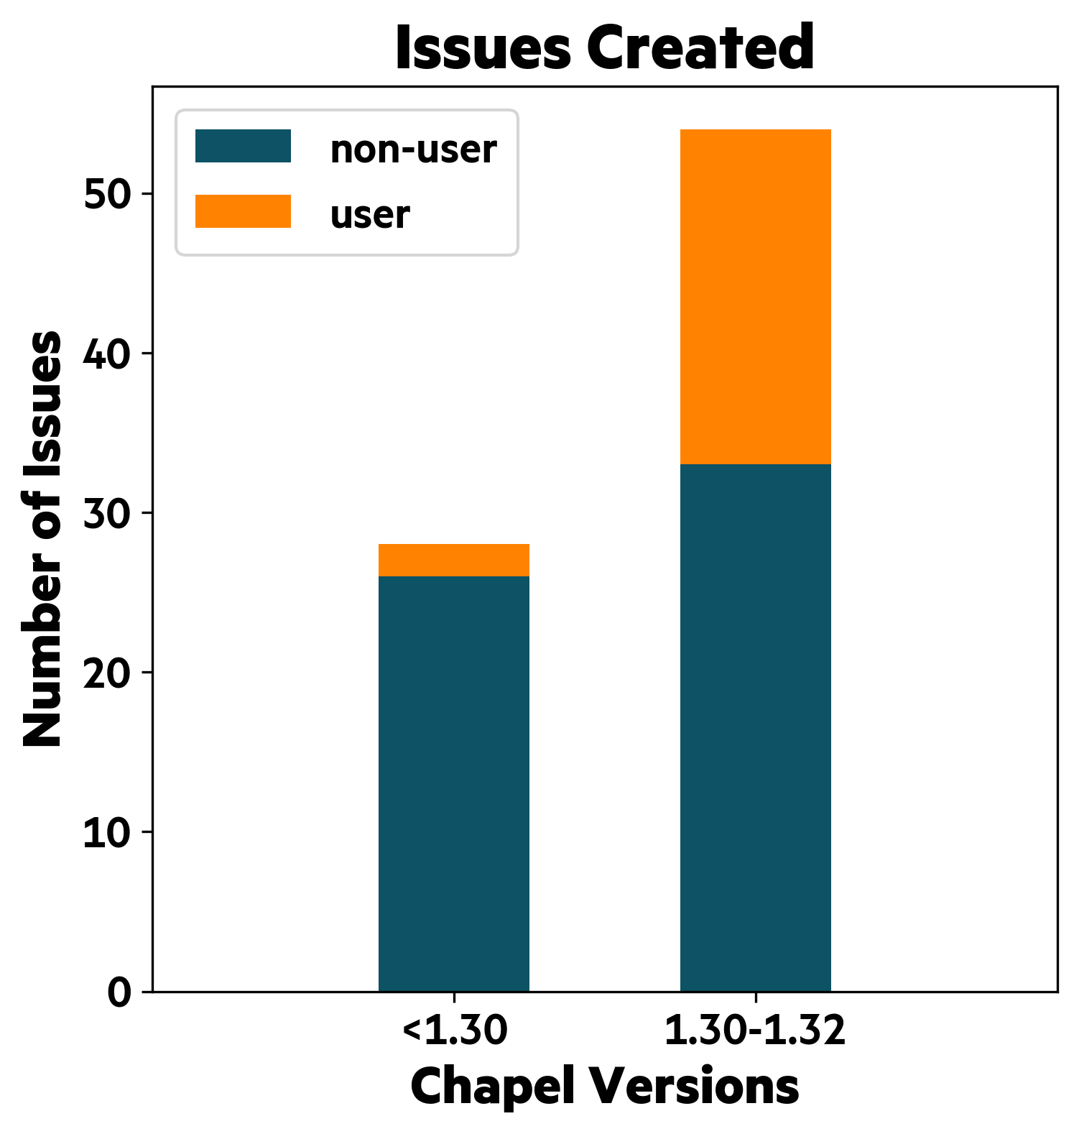
GPU Support
GitHub Activity Summary
GPU support has started to receive attention
Before 1.30:
2 user-reported issues were opened
Between 1.30 and 1.32:
we had 21 user-reported issues
During 1.31/1.32, we prioritized resolving user issues
we closed 27 total issues,
14 of them were reported by users
We also started to report issues publicly ourselves
... while migrating internal discussions to the public repo

Slide 6
Crash Course in GPU Programming Using Chapel

Slide 7
GPU Support
Vector Increment Example: Basics
on here.gpus[0] {
var GpuVec: [1..n] int;
GpuVec += 1;
writeln(GpuVec);
}
'on' statement targets a GPU
array data will be allocated on the targeted GPU
data-parallel operations will launch as a GPU kernel

Slide 8
GPU Support
Vector Increment Example: Data Offload via Bulk Array Assignment
var CpuVec: [1..n] int;
on here.gpus[0] {
var GpuVec = CpuVec;
GpuVec += 1;
CpuVec = GpuVec;
}
writeln(CpuVec);
host-to-device copy
device-to-host copy

Slide 9
GPU Support
Vector Increment Example: Multiple GPUs via 'coforall'
var CpuVec: [1..n] int;
coforall gpu in here.gpus do on gpu {
const myChunk = ...;
var GpuVec = CpuVec[myChunk];
GpuVec += 1;
CpuVec[myChunk] = GpuVec;
}
writeln(CpuVec);
'coforall' creates a task per local GPU
a slice of the data is copied
between host and device

Slide 10
GPU Support
Vector Increment Example: Multiple GPUs on Multiple Locales
var CpuVec: [1..n] int;
coforall loc in Locales do on loc {
coforall gpu in here.gpus do on gpu {
const myChunk = ...;
var GpuVec = CpuVec[myChunk];
GpuVec += 1;
CpuVec[myChunk] = GpuVec;
}
}
writeln(CpuVec);
'coforall' over all locales

Slide 11
GPU Support
Vector Increment Example: Multiple GPUs using Multiple Tasks on Multiple Locales
var CpuVec: [1..n] int;
coforall loc in Locales do on loc {
coforall gpu in here.gpus do on gpu {
coforall workerId in 0..<numTasks {
const myChunk = ...;
var GpuVec = CpuVec[myChunk];
GpuVec += 1;
CpuVec[myChunk] = GpuVec;
}
}
}
writeln(CpuVec);
'coforall' to create multiple tasks per GPU
This pattern has significantly
improved performance in 1.32
See the "Performance" part of this deck.

Slide 12
GPU Support
Overview of Changes in 1.31 and 1.32
Performance:
Faster array access in kernels
Faster Math library calls
Faster multitasking on GPUs
Turned the faster memory strategy on by default
Peer-to-peer access features and exploration
Portability:
CPU-as-Device mode
AMD/NVIDIA feature and performance parity
Initial Intel exploration
CUDA 12/ROCm 5 support
New Features and Capabilities:
Standalone atomic functions
'--report-gpu' compiler flag
Ability to compile for multiple NVIDIA architectures
Improved debugging features:
Ability to inspect assembly for AMD GPUs
Improved auto-generated kernels' names
New loop attribute '@assertOnGpu'

Slide 13
Features
Atomic Operations
'--report-gpu' flag
Assembly Inspection
'@assertOnGpu' attribute
Multi-arch compilation
Improved Kernel Naming
Notes:
Use this for the deck’s top-level outline
Can also use it for a sub-outline within a topic with multiple parts, if/when we have any of those

Slide 14
Atomic operations on gpu
Background: GPUs have support for atomic operations (add, compare-and-swap, etc.)
This Effort: Added the following procedures for atomic operations to the GPU module:
gpuAtomicAdd gpuAtomicMin gpuAtomicDec gpuAtomicXor
gpuAtomicSub gpuAtomicMax gpuAtomicAnd gpuAtomicCAS
gpuAtomicExch gpuAtomicInc gpuAtomicOr
Status: Almost all operations are supported on NVIDIA and AMD GPUs
Caveat: 64-bit, signed, atomic 'min' and 'max' operations do not work when compiling for AMD
These operations are not supported in HIP version < 5.7 (we currently support 4.0–5.4)
We produce a compile-time error if these are used and 'CHPL_GPU=amd' is set
Next Steps:
Allow using variables with Chapel's 'atomic' type and have them lower to these calls as appropriate (#23619)
Enable atomic min and max on AMD GPUs once we support HIP versions >= 5.7
Notes:
For the lack of signed hip operations compare https://sep5.readthedocs.io/en/latest/Programming_Guides/Kernel_language.html?highlight=atomicAdd#atomic-functions and https://docs.nvidia.com/cuda/cuda-c-programming-guide/index.html#atomicmax
https://github.com/ROCm-Developer-Tools/HIP/issues/3340

Slide 15
--report-gpu flag
Background: Chapel generates kernels for all GPU-eligible loops
Users may want to know what loops are and are not GPU-eligible
'assertOnGpu' does a compile-time eligibility check, but needs to be applied manually to all loops
This Effort: Added '--report-gpu' to chpl to dump loop eligibility information
We report on all loops that are order-independent and not already in a GPU kernel
Impact: The following code produces the following output when compiled with '--report-gpu':
foreach i in 0..10 do A[i] = callToExtern();
foreach i in 0..10 do A[i] *= 2;
foreach i in 0..10 do A[i] += 2;
GPU INELIGIBLE LOOPS:
---------------------
foo.chpl:1
GPU ELIGIBLE LOOPS:
-------------------
foo.chpl:2
foo.chpl:3
Next Steps: Consider increasing the verbosity for when we report GPU-ineligibility (#23620)

Slide 16
Emitting gpu assembly with --savec flag
Background: --savec dumps code that can help users gain performance insights
When using the C backend, it saves C files
When using LLVM, it saves various llvm-related intermediate files
(the name "savec" needs to change, at least for LLVM, see #18602)
When compiling for NVIDIA GPUs, it also stores a PTX assembly file
but previously we did not do this for AMD
This Effort: Ensured --savec outputs GPU-related assembly for NVIDIA and AMD
Impact:
Regardless of GPU target, we output a 'chpl__gpu.s'
In the generated assembly, kernels are named 'chpl_gpu_kernel_<fileName>_line_<num>'
We now documented this in the technote and intend to support it going forward

Slide 17
assert-On-Gpu Attribute
Background:
Ensuring that loops were GPU-eligible was handled by a special 'assertOnGpu( )' function
Calls to 'assertOnGpu( )' were either compile-time or run-time depending on its position, which was unusual
If 'assertOnGpu( )' was a top-level statement in an ineligible loop, compiler reported an error immediately
This Effort:
Use recently-added loop attributes to introduce '@assertOnGpu', which always performs a compile-time check
Precludes the need for differentiating function behavior if it’s at the top level
@assertOnGpu
foreach a in A do a += 1;
Status:
'@assertOnGpu' is the preferred way to check GPU eligibility
the standalone 'assertOnGpu' function is deprecated
Next Steps:
Investigate if a runtime-only assertion (like 'assertOnGpu()' not-at-top-level) is necessary

Slide 18
Multi-Architecture GPU Executables
Background:
It’s common for GPU-enabled programs to embed multiple GPU binaries for different architectures
Enables a compiled program to run on devices with different GPU hardware
e.g., a cluster with different GPU nodes, or a laptop with dedicated and integrated GPU
This Effort:
Added prototypical support for multi-architecture executables to Chapel’s GPU functionality
Status:
Initial support for multi-architecture executables for NVIDIA
To access, pass comma-separated architectures to ‘--gpu-arch’
> chpl --gpu-arch sm_70,sm_80
Current approach relies on using the lowest-common version of PTX for named architectures
with additional effort, could specialize PTX per architecture
Next Steps:
Investigate additional specialization for architectures and multi-vendor support (#22783)

Slide 19
GPU Kernel Naming
Background:
Chapel generates GPU kernels by translating loops into procedures (named 'chpl_gpu_kernel')
If multiple kernels are present, the built-in mangling appended '_1', '_2', and more
However, 'chpl_gpu_kernel_1' isn’t very descriptive, and doesn’t make for easy debugging
This Effort:
Change the GPU kernel naming policy to include the filename and line number. e.g.,
chpl_gpu_kernel_fileName_line_13
chpl_gpu_kernel_fileName_line_37
Status:
Kernel naming changes are available in 1.32

Slide 20
Portability
AMD/NVIDIA Parity
Intel Explorations
CPU-as-Device mode
CUDA 12/ROCm 5 support
Notes:
Use this for the deck’s top-level outline
Can also use it for a sub-outline within a topic with multiple parts, if/when we have any of those

Slide 21
GPU architecture Feature Parity
Background: In 1.30, some Chapel code was not portable across AMD and NVIDIA GPUs
Specifically, using the 64-bit versions of these functions caused compile-time failures when building for AMD:
acos acosh asin asinh atan atan2
atanh cbrt cosh erf erfc ldexp
lgamma log1p sinh tan tanh tgamma
This Effort: Fixed a bug causing us to erroneously link to the wrong version of these math functions
Status: We now support the same math functions for NVIDIA and AMD
Notes:
PR: https://github.com/chapel-lang/chapel/pull/22791
For the lack of signed hip operations compare https://sep5.readthedocs.io/en/latest/Programming_Guides/Kernel_language.html?highlight=atomicAdd#atomic-functions and https://docs.nvidia.com/cuda/cuda-c-programming-guide/index.html#atomicmax
https://github.com/ROCm-Developer-Tools/HIP/issues/3340
It got added:
https://github.com/ROCm-Developer-Tools/clr/blob/5914ac3c6e9b3848023a7fa25e19e560b1c38541/hipamd/include/hip/amd_detail/amd_hip_atomic.h#L825

Slide 22
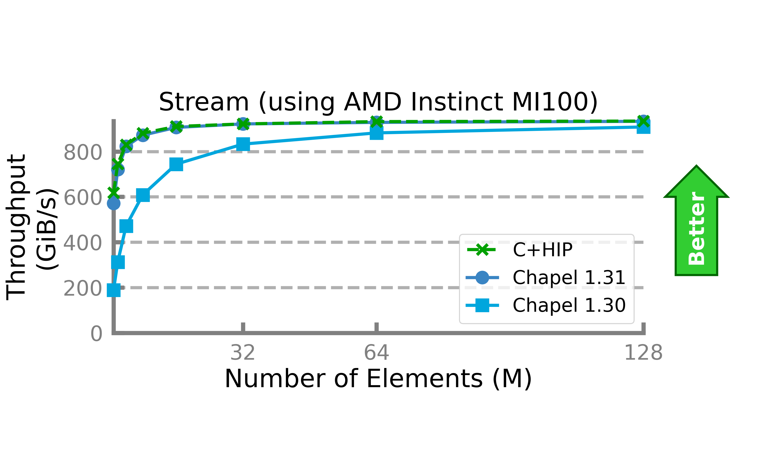
Gpu architecture performance Parity
Background: In 1.30, HPCC-Stream was competitive with CUDA on NVIDIA but not with HIP on AMD
This Effort: Updated runtime to avoid calling a deprecated HIP API
Impact: Stream now performs competitively to C+HIP on AMD
Notes:
This is the API in question: https://github.com/chapel-lang/chapel/pull/22375/files hipHostAlloc -> hipHostMalloc

Slide 23
Targeting Intel GPUs
Background:
Chapel supports targeting NVIDIA and AMD GPUs; but Intel GPUs are not supported, yet
LLVM does not support targeting Intel GPUs
This Effort:
We investigated Intel's LLVM-based 'dpc++' compiler
Discovered that default builds may not be suitable for use as the system LLVM
Headers and some tools are missing
Next Steps:
Allow Chapel to be built with Intel's LLVM as the system LLVM
Create documentation for it for advanced users
Implement a runtime layer for Intel GPUs based on oneAPI Level Zero

Slide 24
CPU-as-Device Mode
Background and This Effort
Background:
Chapel's GPU support required the runtime to be built with CUDA or HIP as a dependency
This meant that even simple development must be done on a system with actual GPUs
Being able to start HPC-oriented development on a personal computer is an important part of productivity
e.g., Chapel also allows multilocale development on a personal computer
This Effort: Chapel now has a cpu-as-device mode for GPU programming without GPUs
No CUDA/HIP dependencies, no need for actual GPUs
To enable this mode:
> export CHPL_LOCALE_MODEL=gpu # required for GPU support in general
> export CHPL_GPU=cpu # mandatory to enable cpu-as-device mode. i.e., will never be set automatically

Slide 25
CPU-as-Device Mode
Status
Compiler works similarly, but the original loop will always execute
Runtime's calls bump up diagnostic counters as appropriate, redirect to other parts of the runtime
i.e., GpuDiagnostics can be used normally in most cases
'@assertOnGpu' on a loop generates:
Compiler error: if the loop is not GPU-eligible
Runtime warning: if the loop is run on a non-GPU locale
The warning can be disabled by setting the 'CHPL_GPU_NO_CPU_MODE_WARNING' environment variable
Runtime code:
void launch_kernel(...) {
num_launches += 1;
return;
}
foreach i in 1..n do
foo()
if (on_gpu()) {
launch_kernel(...);
}
foreach i in 1..n do
foo();
Translates
into

Slide 26
CPU-as-Device Mode
Next Steps
We plan to address some behavior differences we observed
Nested GPU-eligible loops cause GpuDiagnostics to register more kernel launches than expected
Argument passing and outer variable usage details are not captured in this mode
We were unable to reproduce some actual GPU bugs in this mode
The generated kernel is discarded while generating the final code
There's no generated kernel code that is very useful for advanced debugging during development
Runtime code:
void launch_kernel(...) {
num_launches += 1;
for (int threadIdx...
call_kernel(kernel,
threadIdx,
...);
return;
}
foreach i in 1..n do
foo()
if (on_gpu()) {
launch_kernel(...);
}
else { // need 'else' now
foreach i in 1..n do
foo();
}
Will translate
into

Slide 27
CUDA 12.x Support
Background:
Chapel supported CUDA 11.x and 10.x with some limitations
CUDA 12.x was not supported before
Main blocker: LLVM/Clang 15 (highest version Chapel supports) does not support CUDA 12.x
Noted by multiple users
LLVM/Clang 16 supports CUDA 12
This Effort:
We patched our bundled LLVM (version 15) to support CUDA 12
Unsupported versions generate an error while building Chapel
Status:
CUDA 12 is now supported only when using the bundled LLVM
Next Steps:
Complete LLVM 16 upgrade to enable CUDA 12 support with system LLVM too
Consider dropping CUDA 10.x support
Should be a documentation change only: we do not maintain any code to support 10.x specifically

Slide 28
ROCM 5.x Support
Background:
Chapel supported ROCm 4.x
ROCm 5.x was not tested before
Status:
Unsupported versions generate an error while building Chapel
5.0, 5.1: Fully supported
5.2-5.4: Supported, but deprecation warnings from clang are expected
The way the compiler uses a clang tool to bundle device and host binaries is deprecated
We plan to fix this soon
5.5+: Not supported
These versions require LLVM 16
There may be a way to use LLVM 15, or patch it similarly to LLVM 16
For now, we are waiting on the LLVM 16 upgrade
5.7+: Not supported, but required for 64-bit, signed 'gpuAtomicMax' and 'gpuAtomicMin' support
See #23480 for the most up-to-date status of ROCm 5.x support

Slide 29
Performance
Faster Array Access
Peer-to-Peer Access
Array-On-Device
Task Parallelism with GPUs
Faster Math Library Calls
GPU Specialization
Notes:
Use this for the deck’s top-level outline
Can also use it for a sub-outline within a topic with multiple parts, if/when we have any of those

Slide 30
Faster Array Access in Kernels
Background and This Effort
Background:
Arrays have two layers of indirection to get to underlying data
Loop Invariant Code Motion (LICM) is an optimization that moves code from inside to outside a loop
Helps avoid repetitive computations that always have the same value (e.g., 1+1).
Can be used to move array metadata access, too
Chapel’s LICM optimization is conservative; arrays passed by reference are not considered “constant”
proc copyArray(ref A: [?D] int, ref B: [D] int) {
foreach i in A.domain do B[i] = A[i];
}
This Effort:
Arrays passed by reference to GPU kernels won’t be changed from outside
Relax LICM rules to match
Result:
4 metadata accesses per iteration!

Slide 31
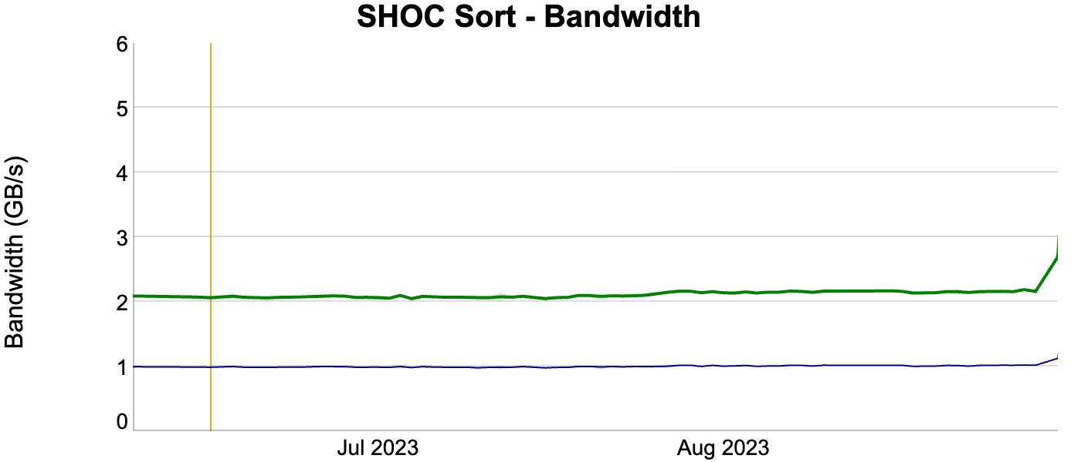
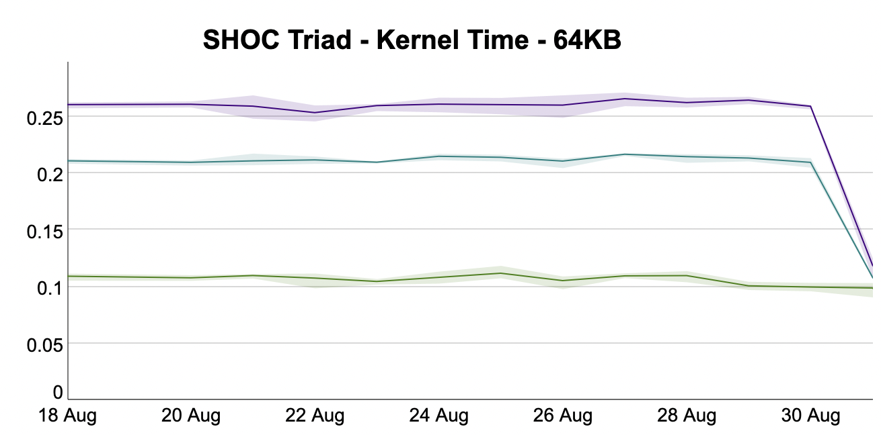
Faster Array Access in Kernels
Impact
Performance improvements across multiple benchmarks
proc copyArray(ref A: [?D] int, ref B: [D] int) {
foreach i in A.domain do B[i] = A[i];
}
4 metadata accesses total!
1.25x faster
SHOC Sort kernel
2.1x faster
SHOC Triad kernel

Slide 32
Peer-to-peer access
Background and This Effort
Background:
GPUs can communicate directly with one other
Can be through PCIe or communication links such as NVLink or Infinity Fabric
Previously, Chapel's GPU runtime would not enable peer-to-peer communication
This Effort: Create a way to enable peer-to-peer communication
Added the 'enableGpuP2P' config constant to 'GPU' module
To use, run your Chapel program with '--enableGpuP2P=true'

Slide 33
Peer-to-peer access
Impact
Impact: On NVIDIA, we see close to 6x throughput improvement in GPU-to-GPU transfers
Tables measure 8 GiB transfers on a system with 4 NVIDIA A100-SXM4 GPUs
Row and column correspond to source and destination GPU
Each transfer was performed individually
Throughput (GiB/s)
enableGpuP2P=false
Throughput (GiB/s)
enableGpuP2P=true
 | 0 | 1 | 2 | 3
0 |  | 13.2 | 11.9 | 13.3
1 | 13.2 |  | 13.4 | 13.5
2 | 13.2 | 13.3 |  | 13.5
3 | 13.2 | 13.2 | 13.4
 | 0 | 1 | 2 | 3
0 |  | 86.2 | 86.3 | 86.3
1 | 86.1 |  | 86.4 | 86.3
2 | 86.6 | 86.5 |  | 86.1
3 | 86.6 | 86.5 | 86.5

Slide 34
Peer-to-peer access
Status and Next Steps
Status: While NVIDIA GPUs benefit from '--enableGpuP2P', AMD GPUs do not
We have observed that AMD conducts peer-to-peer transfers by default
On Frontier we see ~10–47 GiB/s transfers in our benchmark regardless of how '--enableGpuP2P' is set
With AMD, setting 'HSA_ENABLE_SDMA=0' adjusts GPU-to-GPU transfers for higher throughput
We observed up to 160 GiB/s transfer rates on Frontier with this setting
Next Steps:
Find non-artificial benchmarks using peer-to-peer communication
Further investigate peer-to-peer performance with AMD GPUs and Infinity Fabric
Determine if we want Chapel to adjust 'HSA_ENABLE_SDMA'
Determine if we should allow turning on/off peer-to-peer access on an individual GPU level (#23621)
Or allow specifying peer-to-peer communication on an individual put/get basis
Notes:
HAS_ENABLE_SDMA: when disabled communication occurs via kernel launch enabling faster transfers at the expense of being able to overlap communication and computation

Slide 35
Array-On-Device
Background:
'array_on_device' is a memory strategy
Faster data transfers and GPU array initialization
However, CPU array initialization was sub-optimal
This Effort:
Significantly improved performance
Implemented GPU-aware GET/PUT calls
This will also help GPU-driven communication
Status:
'array_on_device' performs better
1.2x – 14x improvements in nightly testing
It is the default memory strategy as of 1.32
Performance in previous
release was lacking
Time (s)
(RTX A2000)
Significantly improved
CPU array initialization
Unified Memory | Array on Device
0.12 | 0.18
0.038 | 0.018
var CpuArr: [1..n] int;
on here.gpus[0] {
var GpuArr: [1..n] int;
GpuArr = CpuArr;
CpuArr = GpuArr;
}
18.16
Unified Memory | Array on Device
0.25 | 0.033
0.14 | 0.034

Slide 36

Avoiding Task Starvation
Background
on here.gpus[0] {
begin {
gpuData2 = cpuData2;
data2Copied.writeEF(true); }
foreach d in gpuData1 do foo(d);
if data2Copied.readFE() then
foreach d in gpuData2 do bar(d);
}
Communication and computation overlap is:
An optimization to make use of different HW units
An important technique in GPU programming
Chapel tasks are a natural way to achieve overlap
However, before 1.32 task starvation prevented that
This copy in 'begin' must wait b/c:
it got scheduled behind the parent task
current scheduler does not allow task stealing
Core 0
pthread 0
... which will happen only when it hits sync variable read
Result: No Overlap
task queue
<will sched. child tasks on core 1>
<will sched. child tasks on core 0>
Task-private counter determines
the core on which child tasks will be scheduled
<will sched. child tasks on core 0>

Slide 37
Avoiding Task Starvation
This Effort
on here.gpus[0] {
begin {
gpuData2 = cpuData2;
data2Copied.writeEF(true); }
foreach d in gpuData1 do foo(d);
if data2Copied.readFE() then
foreach d in gpuData2 do bar(d);
}
With 1.32, a task yields right after launching a kernel
In non-contentious cases, cost is not observable
If tasks contend for a core, allows overlap
The parent task will yield after launching the kernel
Result: Overlap!
Core 0
pthread 0
task queue
The copy in 'begin' can execute
<will sched. child tasks on core 1>
The main task waits in the queue
while GPU kernel is executing
<will sched. child tasks on core 0>

Slide 38
Task-Parallel GPU Operations
Background
To overlap communication/computation on a GPU:
Data can be split into chunks
Multiple CUDA/HIP streams do copy+kernel launch
GPU driver can interleave copies with launches
But they must come from different GPU streams
One way of doing that in Chapel is:
Create multiple worker tasks per GPU
Have each of them run a loop
While picking the next chunk dynamically
Until all the chunks are processed
Before 1.32, this would perform worse
Non-overlapped version is faster
Regardless of per-task size and/or number of tasks
on here.gpus[0] {
coforall worker in 0..#numWorkers {
var DevIn, DevOut: [0..#tSize] real;
while true {
// dynamically pick the next chunk
const myChunkId = curChunk.fetchAdd(1);
if myChunkId >= numChunks then break;
const myChunk = myChunkId*tSize..#tSize;
DevIn = HostIn[myChunk]; // copy in
kernel(DevIn, DevOut); // kernel
HostOut[myChunk] = DevOut; // copy out
}
}
}

Slide 39
Task-Parallel GPU Operations
Background
Previously, Chapel used the default GPU stream
i.e., GPU operations from parallel tasks got serialized
on here.gpus[0] {
coforall worker in 0..#numWorkers {
var DevIn, DevOut: [0..#tSize] real;
while true {
// dynamically pick the next chunk
const myChunkId = curChunk.fetchAdd(1);
if myChunkId >= numChunks then break;
const myChunk = myChunkId*tSize..#tSize;
DevIn = HostIn[myChunk]; // copy in
kernel(DevIn, DevOut); // kernel
HostOut[myChunk] = DevOut; // copy out
}
}
}
Core 0
Default GPU
Stream
Core 1
worker=0
kernel
worker=1
copy out
copy in
kernel
copy in
GPU Driver
Results in completely sequential order:
time
ops | t0 | t1 | t2 | t3 | t4 | t5
xfer | in |  | in |  | out | out
exec |  | kernel |  | kernel

Slide 40
Task-Parallel GPU Operations
This Effort and Impact
This Effort: Per-task, per-device streams
Each worker task will have its own GPU stream
on here.gpus[0] {
coforall worker in 0..#numWorkers {
var DevIn, DevOut: [0..#tSize] real;
while true {
// dynamically pick the next chunk
const myChunkId = curChunk.fetchAdd(1);
if myChunkId >= numChunks then break;
const myChunk = myChunkId*tSize..#tSize;
DevIn = HostIn[myChunk]; // copy in
kernel(DevIn, DevOut); // kernel
HostOut[myChunk] = DevOut; // copy out
}
}
}
Core 0
Per-task GPU
Streams
Core 1
worker=0
worker=1
copy out
kernel
kernel
copy in
copy in
GPU Driver
Enables better overlap:
time
ops | t0 | t1 | t2 | t3 | t4 | t5
xfer | in | in | out | out
exec |  | kernel | kernel

Slide 41
Faster Math Library Calls In Kernels
Background: Math library calls like 'sqrt' were unexpectedly slower compared to CUDA/HIP
Reported by a user (#22112)
This Effort: The performance issue is fixed in 1.32
The compiler was generating calls that were wrapped in some helper functions that should have been inlined
The root issue was the ordering of device library linkage w.r.t. the LLVM optimization pipeline
Impact: Math library functions perform on-par with CUDA/HIP
Two mini-applications benefitted from this optimization
 | Speedup
 | NVIDIA A100 | AMD MI250X
coral | 1.80x | 1.25x
miniBUDE* | 1.82x | 1.92x
* https://github.com/xianghao-wang/miniBUDE/tree/benchmark

Slide 42
GPU Specialization
Background
GPU-eligible loops exhibit different behavior depending on if you are on a GPU locale or not
Namely, if we are on a GPU locale then we do a kernel launch
Checking to see if we are on a GPU adds overhead at every eligible loop
Note the repeated execution of the 'if' statement in this example:
Original code:
The compiler "lowers" this to:
on loc do
for i in 0..<N do
foreach k in 0..<P do ...
on loc do onBody()
proc onBody() do
for i in 0..<N do
if is_gpu_locale(here) then
gpu_kernel_launch(extractedLoopFunc, ...)
else
foreach k in 0..<P do ...
body of 'on' statement is outlined into a function
since the 'foreach' loop is GPU-eligible, we insert a runtime check to see if we are on a GPU locale. If so, launch it as a kernel.

Slide 43
GPU Specialization
This Effort
Clone functions reachable from 'on' statements into ”GPU-specialized" and "non-GPU-specialized" copies
Rewrite calls in GPU-specialized functions to call other specialized functions
Perform a runtime check to see if you are on a GPU in the 'on' statement; if so, call the cloned function
on loc do
for i in 0..<N do
foreach k in 0..<P do ...
if is_gpu_locale(loc) on loc do onGpuBody();
else on loc do onBody();
proc onGpuBody() do
for i in 0..<N do
gpu_kernel_launch(extractedLoopFunc, ...)
proc onBody() do
for i in 0..<N do
if current_sub_locale >= 0 then
gpu_kernel_launch(extractedLoopFunc, ...)
else
foreach k in 0..<P do ...
Lowers to
this specialization can avoid the runtime check
in theory this could too, but we don't currently
account for virtual function calls,
so we still do it here
Notes:
We can safely assume gpuBody is executed on a GPU locale, so we no longer have the 'if' statement here
We should be able to accomplish the same here, but our analysis doesn't currently account for virtual function calls. As such, we can not guarantee this function is on a CPU locale and still need to perform the check.

Slide 44
GPU Specialization
Impact and Status
Impact: Current limitations prevent us from improving performance
In an unsafe version, we see a 3x performance improvement
Unsafe because it does not rewrite virtual function calls in GPU-specialized functions to call GPU-specialized clones
In our current safe version of the transform, we do not see a performance improvement
Safe because we do not remove 'if' statements from non-GPU-specialized functions
Adding extra functions also increases compile time (~30% longer in some cases)
Status: The transform is considered experimental and may be beneficial in the future
It can optionally be turned on by passing '--gpu-specialization' to 'chpl'
Aside from removing a per-eligible-loop runtime check, the transform may prove useful for other optimizations:
specializing reductions on GPU locales
less aggressive wide pointer usage

Slide 45
GPU Specialization
Next Steps
Study more benchmarks, examining overhead from using the GPU locale model on non-GPU bound code
Make the transform cognizant of virtual function calls
Avoid overspecialization when unnecessary
Explore other kinds of specialization that may not add as much compile-time overhead

Slide 46
Summary & Next Steps

Slide 47
GPU Support
Summary: Highlights from 1.31 and 1.32
Performance:
Faster default memory strategy: 1.2x – 14x improvement on several benchmarks
Faster array access in kernels: 1.1x – 2x improvement on several benchmarks
Faster Math library calls: 1.3x – 1.9x improvement on two applications
Can reach peak peer-to-peer bandwidth on Frontier
Portability:
Feature and performance parity between NVIDIA and AMD targets
CPU-as-Device mode
Features:
Atomic operations
Ability to compile for multiple NVIDIA architectures
Increased introspection through: '--report-gpu', '--savec' on AMD and improved kernel naming

Slide 48
GPU Support
Proposed Next Steps for 1.33 and 1.34
Features:
Foreach intents and better shadowing
Warp-/wavefront-level functions
warp-synchronization
data shuffle
Initial support for basic whole-array reductions
Prototype syntax for advanced forall features
Performance:
Continue investigating low-performance cases
Investigate non-GPU execution performance
Outer-loop vectorization for CPU
Portability:
Improve cpu-as-device behavior parity
Improve CUDA 12/ROCm 5 support with LLVM 16
Explorations:
Try using dpc++ as the system LLVM for Intel GPUs
Start working on GPU-driven communication
Investigate launching multidimensional grids
Start improving CPU/GPU portability

Slide 49
Other GPU Improvements

Slide 50
other GPU improvements
For a more complete list of GPU support changes and improvements in the 1.31 and 1.32 releases, refer to the following sections in the CHANGES.md file:
‘GPU Computing’
‘Bug Fixes for GPU Computing’

Slide 51
Thank you
https://chapel-lang.org
@ChapelLanguage

