Slide 1

Global Spillovers from U.S. Bond Supply Shocks
4th PDM Conference
Global financial risks:
spillovers and sovereign market impacts
September 11, 2026
Danila Smirnov (IMF)
The views expressed in IMF Working Papers are those of the author(s) and do not necessarily represent the views of the IMF, its Executive Board, or IMF management.

Slide 2
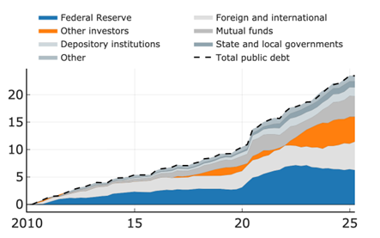
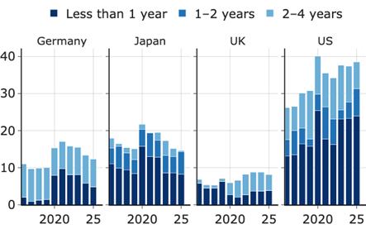
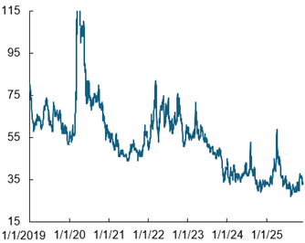
Structural Shifts in U.S. Fiscal Policy Create Global Spillover Triggers
1. Cumulative Change in Holders of US Public Debt since the First Quarter of 2010
(Trillions of dollars)
2. Short-Term Debt in Advanced Economies
(Percent of total outstanding)
3. Domestic Convenience Yield versus AAA Corporate Bonds
(Basis points)
Changing debt structure
Private investors replacing Fed as marginal buyers
U.S. and other AE shift toward short-term debt
"exorbitant privilege" eroding
Global implications
U.S. issuance affects all sovereign borrowers
amplifies spillovers
"safety buffer" that insulated global markets is shrinking

Slide 3
This Project Research Question and Contribution
How do unexpected changes in U.S. Treasury issuance affect?
  Global sovereign bond yields?
  Real economic activity abroad?
  Which countries are most vulnerable?
Key Contribution:
  Identification: Use high-frequency yield movements around Treasury auction announcements to isolate exogenous supply shocks
  Distinction: Supply-side shocks (fiscal expansion) vs. demand-side shocks (monetary policy/safe-haven flows)
  Policy relevance: Quantify fiscal externalities and identify vulnerable countries

Slide 4
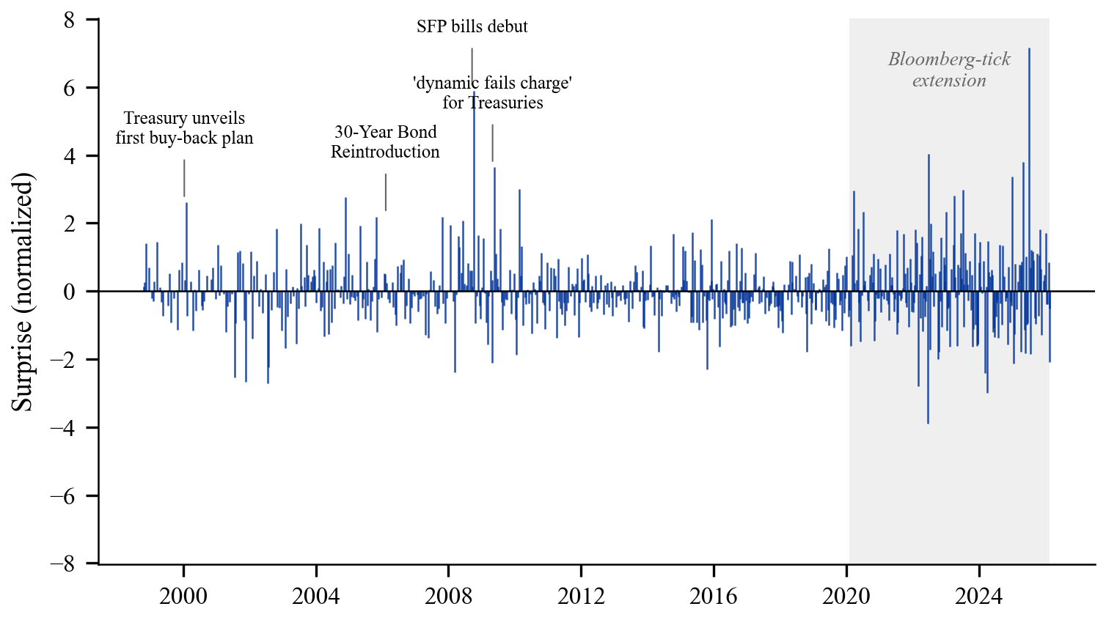
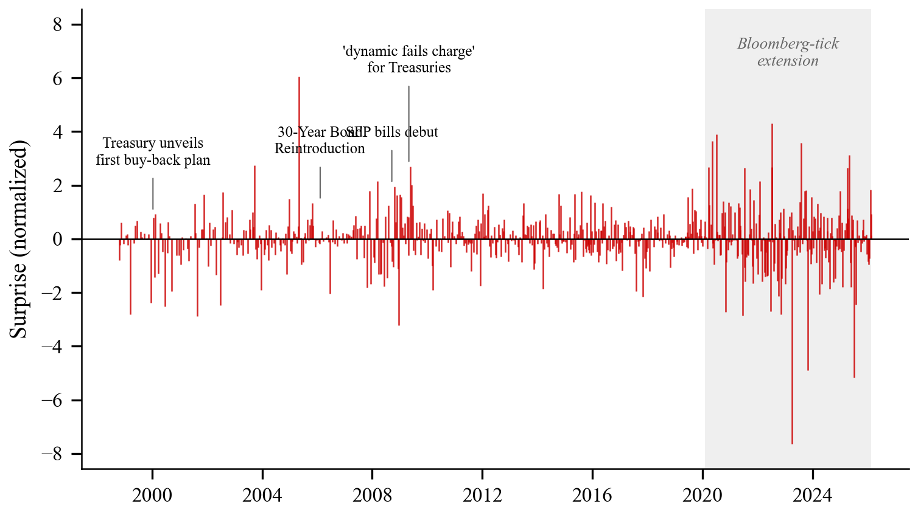
Identifying U.S. Treasury Supply Shocks From Auction Surprises
Event window: 30-minute yield changes around scheduled auction announcements isolate supply news from macro news
Sample: 462 auction events, 1998–2020
Two shocks:
  Debt expansion: broad upward shift in the curve
  Maturity extension: twist/steepening shock
Data from Phillot (2025); Shock decomp. Bi et al. (2026)
Shaded region marks post-2020 extension from Bloomberg intraday tick data under same identification
Debt expansion
(raises the yield curve)
Maturity extension
(steepens the yield curve)

Slide 5
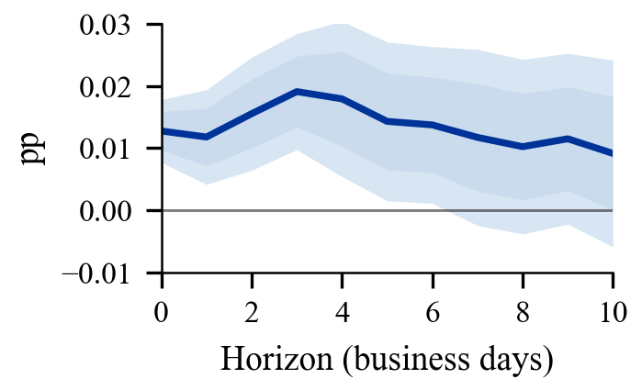
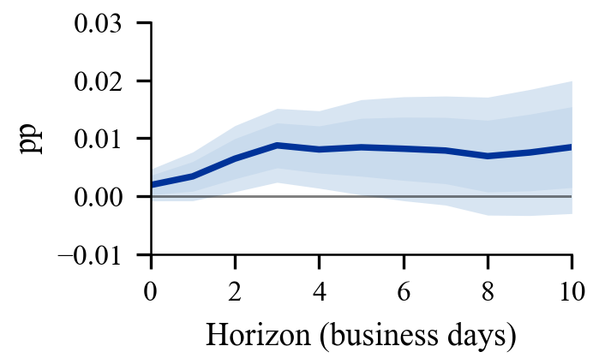
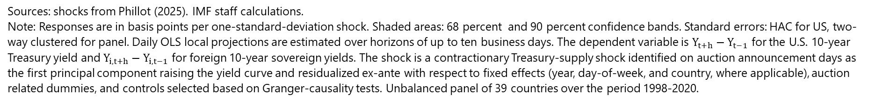
U.S. Treasury Supply Shocks Transmit to Global Bond Markets
10-year Yield Response to a One Standard Deviation Debt Expansion Shock
US
Panel
(Spillover elasticity 0.7)
Sources: shocks from Phillot (2025). IMF staff calculations.
Note: Responses are in basis points per one-standard-deviation shock. Shaded areas: 68 percent and 90 percent confidence bands. Standard errors: HAC for US, two-way clustered for panel. Daily OLS local projections are estimated over horizons of up to ten business days. The dependent variable is $Y_{t+h}−Y_{t−1}$ for the U.S. 10-year Treasury yield and $Y_{i,t+h}−Y_{i,t−1}$ for foreign 10-year sovereign yields. The shock is a contractionary Treasury-supply shock identified on auction announcement days as the first principal component raising the yield curve and residualized ex-ante with respect to fixed effects (year, day-of-week, and country, where applicable), auction related dummies, and controls selected based on Granger-causality tests. Unbalanced panel of 39 countries over the period 1998-2020.

Slide 6
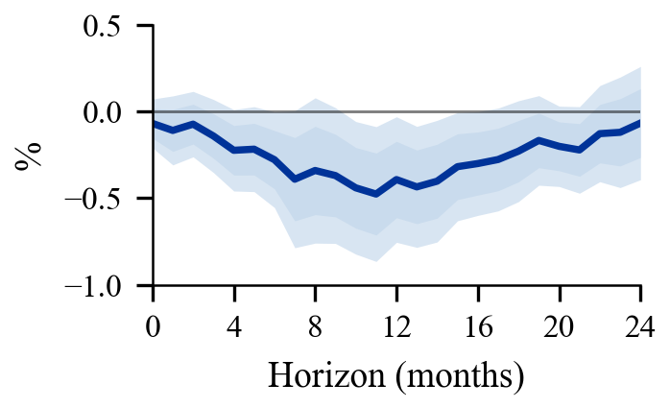
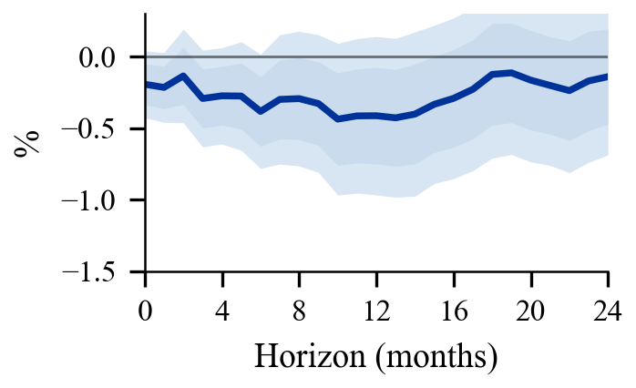
Real Spillovers are Larger Abroad Than in the U.S.
Foreign real effects exceed domestic ones: foreign IP declines by about twice as much as U.S. IP
Why? The shock tightens global financial conditions, weakens U.S. demand for foreign exports, and moves FX
Industrial Production Response to a One Standard Deviation Debt Expansion Shock
US
Panel
(Spillover elasticity 0.8)
Sources: Phillot (2025); IMF staff calculations.
Notes: Monthly panel local projections of cumulative responses $100⋅\left(logIP_{i,t+h}−logIP_{i,t−1}\right)$ to a US Treasury supply shock. Shaded areas denote 68% and 90% confidence bands. The shock is constructed by aggregating high-frequency event-day Treasury supply surprises within each month and set to zero in non-event months. Panel estimates exclude the United States and include country fixed effects and controls. Standard errors are clustered by month. Unbalanced panel of 58 countries over the period 1998-2020.

Slide 7
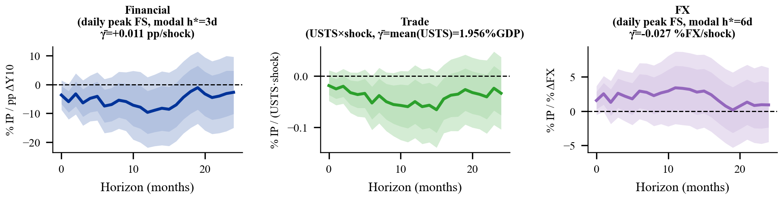
Why are Foreign Effects Larger than Domestic Effects?
Three Channels Reinforce Each Other
Financial channel:
Higher U.S. long rates raise foreign sovereign and corporate borrowing costs
Trade channel:
Lower U.S. activity reduces demand for foreign exports
Exchange rate channel:
Depreciation of foreign currencies further tightens financial conditions and affects competitiveness
Channel-Specific Explanatory Power

Slide 8
Spillovers heterogeneity

Slide 9
Two Dimensions Explain Heterogeneity
    Financial integration amplifies pass-through
    Foreign investor share
    Capital account openness
    Macro resilience dampens real spillovers
    Fiscal space
    Current account balance
    Market access / Debt-at-Risk

Slide 10
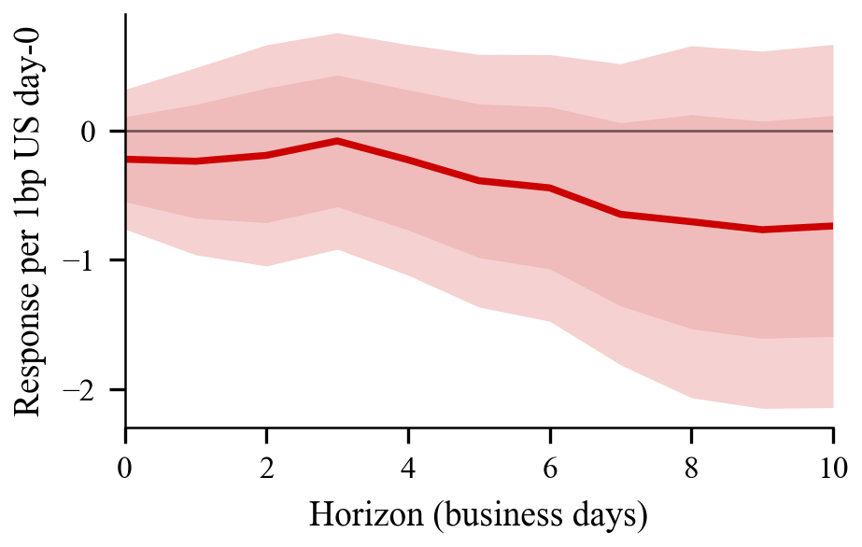
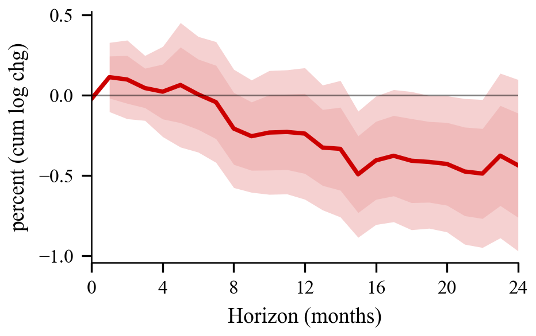
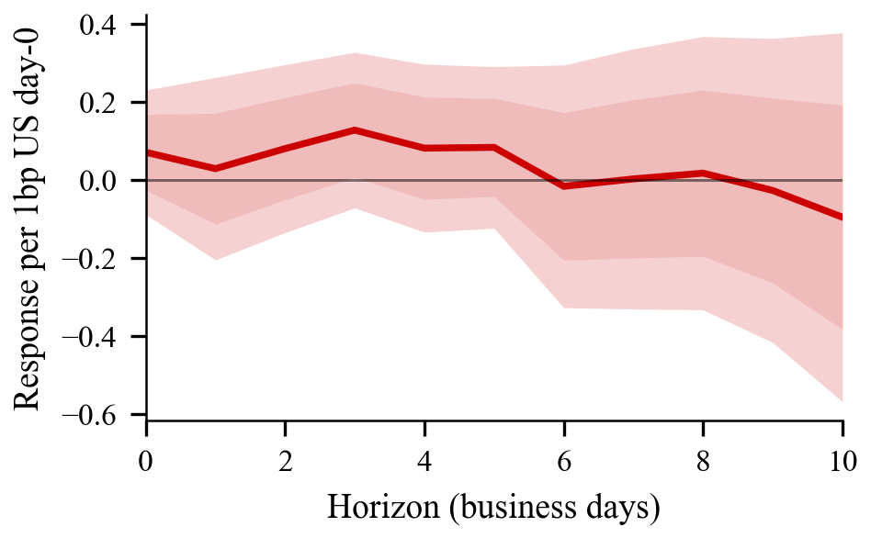
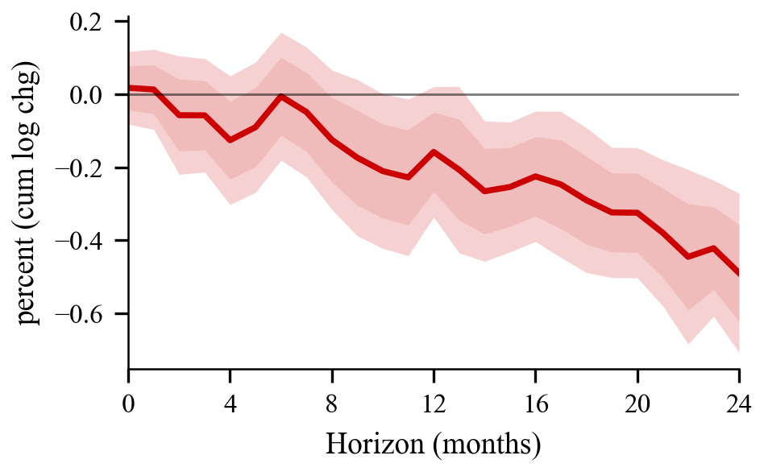
Financial Integration Amplifies Output Losses
Open capital accounts and larger foreign investor bases strengthen portfolio-balance transmission
10-year yield elasticity
Industrial production
Capital account openness
(Chinn-Ito index)
Higher spillover
Higher spillover
Higher spillover
Exposure to foreign
investors
Higher spillover
Sources: Phillot (2025); IMF staff calculations.
Notes: Interacted local projections with time fixed effects. Reported coefficients represent the differential spillover for a country at the 75th vs. 25th percentile of each characteristic (scaled by IQR). Capital account openness is the Chinn-Ito index of cross-border capital flow restrictions. Exposure to foreign investors is the non-resident share of sovereign debt holdings. Shaded areas denote 68% and 90% confidence bands. Unbalanced panel of 39 countries for yields and 58 countries for IP, 1998–2020.

Slide 11
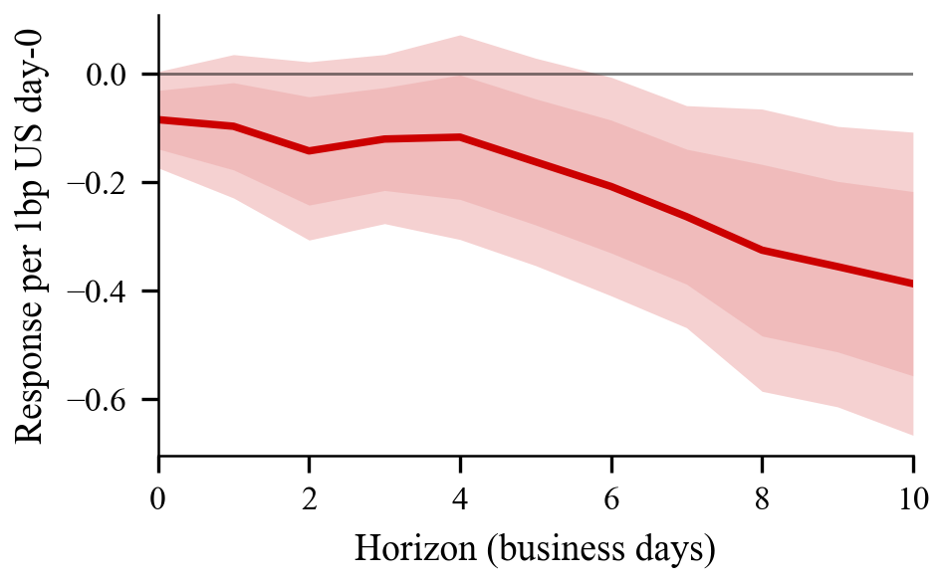
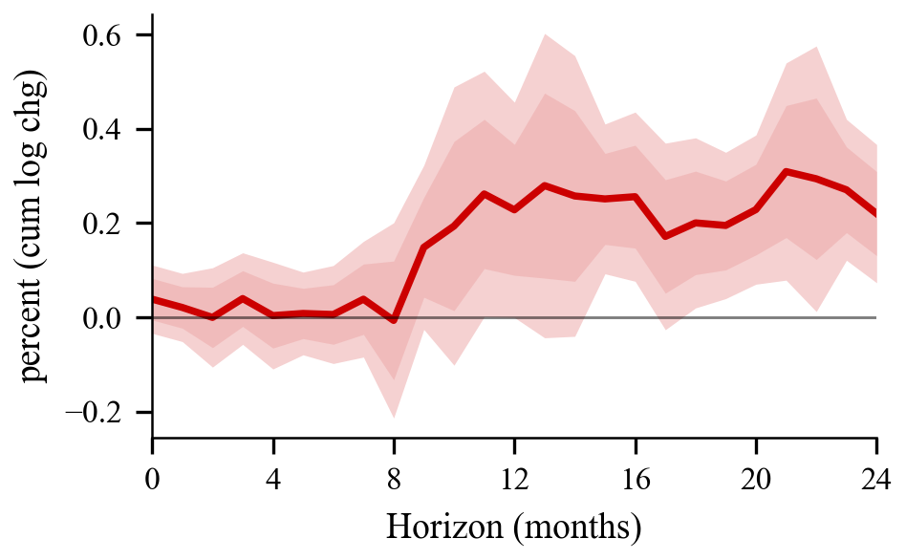
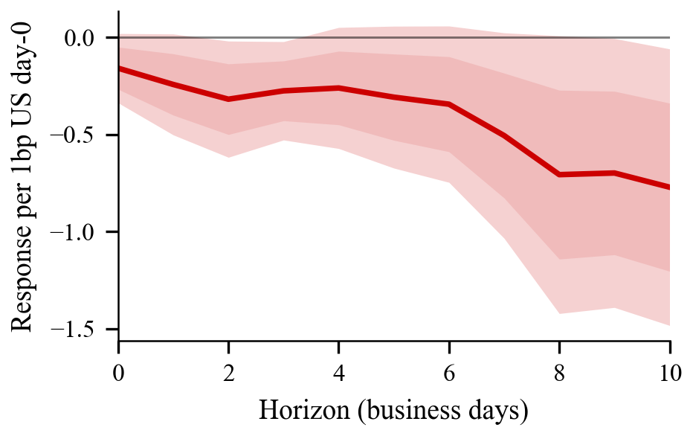
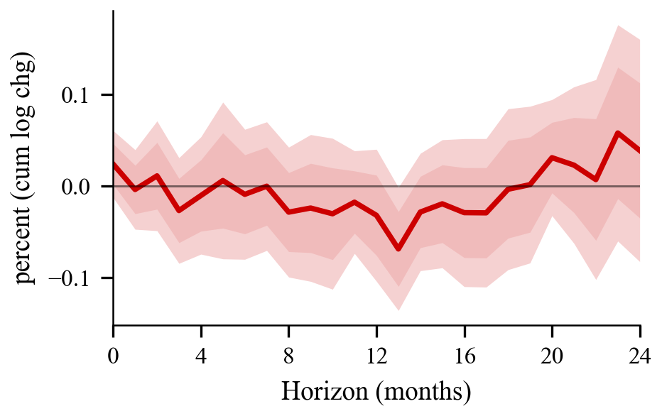
Policy Buffers Matter: Stronger Fundamentals Reduce Spillovers
Countries with stronger current accounts and more fiscal space experience smaller output losses
10-year yield elasticity
Industrial production
Lower spillover
Lower spillover
Current account
to GDP
Lower spillover
Lower spillover
Fiscal space
Sources: Phillot (2025); IMF staff calculations.
Notes: Interacted local projections with time fixed effects. Reported coefficients represent the differential spillover for a country at the 75th vs. 25th percentile of each characteristic (scaled by IQR). Current account to GDP is the ratio of the current account balance to nominal GDP. Fiscal space is capturing a government's capacity to sustainably expand its fiscal position. Shaded areas denote 68% and 90% confidence bands. Unbalanced panel of 39 countries for yields and 58 countries for IP, 1998–2020.

Slide 12
Conclusion

Slide 13
Policy Implications for Policymakers
From Official to Private Creditors
Shift to Short-Term Debt
Eroding 'Exorbitant Privilege'
Marginal buyers price-sensitive, amplifying yield responses
Unexpected short-term issuance → larger shocks
Countries refinancing at higher rates
Supply surprises quickly affect foreign borrowing costs
U.S. Policy Response
Fiscal consolidation to reduce spillover frequency and magnitude
Foreign Policy Response
Fiscal space provides insurance against spillovers
Diversify creditor base (reduce foreign investor concentration)
Extend debt maturity profiles to reduce rollover risk
Build buffers during U.S. easing cycles
Prepare contingency fiscal plans for U.S. tightening scenarios

