Slide 1
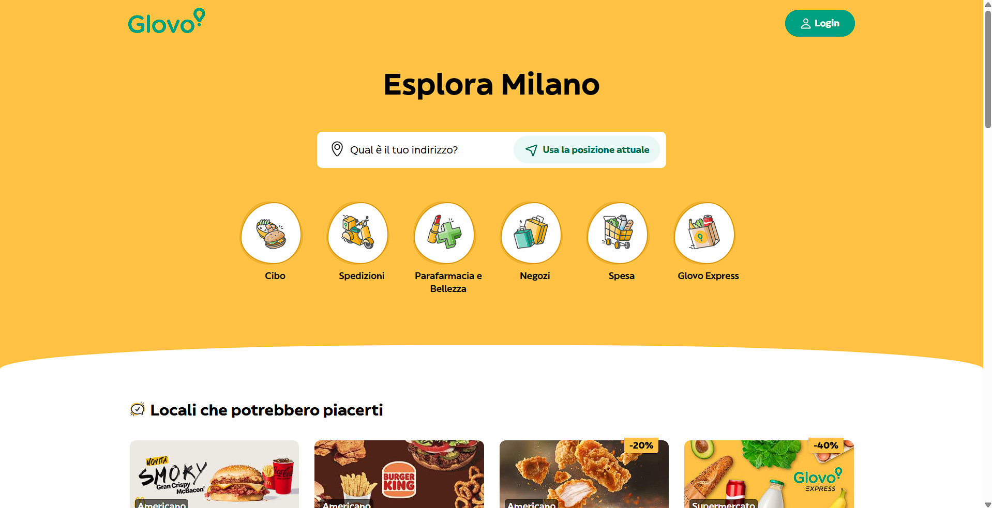
URL: https://glovoapp.com/it/it/milano/

