Slide 1
Rust
Danilo Hidalgo and Christian Trejo

Slide 2
Overview
Fast, statically typed, and compiled.
Created by Graydon Hoare in 2006 and maintained by Mozilla.
Similar to C++ in syntax and hardware abstraction.
Voted “most loved programing language” in Stack Overflow’s annual developer survey since 2016.

Slide 3
Rust Philosophy
Multi-paradigm: Imperative, concurrent, OOP, and functional
Type and memory safety
Only one owner of any given piece of memory
Immutability by default
Complex compiler, simpler binaries
Efficiency
Compile to machine code
Always prefer the stack
No garbage collector
Once a variable is out of scope, the memory associated with it is usually reclaimed automatically
Easy to use toolchain for dependency management (https://crates.io/)

Slide 4
Why Rust?
“Rust is a systems programming language focused on three goals: safety, speed, and concurrency.”
-Rust documentation
Created by Mozilla to fill the spot of a highly concurrent, truly strongly typed low-level language with a safe memory layout.
Despite its age, Rust is an up-and-coming language with a passionate following in many areas of computing.

Slide 5
Influences
C-style syntax
Types inspired by C, ML, and Lisp
Functional programming elements inspired by Haskell and F#
Memory management inspired C++

Slide 6
Evolution
Statically typed from the beginning in 2006
Classes removed in 0.4 in favor of structs with associated methods
Traits added in 0.4 to add a sort of polymorphism
These and other changes in the mid 2010s slowed adoption
Version 1.0 becomes the first stable release in 2015
Much of the Rust team was laid off in August 2020, casting doubt on the language’s future
Rust Foundation created in February 2021 to ensure financial stability and longevity

Slide 7
Use Cases
Low-level systems and server software
Used by Facebook, Microsoft, Dropbox, Amazon, Discord
High performance web server and frameworks
Actix Web: an extremely performant web server
WebAssembly
https://royaltm.github.io/rust-fractx-wasm-demo/
Game development
Veloren, a free and open source voxel Minecraft-clone
Embedded applications
FreeRTOS, an embedded real-time operating system

Slide 8
Syntax and semantics

Slide 9
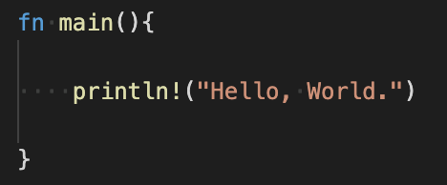
Language basics
Things to note:
Function declared with fn
C-style brace syntax
println is a macro, shown by !
main is a special entry-point function
Whitespace-ambivalent
All statements end with semicolon
Return statement has no semicolon

Slide 10
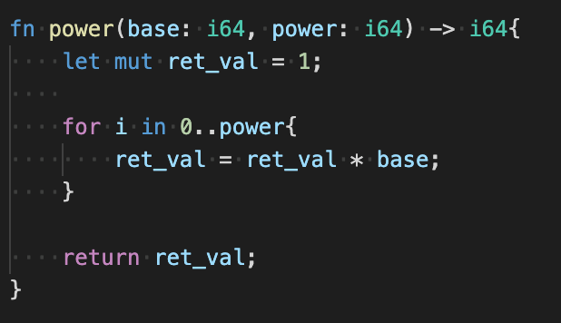
Functions
Function parameters must have types associated with them. There are no optional or variadic functions in Rust. The return keyword can still be used if you don’t like the no-semicolon return syntax. The return value of a function is indicated after the ->.

Slide 11
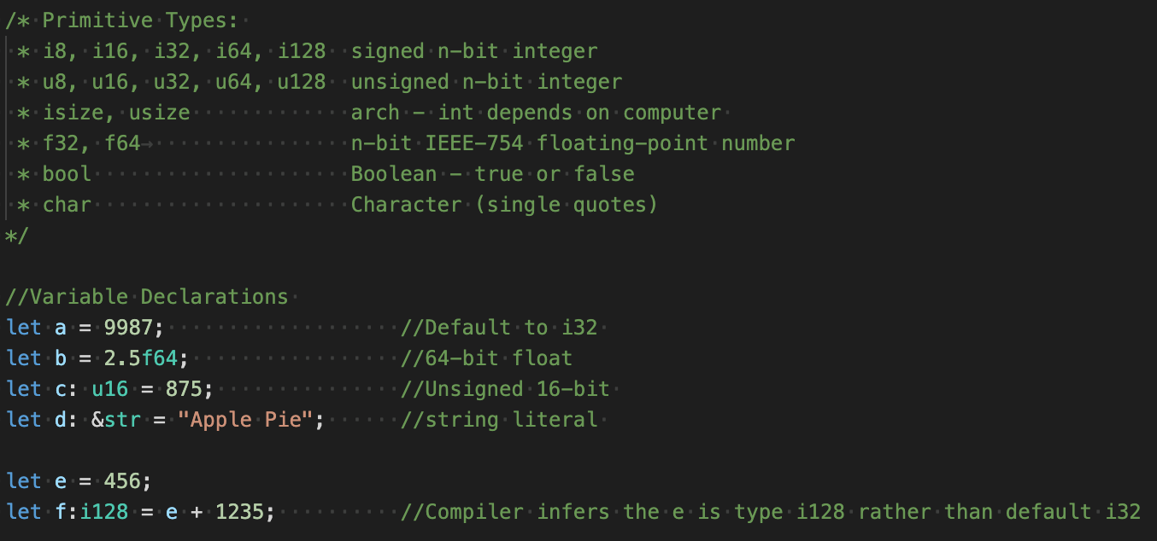
Types, declarations, and inferences

Slide 12
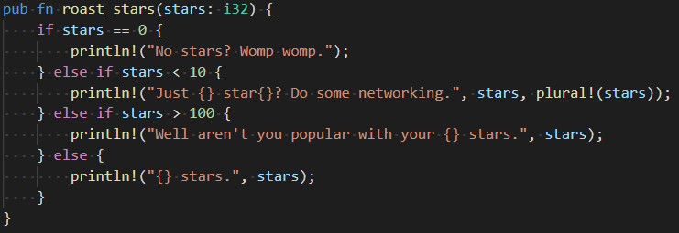
Conditionals
Conditionals in Rust are standard to C-like syntax. One difference is that it does not require parentheses around conditions.

Slide 13
Operators
Symbol | Meaning
+,-,*, / | Arithmetic operators
% | Arithmetic remainder
! | Bitwise or logical complement
! | Macro Expansion
!=, <, <=, >, >=, == | Boolean Operators
>>, << | Bitwise Shift Operators (right/ left)
|| | Logical OR
&& | Logical AND
& | Borrow (~"address of")
* | Dereference

Slide 14
Comments
Symbol | Meaning
// | Line comment
//! | Inner line doc comment
/// | Outer line doc comment
/* ... */ | Block comment
/*! ... */ | Inner block doc comment
/** ... */ | Outer block doc comment
//! and /*!...*/ are doc comments that apply to the parent of the comment, not what follows

Slide 15
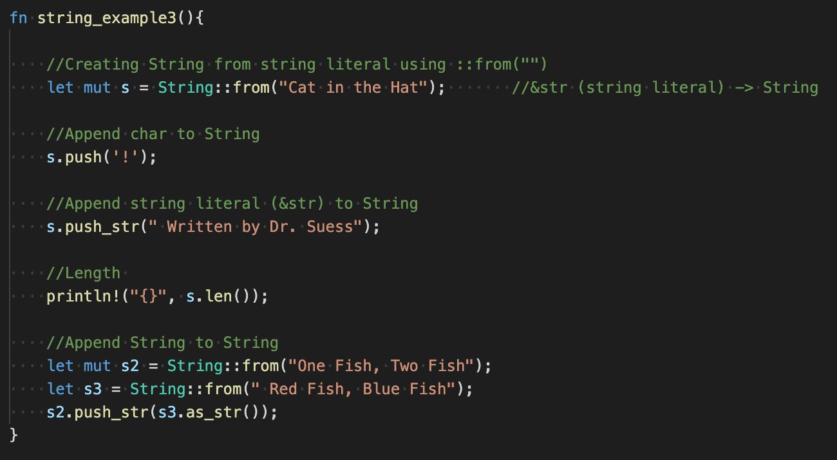
Strings
&str is an immutable string slice. String literals are always of this type.
String is a mutable (if declared as such) and resizable array of characters which can be modified in place like Java’s StringBuilder. The buffer at the core of a String is always stored on the heap, making it somewhat less performant.
Only chars and &str can be appended to Strings.

Slide 16
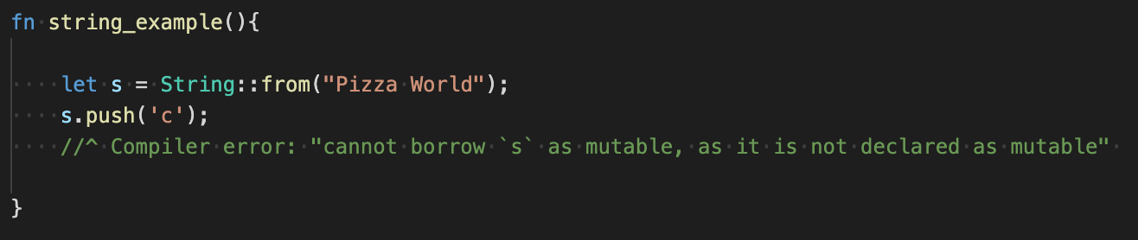
Mutability
Everything is immutable by default. Specifically, a variable can’t be reassigned to, nor can you call methods on it that mutate its state internally.
This is a nuisance on purpose. Mutability is known to cause side effects and can be particularly problematic in concurrent applications.

Slide 17
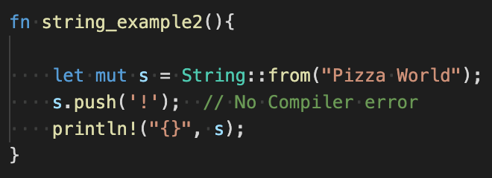
Mutability, cont.
To fix the error from the previous slide, simply add mut to the variable’s declaration.
A more involved example of mutability is coming later.

Slide 18
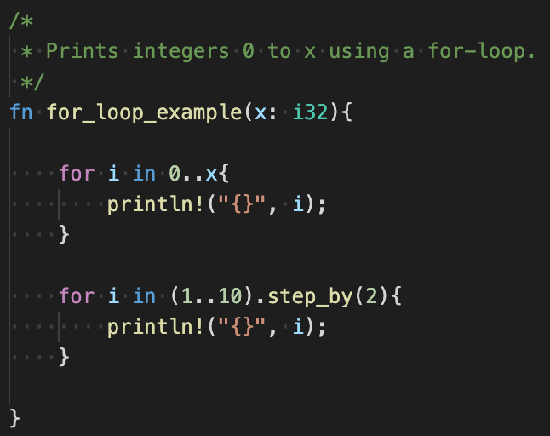
For loops
This code demonstrates a for-loop iterating from 0 to x, non-inclusive of x. To increment by a certain amount, you would call the step_by method on the range as shown in the bottom example.
For-loops can be used to easily iterate through each item in objects that implement an iterator too.

Slide 19
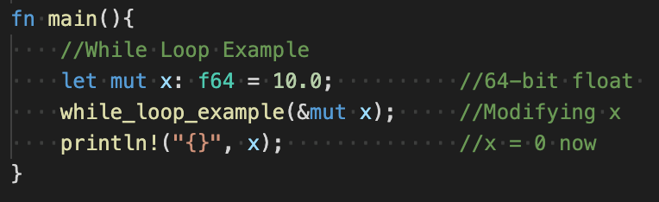
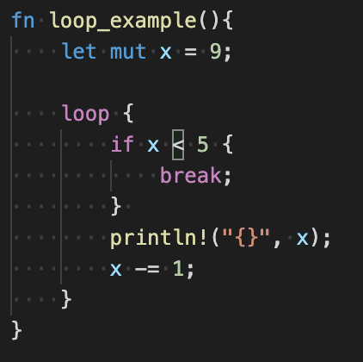
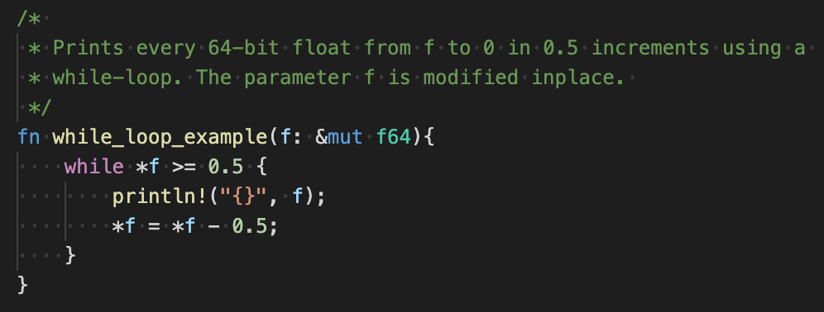
While loops
Here is a while loop inside a function that takes a mutable pointer. This shows C-like manipulation of raw pointers.
Additionally, infinite loops can be written simply with the loop keyword as shown on the far right.

Slide 20
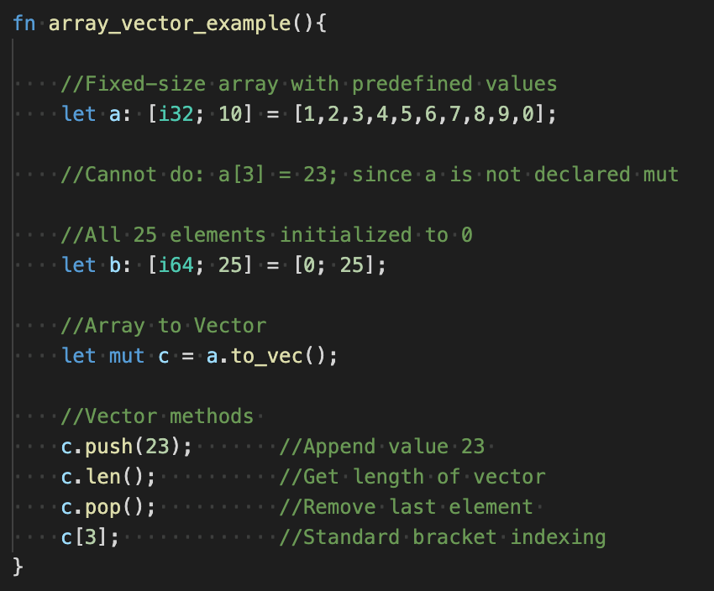
Arrays and vectors
Primitive arrays are of one type, fixed size, and stack allocated. If not defined as mutable, trying to modify their contents will cause a compiler error.
Vectors, since they are growable like Java’s ArrayList, are heap allocated.
Rust also has more advanced data structures like hash and tree maps.

Slide 21
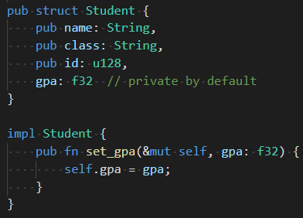
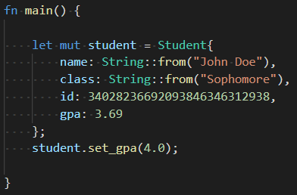
Structs
Structs are declared in a global scope as shown above. To access fields with the dot syntax, they must be declared as public with pub. Simple structs can be literally initiated with the syntax in main, but many complicated structs will implement a constructor.
To bind a method to a struct for OOP-like code, the impl keyword is used. Methods take a self argument similar to Python.

Slide 22
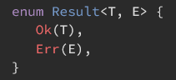


Options and Results
Option<T>
Result<T,E>
Rust avoids null pointers and instead uses Option<T>. This represents a value that may be of type T, or may be absent (null).
Below is a real example of a common idiom when dealing with Options. login is an Option, and is_some is an Option method that returns true if the value exists.
To access the value within, use the unwrap method.
To avoid exceptions (called panics in Rust), Results will often be returned from error-prone operations like file IO. If the operation was successful, its result of type T will be able to be unwrapped.
This is an example of how to verify that a Result’s contents are ok before accessing them.

Slide 23
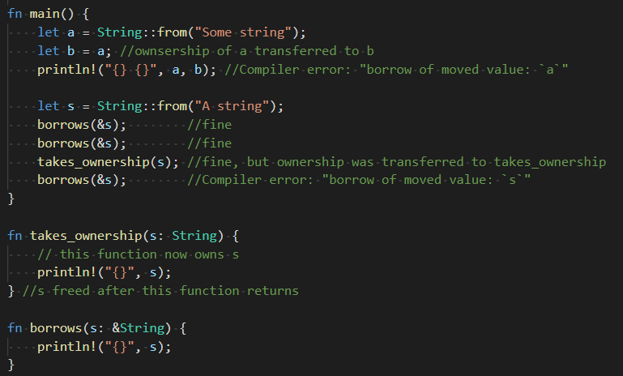
Lifetime and Borrowing/Ownership
Most values have a block scope lifetime, meaning they are freed when they go out of scope completely. Variables specified as having static lifetimes will have a program lifetime.
Borrowing allows to access the value of a variable without actually shifting the ownership.
Variables are borrowed with the & operator. They can be borrowed many times, and borrowing parameters is the defacto convention for this reason.
All of this is to avoid dangling pointers and, above all, garbage collection.

Slide 24
Cargo and the Rust toolchain

Slide 25
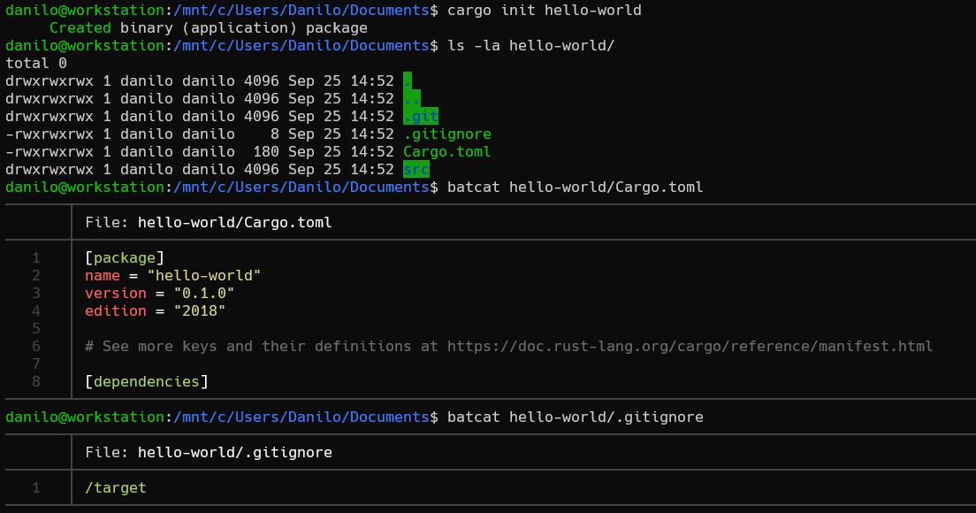
Getting started
Cargo is an essential CLI tool that can be easily installed from rust-lang.org
Create a new project using
$ cargo init <project-name>
Which does the following:
Creates a <project-name> directory with a src/ directory
Crates the shown Cargo.toml file
Initializes an empty Git repo with a .gitignore set up to ignore the directory where your binary will be built

Slide 26
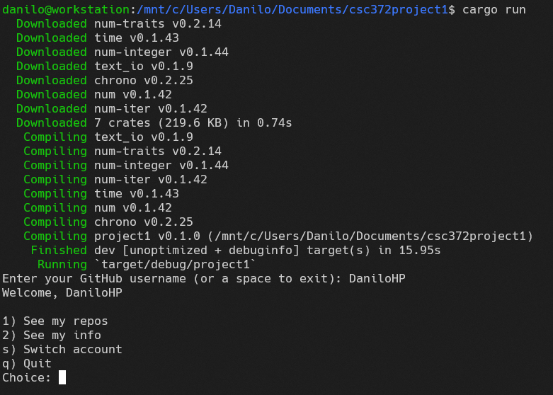
Running an application
Applications are run using the
$ cargo run -- <arguments>
command. Program arguments go after the double dash. The minimum amount of compilation necessary is done each time, similar to Make but without the pain.
Automatically downloads dependencies from the internet if needed
Our program begins outputting here

Slide 27
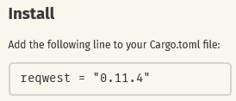
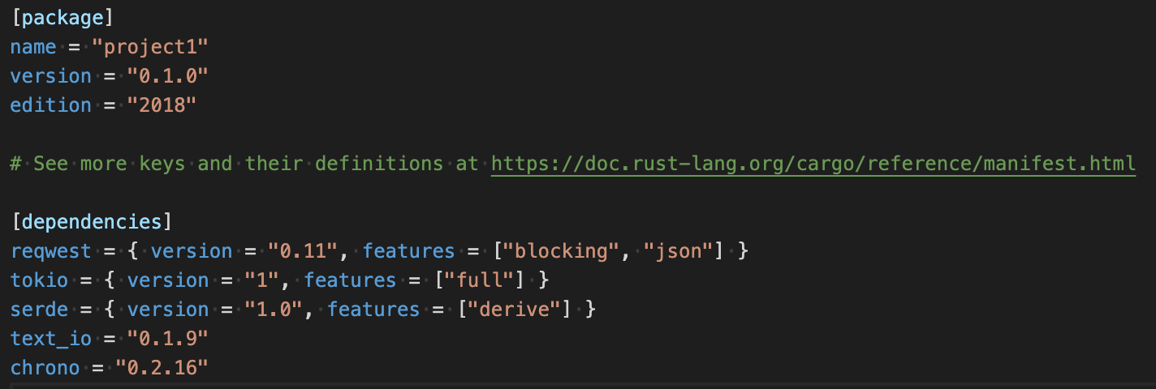
Dependency management
Cargo.toml is similar to package.json for NPM, except that it’s modified directly by the programmer. When viewing a package on crates.io, similar to NPM’s npmjs.com, the author will provide a line to copy-paste into the dependencies section of your Cargo.toml. On the next cargo run or cargo build, the dependencies will be automatically pulled from the internet and compiled.
The full dependency tree is stored in Cargo.lock
Cargo.toml

Slide 28
Nuances
Outright avoidance of null pointers in favor of Options.
Traits: adding methods to structs externally, can’t declare methods inside a struct declaration.
Use of pub and privacy by default
mut keyword
Comprehensive dependency management in a low level language
Indexing strings is non-trivial because of UTF8

Slide 29
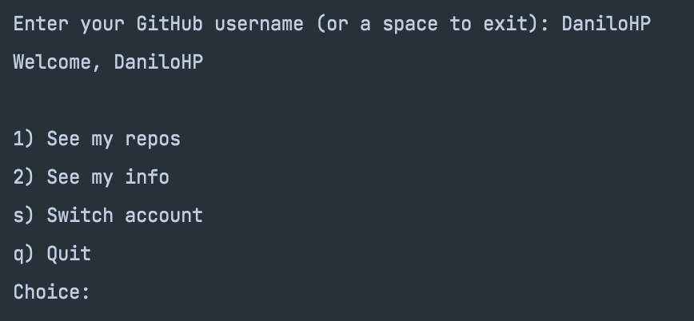
Project
For our project, we decided to write a Rust program that will show a Github user’s publicly available GitHub information. It might also lightly roast your repositories. Specifically, the user is given the freedom to inspect the username’s public repositories and also inspect the username’s general profile information.

Slide 30
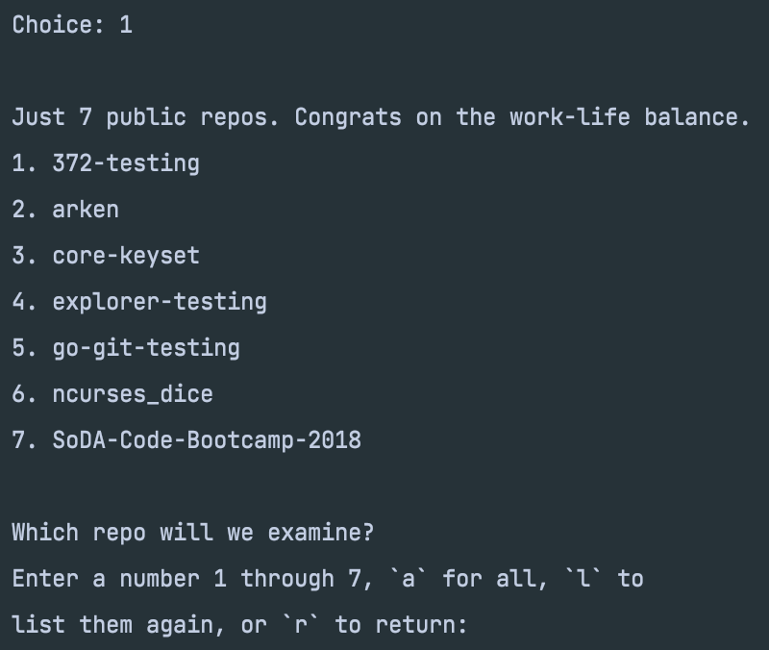
Project Cont.
Chose Option 1: See my repos
Shows all public repos associated with the Github username DaniloHP

Slide 31
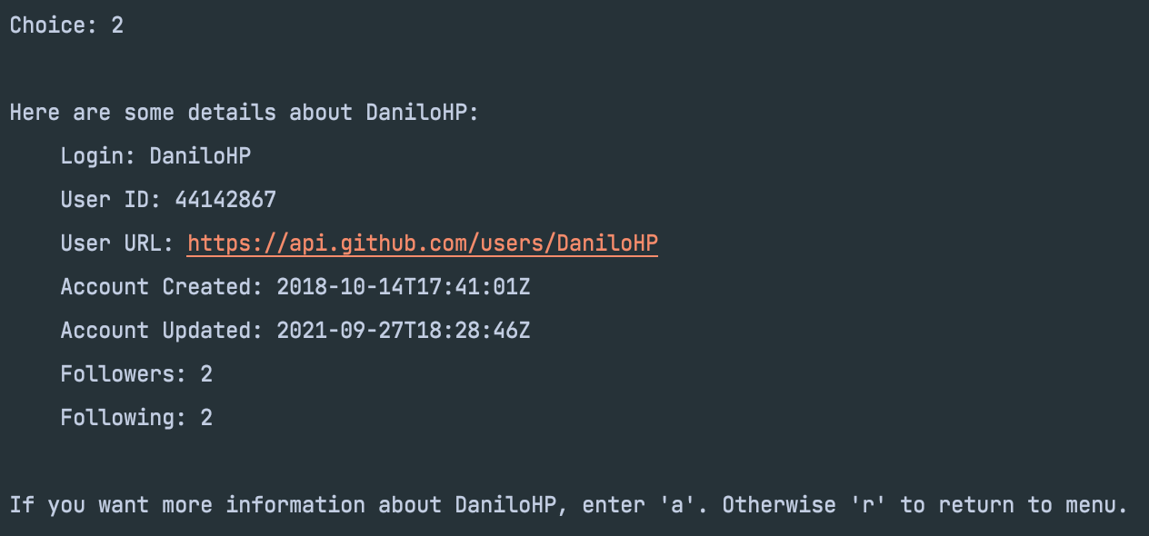
Project Cont.
Chose Option 2: See my info
Shows all public information associated with the Github username DaniloHP

Slide 32
Danilo’s Opinion on Rust
Rust is unlike any other language I’ve ever used. Working with it can be extremely tedious as it is very specific about how you do just about everything. However, true safety can’t come without annoyance.
I think the language is very useful for replacing unsafe legacy C code, but C is so ubiquitous that it will be an uphill battle.
Rust feels closes to C++ in syntax and developer experience, which is not really a compliment for Rust as C++ development is often very painful. However, you can know that your compiled code will work more or less as you expected, unlike C++.
I would personally recommend this language to other programmers, because I hope it sees more adoption and I like the idea behind it.
The main thing I didn’t get to experiment with is concurrency and closures.

Slide 33
Christian’s Opinion on Rust
Although I became a fellow “Rustacean”, I have mixed feelings about Rust. I can see the use and value of the language but the verbose and detail-oriented nature of it can make coding tedious.
I believe the language is very useful as it forces the programmer to think through their code and explicitly tell the computer what they expect. The safety component of Rust is definitely there!
Rust is nothing like Python since we must declare everything and be careful with what we are doing with variables (e.g., ownership and borrowing can be confusing).
I would recommend this language to other programmers only after they have some experience with C or C++, as Rust is quite similar.
Some aspects I would be interested in pursuing are concurrency, and exploring the edge cases of ownership and borrowing

Slide 34
Conclusion
To check out our project, go to: https://github.com/DaniloHP/csc372project1/releases/tag/1.0
Make sure to download the correct executable file to run our program too!

Slide 35
Sources
Madunuwan, Dumindu. “Why Rust?” Why Rust?, https://learning-rust.github.io/docs/a1.why_rust.html.
Rust Team. “Rust by Example.” Introduction - Rust By Example, https://doc.rust-lang.org/rust-by-example/.
Rust Team. “Learn Rust.” Rust Programming Language, https://www.rust-lang.org/learn.
Facebook Engineering. “A Brief History of Rust at Facebook.” Facebook Engineering, 13 May 2021, https://engineering.fb.com/2021/04/29/developer-tools/rust/.
“Rust (Programming Language).” Wikipedia, Wikimedia Foundation, 22 Sept. 2021, https://en.wikipedia.org/wiki/Rust_(programming_language).
Lardinois, Frederic. “AWS, Microsoft, Mozilla and Others Launch the Rust Foundation.” TechCrunch, TechCrunch, 8 Feb. 2021, https://techcrunch.com/2021/02/08/the-rust-programming-language-finds-a-new-home-in-a-non-profit-foundation/.

