Slide 1
IAC and CI/CD
Platform Team
Danilo Tessler
April 2025

Slide 2
Content
Current process and challenges
Proposed new process
Branching strategy

Slide 3
Current process and challenges

Slide 4
Current process and challenges
Current process and challenges
Current Process
Tools
CloudFormation
Ansible
Repository
Github
CI/CD
PowerShell script running on the developer machine

Slide 5
Current process and challenges
Challenges
Tools
Lack of consistency, reuse.
Multiple versions of the same code instead of parametrization to drive behaviour.
Repository
Already migrated to GitHub.
Still missing enforcement of policies (Pull Request / Pair review)
CI/CD
Deployed from a developer machine, not enforcing process. Multiple situations of code collision.

Slide 6
Proposed new process

Slide 7
Proposed new process
CDK
What is AWS CDK?
Open-source framework to define cloud infra using familiar programming languages
Supported languages: Python, TypeScript, Java, C#, Go
Synthesizes into CloudFormation templates
AWS product
Benefit | Details
✅ Familiar Language | Use known programming languages (Python)
✅ Reuse & Abstraction | Functions, loops, conditionals = less repetition
✅ Strong Typing & IDE Support | Autocompletion, linting, testing (VSCode)
✅ Synthesizes to CloudFormation | Same robust infra backend, just higher level
✅ Faster Prototyping | Less boilerplate, more flexibility

Slide 8
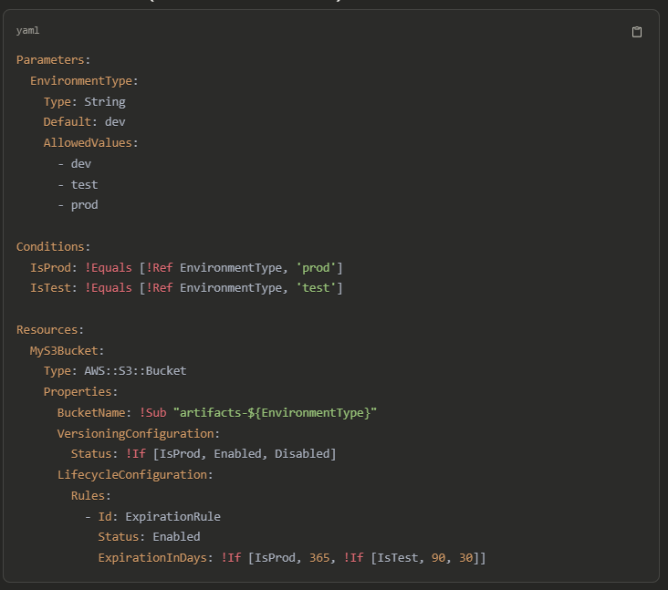
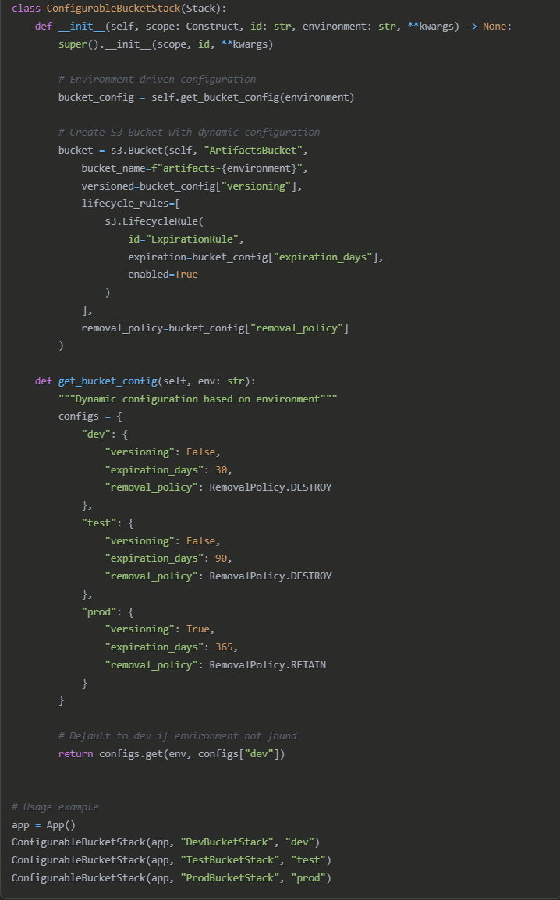
Proposed new process
Parameter driven stack
Cloud Formation
CDK

Slide 9
Branching strategy

Slide 10
Branching strategy
Premises
Each environment maps to one branch
A unique stack per project
One config file per environment to drive behaviour
Process
Developer
Pull from Git “Dev” branch
Changes code on its machine
CDK synth: Check if the stack has errors
Commit/Push code to GitHub
Commit trigger Jenkins deployment to the specific environment
When the correct time, a pull request is made to the remaining environments

