Slide 1
Homecoming Project
Project team:
Laura Bandera Elena, designer and programmer.
Pablo Benítez Osuna, designer and programmer.
Juan García Ruíz, designer and programmer.
María Hernández Arias, designer and programmer.
José Daniel Montero Archilla, software architect.
Adrián Laguna Machuca, database manager and programmer.
Lucía Longarela Gómez, designer and programmer.
Gonzalo Rueda Cortés, designer and programmer.

Slide 2
Introduction – the problem
A lot of women feel unsafe returning home alone at night.
Women are more likely to be sexually harassed or abused when they are alone.

Slide 3
The team and teamwork
This problem required several meetings to discuss the security of the application.
For class assignments our team was divided in 2 or 3 smaller groups to consider different approaches.
Finally, for the development, we divided the group for the different tasks (GUI, Data Base, Java Project and Map research).

Slide 4
The different tasks were assigned voluntarily, based on each member’s skill set.
We had a common GitHub repository and communicated via WhatsApp.

Slide 5
The solution
We designed an app to help women find other women, so they can travel together and feel safer on their way back home.

Slide 6
The most challenging part of this problem was to define its security.
To enter in a group the user has to send a request with a photo of herself posing (established by the group) and it has to be accepted by at least half of its members.
We have also implemented a system of reports for users and zones. Each user who reaches 3 strikes is automatically banned in the app. There is also a rating system for the users.

Slide 7
Software engineering activities
Non-Functional Requirements
We focus on the safety and security part of the app.
Filtering the users in each group sending an specific photo
Requirements
Architecture
Models
Principles/Patterns
Testing

Slide 8
Software engineering activities
Functional requirements
The most important function is the creation of groups.
The user can either find a group that suits her needs, or create a new one.
Requirements
Architecture
Models
Principles/Patterns
Testing

Slide 9
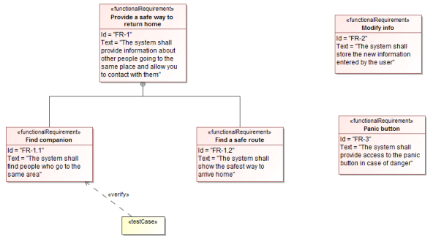
Software engineering activities
Functional Requirements
Requirements
Architecture
Models
Principles/Patterns
Testing

Slide 10
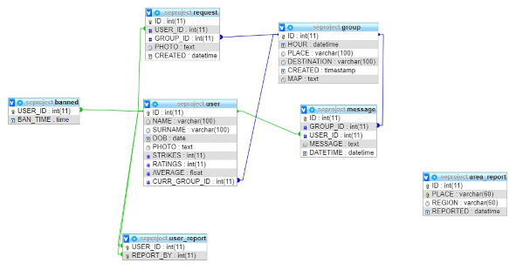
Software engineering activities
Database
This is a representation of the database that we will use for consulting and storing everything about our users and events.
Requirements
Architecture
Models
Principles/Patterns
Testing

Slide 11
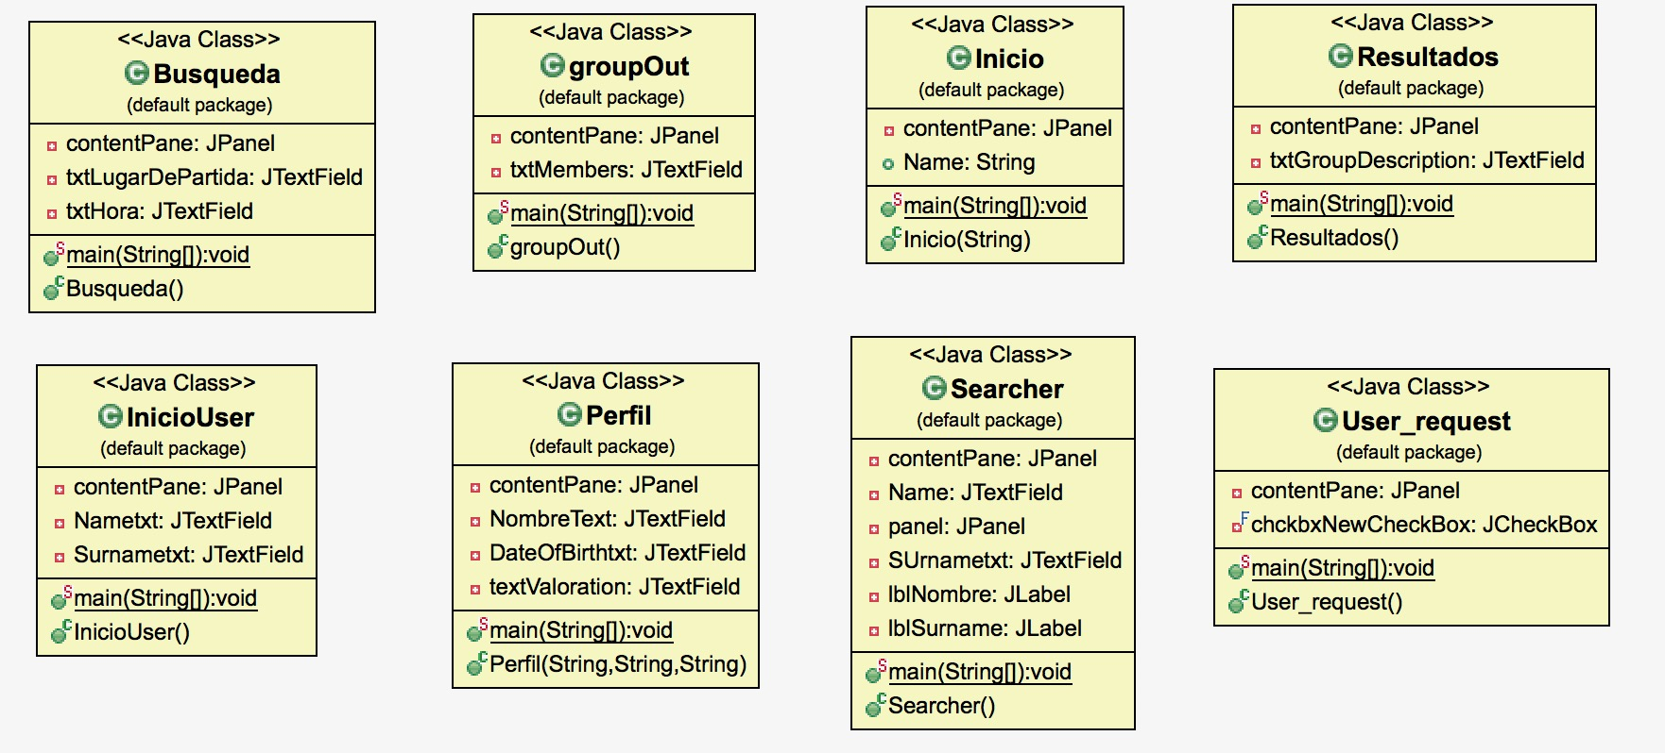
Software engineering activities
GUI
Our domain model requires users to interact between them, so we have implemented a Graphic User Interface (GUI).
Requirements
Architecture
Models
Principles/Patterns
Testing

Slide 12
Software engineering activities
Use case diagram
Requirements
Architecture
Models
Principles/Patterns
Testing
Notes:
In the use case diagram, the “find user” and “profile” branches relate to some of the User class functions in the domain model.
The “find route” and “panic button” ramifications refer to some functions of the Group class.

Slide 13
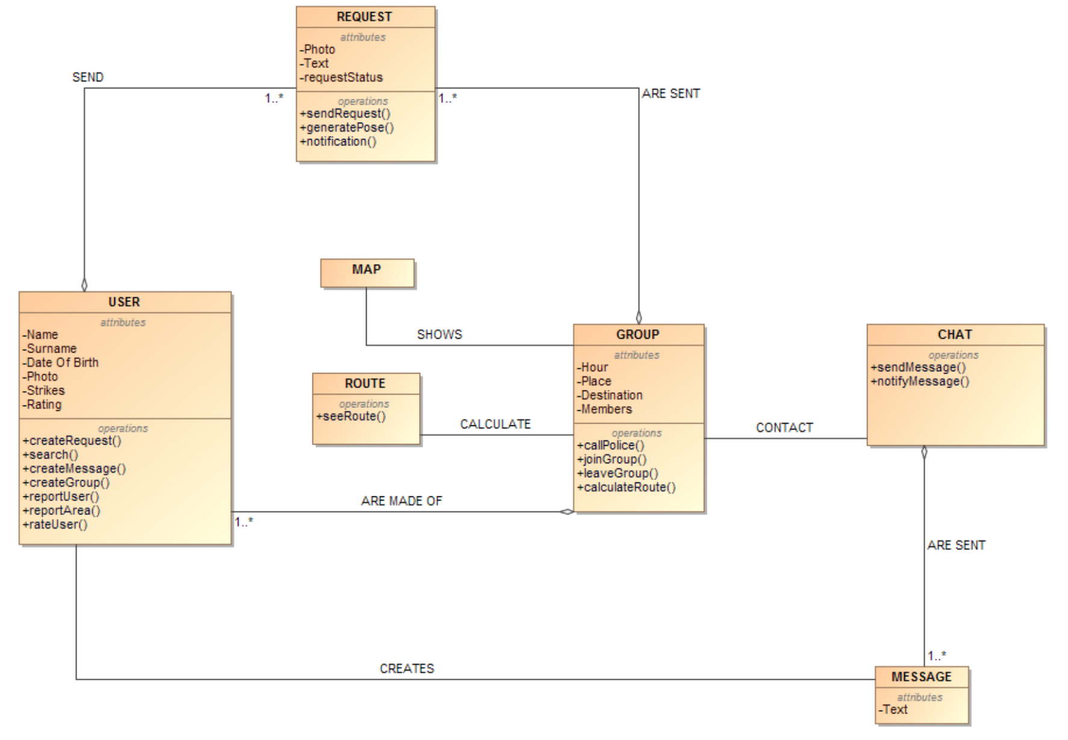
Software engineering activities
Domain model
Requirements
Architecture
Models
Principles/Patterns
Testing
Notes:
In the use case diagram, the “find user” and “profile” branches relate to some of the User class functions in the domain model.
The “find route” and “panic button” ramifications refer to some functions of the Group class.

Slide 14
Software engineering activities
We decided to include the Delegation Pattern.
User delegates its request method to another class, which is its only function.
We also considered applying it for chat and message classes.
The advantage of using this pattern is that it increases modularity.
Requirements
Architecture
Models
Principles/Patterns
Testing

Slide 15
Software engineering activities
We developed several unit tests in JUnit to test if values introduced by users are null, if indexes are out of bounds, getters and setters,…
We also ensured that the code behaves correctly in exceptional circumstances (Exceptions).
Requirements
Architecture
Models
Principles/Patterns
Testing

Slide 16
Development/Deployment
Strategies:
TDD (Test Driven Development)
Tools:
MagicDraw Keys
Eclipse
Swing
PHP myAdmin
Strategies and tools
Implementation model
Deployment

Slide 17
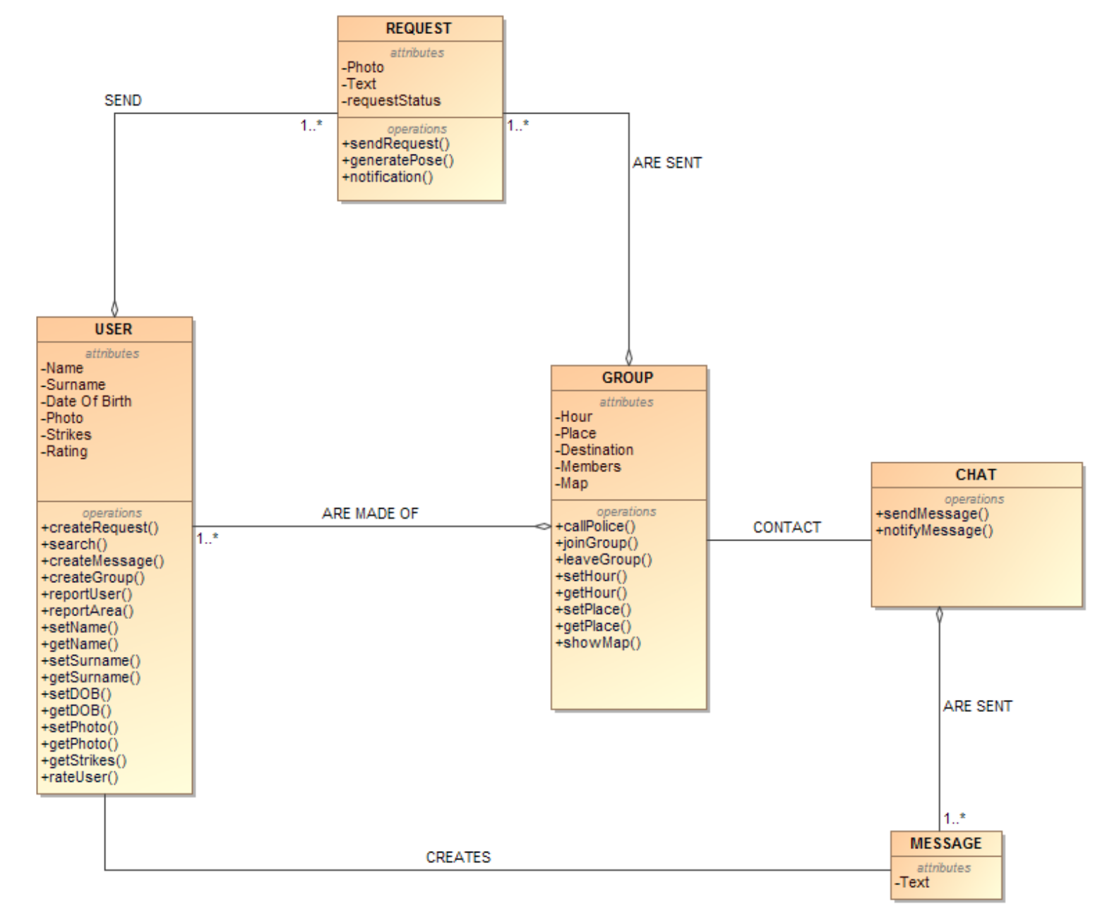
Development/Deployment
Strategies and tools
Implementation model
Deployment

Slide 18
Development/Deployment
What we have implemented:
A user interface that allows the user to create a new profile, create or find groups and request to join one.
A group interface that implements a group chat.
A report system that bans users based on strikes.
Strategies and tools
Implementation model
Deployment

Slide 19
Development/Deployment
What we have not implemented:
Working maps that create routes with a given initial and final destination.
A report system with different options to report an area, that would show in the map using a colour code for each danger level.
A panic button that alerts the police.
A rating system for users to rank each other after being in a group together.
Strategies and tools
Implementation model
Deployment

Slide 20
Results
We have a graphic user interface supported by a database.
Due to time restraints we have not been able to implement everything we set out to, but we have a functional app that will be the base for the final product.

Slide 21
Conclusions
Even though we have encountered many problems along the way, we are confident that we have implemented a safe app that will make women feel safer using it.

