Slide 1

Supervisor
Dr. Basanta Joshi
Aavaas Gajurel (068/BCT/501)
Anup Pokhrel (068/BCT/505)
Manish K. Sharma (068/BCT/523)
Notes:
15 sec

Slide 2
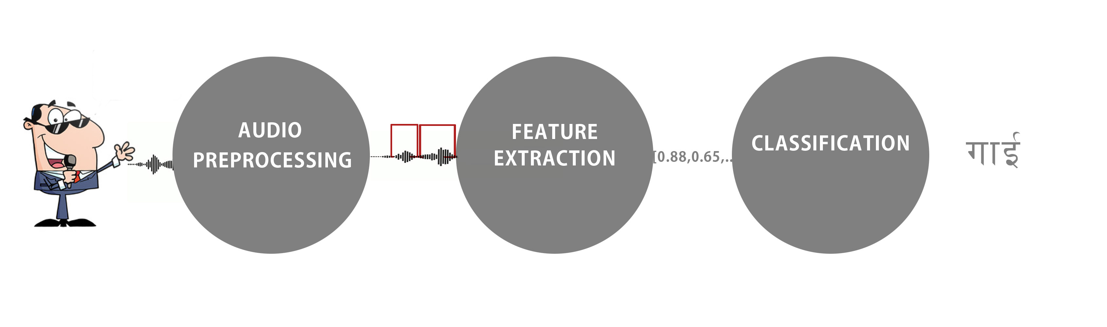
System Overview
Notes:
15 sec (classification to recognition)

Slide 3
System Block Diagram - Training
Noise Reduction
Split Module (VAD Based)
Training Set
Train HMM
MFCC Features
Notes:
45 sec (add train hmm)

Slide 4
System Block Diagram - Recognition
Audio Input
Noise Reduction
Split Module (VAD Based)
MFCC Computation
Audio Classifier
HMM
Language Model
Output

Slide 5
SYSTEM DESIGN METHODOLOGY

Slide 6
NOISE REDUCTION
Notes:
40 sec

Slide 7
Creating Noise Profile
FOURIER TRANSFORM
FFT of 32ms Audio Samples
BUILD NOISE PROFILE
Update the computed Noise Profile
$$\frac{1}{N} [Sum of FFT Component >10 frames]$$
1/𝑁 [𝑆𝑢𝑚 𝑜𝑓 𝐹𝐹𝑇 𝐶𝑜𝑚𝑝𝑜𝑛𝑒𝑛𝑡 >10 𝑓𝑟𝑎𝑚𝑒𝑠]
AVERAGE OVER TIME

Slide 8
Spectral Subtraction
FOURIER TRANSFORM OF SIGNAL
FFT of 32ms Audio Samples
SUBTRACT NOISE PROFILE (STATIC AND MUSICAL)
Over Subtraction
INVERSE FOURIER TRANSFORM
Rebuild the Signal
Short Segment Removal

Slide 9
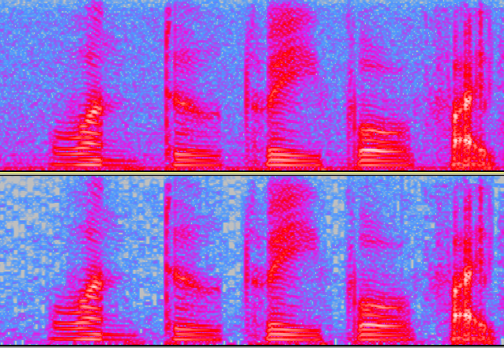
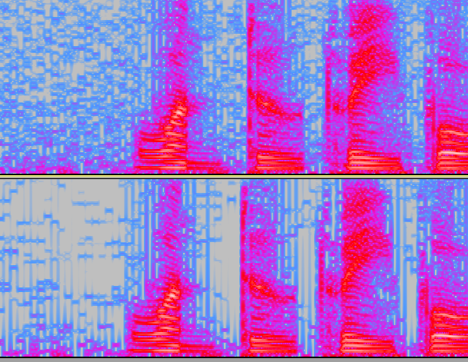
Before Noise Removal
Spectral Subtraction output
After Spectral Subtraction
After Musical Noise Removal

Slide 10
VOICE ACTIVITY DETECTION
Notes:
40 sec

Slide 11
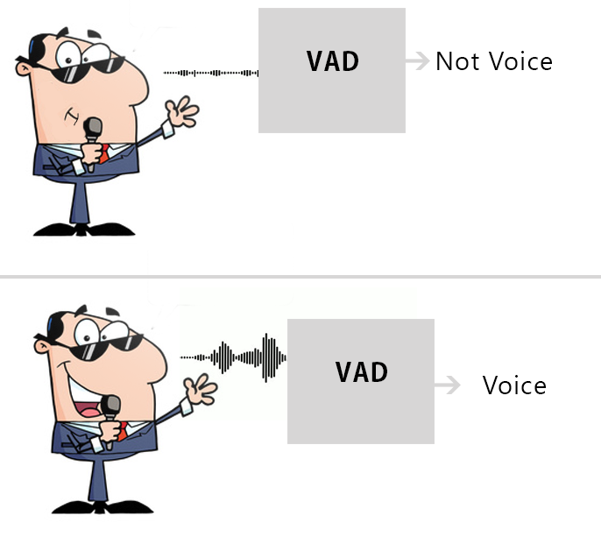
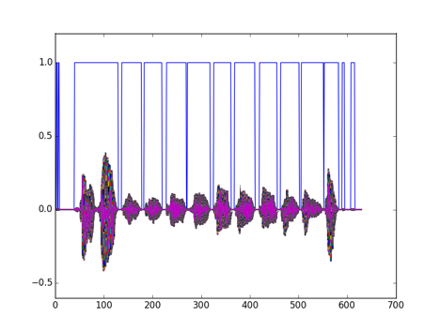
Voice Activity Detection

Slide 12
Voice Activity Detection Process I
SAMPLE
10 Frame Sampling
COMPUTE mean AND variance
CALCULATE THE TRIGGER
$$t_{w}=μ+αδ_{w}$$
𝑡_𝑤=𝜇+𝛼𝛿_𝑤

Slide 13

Voice Activity Detection Process II
READ THE SAMPLE
Read the frame
CLASSIFY
If greater than trigger then voice
COMPUTE CLASSIFICATION MEASURE
$$W_{s1}\left(m\right)=P_{s1}(m)\left(1−Z_{s1}\left(m\right)\right)S_{c}$$

Slide 14
Feature Extraction
Notes:
40 sec

Slide 15
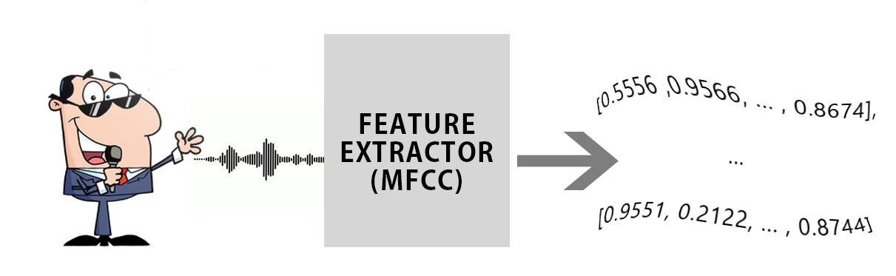
Audio Feature Extraction

Slide 16
Feature Extraction Process I
FRAMING
Divide Audio into Sections of 20ms-40ms
CALCULATE PERIODOGRAM ESTIMATE
$$P_{i}\left(k\right)=\frac{1}{N} {| S_{i}(k)|}^{2}$$
𝑃_𝑖 (𝑘)=1/𝑁 〖| 𝑆_𝑖 (𝑘)|〗^2
APPLY MEL FILTERBANK
Multiply Filterbank(20-40) by Periodogram Estimate

Slide 17
Feature Extraction Process II
SCALING
Take Logarithm of Filterbank Energies
DISCRETE COSINE TRANSFORM OF ENERGIES
KEEP REQUIRED COEFFICIENTS
Keep Required Number of Coefficients
Take DCT of Coefficients of Above Step

Slide 18
Language Model
Notes:
40 sec

Slide 19
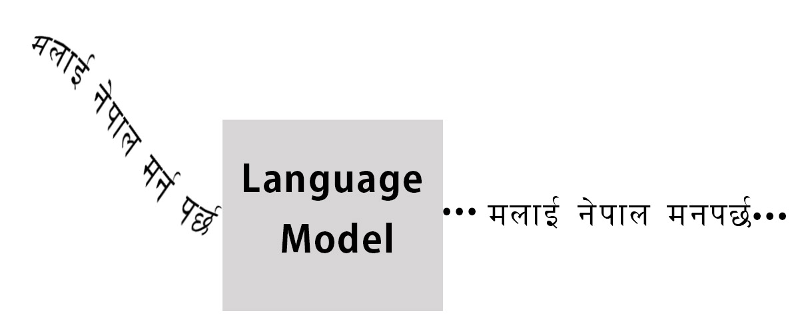
Using Language Model

Slide 20
Language Model Training
FETCH RAW DATA
Currently From News Websites
CREATE LANGUAGE MODELS
Derive NGram Models
UPDATE DICTIONARY
Add to existing Dictionary

Slide 21
Language Model Based Classification
READ PREVIOUS WORD
GET POSSIBLE CANDIDATES
From Acoustic Model
SELECT BEST
$$P\left(W_{i} | W_{i−1}\right)=λ_{1}\left(P\left(W_{n} | W_{n−1}\right)\right)+λ_{2}P(W_{n})$$
𝑃(𝑊_𝑖│𝑊_(𝑖−1) )=𝜆_1 (𝑃(𝑊_𝑛│𝑊_(𝑛−1) ))+𝜆_2 𝑃(𝑊_𝑛)

Slide 22
ACOUSTIC MODEL
Notes:
40 sec

Slide 23
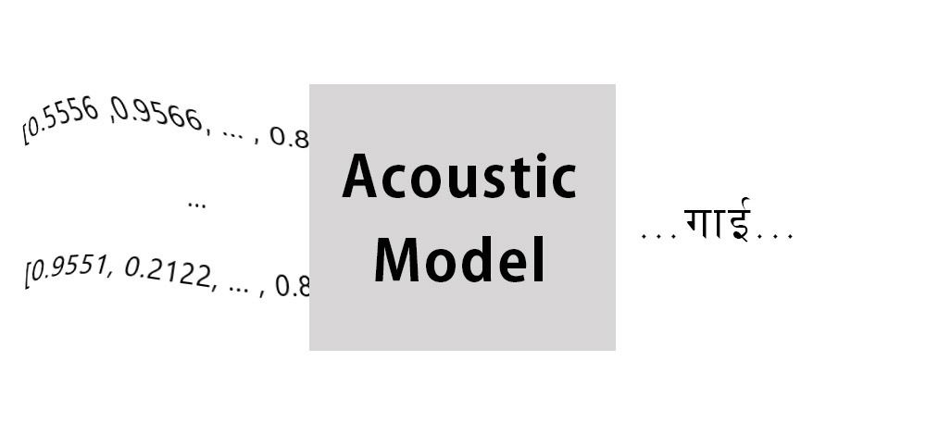
HMM Based Classification

Slide 24
Training the Acoustic Model
READ MFCC COEFFICIENTS AND WORD
TRAIN USING BAUM WELCH ALGORITHM
SELECT HMM MODEL

Slide 25
Using the Acoustic Model
READ MFCC COEFFICIENTS OF WORD
SELECT MODEL WITH MAXIMUM PROBABILITY
FIND LOG PROBABILITY OF WORD FOR EACH MODEL
OUTPUT WORD CORRESPONDING TO MODEL

Slide 26
RESULTS
Notes:
3 min

Slide 27
Trained vs. Untrained Input
3 Speakers
5X10 Words Each
5 Testing Set Each

Slide 28
Noise Reduced vs. Not Noise Reduced
3 Speakers
5X10 Words Each
Untrained Input Files for Testing
5 Testing Set Each

Slide 29
Gender Based Results
7 Speakers
3 Females, 4 Males
Animal Names as Test
Untrained Input Files for Testing

Slide 30
LIMITATIONS AND RECOMMENDATIONS
Notes:
1 min

Slide 31
Limitations
Static MFCC Coefficients Only
User Specific Noise Profiles
Training Data Storage Absent
Limited Vocabulary
Non-Continuous Recognition

Slide 32
Recommendations
Using Dynamic Coefficients
Continuous HMM Model
Extensive Training
Better Phonemic Modeling
Dynamic Noise Modeling

Slide 33
USAGE SCENARIO
Notes:
1 min

Slide 34
Usage Scenario I
Easy Nepali Input
Automated Telecom Assistance
Speech Controlled Interface
Automated Transcribing

Slide 35
Usage Scenario II
Military Sector for Automated Wire Tapping
Public Guidance System
Automated User Support (banks, corporate houses,etc.)

Slide 36
Thank You !

