Slide 1

SVKM’s Institute of Technology, Dhule Department of Information Technology
Project Presentation
On
Student’s Skills Evaluation System
By
Name Roll
Danish Khan 19
Yashraj Ahirrao 03
Tushar Patil 38
Sagar Dalvi 12
Guide
Ms. Rubi Mandal

Slide 2
Contents
Project Details
Project Motivation
Project Title
Project Abstract
Approach & Technology Stack
Architecture
Literature Survey
References

Slide 3
Project Details
Project Title : 360 Degree Student Evaluation & Achievement Tracking Web System
Project Domain: EdTech, Image processing
Project Group Members:
T2054491246011 - Danish Khan
T2054491246061 - Yashraj Ahirrao
T2054491246044 - Tushar Patil
T2054491246058 - Sagar Dalvi

Slide 4
Motivation
The eligibility criteria of 60% and above throughout academics set by many companies can create barriers for numerous students, preventing them from applying for job opportunities and hindering their career prospects.
As a result, students who may have excelled in other areas such as certifications, projects, or programming skills, but fell short of the rigid 60% benchmark, are unjustly excluded from consideration. This practice limits diversity in the job market and fails to recognize the practical skills and talents that contribute significantly to a candidate's potential value to an organization.

Slide 5
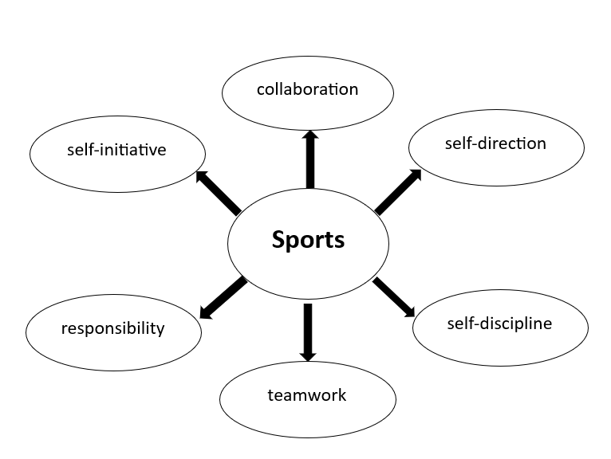

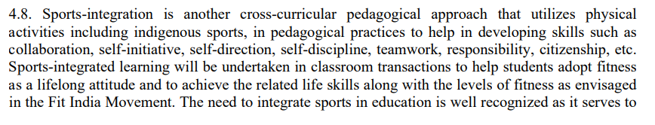

Slide 6


The above student having an excellent programming skills, multiple certifications, and impressive projects have been exempted from many of the drives because of the bench mark in the marks criteria.
However, He was not allowed to apply for many companies because they required at least a 60% academic score.

Slide 7
Problem Abstract
This web application aims to revolutionize how we evaluate IT students by going beyond traditional academic measures and including a comprehensive set of factors. The system assesses the overall development of students, including their academics, certifications, programming skills, projects, and sports.
The solution involves creating a user-friendly interface that enables students to enter relevant information. Educators and evaluators can access this data through a secure dashboard, where they can see and analyze each student's progress.
The application will use APIs and various algorithms to identify and evaluate each student based on different parameters. Additionally, students will have access to their individual progress reports.

Slide 8
Approach and Technology Stack
Our approach :- Creating a fully fledged application that evaluates a student in a 360 degree angle with multiple parameters.
Parameter Evaluation :- We are Developing algorithms to assess students across various criteria, including academics, certifications, projects, programming skills, and sports. Each parameter will carry a distinct weightage based on its significance.
Certifications : Points will be assigned to different certifications according to their relevance to the student's field of study or future career & according to their marks that achieve in test.
Projects : We are constructing a scoring system that evaluates the quality, complexity, and impact of the student's projects.
Programming Skills : Design coding challenges or test that assess the student's programming proficiency.
Sports Certifications : additional marks will be assign according to certificate levels using OCR (optimal character recognition) Technology.

Slide 9
Approach and Technology Stack
Final Score : Calculating a final score from the above-mentioned parameters involves aggregating the individual parameter scores while considering their assigned weightage.
Database : All the above information saved in Database including login and signup of a particular student.
Technology Stack :
Frontend: HTML, CSS, JavaScript, React.
Backend: Node.js, Python (Django or Flask).
Database: MySQL.
API : GitHub API, OCR Tool ,Virtual assistant tool.

Slide 10
Data flow diagram zero level
Certification
Student’s scores
Project’s
Programming skill
Sport’s

Slide 11
Data flow diagram First level
Certification’s
Programming skill
Student
Score
Project
Database
Sport

Slide 12
Data flow diagram Second level
Login to system
Upload
admin
Certification
Test
Forgot password
Manage modules
C, C++, etc..
Programming skill
Sent email to user’s
Particular Time
sport
Project’s
Certification
API throw access github code

Slide 13
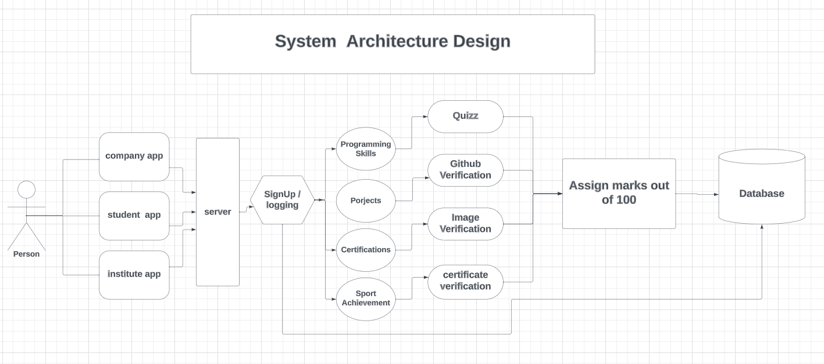
ARCHITECTURE

Slide 14
Literature Survey
Reference No / Paper Title | Issues Found | Parameters/Tools used | Work Description
[1 RepoQuester: A Tool Towards Evaluating GitHub Projects. Kowndinya Boyalakuntla1∗, Meiyappan Nagappan2†, Sridhar Chimalakonda1∗, Nuthan Munaiah3‡ Indian Institute of Technology Tirupati, India1, University of Waterloo, Canada2, Rochester Institute of Technology, USA3 cs17b032@iittp.ac.in∗, mei.nagappan@uwaterloo.ca†, ch@iittp.ac.in∗, nm6061@rit.edu‡ | The study did not explicitly mention any issues found during the data collection and analysis process. But there my be issues with Git-hub API data such as inability to distinguish levels and intensity of project activity | Parameters: Pull Requests Ratio: A metric that measures the ratio of pull requests to the total number of commits in a repository. Tool: Repo Quester: A tool developed by adapting an existing tool named Reaper. It works on individual repositories and can be run on a local machine without relying on pre-defined datasets. | Repo Quester, a tool designed to evaluate the quality metrics of software projects on GitHub. It is an improved version of the existing tool Reaper, with the ability to analyze individual repositories on a local machine. Two new metrics, pull requests ratio and releases, have been added to Repo Quester. The tool has been evaluated and found to be accurate and efficient, with analysis taking less than 10 seconds per repository.
[2] Small Text Extraction from Document and Chart Image Rominkumar Busa, Shahira K C, Graduate student member, IEEE, and Lijiya A, Member, IEEE | there are limitations in recognizing adjacent characters and different sizes of characters within a word. | The parameters used in the study are not explicitly mentioned in the provided paper but use of the CRNN (Convolutional Recurrent Neural Network) model with CTC (Connectionist Temporal Classification) for text recognition | It extracting small text from images, using a deep learning model called CRNN with CTC It include image enhancement techniques like super resolution and character segmentation. The results demonstrate that the proposed method improves text recognition accuracy for small text images.

Slide 15
Literature Survey
[3] Small Text Extraction from Document and Chart Image Rominkumar Busa, Shahira K C, Graduate student member, IEEE, and Lijiya A, Member, IEEE | there are limitations in recognizing adjacent characters and different sizes of characters within a word. | The parameters used in the study are not explicitly mentioned in the provided paper but use of the CRNN (Convolutional Recurrent Neural Network) model with CTC (Connectionist Temporal Classification) for text recognition | It extracting small text from images, using a deep learning model called CRNN with CTC It include image enhancement techniques like super resolution and character segmentation. The results demonstrate that the proposed method improves text recognition accuracy for small text images.
[4]“Software Certification for Industry – Verification and Validation Issues in Expert System. Anca I. Vermesan Det Norske Veritas AS Veritasveien 1, 1322 Hovik, Norway Email: Anca.Vermesan@dnv.com | it is clear that the certification of a knowledge-based system (KBS) requires a combination of static and dynamic testing techniques. Static testing techniques, such as static analysis, can be used to evaluate the knowledge base component of a KBS | Static Testing Techniques: such as static analysis used to evaluate. Dynamic Testing Technique: it involve executing the kbs and observing behavior in a simulated or real environment | the certification of knowledge-based systems (KBS) in the software industry, highlighting the specific challenges and components of KB-software certification. It emphasizes the need for adapting certification methods to accommodate the specific aspects of KBS.

Slide 16
References
[1] Georgios Gousios, MSR '13. The GHTorent dataset and tool suite(2013).
[2] Rakesh Agrawal and Ramakrishnan Srikant.1994. Fast algorithms for mining association rules in large databases. Proceedings of the 20th VLDB Conference, 1994 .
[3] Watson, C.; Li, F.W.B. Failure rates in introductory programming revisited. In Proceedings of the 19th conference on (ITiCSE’14), Uppsala, Sweden, 21–25 June 2014; pp. 39–44
[4] Amelung, M.; Krieger, K.; Rösner, D. E-assessment as a service. IEEETrans. Learn. Technol. 2011, 4, 162–174. [CrossRef].
[5] DNV-Rules (1997), Det Norske Veritas - Rules for Classification of Ships. Pt.4 Ch.5 Instrumentation and Automation

Slide 17
References
[6] ISO/IEC 9126 Information Technology - Software product evaluation – Quality characteristics and guidelines for their Use.
[7] Vassilieva, Natalia Fomina, Y.. (2013). Text detection in chart images. Pattern Recognition and Image Analysis. 23. 10.1134/S1054661813010112.
[8] Balaji, Abhijit Ramanathan, Thuvaarakkesh Sonathi, Venkateshwarlu. (2018). Chart-Text: A Fully Automated Chart Image Descriptor.
[9] X. Y. Geng and Y. P. Zhang, Editor, “Android Mobile Phone Programming Practical Course”, Tsinghua University Press, Beijing, (2013).
[10] H.H.He, Editor, “Android Programming from Journeyman to Master”,
Posts and Telecom Press, Beijing, (2016)

