Slide 1

MedRAG: How the System Works
An agentic, multimodal Retrieval-Augmented Generation system for evidence-grounded clinical decision support
Danish Ali Raza · MS Computer Science · GC University Faisalabad
Notes:
Title slide. This deck explains the process the MedRAG system follows, from patient registration to clinician sign-off.

Slide 2




The problem MedRAG is built to solve
Hallucination
No attribution
Text only
Privacy & oversight
Language models write fluent text that may not be supported by any source.
Answers rarely cite where a claim came from, so clinicians cannot verify them quickly.
Most models ignore images, yet much diagnostic evidence is visual.
Patient data must stay local and a human must remain responsible for every decision.
Goal: draft a structured, cited diagnostic report from an image plus a clinical question, check every claim against retrieved evidence, remove all patient identifiers, and leave the final decision to a credentialed clinician.

Slide 3







The end-to-end process in seven steps
1
2
3
4
5
6
7
Register
Upload & de-identify
Ask
Retrieve
Read image
Draft & verify
Sign off
Patient ID turned into an irreversible pseudonym
Metadata and burned-in text removed
Clinician enters a clinical question
Hybrid search over guidelines
Vision model lists findings
Cited draft, every claim checked
Only a clinician can finalise
Steps 4–6 run inside the agent and repeat (up to 3 times) whenever the verifier finds an unsupported claim. Every step is written to a tamper-evident audit log.

Slide 4
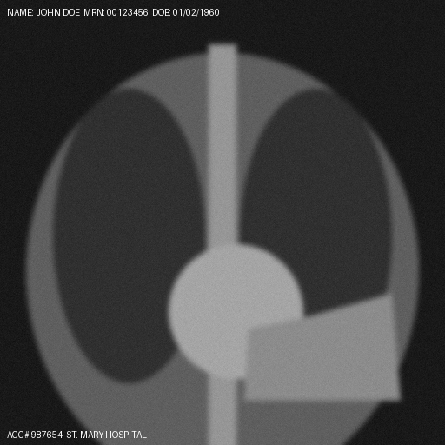

Steps 1–2: Registration and de-identification
Patient ID
HMAC-SHA256 pseudonym (pt_…), raw ID never stored
Age
Reduced to a band: 0-17, 18-39, 40-64, 65+
Image metadata
Image re-encoded from raw pixels; EXIF/PNG text dropped
Burned-in text
Glyph-stroke detector blacks out text regions
Clinical notes
Uploaded: fake name and MRN burned into pixels
Stored: text masked, metadata stripped
Names, MRN, dates, phones, CNIC, emails redacted
Vector database
Payload allowlist blocks any identifying field

Slide 5




Building the knowledge base
Evidence
Chunk
Embed
Index twice
31 CC BY PubMed Central reviews + imported NICE/WHO PDFs
Split at sentence boundaries, ~500 tokens, with overlap
BGE-M3 dense vector per chunk
Vector store + BM25 keyword index, kept in sync
Automatic refresh: the index is fingerprinted and rebuilt only when a source changes. Admins can import guideline PDFs from the browser; every citation carries its source and licence.

Slide 6
Step 4: Hybrid retrieval pipeline
Dense search
(meaning)
Clinical question
Metadata filter
(modality, age band)
Reciprocal rank fusion
Cross-encoder re-rank → top 5
Sparse BM25
(exact terms)
Why both? Dense search finds paraphrases and synonyms; keyword search catches exact drug names and abbreviations. Fusion keeps the strengths of both, and the re-ranker sharpens precision so fewer agent loops are needed.

Slide 7
Steps 4–6: The agent state machine
Route
Retrieve
Inspect image
Draft
Verify
picks modality, decides if the image is needed
hybrid search, merges evidence
VLM findings + similar cases
structured, cited report
checks every claim
unsupported claim → reformulated query → retrieve again (max 3 rounds)
verified
needs_review
unverified
All claims supported
Still unsupported after 3 rounds: flagged
Ablation run without the verification loop
Notes:
The agent can never reach 'signed off'; that transition lives outside the agent.

Slide 8
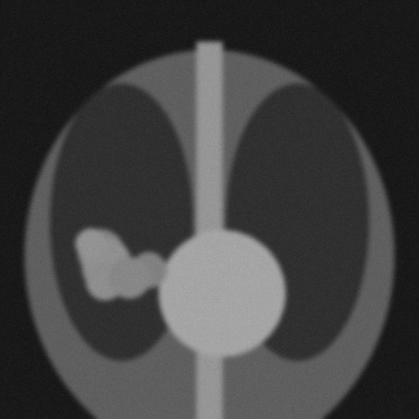
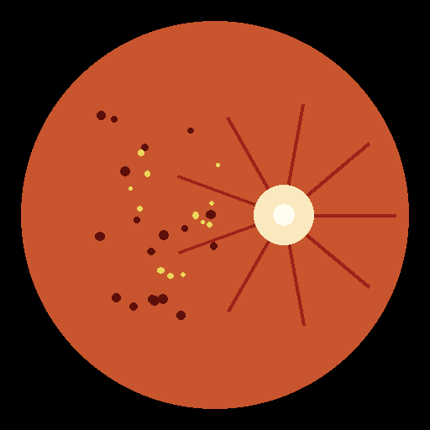
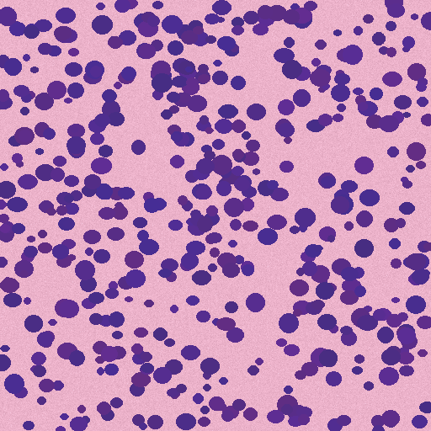
Step 5: Reading the image
Chest radiograph
Retinal fundus
Histopathology
Consolidation, pleural effusion, cardiomegaly, pneumothorax
Haemorrhages, hard exudates, diabetic retinopathy, optic-disc cupping
Nuclear crowding and pleomorphism, carcinoma vs benign tissue
GPU mode: Qwen2.5-VL describes the image and BiomedCLIP finds similar signed-off cases. Offline mode: a deterministic stand-in analyser (images shown are synthetic).

Slide 9
Step 6: Drafting and self-verification
Image findings
How a claim is checked
grounded in the image itself
Claim must cite at least one passage [n]
Real mode: an NLI model must find a cited sentence that entails it
Contradicting the source is caught, even with the same words
Unsupported → its concept becomes the next search query
Impression
must cite evidence
Differential
must cite evidence
Recommendations
must cite evidence
Unsupported claims are shown in red in the workspace and flagged in the PDF.

Slide 10

Step 7: Human sign-off is enforced in code
clinician only
verified
signed_off
The agent, the system, admins and viewers are all refused
agent
draft
Rejecting requires a written reason
Signed-off and rejected reports can never change
needs_review
rejected
Every refused attempt is written to the audit log
PDF report
Unsigned drafts carry a diagonal “DRAFT – NOT FOR CLINICAL USE” watermark on every page. The watermark disappears only after a credentialed clinician signs off. The signing clinician’s name and time then appear in the sign-off block, with the cited evidence listed at the end.

Slide 11

Access control and audit trail
Clinician
Append-only, hash-chained audit log
Register, upload, analyse, sign off, reject
Database triggers block any edit or delete
Each entry stores the SHA-256 hash of the previous one
“Verify hash chain” detects tampering, even with direct file access
Logs logins, uploads, analyses, sign-offs and denials
Admin
Add guidelines, read and verify the audit log; cannot sign off
Viewer
Read-only (e.g. medical student)
Login uses signed, expiring tokens; passwords are stored as PBKDF2 hashes.

Slide 12
How the system is evaluated
Retrieval quality
Recall@K, Mean Reciprocal Rank, latency mean and 95th percentile, for dense, sparse, hybrid and hybrid + re-rank.
Clinical drafting
Ungrounded-claim rate, similarity to a reference report, finding accuracy, compared across four system variants.
Release gates
Recall@5 ≥ 0.80 and ungrounded rate ≤ 0.10, checked on every push.
Offline figures prove the harness and the safeguards on synthetic cases. Real-image results follow on the next slides.

Slide 13
Real evidence and real images
31
150
6
open-access clinical reviews & guidelines
real chest X-rays with radiologist reports
findings scored per report
PubMed Central, CC BY, cited with attribution
Indiana University collection, de-identified again on ingest
effusion, cardiomegaly, consolidation, pneumothorax, atelectasis, nodule
Clinical scoring: the same negation-aware labeller ("without effusion or pneumothorax", "pneumothorax is not visualized") reads both the radiologist's report and MedRAG's draft; precision, recall and F1 compare the findings.

Slide 14
Real-mode pilot on real chest X-rays
Retrieval grounds the drafts
Ungrounded-claim rate 0.28 (full) vs 0.38 (single-pass) vs 1.00 (no retrieval).
Real vision ≈ stand-in at this scale
Finding F1 0.11 vs 0.09 for the offline heuristic on the same X-rays.
Vision is the bottleneck
The 3B model at low resolution over-calls findings on normal films; the thesis run should use the 7B model on GPU.
Pilot only: 12 studies, rule-based labels, CPU model. Not a clinical result; the protocol is ready for the full GPU run.

Slide 15



Three ways to run the same pipeline
Offline
Real on CPU
Real on GPU
Any laptop, no GPU
Deterministic stand-ins
Development, tests, demos
make run
Real models, no GPU
Built-in Qwen2.5-VL-3B server
Minutes per study
medrag llm-server
vLLM + Qwen2.5-VL-7B
Qdrant vector database
Thesis-scale experiments
docker compose --profile gpu
Heavy model libraries load only when first used, so the same code imports and tests on a CPU-only machine.

Slide 16
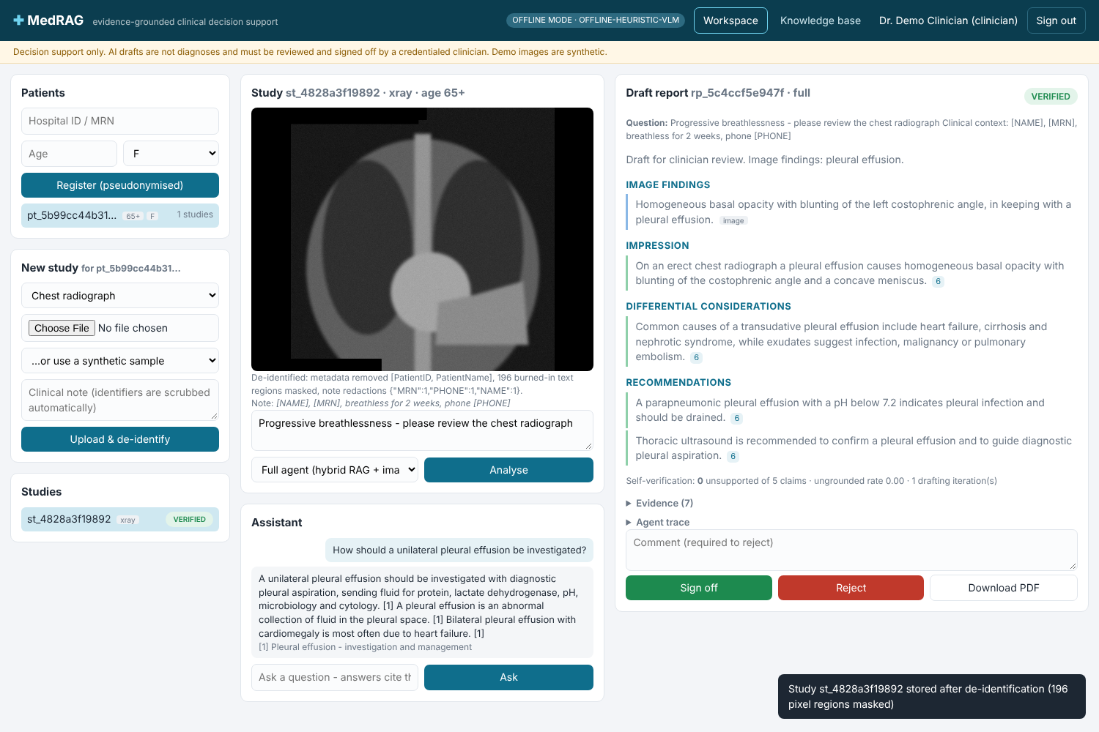
What the clinician sees
1
Patients and studies (left)
2
De-identified image, question and assistant chat (centre)
3
Cited draft with verification result, evidence and agent trace (right)
4
Sign off, reject or download the PDF

Slide 17
Next steps
Apply for MIMIC-CXR credentialing (PhysioNet) now: it takes weeks
Rent GPU time and run the full IU X-ray evaluation with the 7B model
Clinicians rate the drafts in the generated review sheet
Import the licensed NICE / WHO guidelines your institution may use

