Slide 1

ś

Slide 2


Slide 3


Slide 4


Slide 5
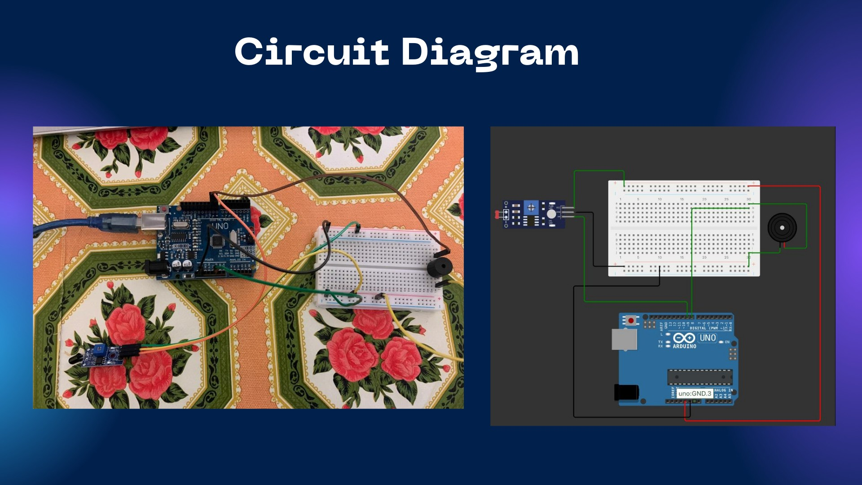

Slide 6

const int buzzerPin • 9; const int fireSensorPin = 8; void setup()
4 {
5 Serid .begin(9600);
pinMode(buzzerPin, OUTPUT);
pinMode (fireSensorPin, INPUT);
o sketch..dec17a
10
• 11
12
13
14
15
16
17
18
19
29
21
22
23
24
void loop()
{
int fireVllue = digihlRead(fireSensorPin); Serial .println(firevalue);
if(fireValue •• 9)
digitalHrite(buzzerPin₁ HIGH);
delay(5909);
else
digitalWrite(buzzerPin, LOW);
)
deloy ( SOO);

Slide 7


Slide 8


Slide 9


Slide 10


