Slide 1

Unit 2 Exploratory Data Analysis
Prepared By: Prof. Rashmi Hirani

Slide 2
Outline
Intro to Descriptive statistics
Data and histogram
Central tendencies 3Ms
Measures of Dispersion
Range and IQR
Standard deviation
Five number summary:- box plot

Slide 3
Intro to Descriptive statistics
Descriptive Statistical Analysis helps you to understand your data and is a very important part of Machine Learning.
This is due to Machine Learning being all about making predictions.
On the other hand, statistics is all about drawing conclusions from data, which is a necessary initial step.
Doing a descriptive statistical analysis of your dataset is absolutely crucial.
A lot of people skip this part and therefore lose a lot of valuable insights about their data, which often leads to wrong conclusions.
Take your time and carefully run descriptive statistics and make sure that the data meets the requirements to do further analysis.

Slide 4
Intro to Descriptive statistics
But first of all, we should go over what statistics really is:
Statistics is a branch of mathematics that deals with collecting, interpreting, organization and interpretation of data.
Within statistics, there are two main categories:
1. Descriptive Statistics: In Descriptive Statistics your are describing, presenting, summarizing and organizing your data (population), either through numerical calculations or graphs or tables.
2. Inferential statistics: Inferential Statistics are produced by more complex mathematical calculations, and allow us to infer trends and make assumptions and predictions about a population based on a study of a sample taken from it.

Slide 5
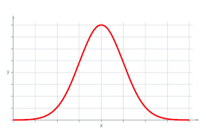
Normal Distribution
The normal distribution is one of the most important concepts in statistics since nearly all statistical tests require normally distributed data.
It basically describes how large samples of data look like when they are plotted.
It is sometimes called the “bell curve“ or the “Gaussian curve“.

Slide 6
Normal Distribution
Inferential statistics and the calculation of probabilities require that a normal distribution is given.
This basically means, that if your data is not normally distributed, you need to be very careful what statistical tests you apply to it since they could lead to wrong conclusions.

Slide 7
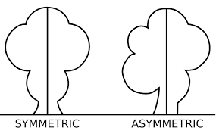
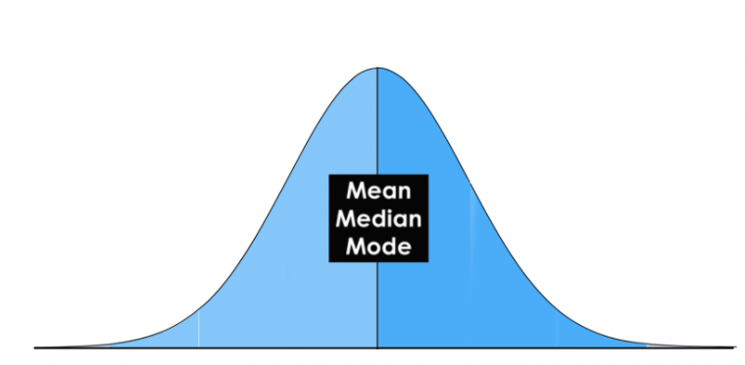
Normal Distribution
A normal Distribution is given if your data is symmetrical, bell-shaped, centered and unimodal.

Slide 8
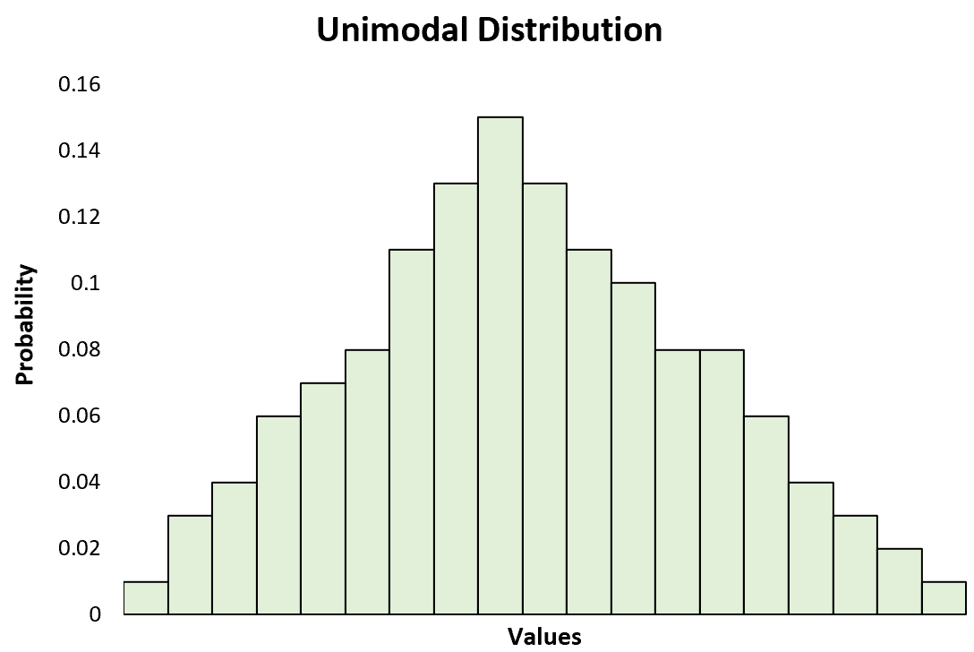
Normal Distribution
In a perfect normal distribution, each side is an exact mirror of the other.
You can see on the picture that the distribution is bell-shaped, which simply means that it is not heavily peaked. Unimodal means that there is only one peak.

Slide 9
Central Tendency
In statistics we have to deal with the mean, mode and the median. These are also called the „Central Tendency“.
These are just three different kinds of „averages” and certainly the most popular ones.
The mean is simply the average and considered the most reliable measure of central tendency for making assumptions about a population from a single sample.
Central tendency determines the tendency for the values of your data to cluster around its mean, mode, or median.
The mean is computed by the sum of all values, divided by the number of values.

Slide 10
Central Tendency
The mode is the value or category that occurs most often within the data.
Therefore a dataset has no mode, if no number is repeated or if no category is the same.
The mode is also the only measure of central tendency that can be used for categorical variables since you can’t compute for example the average for the variable „gender“.
You simply report categorical variables as numbers and percentages.

Slide 11
Central Tendency
The median is the “middle” value or midpoint in your data and is also called the „50th percentile“.
Note that the median is much less affected by outliers and skewed data than the mean.
I will explain this with an example: Imagine you have a dataset of housing prizes that range mostly from 10,00,000/- to 30,00,000/- but contains a few houses that are worth more than 3 crores.
These expensive houses will heavily effect then mean since it is the sum of all values, divided by the number of values.
The median will not be heavily affected by these outliers since it is only the “middle” value of all data points.
Therefore the median is a much more suited statistic, to report about your data.
In a normal distribution, these measures all fall at the same midline point.
This means that the mean, mode and median are all equal.

Slide 12
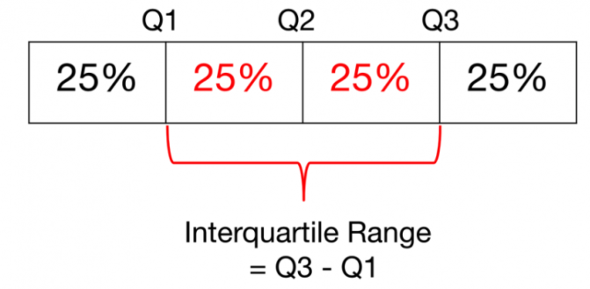
Measures of Variability
The most popular variability measures are the range, interquartile range (IQR), variance, and standard deviation.
These are used to measure the amount of spread or variability within your data.
The range describes the difference between the largest and the smallest points in your data.

Slide 13
Measures of Variability
The interquartile range (IQR) is a measure of statistical dispersion between upper (75th) and lower (25th) quartiles.
While the range measures where the beginning and end of your datapoint are, the interquartile range is a measure of where the majority of the values lie.

Slide 14
Variance and Standard Deviation
The Standard Deviation and the Variance also measure, like the Range and IQR, how spread apart our data is (e.g the dispersion). Therefore they are both derived from the mean.
The variance is computed by finding the difference between every data point and the mean, squaring them, summing them up and then taking the average of those numbers.
The squares are used during the calculation because they weight outliers more heavily than points that are near to the mean. This prevents that differences above the mean neutralize those below the mean.
The problem with Variance is that because of the squaring, it is not in the same unit of measurement as the original data.

Slide 15
Variance and Standard Deviation
Let’s say you are dealing with a dataset that contains centimeter values.
Your variance would be in squared centimeters and therefore not the best measurement.
This is why the Standard Deviation is used more often because it is in the original unit.
It is simply the square root of the variance and because of that, it is returned to the original unit of measurement.
Let’s look at an example that illustrates the difference between variance and standard deviation:
Imagine a data set that contains centimeter values between 1 and 15, which results in a mean of 8. Squaring the difference between each data point and the mean and averaging the squares renders a variance of 18.67 (squared centimeters), while the standard deviation is 4.3 centimeters.

Slide 16
Variance and Standard Deviation
When you have a low standard deviation, your data points tend to be close to the mean.
A high standard deviation means that your data points are spread out over a wide range.
Standard deviation is best used when data is unimodal. In a normal distribution, approximately 34% of the data points are lying between the mean and one standard deviation above or below the mean.
Since a normal distribution is symmetrical, 68% of the data points fall between one standard deviation above and one standard deviation below the mean.
Approximately 95% fall between two standard deviations below the mean and two standard deviations above the mean. And approximately 99.7% fall between three standard deviations above and three standard deviations below the mean.

Slide 17
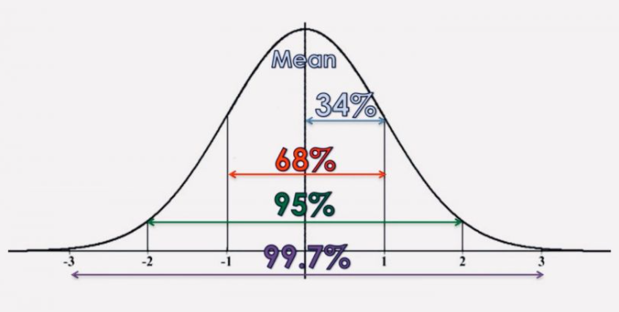
Variance and Standard Deviation
With the so-called „Z-Score“, you can check how many standard deviations below (or above) the mean, a specific data point lies. With pandas you can just use the „std()“ function. To better understand the concept of a normal distribution, we will now discuss the concepts of modality, symmetry and peakedness.

Slide 18
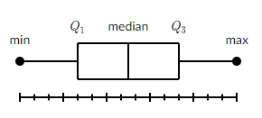
What is a box plot?
A box and whisker plot—also called a box plot—displays the five-number summary of a set of data.
The five-number summary is the minimum, first quartile, median, third quartile, and maximum.
In a box plot, we draw a box from the first quartile to the third quartile.
A vertical line goes through the box at the median.
The whiskers go from each quartile to the minimum or maximum.

Slide 19
What is a box plot?
Example: Finding the five-number summary
A sample of 10 boxes of raisins has these weights (in grams):
25, 28, 29, 29, 30, 34, 35, 35, 37, 38
Make a box plot of the data.
Step 1: Order the data from smallest to largest.
Our data is already in order.
25, 28, 29, 29, 30, 34, 35, 35, 37, 38

Slide 20
What is a box plot?
Step 2: Find the median.
The median is the mean of the middle two numbers:
25, 28, 29, 29, 30, 34, 35, 35, 37, 38
30+34/2=32
The median is 32.
Step 3: Find the quartiles.
The first quartile is the median of the data points to the left of the median.
25, 28, 29, 29, 30
Q1=29
The third quartile is the median of the data points to the right of the median.
34, 35, 35, 37, 38
Q3​=35

Slide 21
What is a box plot?
Step 4: Complete the five-number summary by finding the min and the max.
The min is the smallest data point, which is 25.
The max is the largest data point, which is 38.
The five-number summary is 25, 29, 32, 35, 38.

Slide 22
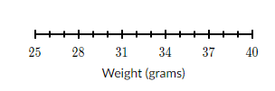
What is a box plot?
Let's make a box plot for the same dataset from above.
Step 1: Scale and label an axis that fits the five-number summary.

Slide 23
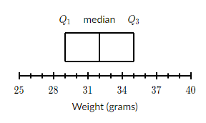
What is a box plot?
Step 2: Draw a box from Q1 to Q3, with a vertical line through the median.
Recall that Q1=29, the median is 32, and Q3=35.

Slide 24
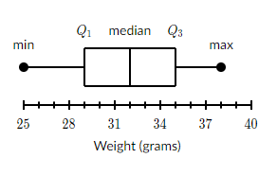
What is a box plot?
Step 3: Draw a whisker from Q1 to the min and from Q3 to the max.
Recall that the min is 25 and the max is 38.

Slide 25
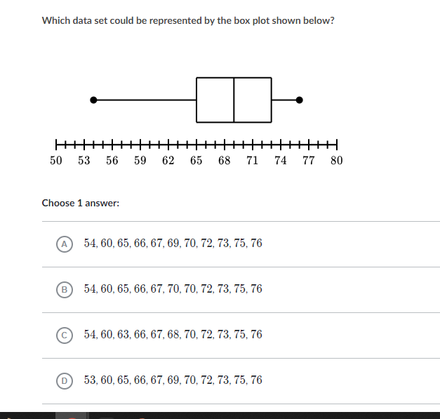
What is a box plot?

Slide 26
What is a box plot?
10,11,12,25,25,27,31,33,34,34,35,36,43,50,59

Slide 27
What is a box plot?
Mode: refers the data value that is most frequently observed
154cm,139cm,154cm,192cm,180cm, 140cm, 154cm, 155cm,192cm.
Median: refers to the data value that is positioned in the middle of an ordered data set.
N+1
Mean:

Slide 28
What is a box plot?
1) https://builtin.com/data-science/intro-descriptive-statistics

