Slide 1
Fine-Tuning LLaMA-2 for a Medical AI Chatbot Project Goals:
Build a domain-specific medical AI chatbot using state-of-the-art models.
Fine-tune LLaMA-2 for efficient, context-aware responses to healthcare queries. Team Members:
Daniyal Haider
Mohsin Raza

Slide 2
Data Preprocessing Details
Key Points:
Dataset Overview: 2000 rows with columns: Description, Patient Query, and Doctor Response.
Steps Taken:
Removed duplicates and missing values.
Tokenized and normalized text using the LLaMA-2 tokenizer.
Padded or truncated text sequences to maintain consistency.
Rationale: Preprocessing ensures consistent input/output pairs and improves model accuracy.

Slide 3
Dataset Details
Key Statistics:
- Total Records: 228,722
- Unique Patients: 246,006
- Unique Doctors: 242,150
Features:
- Columns: Description, Patient, Doctor

Slide 4
Advanced EDA - Quantitative Analysis
Key Points:
Data Distribution:
Average query length: 15 words.
Most frequent medical terms: fever, headache, symptoms.
Correlations:
Strong alignment between common queries and responses in the dataset.
Visuals: Histogram of query lengths, Heatmap showcasing term frequencies.

Slide 5
Advanced EDA - Qualitative Analysis
Title: Patterns in Text Data Key Points:
Word cloud highlighting frequently used terms.
Analyzed contextual alignment between queries and responses.
Visuals: Word cloud with terms like diabetes, treatment, prescription, and t-SNE visualization for clustering similar queries.

Slide 6
Model Selection Recap
Title: Why LLaMA-2 with PEFT and LoRA? Key Points:
Model Chosen: LLaMA-2 for its advanced language understanding.
PEFT and LoRA:
Lightweight methods to fine-tune large models efficiently.
Reduced training time and computational resources.
Cosine Similarity: Measures relevance between patient queries and the closest response.

Slide 7
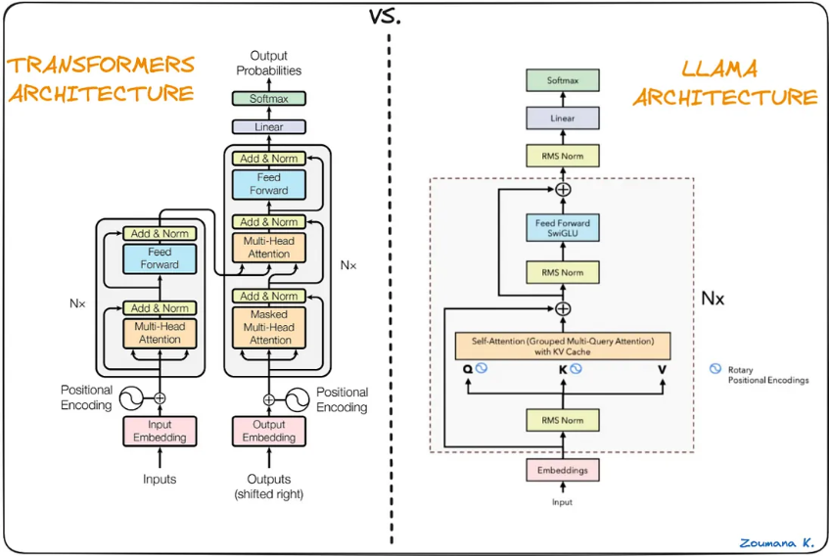

Slide 8
Detailed Model Architecture (Part 1)
Model Configuration Key Points:
Base Model: LLaMA-2 pre-trained on diverse language tasks.
LoRA (Low-Rank Adaptation): Injected lightweight layers to adjust weights for domain-specific tasks.
PEFT (Parameter Efficient Fine-Tuning): Optimized the number of trainable parameters.

Slide 9
Detailed Model Architecture (Part 2)
Workflow Overview Key Points:
Input → Tokenization → Fine-Tuned Model → Output
Cosine similarity used to match user queries with appropriate responses.

Slide 10
Model Training Process
Title: Fine-Tuning Process Key Points:
Hyperparameters:
Learning Rate: 2e-3
Batch Size: 4
Epochs: 1
Visuals: Line chart showing training loss reduction over epochs.

Slide 11
Results
Model Achievements Key Points:
High accuracy in providing contextually appropriate responses.
Efficient fine-tuning with PEFT and LoRA reduced resource consumption.
Sample Response:
User: What are the symptoms of diabetes?
Chatbot: Common symptoms include increased thirst, frequent urination, fatigue, and blurred vision. Please consult a doctor for a diagnosis.

Slide 12
THANK YOU

