Slide 1
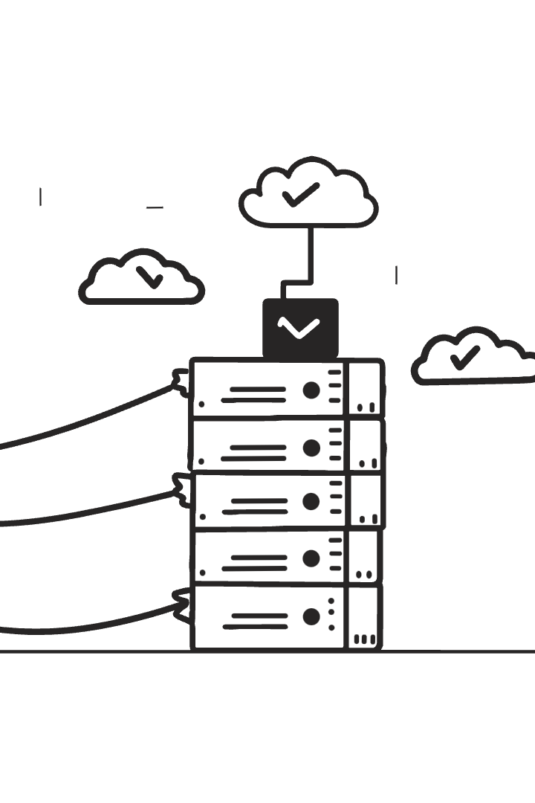

Scaling Deep Learning Data Management with Cassandra DB
This presentation explores a scalable solution for managing large-scale deep learning data using Apache Cassandra, a NoSQL database. The approach addresses inefficiencies in data loading pipelines caused by millions of small files, enabling efficient network access and decentralized data distribution for parallel training.
We will cover the architecture, implementation, performance evaluation, and advantages of this Cassandra-based data loader, highlighting its high throughput and scalability.
By Daniyal Haider

Slide 2

Challenges and Research Objectives
Challenges
Deep learning datasets often contain millions of small files, straining filesystems and complicating metadata management. Current data loading pipelines lack scalability and standardization.
Objectives
The solution aims to enable horizontal scalability with low-latency access, support dynamic dataset splits and metadata tracking, and optimize throughput for distributed deep learning training.

Slide 3
Literature Review: Existing Solutions
TFRecord & Parallel Filesystems
Synthetic Data & Key-Value DBs
TFRecord groups records but lacks random access.
Synthetic data avoids transfer but is context-limited.
Parallel filesystems improve scalability but struggle with metadata.
Key-value DBs like LMDB lack Cassandra’s scalability.

Slide 4
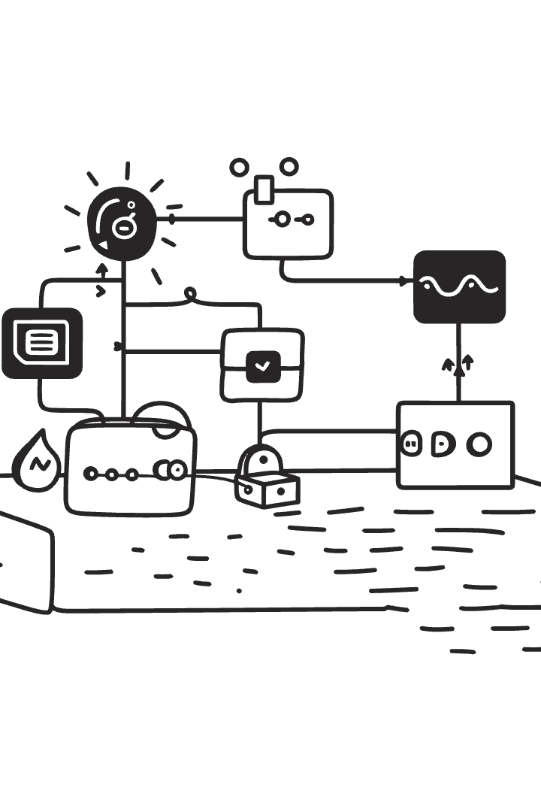
Methodology: Data Model and Implementation
Data Model
Three Cassandra tables manage metadata and image data using natural keys and UUIDs for efficient indexing.
Implementation
Includes CassandraListManager for dynamic splits and BatchPatchHandler for optimized batch prefetching with thread pooling and double buffering.

Slide 5
Performance Evaluation
Data Loader Throughput
Server and Network
JPEG images achieve 11,000–18,000 images/second; TIFF images reach 3,800–4,900 images/second at batch size 128.
Cassandra server saturates 10 GbE bandwidth with stable latency under 1 ms for JPEGs, supporting high throughput and low latency.

Slide 6

Distributed Training and Scalability
1
Multi-GPU Simulation
Simulated training with MPI for gradient synchronization demonstrates linear scalability.
2
Validation Throughput
Achieved 54,200 JPEG images/second with 64 workers, confirming efficient parallel data distribution.

Slide 7
Discussion: Advantages and Limitations
Advantages
Limitations
Dynamic dataset splits enable flexible reconfiguration.
Higher CPU usage for uncompressed data.
Decentralized distribution simplifies parallel training.
Network dependency affects performance.
Adding Cassandra nodes increases throughput linearly.
Latency trade-offs compared to RDMA-based systems.

Slide 8
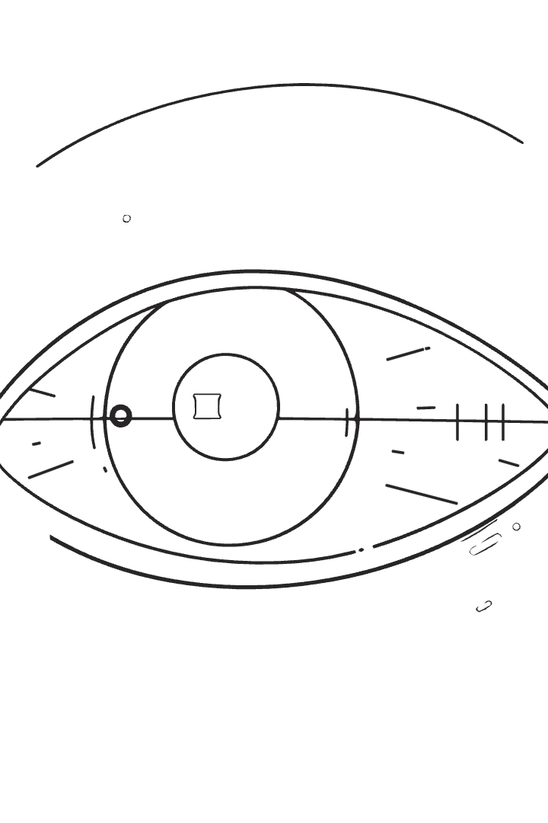
Conclusion and Future Work
Conclusion
The Cassandra-based data loader achieves high throughput and efficient decentralized data distribution, addressing key deep learning data management challenges.
Future Work
Plans include extending support to TensorFlow and PyTorch, optimizing for scientific tensor data, and exploring in-node Cassandra deployment to reduce network overhead.

