Slide 1

How Entrepreneurs Can Unlock Their Full Potential
Jay Bailey | TED Talk
Discover how belief, environment, and representation empower entrepreneurs.
By: Daniyal Haider Anas Khalid

Slide 2
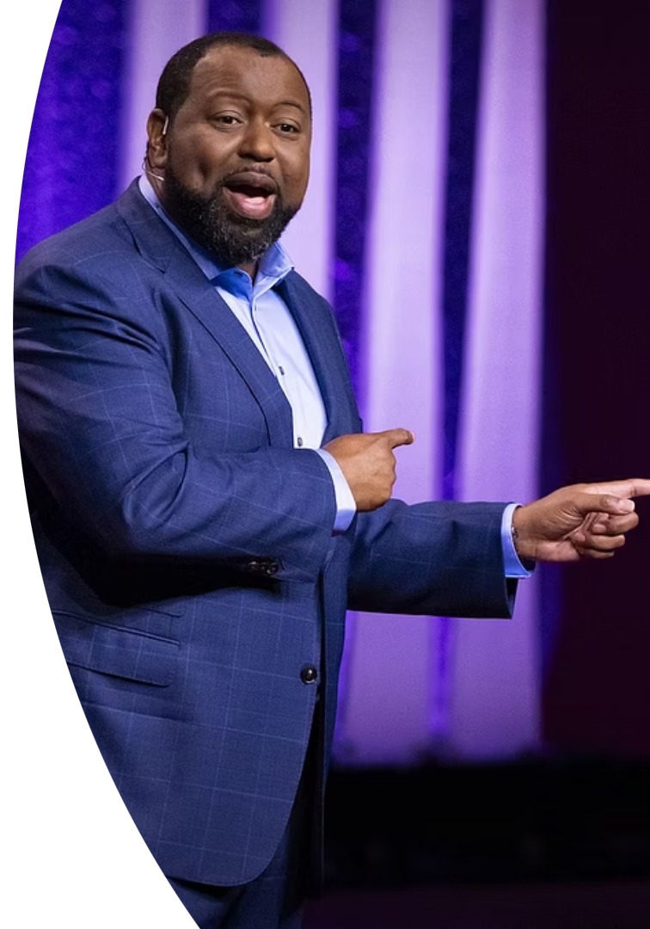
Meet Jay Bailey:
Jay Bailey is an influential business leader and the President & CEO of the H.J. Russell Innovation Center for Entrepreneurs in Atlanta, Georgia. A lifelong entrepreneur, he began his business journey as a child and now leads a major center supporting and developing Black-owned businesses. His mission is grounded in empowering underserved communities through opportunity, belief, and ownership.
Early Start
Leader & Advocate
Childhood entrepreneur building skills from a young age.
President & CEO of H.J. Russell Innovation Center.
Mission
Empowers Black-owned businesses through opportunity and belief.

Slide 3
TED Talk Summary: Unlocking Entrepreneurial Potential
In this inspiring TED Talk, Jay Bailey challenges limiting beliefs and explores how environment, access, and belief systems shape entrepreneurial potential. He shares his journey from a misunderstood gifted student to a successful entrepreneur and community leader. His message centers on the power of belief, representation, and support to unlock true potential in underserved communities.

Slide 4



Unlocking Potential Through Belief and Environment
Redefine Identity
Align your environment with your true potential.
2
Challenge Limiting Beliefs
For example, surrounding yourself with mentors who inspire growth.
Overcome the stories that hold you back.
1
For example, shifting from "I can't do this" to "I can learn and improve."
Representation Matters
Inclusive spaces fuel confidence and growth.
3
For example, seeing entrepreneurs like speaker succeed builds belief.

Slide 5





The Transformative Power of Exposure
Early Lessons
From selling popsicles to understanding ownership.
Life-Changing Encounter
A barber’s wisdom sparked a new entrepreneurial path.
Community Spaces
Building environments where Black entrepreneurs thrive.
Russell Center Impact
360+ entrepreneurs supported; $450M economic value created.

Slide 6

Conclusion & Reflections
Key Insight
Impact
Belief, access, and representation unlock human potential.
One moment of exposure can change a life forever.
Jay Bailey’s story inspires authentic entrepreneurship for social change.

Slide 7
Critique and Reflections
While deeply motivational, the talk could benefit from incorporating more data-driven outcomes and scalable policy implications to enhance its impact.
Some comparisons, such as equating drug dealers with entrepreneurs, may oversimplify complex socio-economic realities, which calls for a more nuanced discussion.
Nonetheless, the core message about belief, environment, and representation remains powerful and inspiring for fostering authentic entrepreneurship and social change.

