Slide 1
Android Network Operations

Slide 2
Android Network
A device can have various types of network connections.
Android lets your application connect to the internet or any other local network and allows you to perform network operations.

Slide 3
ConnectivityManager
Before you perform any network operations, you must first check that are you connected to that network or internet e.t.c.
For this android provides ConnectivityManager class. You need to instantiate an object of this class by calling getSystemService() method.

Slide 4
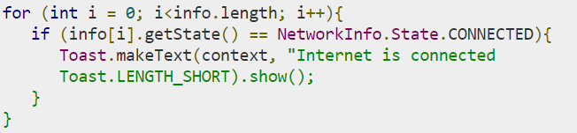
ConnectivityManager (Cont…)
Once you instantiate the object of ConnectivityManager class, you can use getAllNetworkInfo method to get the information of all the networks

Slide 5
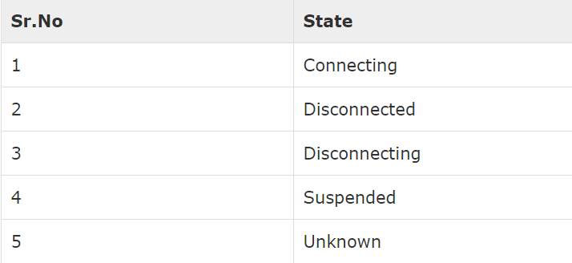
Other States of Connection

Slide 6

Connecting to the Network
After checking that you are connected to the internet, you can perform any network operation. Here we are fetching the html of a website from a url.
Android provides HttpURLConnection and URL class to handle these operations. You need to instantiate an object of URL class by providing the link of website

Slide 7
Connecting to the Network (Cont…)
After that you need to call openConnection method of url class and receive it in a HttpURLConnection object

Slide 8
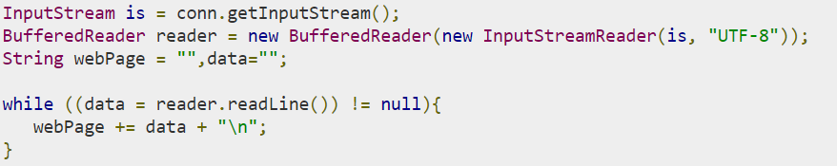
Reading Data from URL
And the last thing you need to do is to fetch the HTML from the website. For this you will use InputStream and BufferedReader class

Slide 9
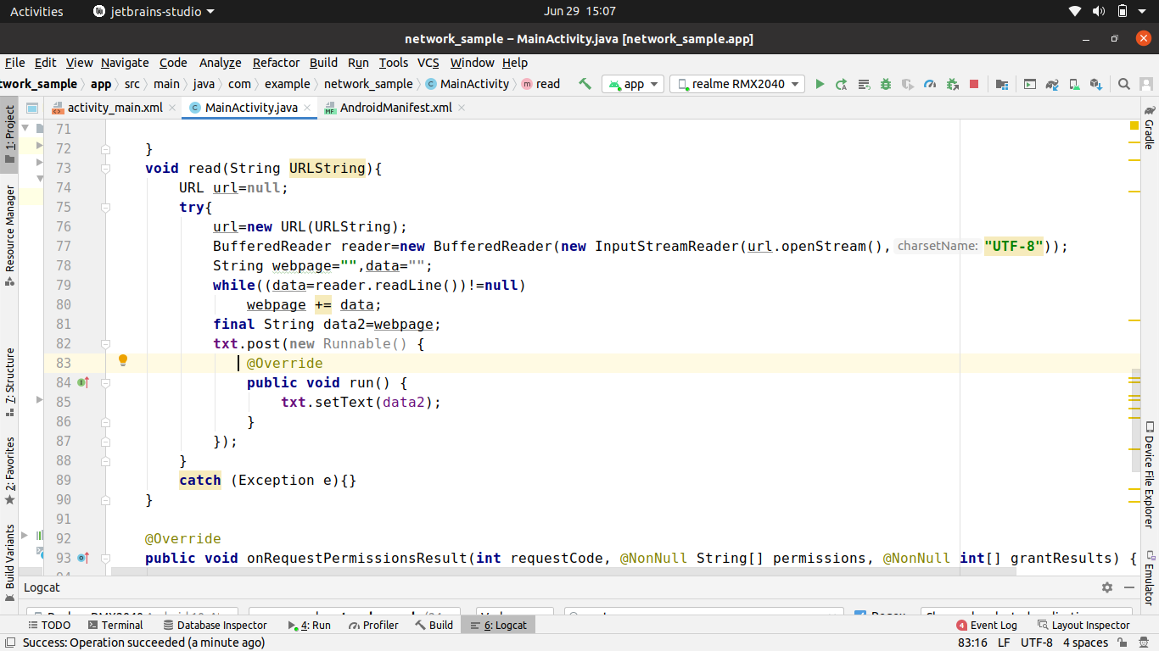

Slide 10
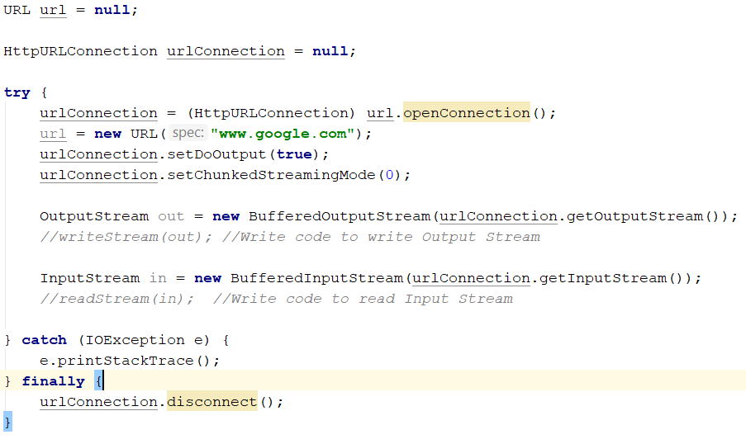
Sending Data to URL

Slide 11
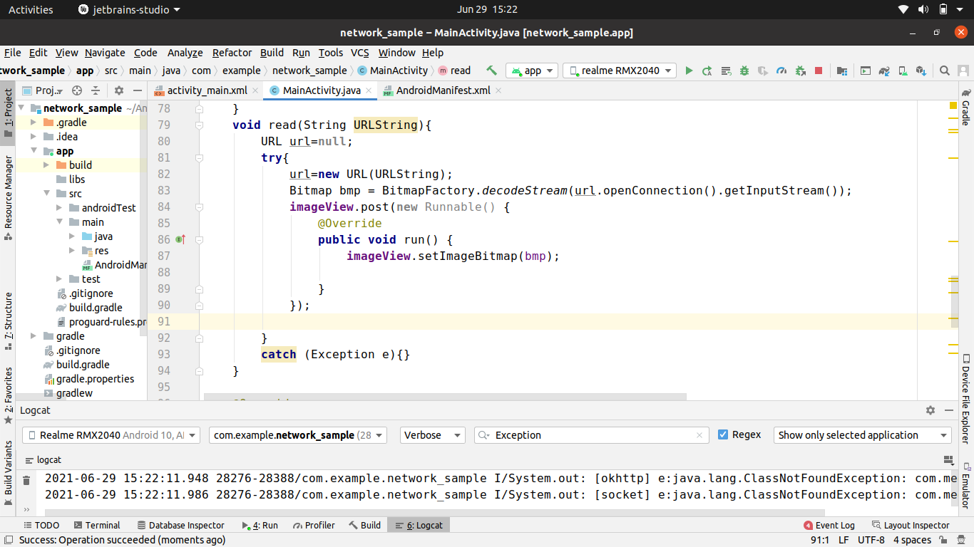

Slide 12
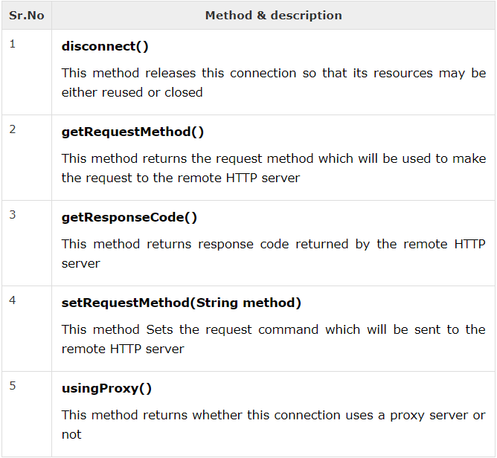
Other HTTPURLConnection Methods

Slide 13
Task .. Download image from given URL
http://www.tutorialspoint.com/green/images/logo.png

Slide 14
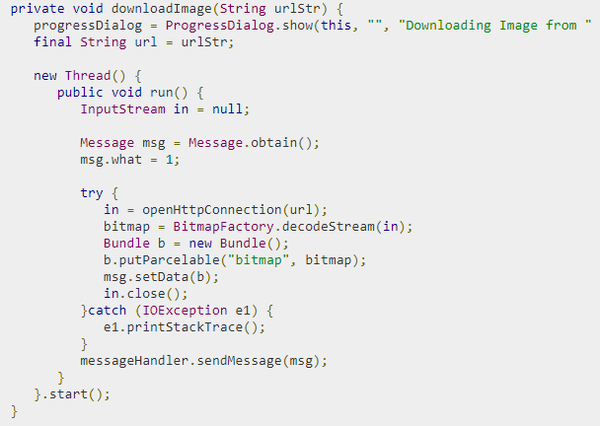
Image Downloading Code

Slide 15
URL url = new URL(“write url here"); HttpURLConnection urlConnection = (HttpURLConnection) url.openConnection(); InputStream in = urlConnection.getInputStream();
Bitmap bmp = BitmapFactory.decodeStream(in);

