Slide 1
BookMyVenue – Event Booking and Management System
Seamless Venue & Event Service Booking Website
Daniyal Wajid (SAP ID: 48528)
Uzair Hassan (SAP ID: 48525)

Slide 2
Problem Statement
Difficulty in booking venues and services – Users need to visit multiple platforms to find venues, catering, décor, and food options for their events.
Hard to find the right venue – Users face challenges in discovering venues that match their specific event requirements, making the process time-consuming.
Scalability issues – Traditional event platforms often can't handle growing user traffic and service providers, leading to performance problems.
Security concerns – Many platforms lack robust and secure login and registration features, compromising user and business owner data.

Slide 3
Proposed Solution
BookMyVenue offers a complete digital platform connecting users with event venues and services.
Business owners can register and manage their offerings (halls, décor, catering, food, etc.).
Users can log in, browse, and book venues with optional add-ons (catering, décor, food) all in one place.
Built using the MERN Stack (MongoDB, Express.js, React.js, Node.js) for scalability, performance and security.

Slide 4
Competitive Analysis
Feature / App | Bookeria | BookEvent | BookMyVenue
2 Factor Authentication | ✔ | ❌ | ✔
360 deg Images | ❌ | ❌ | ✔
Multi-Service Booking (Hall + Food) | ❌ | ❌ | ✔
Discounts and Offers | ❌ | ❌ | ✔
Payment Integration | ✔ | ✔ | ✔
Real-Time Availability | ❌ | ❌ | ✔
Notifications | ✔ | ✔ | ✔

Slide 5
SWOT Analysis
Strengths:
Centralized platform for venue and service booking.
A platform which allows users to book venues for events online with the comfort of staying at their homes.
Weaknesses:
New entrant with limited brand recognition.
This covers events at a national level and not at global level

Slide 6
SWOT Analysis (Continued)
Opportunities:
Growing market for digital event planning and management.
Potential to expand into new regions and partner with major event organizers.
Threats:
Strong competition from established platforms.
Dependency on business owners' participation for service variety.

Slide 7
PEST Analysis
Political:
Data protection and compliance with local regulations (GDPR, local data laws).
Licensing and permits for event venues and services.
Economic:
Growing demand for event services and digital solutions.
Economic cycles affecting event budgets (weddings, goods prices etc).

Slide 8
PEST Analysis (Continued)
Social:
Rising preference for digital booking platforms and cashless payments.
Social trends driving personalized and themed events.
Technological:
MERN stack enables modern web technologies; increasing adoption of cloud services and real-time data processing.
Growth of mobile-first usage and integration with social media for marketing.

Slide 9
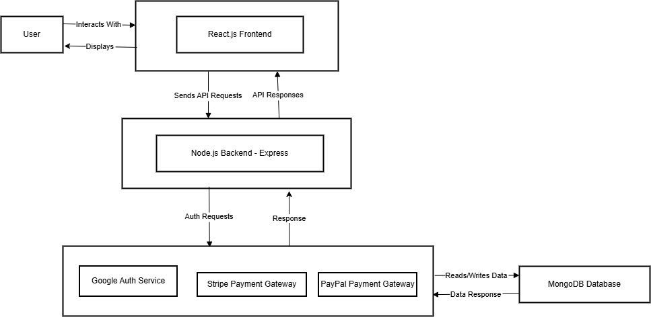
System Architecture Diagram

Slide 10
SDLC Model
Model: Agile
Why: Allows iterative development with regular feedback and adjustments.
Stages:
Planning & Requirement Gathering
Design
Development (sprints using MERN Stack)
Testing & Quality Assurance
Deployment
Feedback & Maintenance

Slide 11
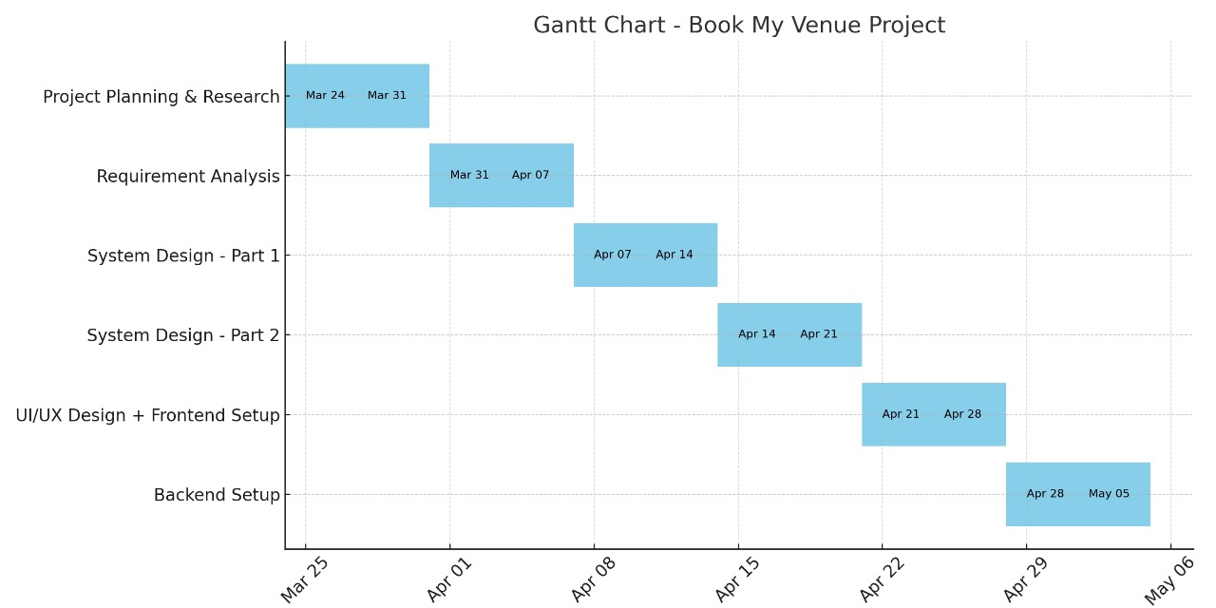
Project Timeline

Slide 12
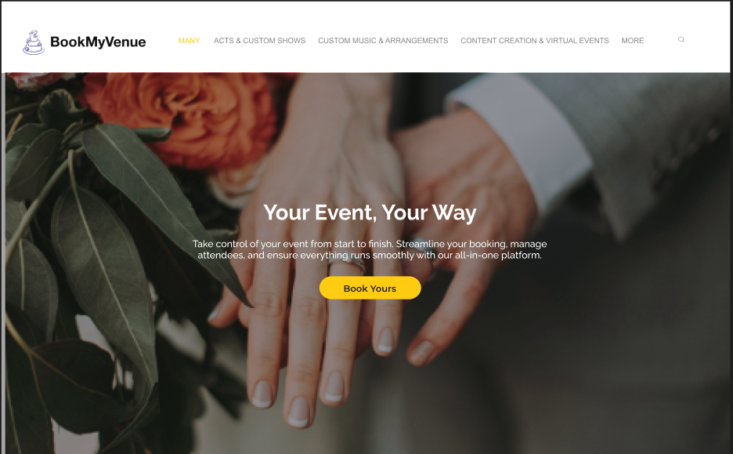
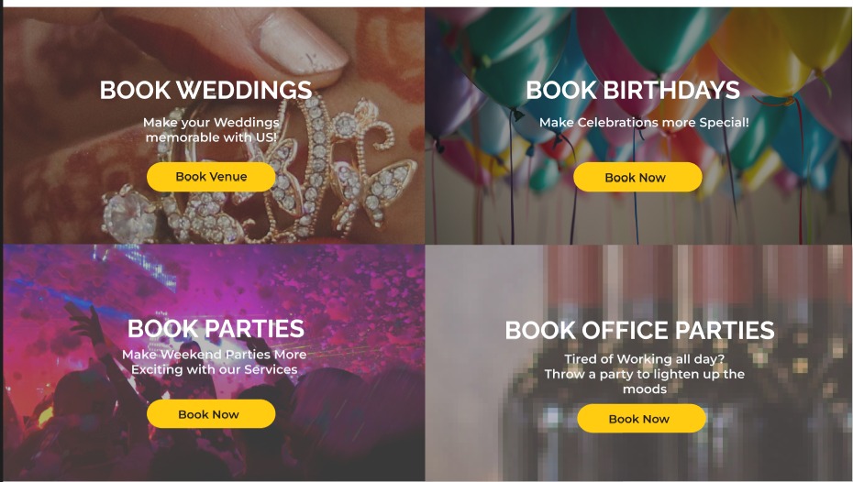
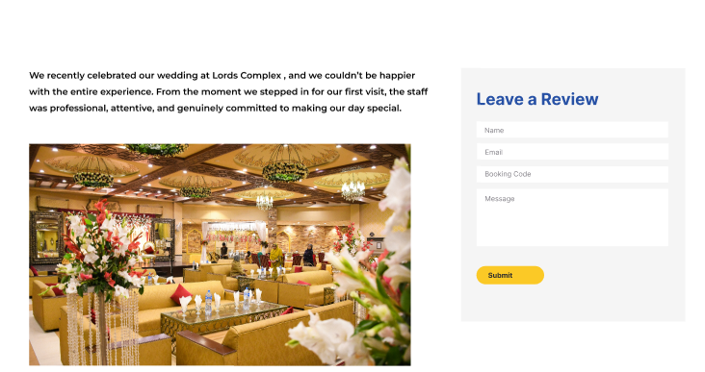
Basic Prototypes

