Slide 1
Investigating Volumetric Analysis of
Constituents of Brain Soft Tissue
Presented by:
Daniyal Ahmed Gul
Muhammad Hasan Nauman
Hadia Khan

Slide 2
Problem Overview
Manual brain tissue volumetric analysis is time-consuming
Existing tools require full 3D scans and expert correction
High computational cost and limited scalability
Need for automated and efficient volumetric analysis

Slide 3
Research Gap
Most systems rely on 3D MRI volumes
Performance degrades across scanners
Limited interpretability in deep models
Lack of efficient 2D slice-based volumetric estimation

Slide 4
Proposed Solution
Automated volumetric analysis using 2D MRI slices
Hybrid ML + DL framework
Combines classical features and CNN embeddings
Produces reliable GM, WM, and CSF volume ratios

Slide 5
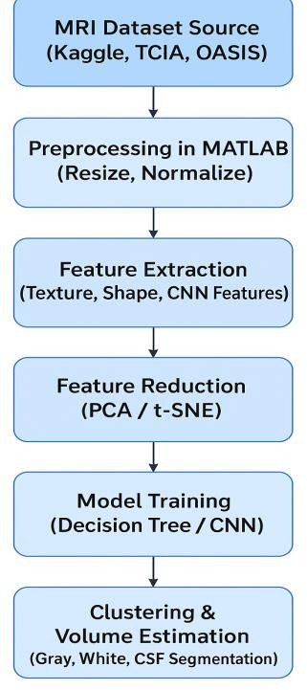
Methodology Flow

Slide 6
System Architecture (3-Layer Model)
Presentation Layer
Web UI
MRI Upload
Results & Reports
Business Logic Layer
Preprocessing
Feature Extraction
ML/DL Models
Volumetric Computation
Data Layer
MRI Images
Feature Sets
Models
Reports

Slide 7
Expected Results
Accurate tissue segmentation and volumetric estimation
Target Dice similarity score above 90% (based on benchmark datasets)
Significant reduction in manual segmentation effort
Scalable framework suitable for large-scale neuroimaging research

Slide 8
System Diagrams Used
Use Case Diagram
Sequence Diagrams
Class Diagram
Entity Relationship Diagram
Database Schema

Slide 9
Tools & Technologies
MATLAB – Image preprocessing
Python – ML/DL model training
CNN, Decision Tree, PCA, K-Means
Public MRI datasets

Slide 10
Conclusion
AI-driven volumetric brain tissue analysis
Efficient alternative to traditional 3D methods
Clinically interpretable and scalable framework
Strong foundation for future disease-specific analysis

