Slide 1

FASTBOOK
Presentation by
Amna Siddiqui - 22i0830
Daniyal Faraz - 22i1096
Hammad Ali - 22i0914
Instructor: Majid Hussain

Slide 2
Introduction
Intellox - A tech company established to provide modern and robust software solutions to everyday problems
1

Slide 3
Table Of Content
Problem Statement
NFRs
ERD
Solution
Use Case Diagram
Interfaces
Architecture
Domain Model
FRs
Class Diagram
2

Slide 4
Problem Statement
Many social media platforms exist in this digital era to connect people around the world but:
These general social media platforms are too broad
FAST students lack a tailored platform for connection
Current platforms don't focus on university communities
3

Slide 5
Solution
A JavaFX-based social media application for FAST students
Centralized SQL database for secure data storage and efficient retrieval
Enables connections based on academic skills, interests, and activities
Includes features like chat, activity posts, and notifications
Provides a university-focused, privacy-first community platform
4

Slide 6


Software Architecture
Model
View
Controller
It represents the data and the business logic of the application. Handles user data operations and manages database
Manages the user interface (UI) and presentation logic. Displaying JavaFX scenes, textboxes, buttons etc
Acts as the intermediary between the model and the view. Contains event handlers and logic to manage various actions
5

Slide 7
Functional Requirements
A user is able to:
Register and Login to the application
View and Edit their profile
Send, Accept and Reject friend requests from other users
Engage in one-to-one chat conversations with friends
Create, View, Update and Delete various types of posts
Comment and React on different posts created by other users
6

Slide 8
Non Functional Requirements
Safety and Security
Robust and Maintanable
Database backups
User authentication
Secure passwords
Validations and error handling
Modular programming approach
7

Slide 9
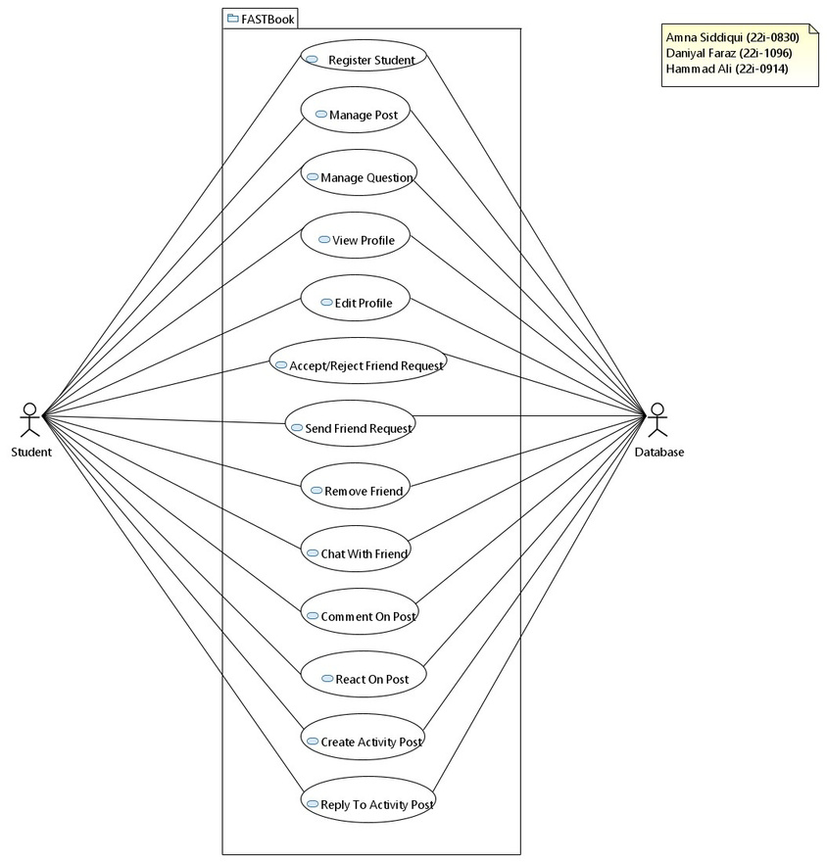
Use Case Diagram
Register Student
Manage Posts
Manage Questions
View Profile
Edit Profile
Accept/Reject Friend Request
Send Friend Request
Remove Friend
Chat With Friend
Comment On Post
React On Post
Create Activity Post
Reply To Activity Post
8

Slide 10
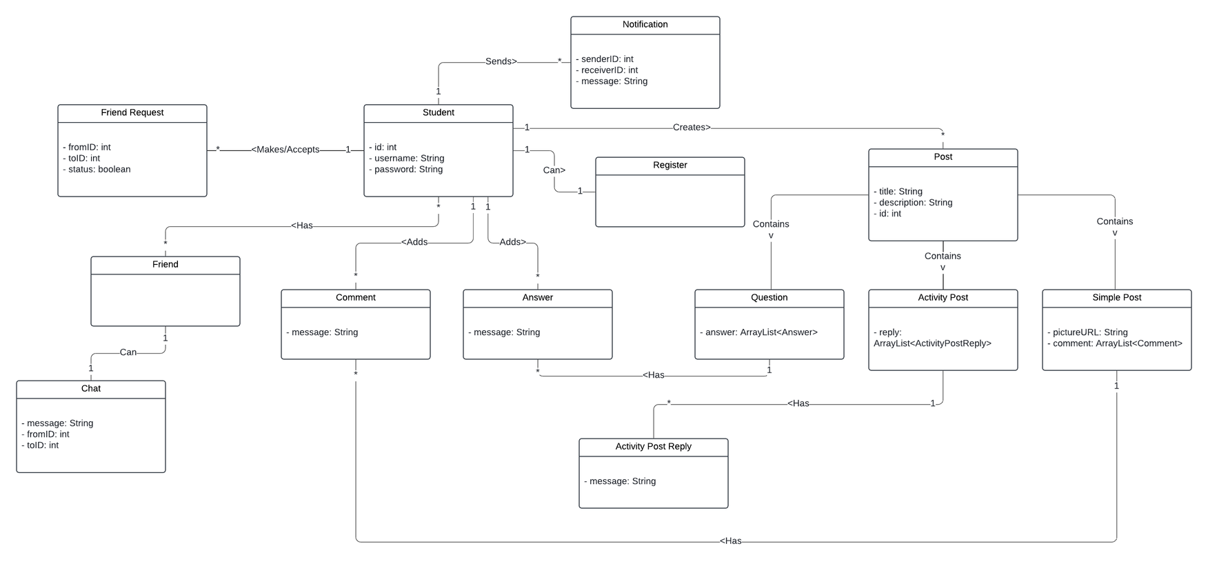
Domain Model
9

Slide 11
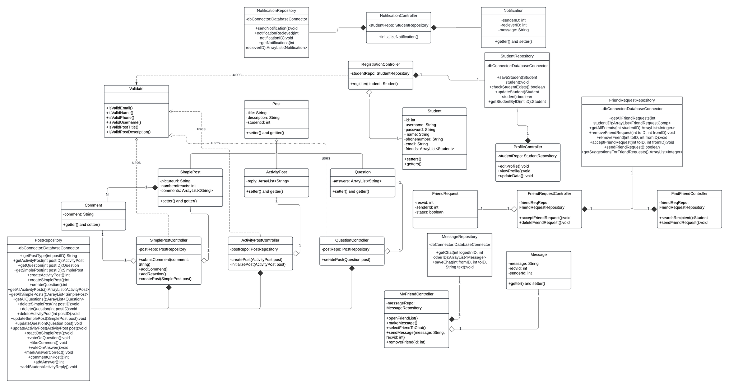
Class Diagram
10

Slide 12
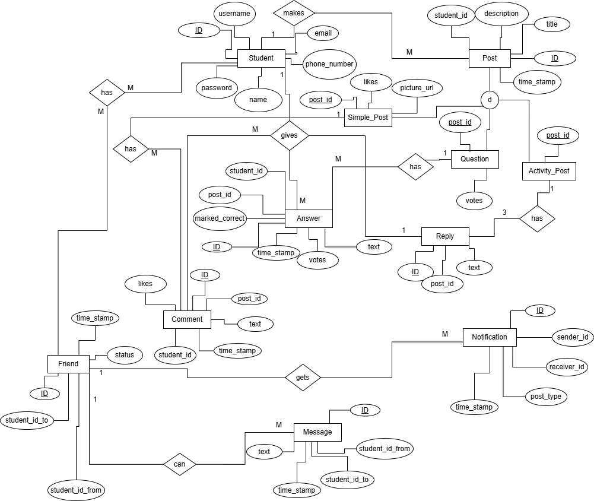
Entity Relation Diagram
11

Slide 13
INTERFACES

Slide 14
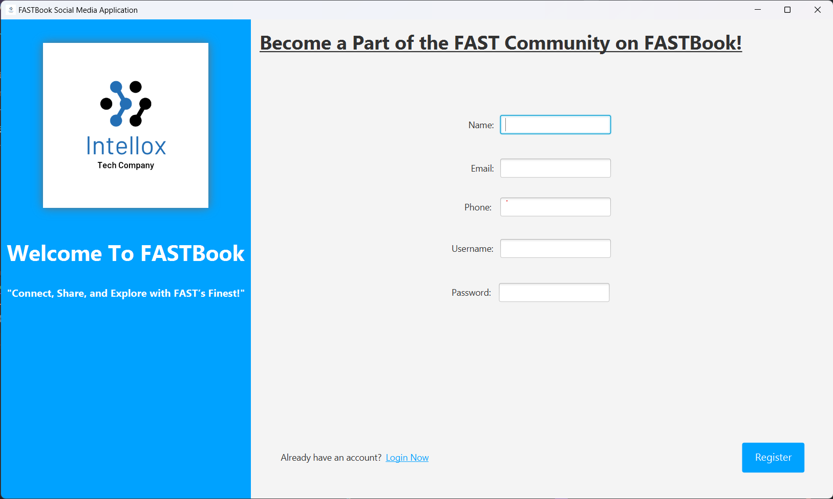

Slide 15
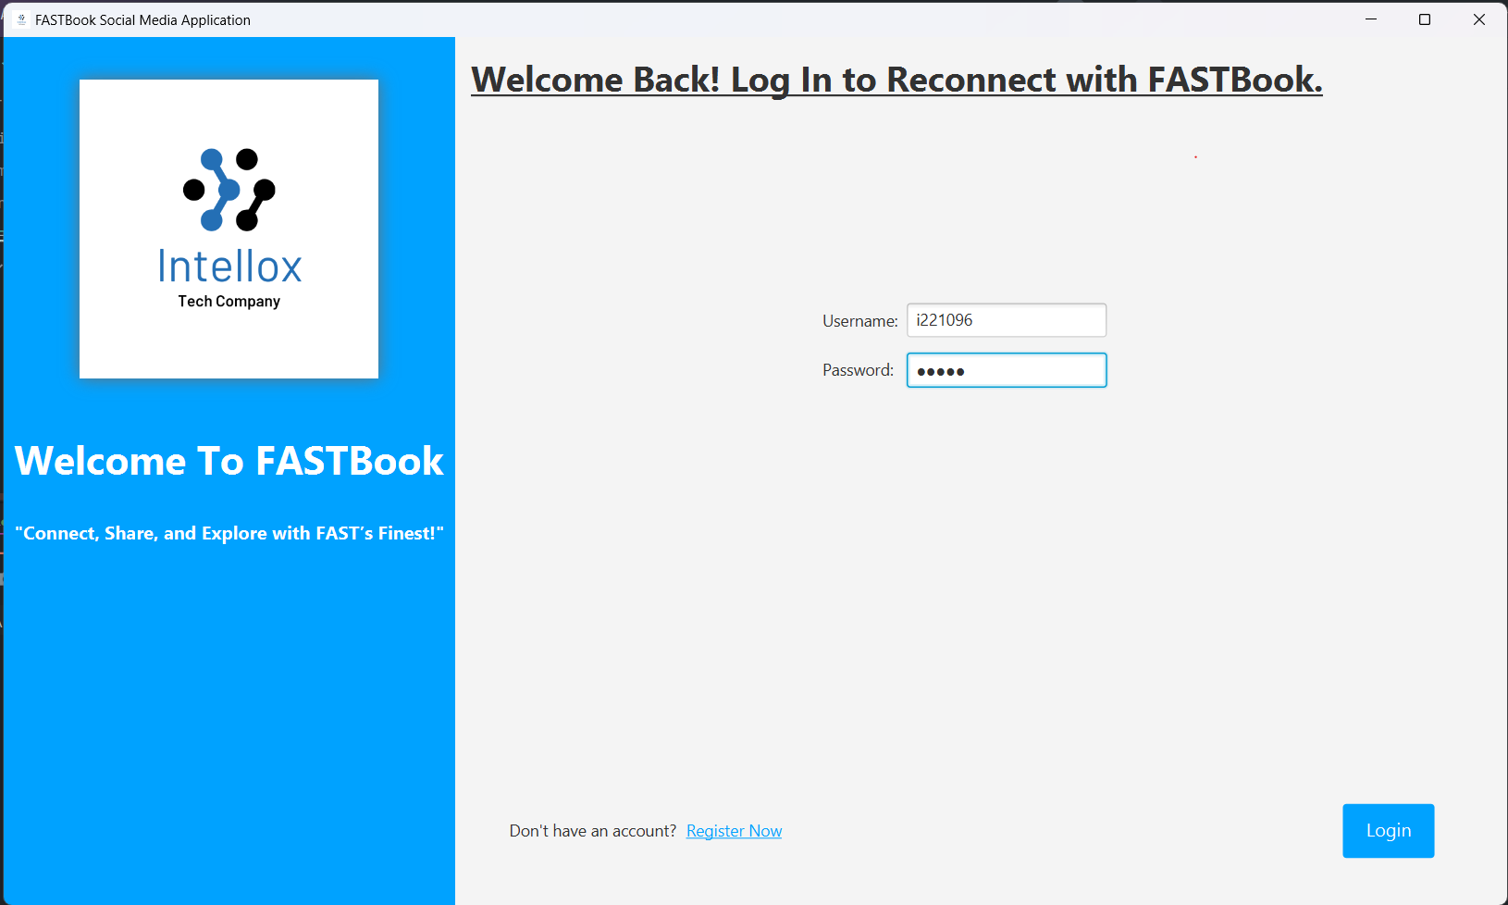

Slide 16
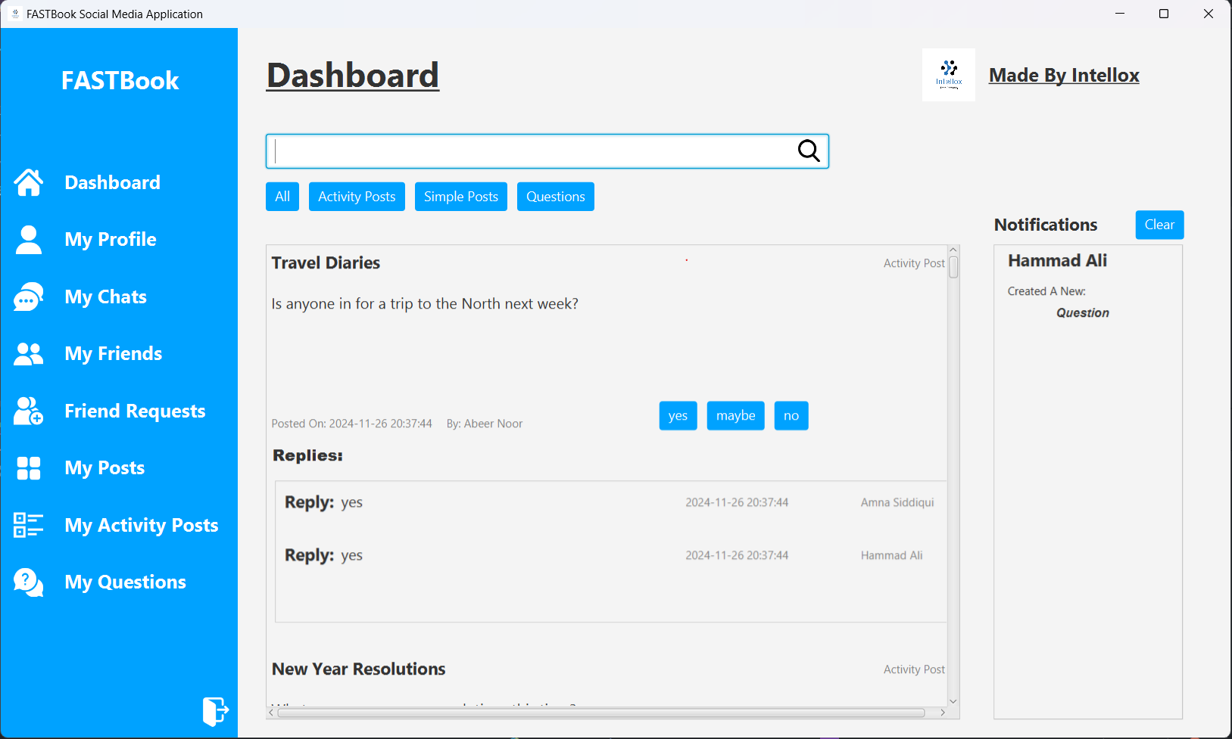

Slide 17
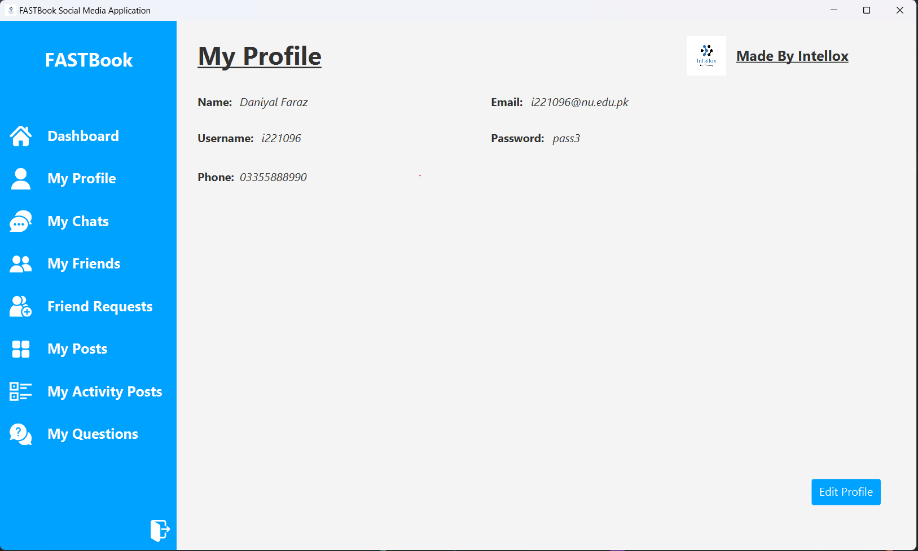

Slide 18
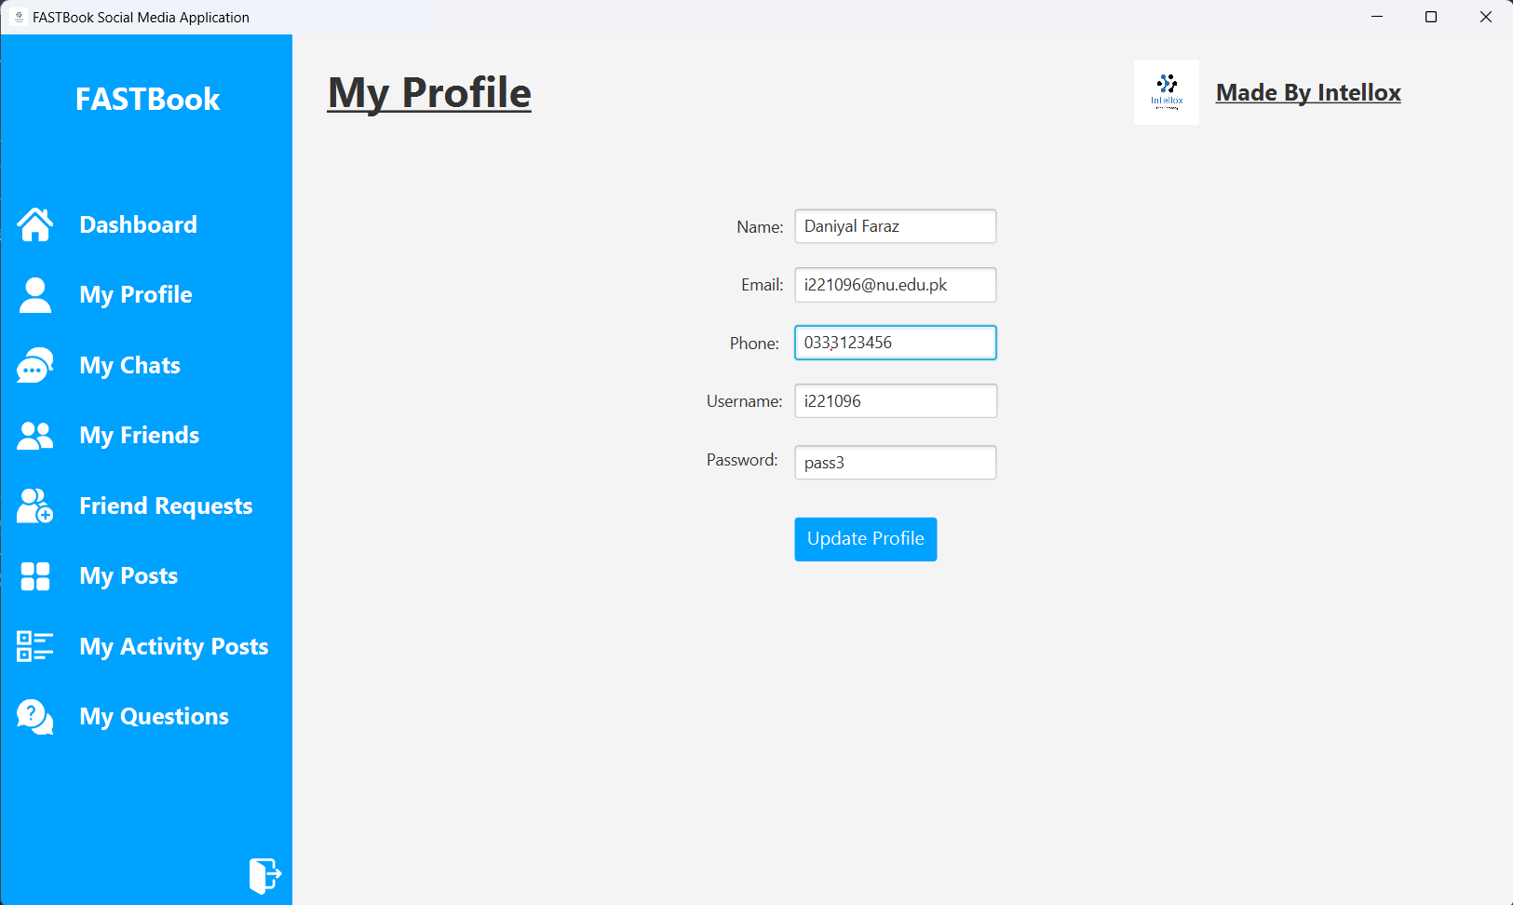

Slide 19
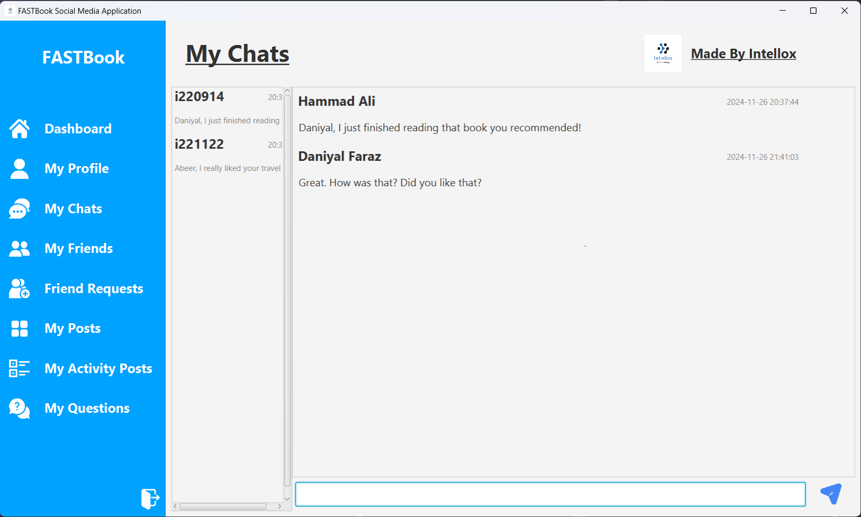

Slide 20
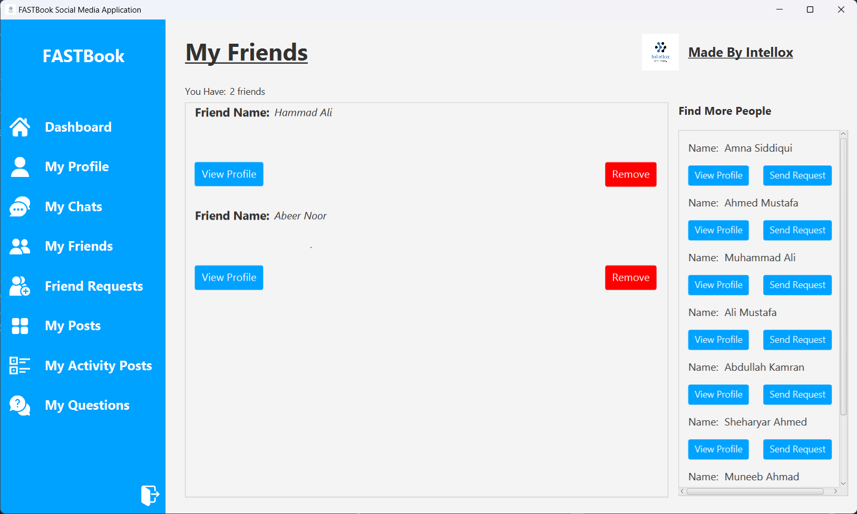

Slide 21
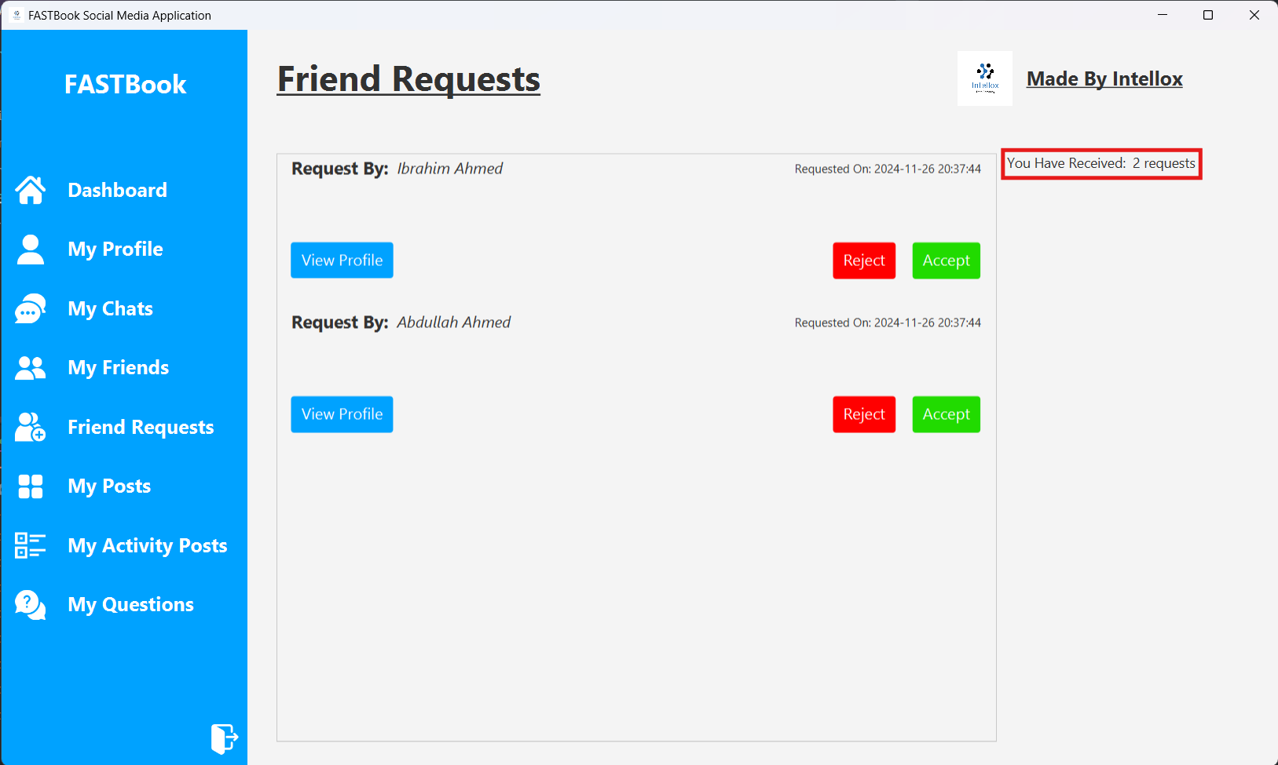

Slide 22
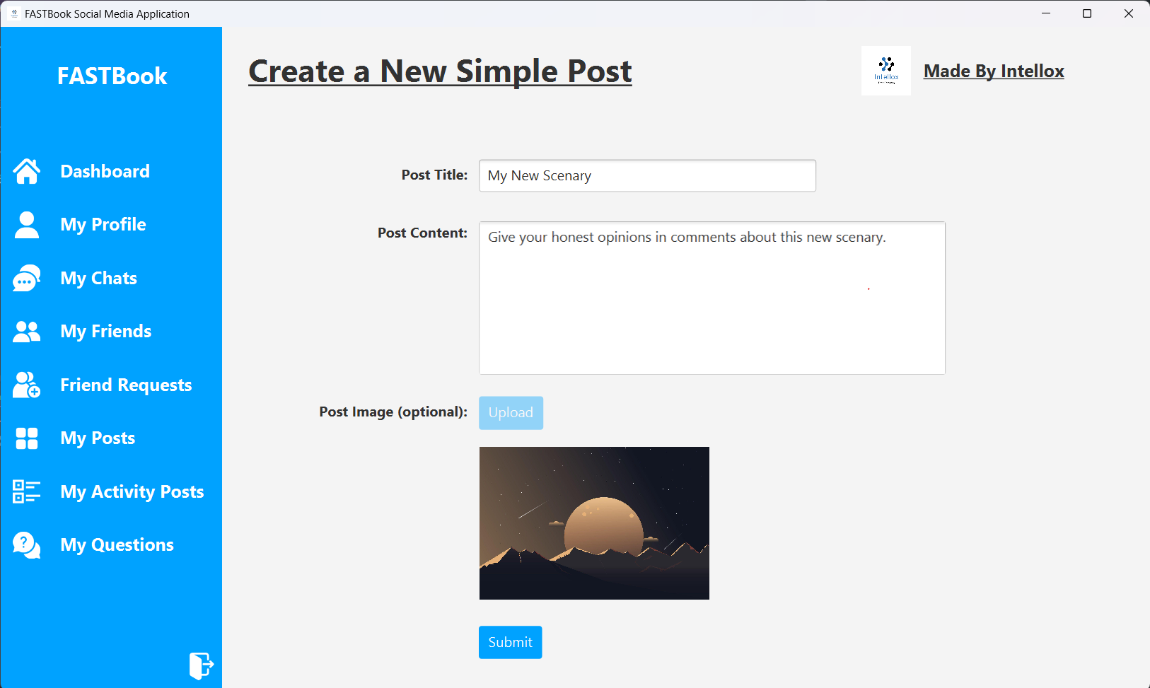

Slide 23
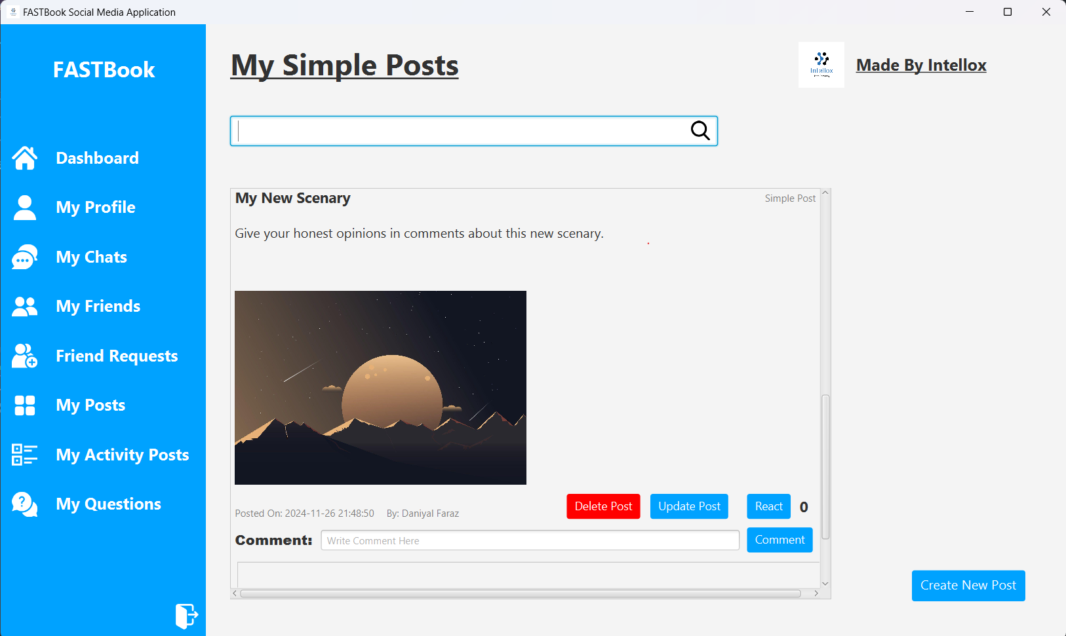

Slide 24
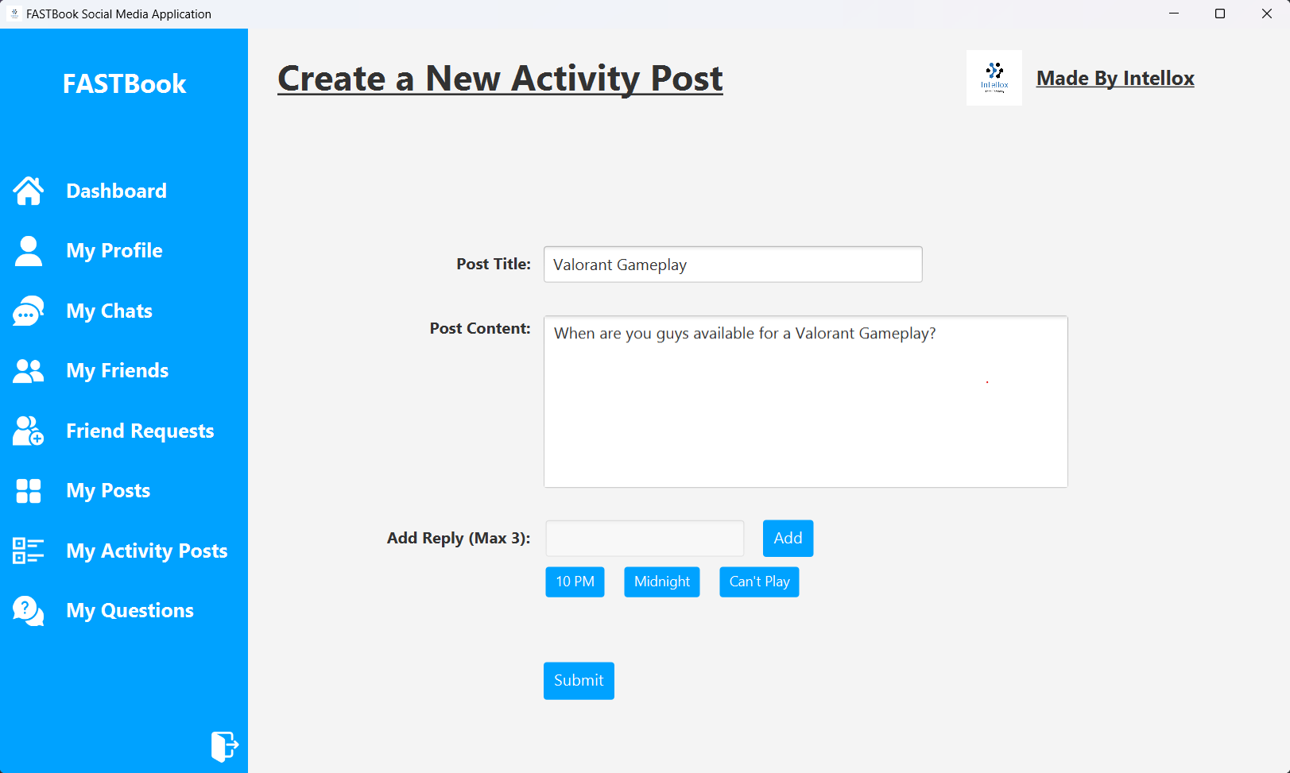

Slide 25
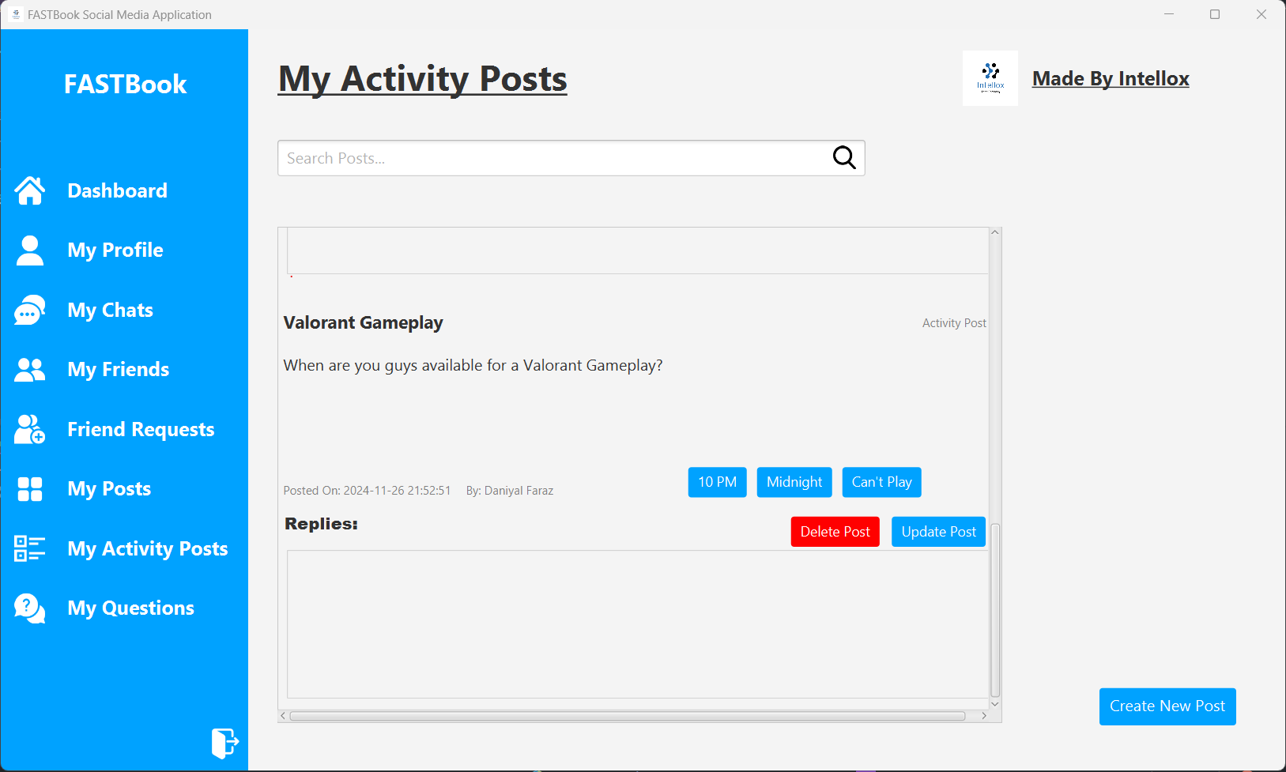

Slide 26
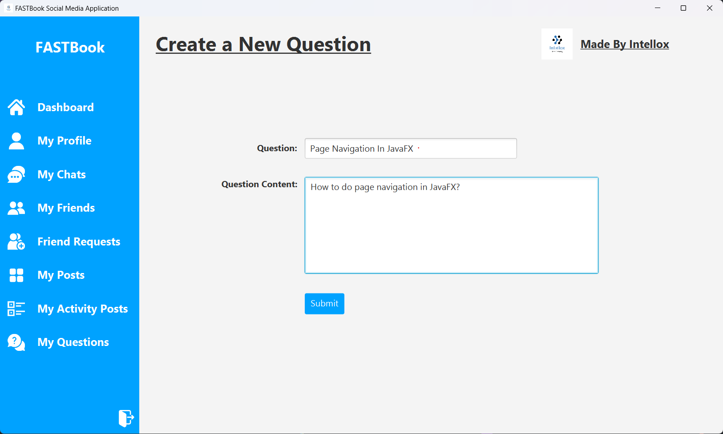

Slide 27
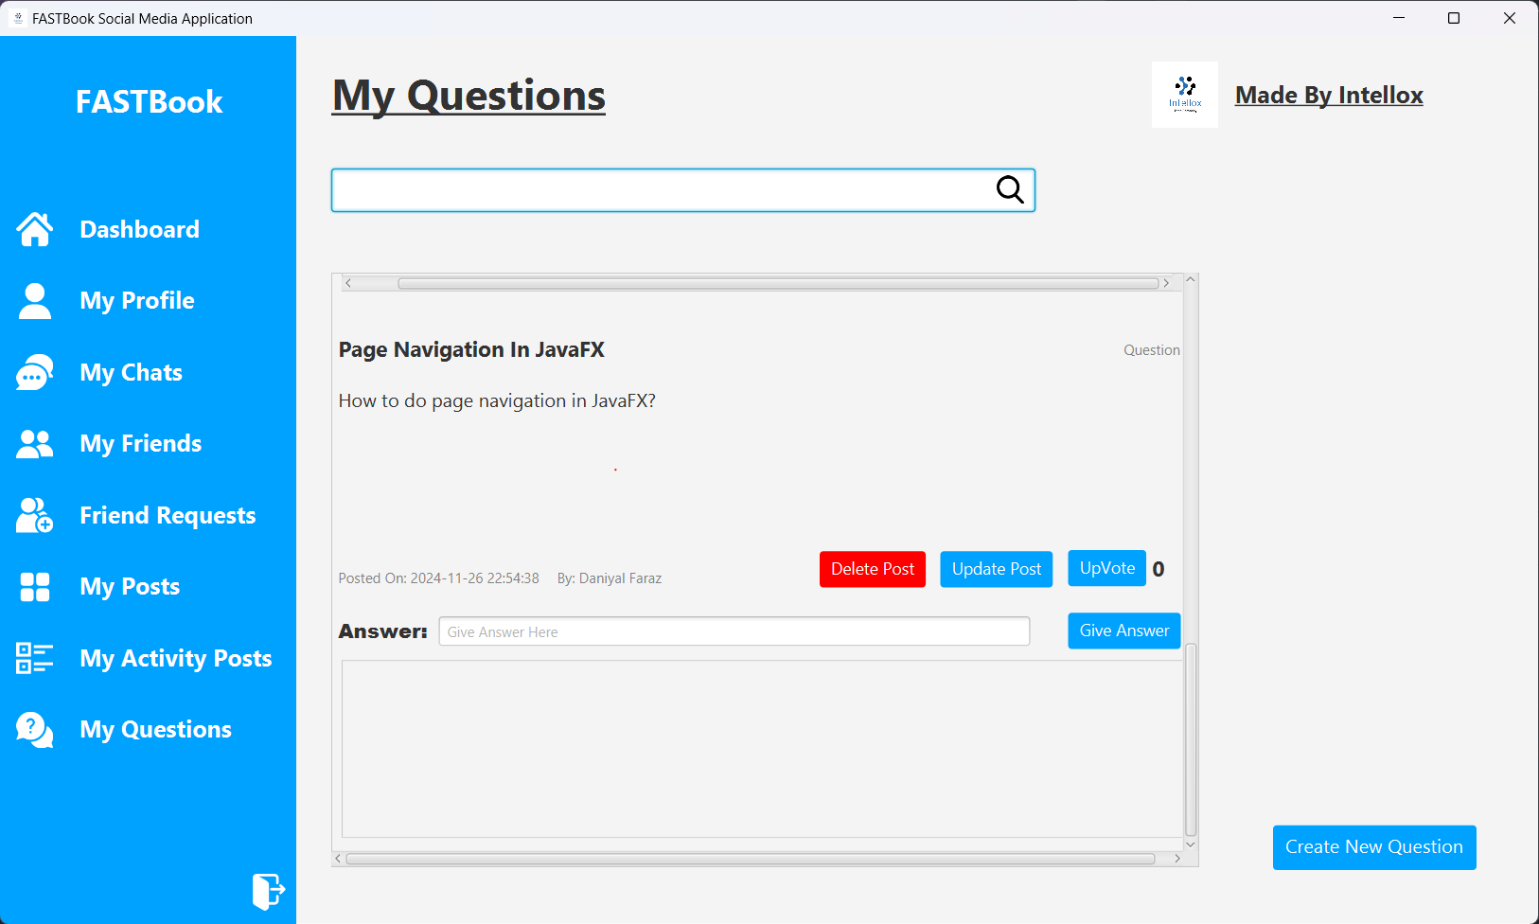

Slide 28
THANK YOU!

