Slide 1
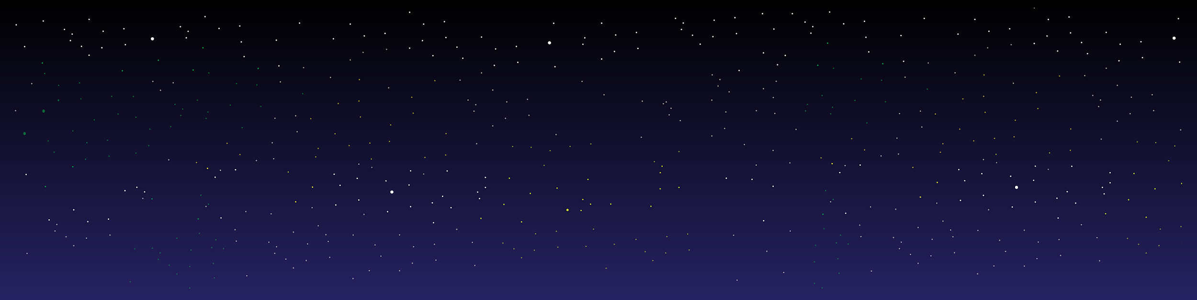
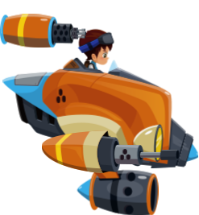
Space Force
Daniyal Mufti
Jaka Jazbec
Jonathan Alcantara
Himanshu Tanwar
Yegor Kozhevnikov
Keith Gallimore

Slide 2
What is SpaceForce?
SpaceForce is a side scrolling computer game where a user controls a spaceship like character.
The character is floating through space, avoiding several obstacles, all while the user is trying to achieve the highest possible score.
Character is controlled by continuously pressing spacebar, keeping it floating.
The game is intended for all ages, however our main targeted population are undergraduate students looking to fill in their microbreaks.
Notes:
Our group took a vote on what we wanted to design based off of common interests within the group and chose to design a game for our project. We drew inspiration from games such as Flappy Bird and asteroids.

Slide 3
Targeted E - Engaging
We have focused on the Engagement dimension of our application.
Since SpaceForce is a game, we wanted to ensure users want to play the game and that they enjoy it as much as possible.
Main idea is for the game to be an enjoyable and be an engaging activity that people partake in to pass time and relieve stress.
Notes:
Engaging seemed like the most relevant E to focus on for a video game.

Slide 4
Measuring improvement
To measure ‘Engagement’ in our application we measure the satisfaction level of users when they play our game as well as time spent playing the game.
This data is collected through anonymous form submissions of our users (Using Google forms).
We also collected the total time played, total attempts, and the user’s high score (the application outputs the info after the user exits the game in Results.txt).
If the feedback received is better and the average time playing plus total attempts have all increased, we can determine the game engagement has also increased.
Notes:
Measuring engagement at first was kind of confusing to measure. But through research and testing we were able to come up with the following. Using surveys and in game statistics to see changes. The following is the link to the forms: https://docs.google.com/forms/d/e/1FAIpQLSfvAiMQ6zhtKTdVeuN5VsfeeLmPDM38-IZG1oKb1gyGYvnczA/viewform?vc=0&c=0&w=1&flr=0

Slide 5
Preliminary User Survey Results and Industry Data
Based on WEPC around 64% of the general public in the US are “Gamers” with average age between 15 – 19 (1).
Furthermore, a study on Statista can tell us 54% of people who play games are male (2), with around 37% of gamers being college graduates (3).
All this information helped us create our persona of Tyler the college student.
https://www.wepc.com/news/video-game-statistics/#mobile-gaming
https://www.statista.com/statistics/232383/gender-split-of-us-computerand-video-gamers
https://www.statista.com/statistics/499707/share-consumers-ever-playvideo-games-by-education-level-usa
Notes:
Sources
1. https://www.wepc.com/news/video-game-statistics/#mobile-gaming
2. https://www.statista.com/statistics/232383/gender-split-of-us-computerand-video-gamers/
3. https://www.statista.com/statistics/499707/share-consumers-ever-playvideo-games-by-education-level-usa/

Slide 6

Persona
Basics
Tyler Tylerson
Male / 19 years old
Software Engineer Intern
Tyler is a 19 year old undergraduate student at a major university. He is majoring in Computer Science and is part of the Lacrosse club. He is currently an intern at one of the local Software shops and wishes to become a full time software developer after graduation.
Tyler is a motivated individual, that likes to spend time with his friends, but also enjoys playing games when time permits. He is a casual gamer, mostly on the weekends or during breaks between school, interning and lacrosse.
Notes:
We created a few personas such as the one above of people who would be in your targeted audience. The persona of Tyler was a perfect candidate for our game, as he is of the right age, already games casually which is perfect for our very casual game, and because of his busy schedule, he would have lots of short breaks in order to kill time with on small things such as our game.

Slide 7
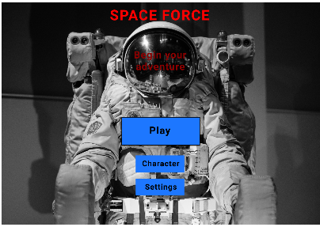
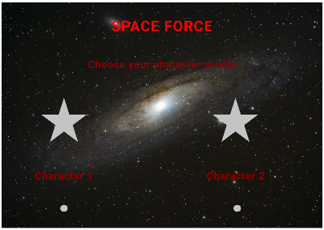
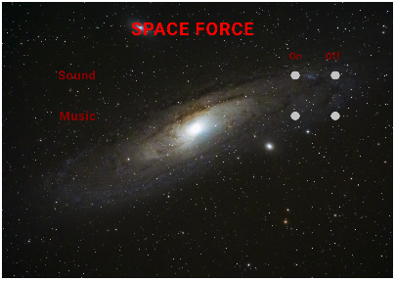
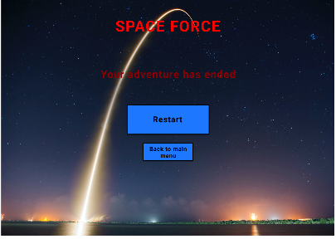
First Design (Low fidelity)
Low Fidelity Design:
We designed our low fidelity in paint instead of paper (since none of us were artists)
Four different screens were created based off of what we’ve seen in other games
Screen for main menu, character, option, and the game over screen are shown
Notes:
The first mocks of the main screens presented a first opportunity for us to visualize the game, which was very important. It was clear to us, that the overall theme of the game needs to revolve around space. We also needed background images that would have a “wow” effect and draw users to stay in the game.
The idea was to relate to college students that are intrigued by space and so engaged in the game.
Key design was focused on defining the amount of screens needed to provide optimum experience between options and ease of use. We also wanted a great looking main screen to catch the users attention from the beginning.

Slide 8
User Feedback – First Design
We talked to 3 users for the initial design feedback.
One user suggested that there should be an option to exit the game on the main screen.
Background should be consistent throughout the different screens within the application.
Users liked the option of being able to change characters.
They also liked that there were options to turn off audio.
Notes:
We wanted to get an initial reaction from people with varied views, so we asked 3 other people who are not in a technology related degree/job questions about the design. This gave us a good starting ground to know that we were headed in the right direction, and got some good tips from the feedback gathered to adjust out direction.

Slide 9
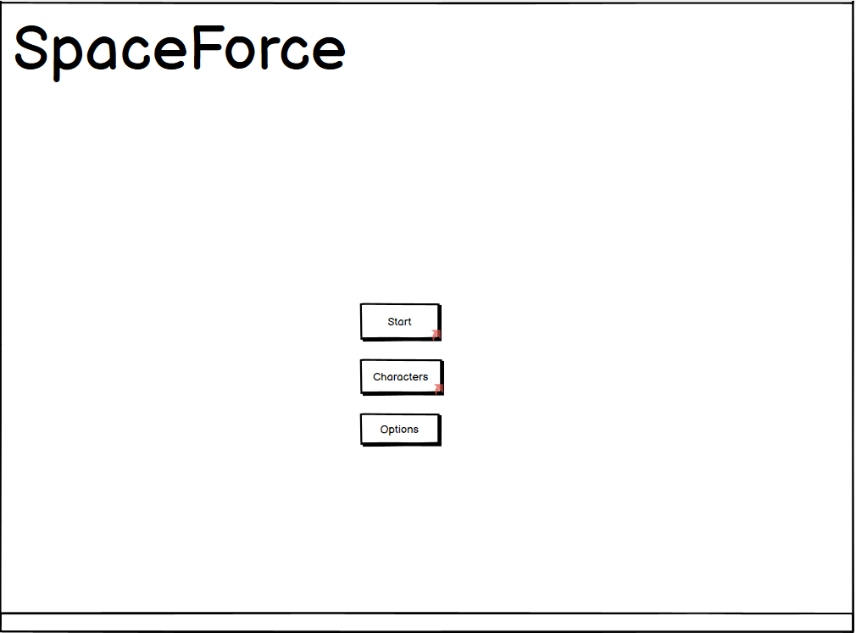
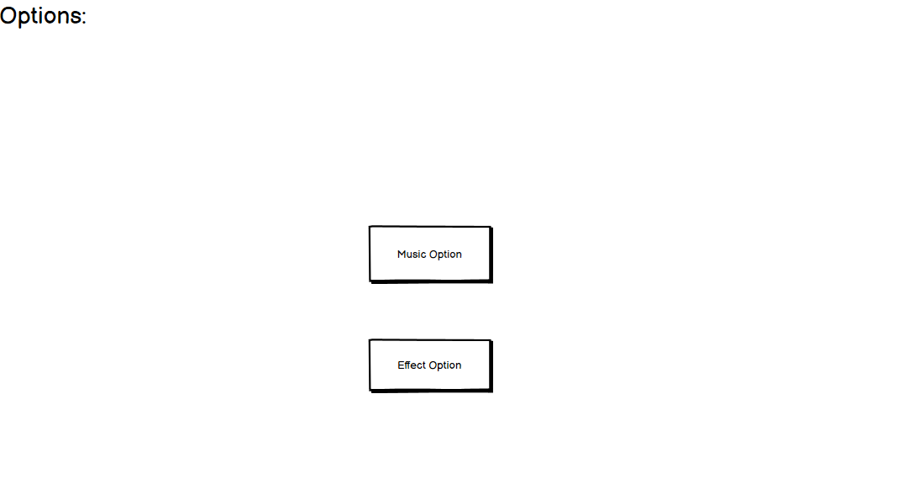
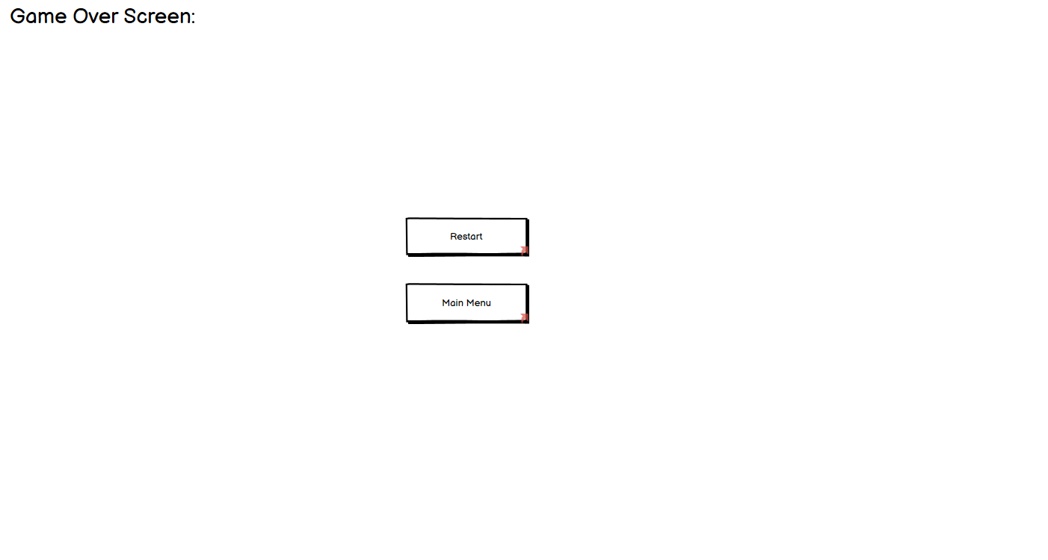
Second Design (Moderate fidelity)
Moderate Fidelity Design:
Based off the feedback from the low fidelity we designed our moderate fidelity prototype in Balsamiq
We shows users the flow of what will happen when they clicked on a certain option and the screen they would be brought to
Notes:
For the moderate fidelity prototype we used Balsamiq to design the wireframe. We designed 4 screens for our moderate fidelity prototype. We had the main menu screen, the options screen, a characters screen, and the game over screen.
The goal was to provide users with an idea of how the game will flow with all these different options. Which is why we didn’t add any fancy backgrounds or images throughout the screens.

Slide 10
User Feedback – Second Design
For the medium fidelity user feedback we talked to 3 users again and overall it was very positive.
They really liked the orientation of all the button placements and the overall design of the game.
Users wanted to see what the play screen would look like, but we told them the focus was on the flow of the application for this prototype.
Users suggested adding an exit option in the main menu.
Notes:
Thanks to the relative simplicity of our app, the users found navigation to be very self explanatory and easy, and while the lack of artistic elements was a little confusing to them, they had very little constructive criticism of the flow. The positive reactions helped to reinforce our design decisions, and mostly minor cosmetic changes would be made past the point, barring additional menu options.

Slide 11
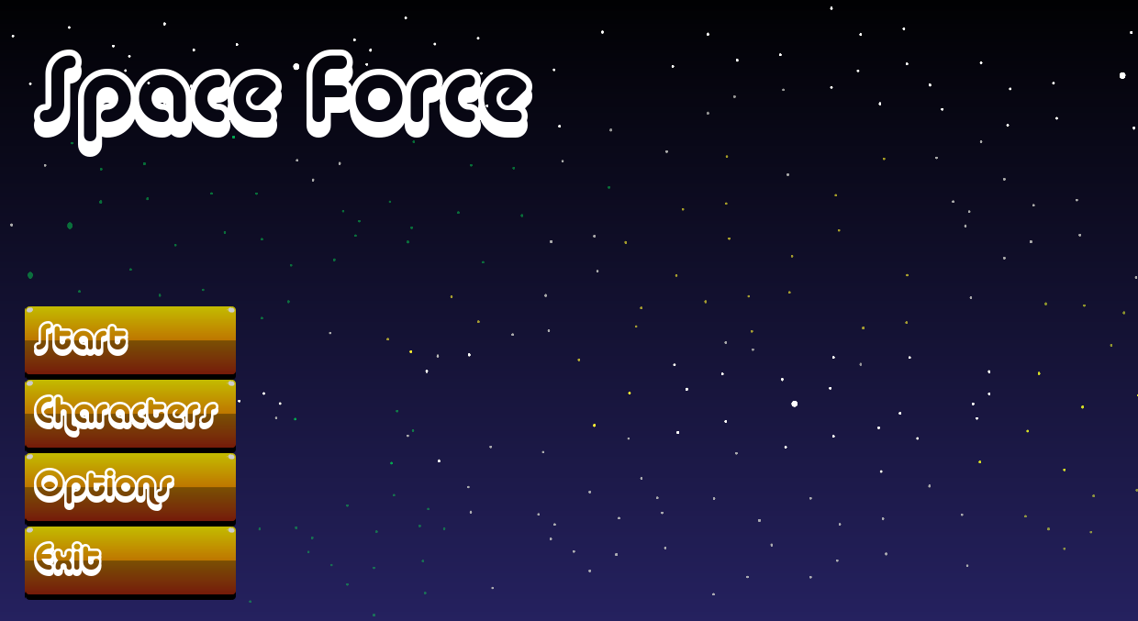
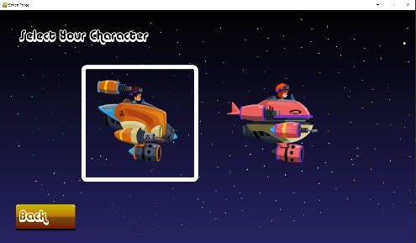
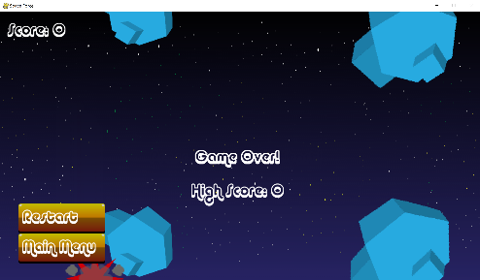
Third Design (High fidelity)
High Fidelity Design:
Addition of Start, Character, Option, and Exit options on main menu
Start allows the user to play the game (play for high score)
Character page to change characters
Options page to change settings such as sound effects on/off
Game over screen provides a restart or return to main menu option
Game over screen also shows the current score and high score
This iteration we focused on delivering everything we promised and added what was suggested from earlier designs
Notes:
First iteration was our first example of a high fidelity design, where we built the game based on the feedback provided from the low and medium fidelity phases. In this version we presented the user with a fully operational game, which had a Main Menu, the play screen (by clicking on start button in the main menu screen), the character screen where the user can choose between 2 different characters to play with, an options screen (which has options to turn off sounds effects and turn on colorblind mode), and the option to exit the game (which the user can do by click the X in the window or by clicking Exit from the main menu). The Play Screen displayed the moving character and the randomly spawned obstacles the player had to avoid. The play screen also featured the score in the top left corner of the screen, which goes up after successfully avoiding an obstacle. If the player collides with an obstacle, the player is brought to the game over screen which displays the current score in the top left, the high score in the middle and the options to return to the main menu or to restart and try again.

Slide 12
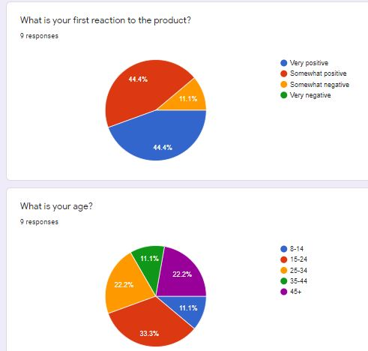
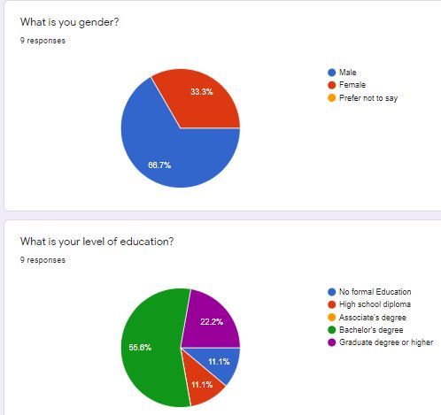
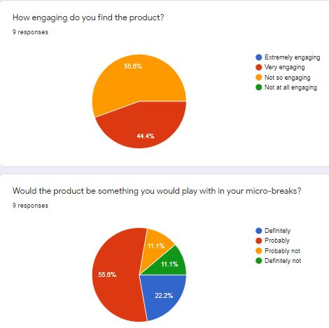
User Feedback – Third Design
Note: Final Inference available on final data from users slide.
Notes:
At this point we started to gather much more data, giving google forms to those who participated, and gathering data from playing such as their high score, playtime, and number of attempts, so we had subjective written opinions, but could also do an objective analysis of future iterations and see how the engagement changes each time.

Slide 13
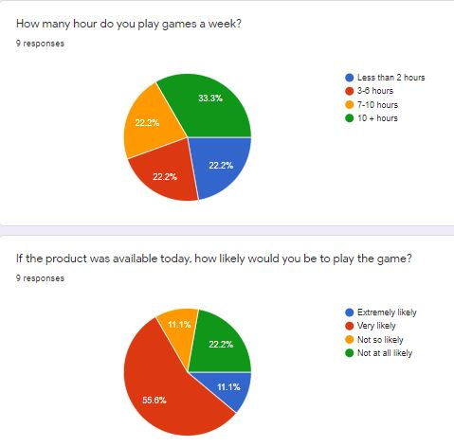
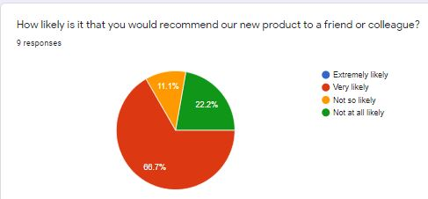
User Feedback – Third Design Cont.

Slide 14
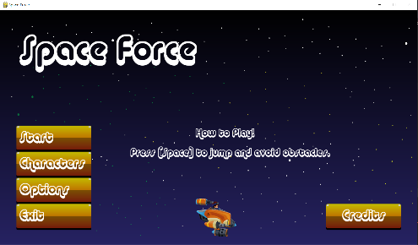
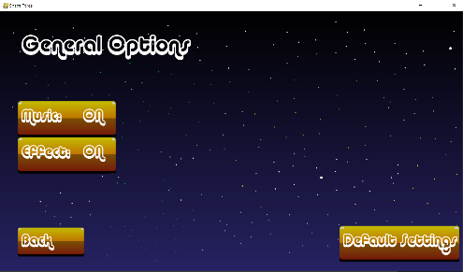
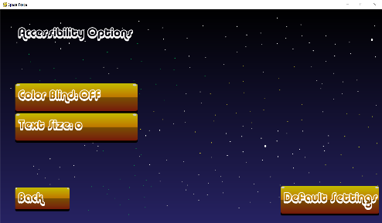
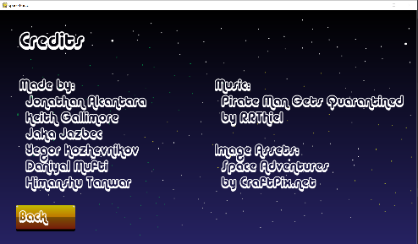
Final Design (High fidelity)
Final Design Additions:
More animations and sound effects during gameplay
Added separate Accessibility page, can change font size
How to play instructions on main page
Added Credits page for creators
Generally improved microinteractions in this iteration
Notes:
Final iteration (second iteration) provided few smaller improvements. More animations and sound effects during gameplay have been added to improve micro-interactions. We also updated the accessibility options, which now included its own options page. The accessibility page now had the option to change the font size and included the previously added color blind mode. From the feedback from our first iteration of high fidelity we added a how to play in the main menu, and a credits page to show the creators, the source of our images, and the source of the music. Our biggest change this iteration was improvements by adding sound effects. We added a sound effect for successfully clearing an obstacle, and a sound effect for clicking on different buttons. We also added a catchy background music, which we heard many positive things on after this addition. Main focus was also on micro-interactions to improve user interaction and increase length of play.

Slide 15
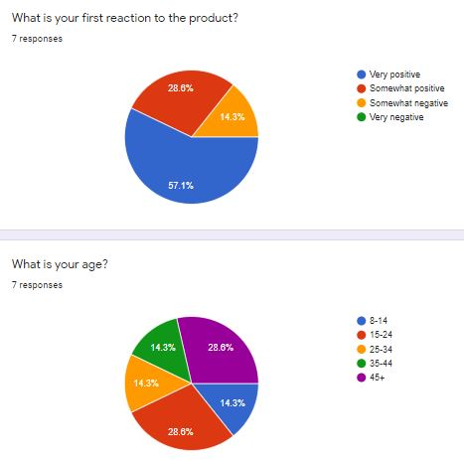
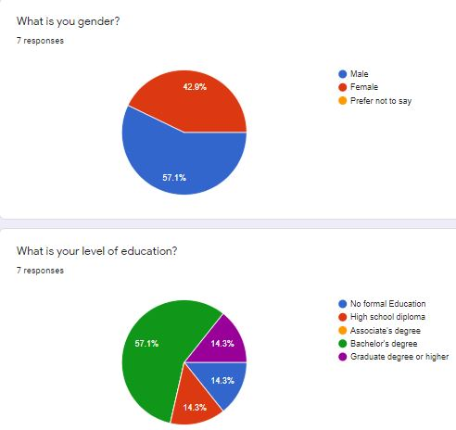
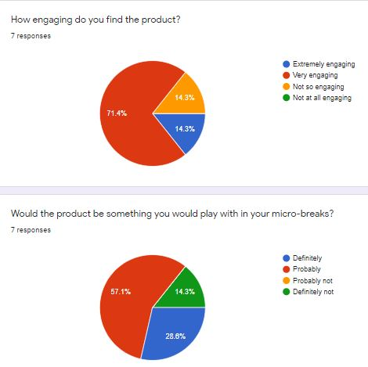
User Feedback – Final Design
Note: Final Inference available on final data from users slide.
Notes:
We used the same data gathering methods of google forms as well as play data to get final information on our last iteration. Engagement went up, with palytime, high scores, and attempts going up. The specific criticisms and complaints appear to have been mitigated, and overall testers were more happy with the final product, thanks to encorpetaing suggestions from the third iteration.

Slide 16
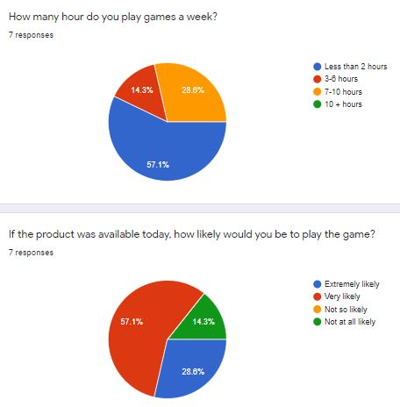
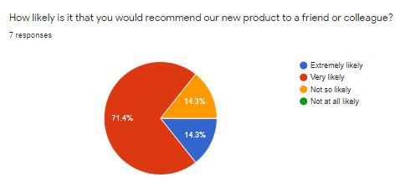
User Feedback – Final Design Cont
Note: Final Inference available on final data from users slide.

Slide 17
Final Data from Users
Above gameplay statistics clearly infer increase in engagement. Both, mean attempts and mean playtime, indicate an increase in engagement from the users.
User feedback from our questionnaire also display an increase in engagement and appreciation towards the final design. A quick summary:-
Initial reaction to the game was more positive.
Users found the game more engaging after the final redesign.
Higher percentage of positive user responses towards the question regarding playing the game during microbreaks.
There was a percentage decrease in users responding positively to “would you play the game today if it was available?” This is probably because the sample size was not large enough for the responses on the second questionnaire.
Increase in positive recommendations to friends and colleagues after final redesign.
Notes:
This is the graphed gathered data from play sessions of our test users from our final and antepenultimate iteration of our game, showing overall engagement increase.

Slide 18
Demo/Walkthrough Final Design
Demo is uploaded as an unlisted video on youtube: https://youtu.be/R-e4erMUeZs
To run the game, run SpaceForce.exe from the project folder. Or if on a Mac just pip install pygames and run main.py.
If you don’t have the project folder download the final version from:
https://github.com/htanwar/SpaceForce
Notes:
The demo we uploaded directly to youtube as an unlisted video. The project folder can be found on our github https://github.com/htanwar/SpaceForce.

Slide 19
PAR review
PERCEPTION
The game has a simple and clean design. It is consistent throughout the application and provides a simple interface into the game. A user is one click away from playing the game.
ATTENTION
The user attention remains on the game with the use of character animations and sound effects to inform the user of his actions. There is a clear separation between gameplay and screens.
RETENTION
The gameplay is intentionally simple. However, there is reinforcement of the gameplay options on the main menu as well each time before the game is started.
Notes:
We reviewed and found our final product to meet PAR requirements to the best of our ability given its category of a microbreak game.

Slide 20
Simplicity review
REDUCE
We decided on reduce as the game is designed to provide a form of entertainment during users micro-breaks.
The options we provide are minimal so the user does not get confused and spends most of the time on the game screen. The gameplay is extremely simple, with a push of a single button.
Interaction is focused on the character.
TIME
The game needs to be available to the user as soon as possible. We focused on making the wait times minimal and giving the opportunity to the user to start the game right away by providing an option to the start the game immediately upon entering the application.
Notes:
From the beginning we wanted to be sure that our game was extremely simple in order to better fit our target demographic of young adult’s microbreaks. In the end we found that we managed to stick to this principal, and the feedback we gathered confirms that.

Slide 21
Accessibility review
SpaceForce is designed with accessibility in mind.
The game provides an option for people with color blindness (Deuteranope and Protanope).
For people who have other rare conditions of color blindness, we added a Grayscale mode.
The game provides the ability to change the font size as well.
We used the following sites to check and convert our images to support color blindness:
http://hclwizard.org/cvdemulator/
https://www.color-blindness.com/coblis-color-blindness-simulator/
Notes:
From the beginning we knew how important accessibility was to have in any product you design. We researched different ways we can include accessibility options into video games. Based off our research and personal experience we decided to include options such as increasing or decreasing the text size, as well as including a color blind mode.

Slide 22
Heuristic evaluation (1)
We used Nielsen’s Heuristic Evaluation
Nielsen 1 - Our application lets the users know what the current status of the application is based on the titles we have on each Screen. For example General Options, Credits, Accessibility, Game Over screen. We also used naming systems and languages that are used in the real world so the user has a sense of familiarity. On each of our screens the user can exit the game whenever they want. Also on the options page we provide a “Default settings” option so if the user makes a mistake they can return to the Default stage. Each options page has a back button to return back to the main menu. Also on the Game Over screen we provide the user with a Return to Main Menu option or a Restart option. In our application we gave the users an “Emergency Exit” option as well as an undo option.
Notes:
Using Nielsen’s Heuristic Evaluation we made sure to hit all the major points to the best of our ability with the game. (Nielsen 1 refers to the first 3 bullets of Nielsen’s evaluation from hcilec5.pdf slide 22)

Slide 23
Heuristic evaluation (2)
Nielsen 2 - Throughout our application we provided the user with standards and consistency so the user is not confused what something does in the game. We kept error prevention in mind when building our game, with our simplistic design and control. For example even on our options page we added a Default Settings options to return the settings to default. Our application minimizes the users memory load by presenting everything in plain text and using familiar words that other application use. Also the main menu always displays the how to play message so that it is clear.
Nielsen 3 - SpaceForce caters to both experienced and inexperienced users because of our simplistic design. We only provide necessary information and never burden the user with anything unnecessary. There are almost no error states the user can be in, but if the user enters a state which they didn’t intent on entering there is an option to return to the previous state (such as return to main menu or restore default settings). Our system can be used without documentation. But we do provide enough information such that the user knows what to do within different screens.
Notes:
Nielsen 2 and 3 are based off of the bullet points from hcilec5.pdf slides 23-24. We explained if and how we hit the bullet points.

Slide 24
Improvement of engagement
Our first iteration of the game was, predictably, very drab and lacking in colors and micro interactions.
In the next two iterations, we added functionality, coloring, and images for our game characters, obstacles, etc. to make the scene more visually appealing.
By our final iteration, we added in most of our microinteractions; animating characters, sound effects, adding an accessibility menu, etc.
We gradually improved our engagement by making the game visually pleasing to look at, adding recognizable sound effects, and adding accessibility options to ensure anyone and everyone could enjoy playing our game.
Notes:
Our team has decided that our improvement of our targeted E of engagement was overall a great success, based off both objective data gathered, and the opinions of those we had test the game.

Slide 25
Future Work
Based on comments from friends and family regarding the game they suggested things such as adding difficulty levels (Easy, Normal, and Hard), which will change the pace of the game.
Another addition that we would like to add is more customizable characters and making them earnable through in game currency.
The completion of the online leaderboard.

